Slide 1
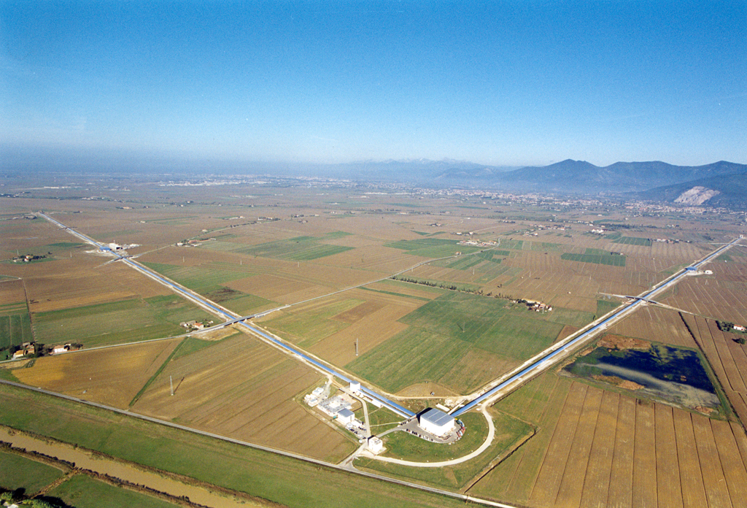
Virgo, an extremely sensitive detector in a noisy environment
Irene Fiori - EGO
JRC Workshop – Pisa
18 May 2018

Slide 2
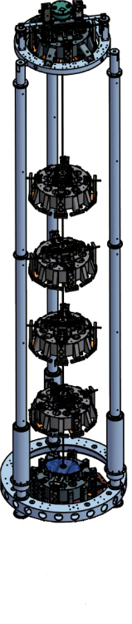
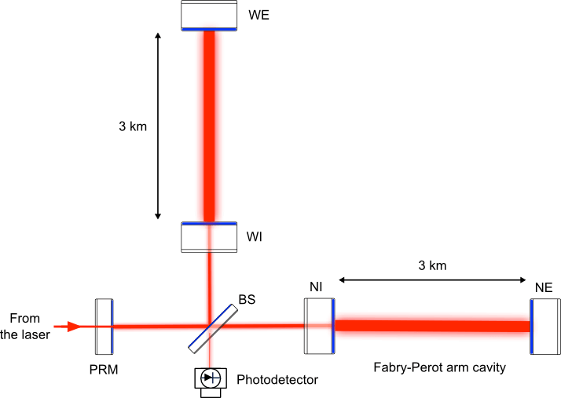
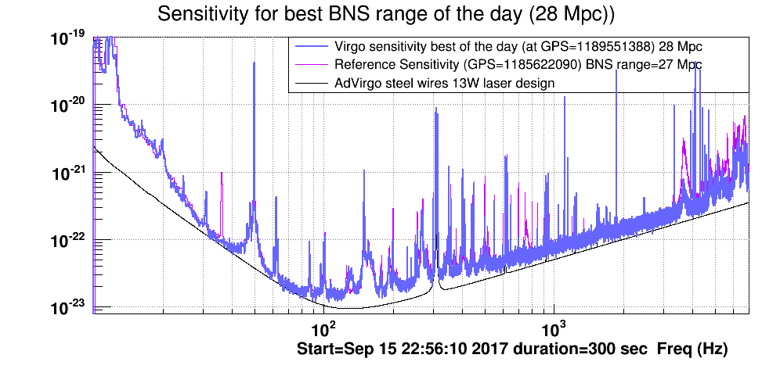

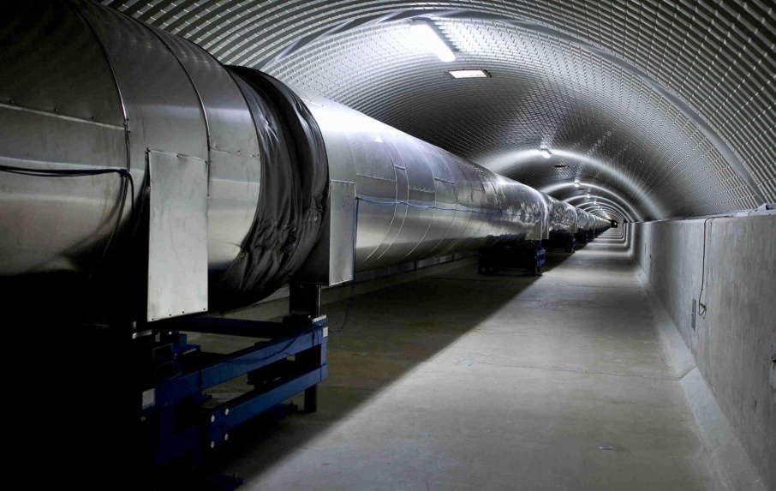
Virgo and the environment
Virgo is a laser interferometer to detect gravitational waves
Seismic
isolator
Very well isolated from external disturbances
Nevertheless, intense or close disturbances can couple
  Sounds, vibrations, EM fields (10 Hz to 10 kHz)
  Radio waves @ laser modulation frequency (6 – 60 MHz)
  Infra noise, low frequency seism or sound can excite mechanical modes, or up-convert (i.e. back scattered light)
ULTRA-HIGH VACUUM

Slide 3
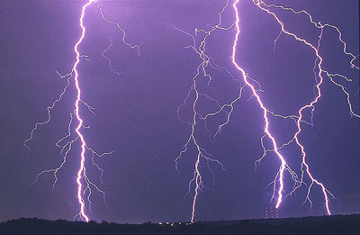
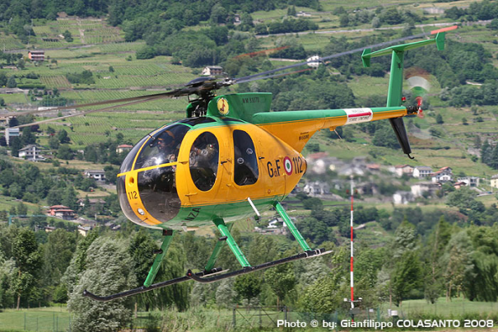

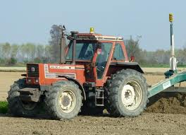

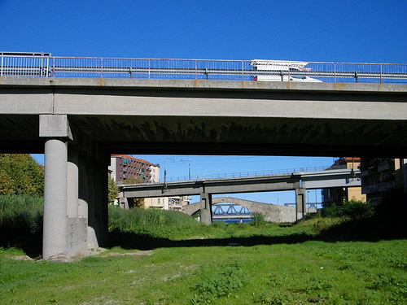
Remote but loud sources

Slide 4
Noise hunting
Our work (the EGO-Virgo environmental team)
  Identify and mitigate offending sources
  Measure, model and mitigate noise coupling paths
  Preserve noise climate around the site (measure and modeling of seismic, acoustic or EM emissions from noisy facilities and projects to be realized in the site proximity to evaluate impact on Virgo)
  Tag and veto transient noise
  Data mining & analysis
Focus on infra-noise

Slide 5
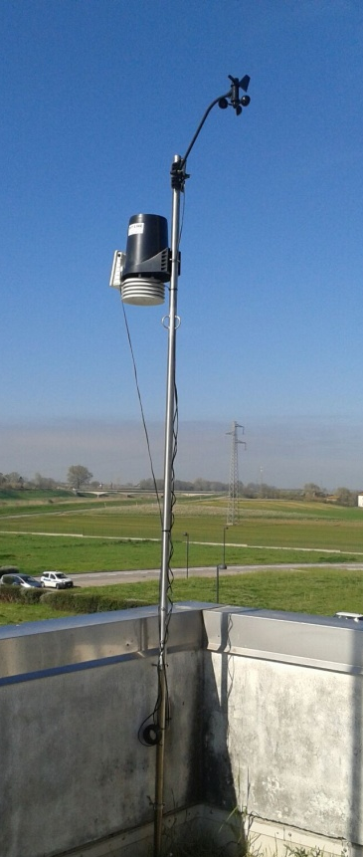
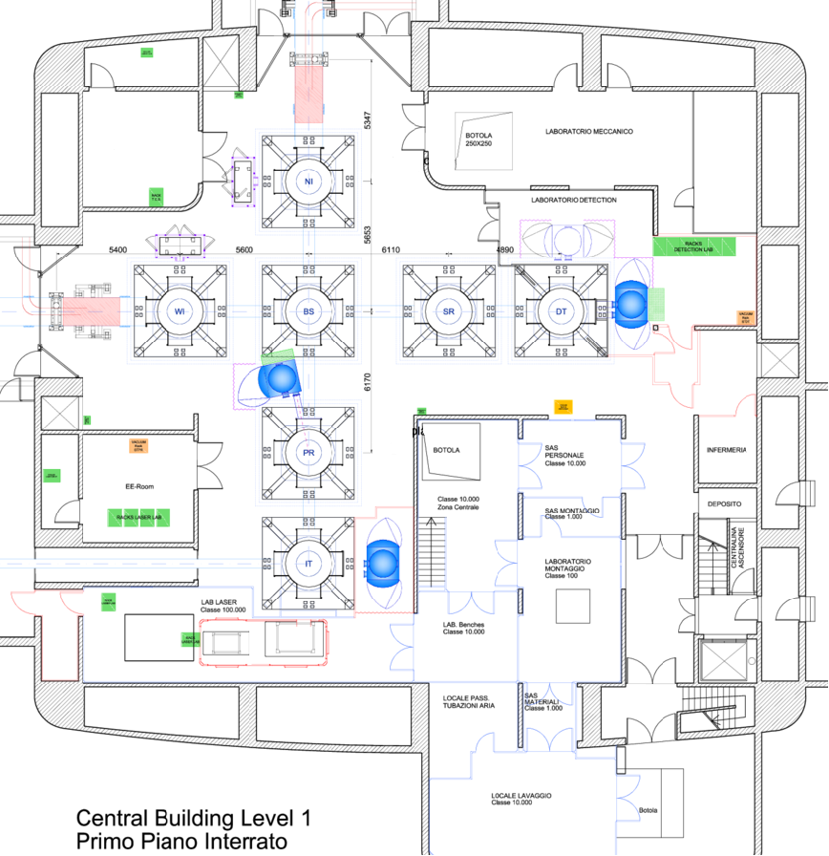
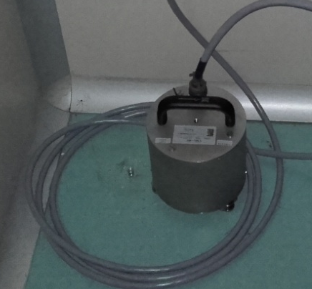
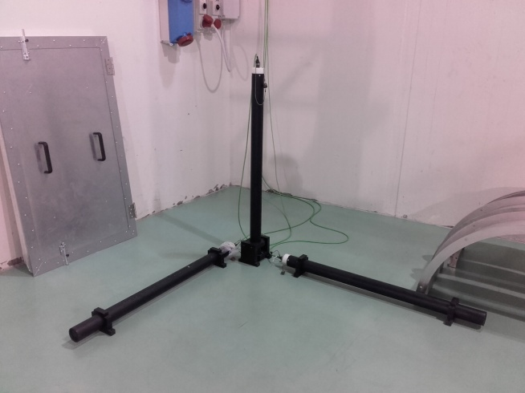
Sensors
Network of 500 slow probes (temperature, pressure,…) and 100 fast sensors, among which
  Seismometers (Guralp-40s, 0.025 – 50 Hz) → soon will be included in the INGV seismic network
  Infra-sound microphones (B&K 4190, 4193, 0.1 Hz – 20kHz)
  Ultra low noise magnetometers (Metronix MFS-06, 0.0001 Hz to 10kHz)
Outdoor: weather station, magnetic station, lightning detector
Continuously recorded and data archived
Seismic low freq (tri-axial, velocimeter)
Seismic mid freq (tri-axial, accelerometer)
Seismic high freq, piezo
Seismic mid freq (accelerometer)
Acoustic, audio
Acoustic, infra-sound
Acoustic, low noise
Magnetic probe (x3 --> tri-axial)
RF antenna receiver
Current (x3 one for each phase)
Voltage
Fast Sensor Map
Central experimental hall

Slide 6
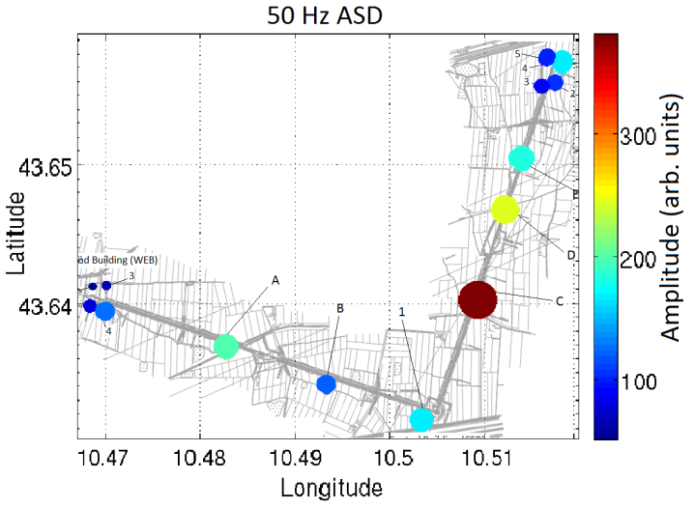
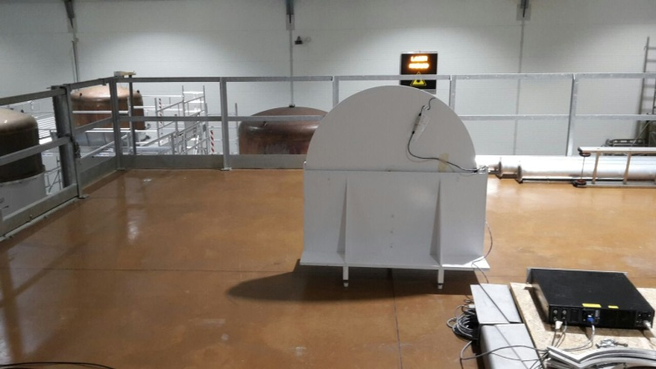
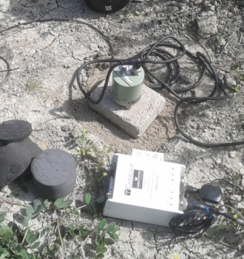
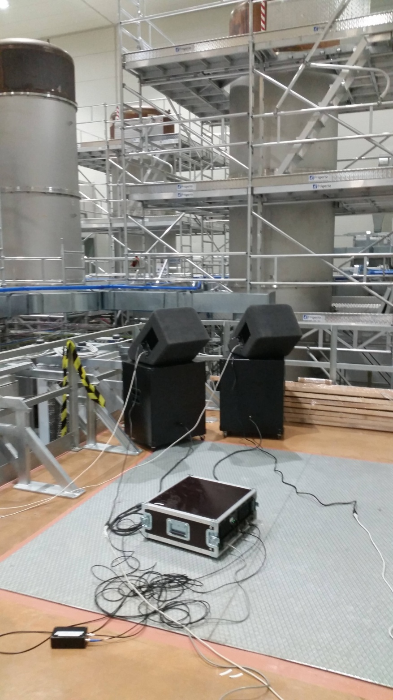
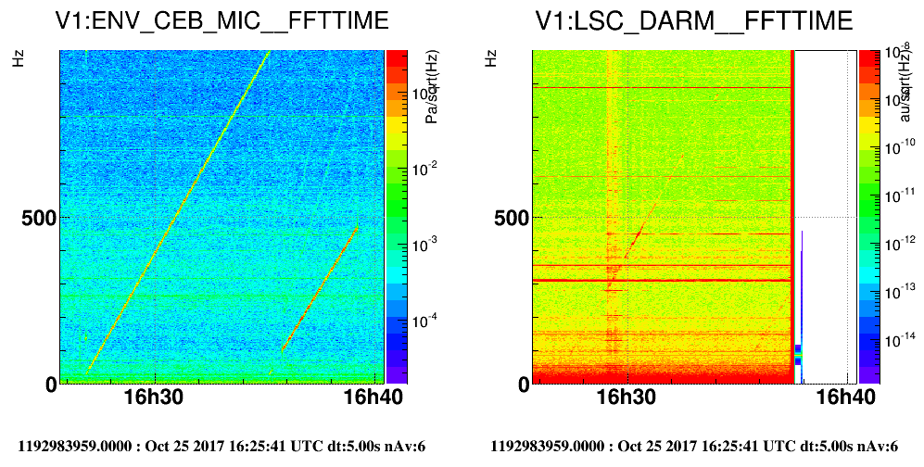
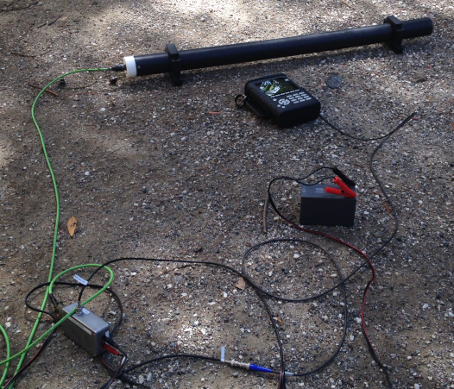
Hunting instrumentation
Sensors and data loggers for indoor and outdoor measuring campaigns
Tools to measure ITF noise coupling and compatibility (noise injections): shakers, sub-woofers, coils, RF emitting antenna

Slide 7
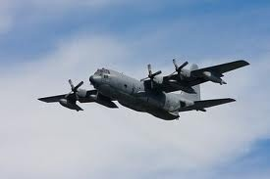
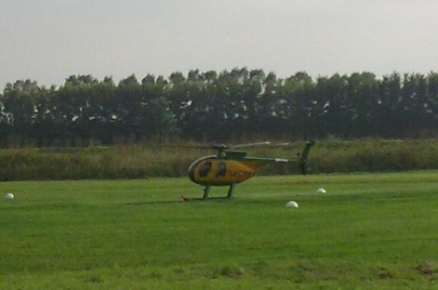
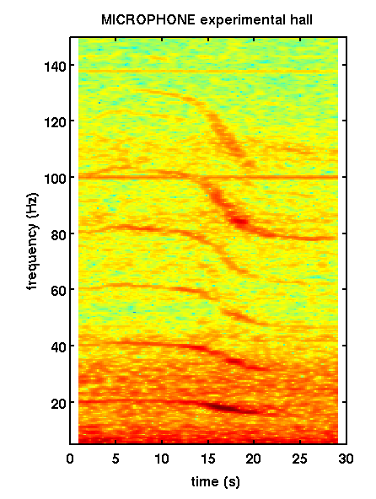
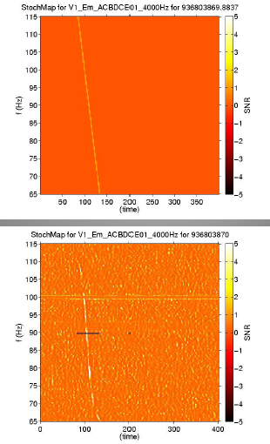
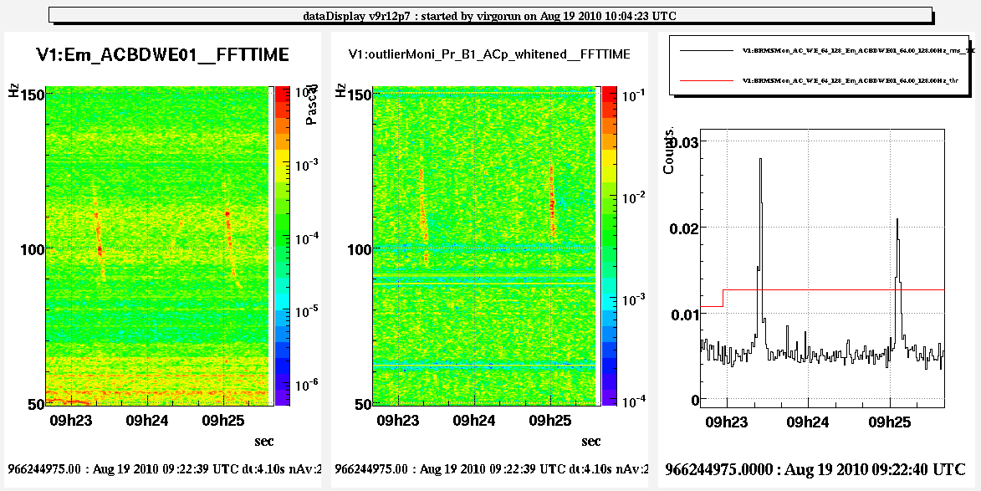
Case study
Airplanes acoustic noise, automatic tag and veto in the online GW pipeline. Michael Coughlin et al. https://arxiv.org/abs/1108.1521

Slide 8
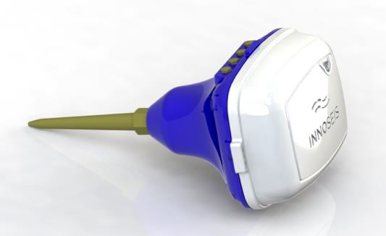
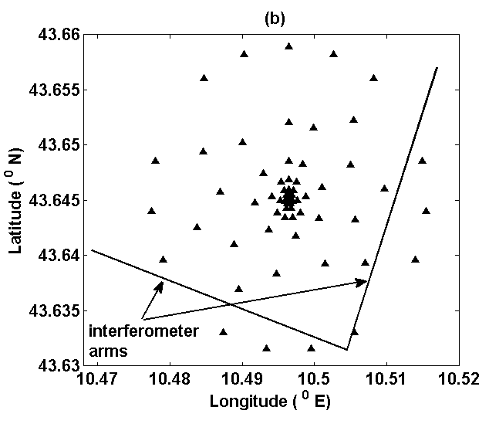
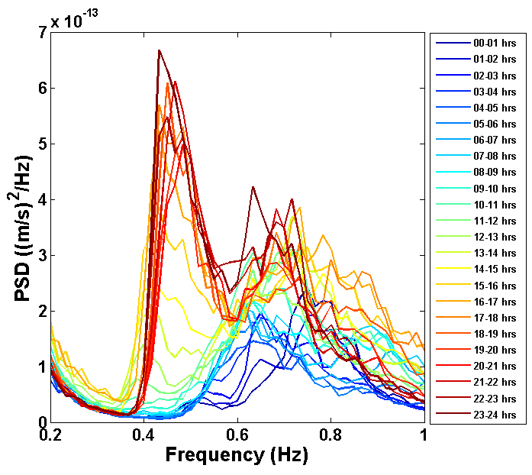
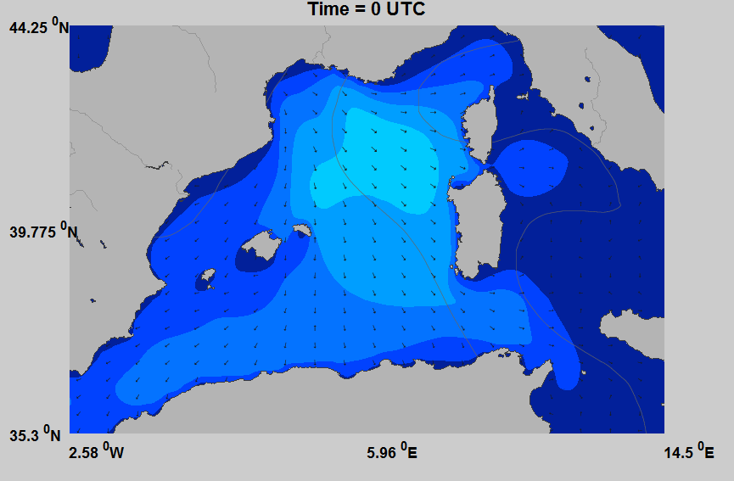
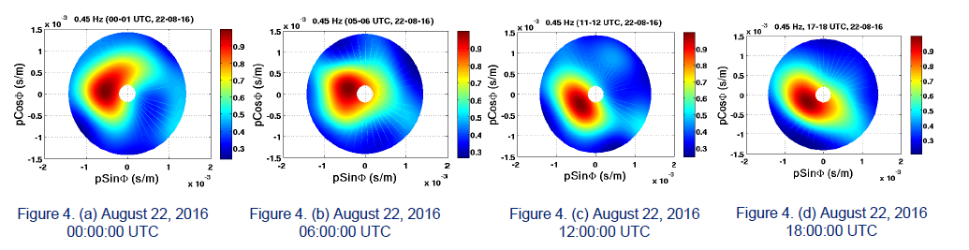
Case study
Soumen Koley et al, https://doi.org/10.1190/segam2017-17681951.1
Seismic array for Gravity Gradient noise studies (by Virgo Collaboration)
test deployment of 100 sensors, beamforming analysis 0.2 – 1 Hz
Sea micro-seism evolution during a storm and correlation with waves height

Slide 9
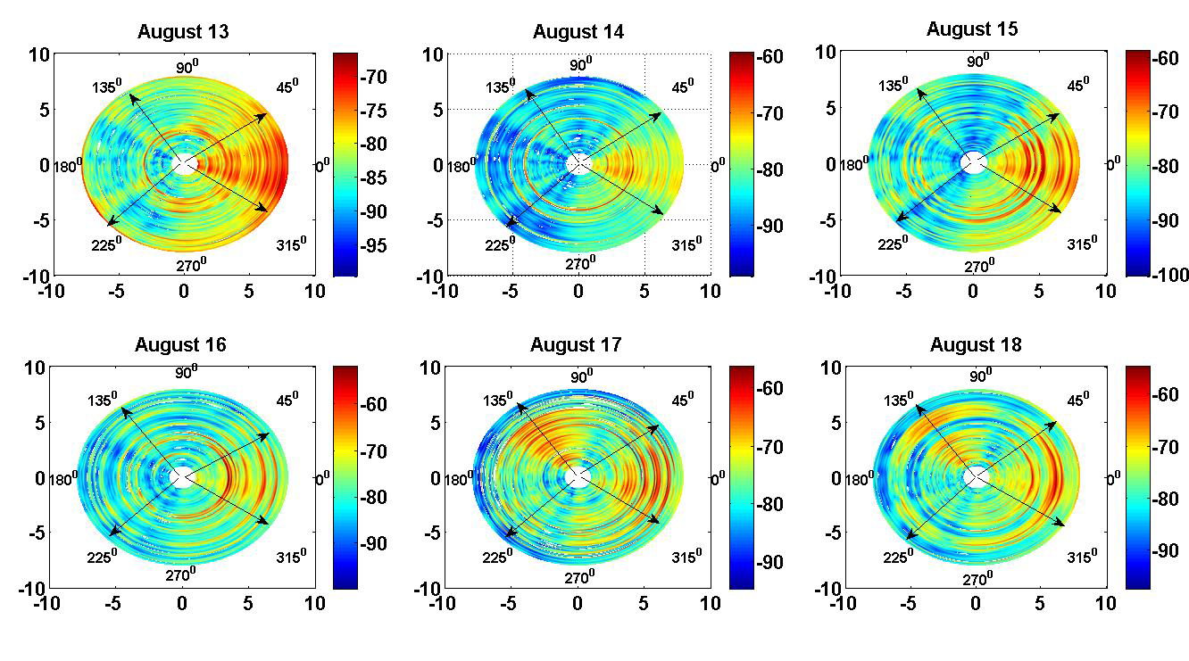
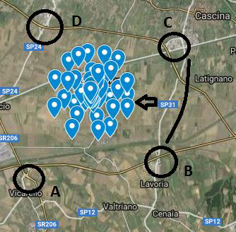
Case study
Soumen Koley et al, https://doi.org/10.1190/segam2017-17681951.1
Seismic array for Gravity Gradient noise studies (by Virgo Coll.)
test deployment of 100 sensors, beamforming analysis 1 - 4Hz
Identification of seismic waves from nearby viaduct bridges

Slide 10
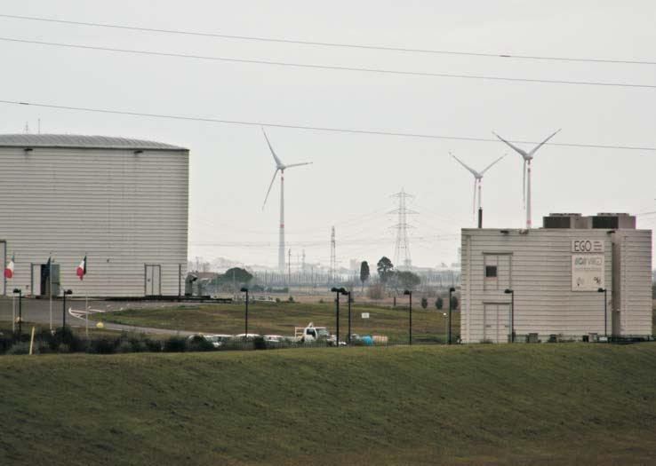
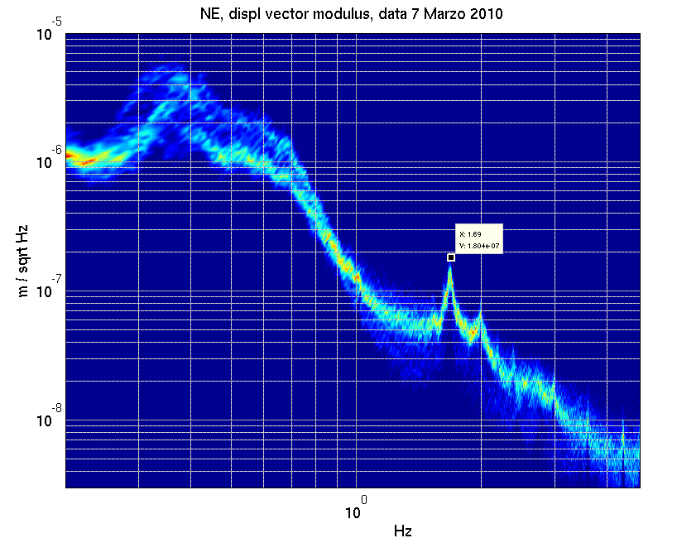

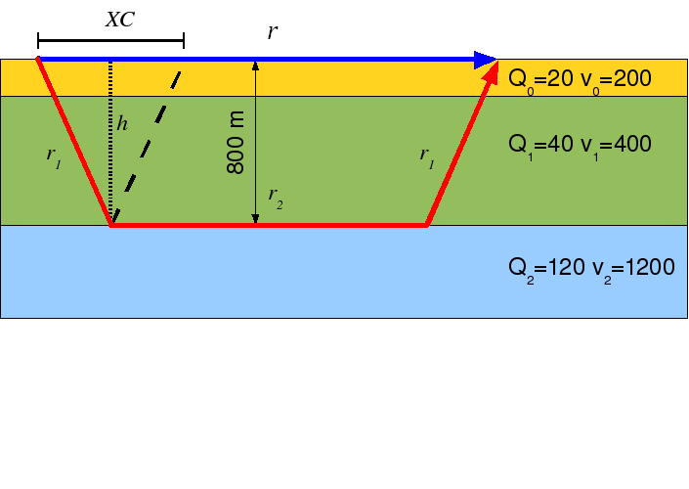
Case study
Gilberto Saccorotti et al, https://doi.org/10.1785/0120100203
Wind turbines, vibration noise (with INGV)
Soil vibration at 1.7Hz
detected at 6km distance
Propagation model
6km
VIRGO
1.7 Hz
3/26/2019
irene fiori - JRC workshop Pisa

Slide 11
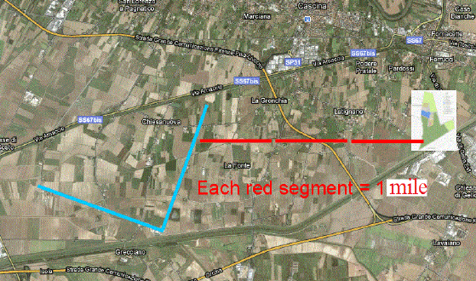
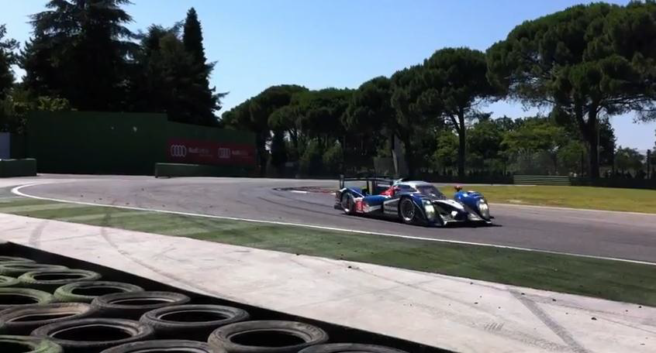
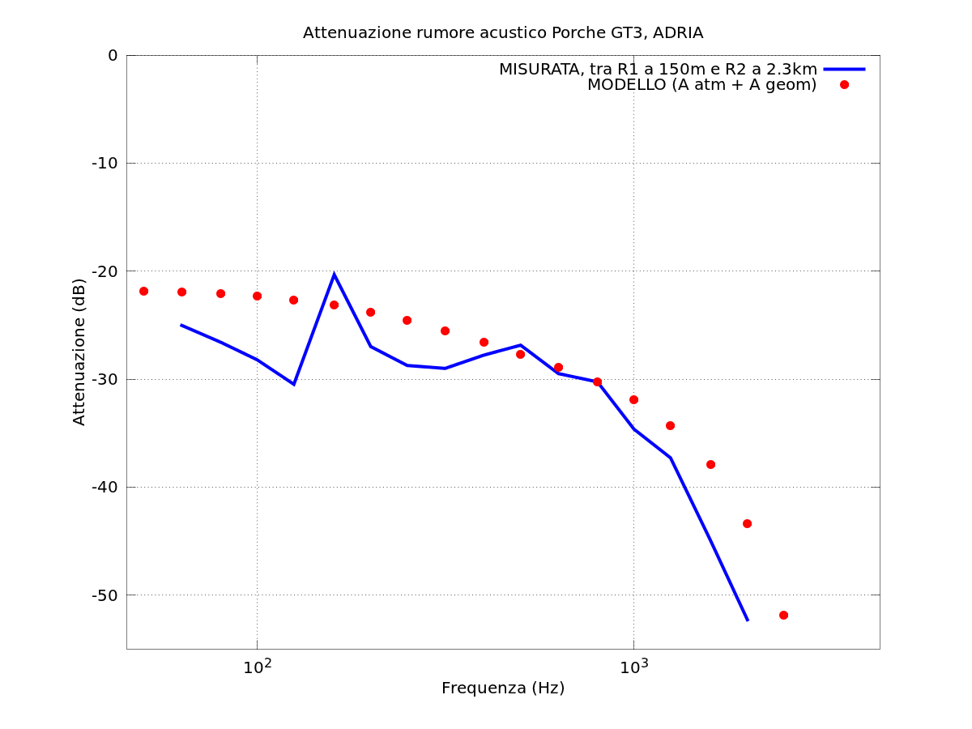
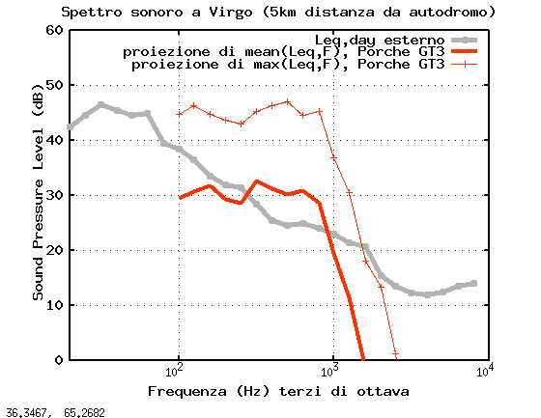
Case study
https://tds.virgo-gw.eu/ql/?c=8505
Speedway project, evaluation of acoustic noise impact at EGO
0
-10
-20
-30
-40
-50
Attenuazione tra R1 (150m) e R2 (2300m)
Blue: measued, Red: model
(Adiv + Aatm)
Attenuazione (dB)
100 1k
Frequenza (Hz)

Slide 12
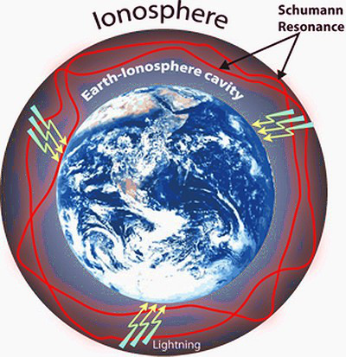
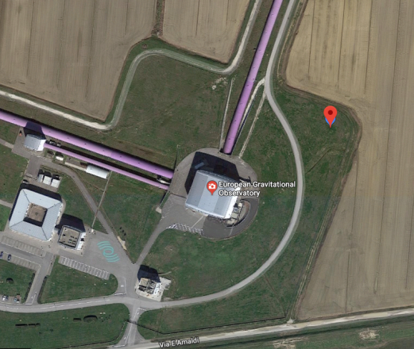
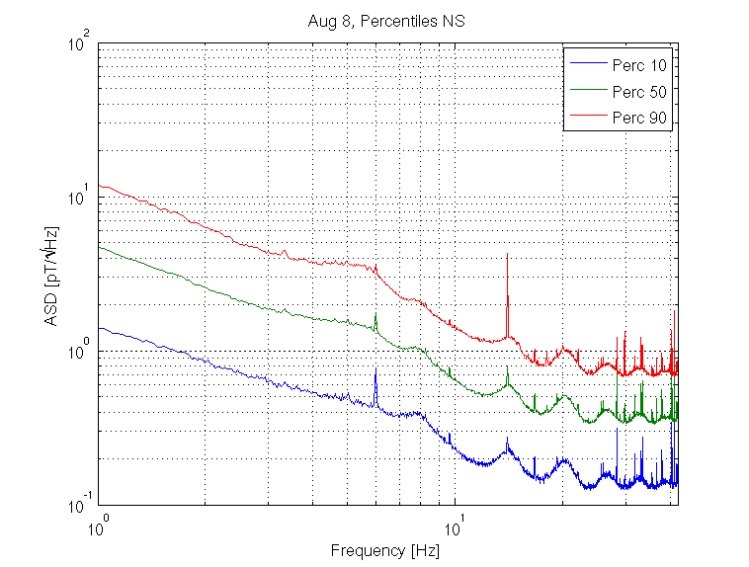
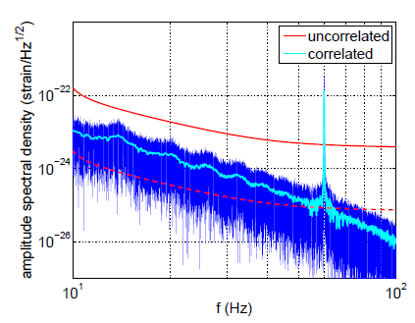
Case study
Earth global magnetic noise
M.Coughlin et al, https://arxiv.org/abs/1802.00885
Outdoor magnetic station at EGO site
Monitor and subtract correlated noise from other GW detectors
Projected correlated noise
between Ligo and Virgo+
From https://arxiv.org/abs/1406.2367

Slide 13
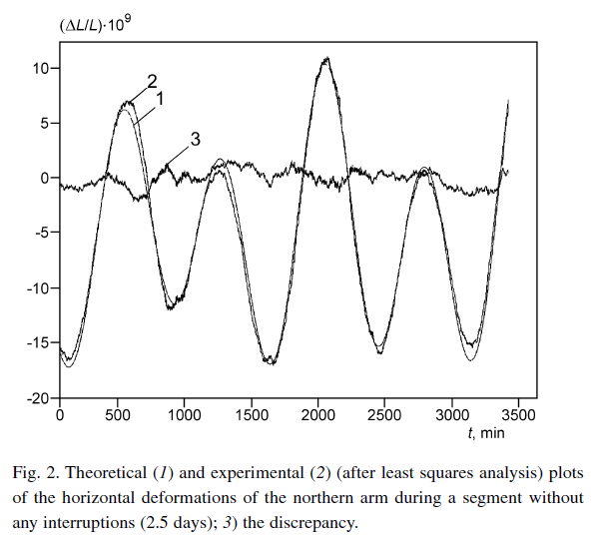
Case study
At very low frequency (≤10mHz) Virgo’s Fabry-Perot optical cavities work as extremely accurate sensor of Earth crust deformations (1µm over 3 km). Could be used for Geophysical studies.
A.V. Gusev, V.Rudenko, E.Majorana, et al https://link.springer.com/article/10.1007/s11018-009-9245-z
Tidal variations in the Virgo arms length:

Slide 14
New challenges
Advanced Virgo and future GW detectors aim for better and better sensitivities.
Study and suppression of environmental noise influences pose new challenges:
  Quieter infrastructure devices, such as less noisy ventilation systems, conductive cooling to get rid of noisy fans, low EM emission devices
  Measurement of atmosphere density changes to subtract Gravity Gradient noise from motion of air masses (i.e. clouds) for example using LIDARs
  Measure or model tilt ground motion induced by wind (affects mirror suspensions below 100mHz)
  Earthquake early warning alert system with few seconds latency and good coverage over Europe and Italy. Allows to engage robust detector configuration
  → Started collaboration project with INGV (ASPIS)

Slide 15
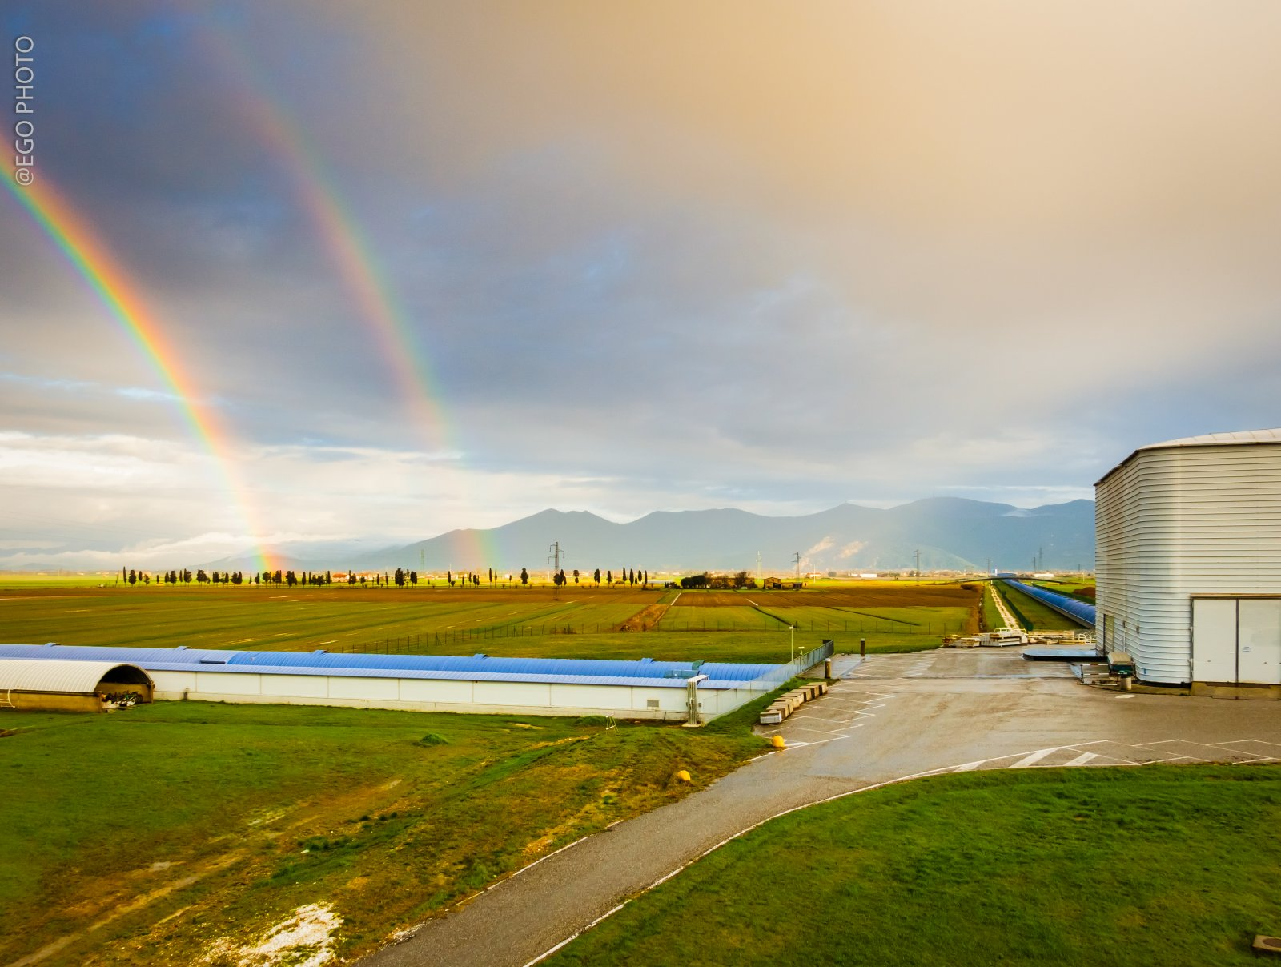
Thank you for your attention

