Slide 1
VIR-0287A-15
DQ Flags from the
Detector Monitoring System (DMS)
D. Verkindt
Virgo detchar meeting 19 june 2015

Slide 2
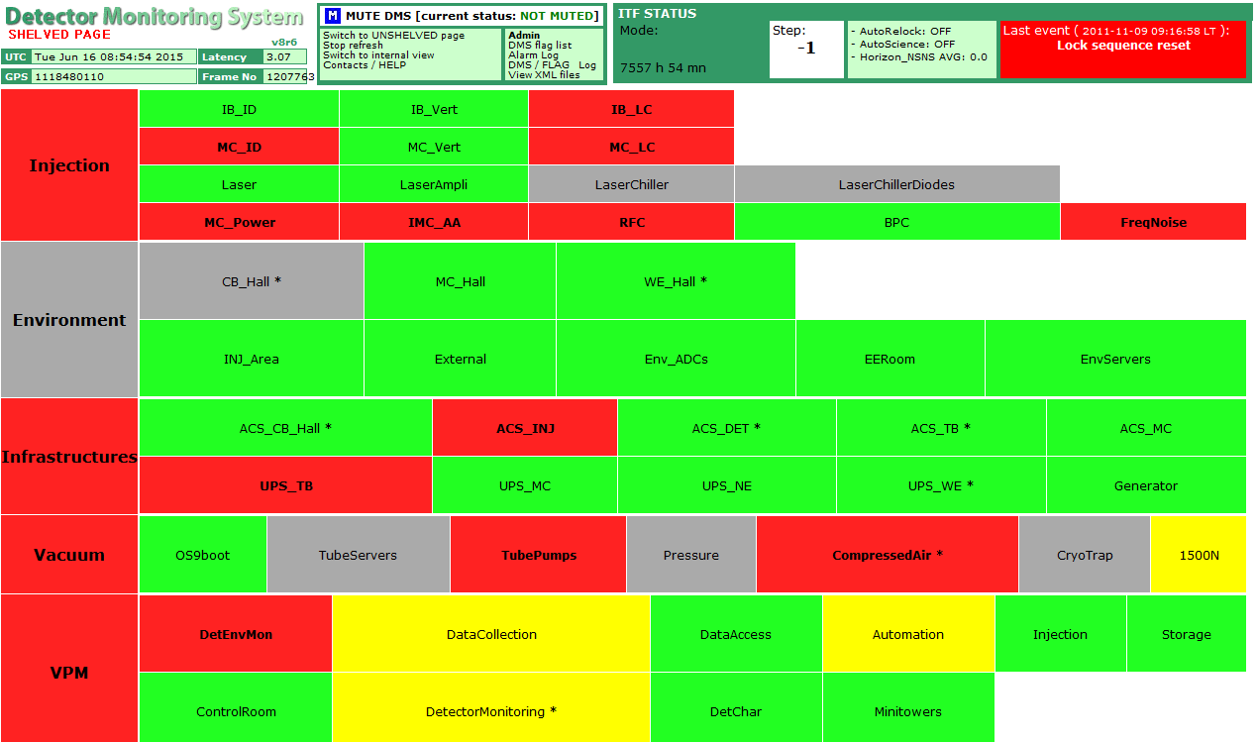
Detector Monitoring System (DMS)

Slide 3
Detector Monitoring System (DMS)
Current DMS is based on
  a set of Moni processes producing flags (sent to raw/trend data) and XML files
  php scripts that read XML files and provide the DMS web page
New Moni library:
  Will produce only flags with 0/1 values (no more bits coding)
  Will produce per process only one overall flag + one set of subflags (no more flag levels)
  Will always use calibrated data (no more use of REALUNITS keyword)
  Will follow a DMS flags naming convention : DQ_MoniName_FlagName
  Does not require large modifications in DMS web page tools.
Use of DMS flags for data analysis:
  SegOnline will select the flags to be included into the State Vector for online analyses
  SegOnline will select the flags to be propagated to DQSEGDB for offline analyses
  Should be only a matter of SegOnline configuration file
  Or will need SegOnline code modification, depending on selection criteria we want

Slide 4
Configuration file of InjMoni_new
QC_XML ./QcInjectionData_new.php 5
QC_NAME Qc_Injection
QC_FLAG MasterLaser "MasterLaser parameters out of range"
QC_FLAG SlaveLaser "SlaveLaser parameters out of range"
/*** MastereLaser ***/
QC_MONITOR * MasterLaser "mean(PSL_ML_DC,60)>0.5" "Master laser thermal correction voltage saturated"
/*** SlaveLaser ***/
QC_MONITOR * SlaveLaser "0.5<mean(PSL_SL_PUMP1_CURR,60)<1.8" "Slave Laser current too high"
QC_MONITOR * SlaveLaser "0.5<mean(PSL_SL_PUMP2_CURR,60)<1.8" "Slave Laser current too high"
QC_MONITOR * SlaveLaser "0.2<mean(PSL_SL_REFL_PD2_DC,60)<3.8" "problem with the master or slave laser"
Will produce the following flags sent to SegOnline:
DQ_Qc_Injection_overall
DQ_Qc_Injection_MasterLaser
DQ_Qc_Injection_SlaveLaser
Will produce the XML file QcInjectionData_new.php
which will contain those flags + the results of the various QC_MONITOR

Slide 5
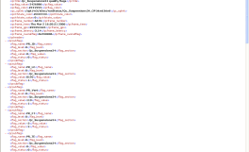
Scheme of implementation
Raw data + h + quality flags
raw.ffl
raw data
raw data
DAQ last stage
FbmAlp
trend.ffl
raw data
h Rec
DMIn
xxxMoni
DMS flags collection
xxxMoni
xxxMoni
quality flags
xxxMoni
InjMoni
Xml files
DQXML files
SegOnline
rsync
DQSEGDB

Slide 6
Next steps?
New Moni library ready to be tested : June 2015
Configurations of Moni processes changed and tested: July or Sep 2015? (DV or DV+FB)
XML files format changed: need small modifications of the DMS php scripts : Sep 2015? (FB)
SegOnline ready to get DMS flags : need a test for the selection of DMS flags (DV)
Upgrade of the DMS web page tools (php, mySQL…) : Nov 2015?
New user requirements, new software requirements : Nov 2015?
  Investigate the possibility to read trend data frames with php script?
  (no more use of XML files)
Look how to include VirgoCAM information?
VPM monitors many Virgo processes. It provides only a XML file (no flag sent to DAQ).
Do we need also DMS flags coming from it?

