Slide 1


Noise subtraction with SilenteC
Vincent Germain June 10, 2016

Slide 2
Aim
Use the auxiliary channels of Virgo/LIGO to predict transient noise (glitches) in h(t)
Mitigate the glitches produced by these noise sources
  instead of using CAT1 veto → more data to be analyzed
  instead of using gating → data available for analysis
History: Matlab code (Silente) inherited
from Gianluca Guidi & Francesco Piergiovanni

Slide 3
Difficulties
Non-linearity → frequency of the noise can change from an auxiliary channel to h(t) (up-conversion)
Orthogonality → do not create “holes” (e.g. by removing a noise twice)
Safety → do not remove GW signal in h(t)

Slide 4
SilenteC
Main channel
h(t)
Resampling
(option)
Pass-band filtering (option)
Correlation
Main <--> Aux.
Channels sorted by Correlation
Auxiliary channels
Resampling
Products of channels
Pass-band filtering (option)
Robust Fast Orthogonal Search
Properties:
  List of auxiliary channels to reconstruct the glitch in the main channel
  Linear & bi-linear reconstruction → Takes into account the up-conversions
  Orthogonality
  Estimation of the contribution of every auxiliary channel (and product of channels)
  Code planned initially for lines, not for glitches
Contributions removed
Clean channel created

Slide 5
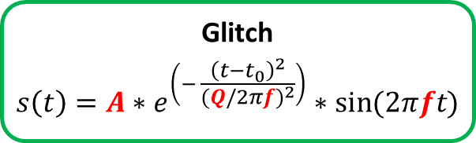
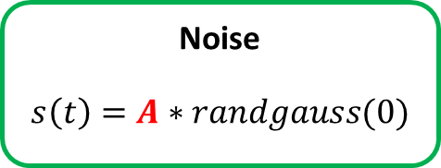
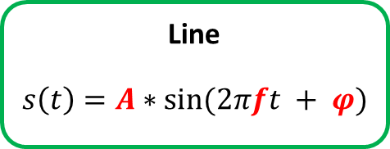
Simulation tool
Auxiliary channels
Line
$$s\left(t\right)=A∗\sin{(2πft + φ)}$$
Glitch
$$s\left(t\right)=A∗e^{\left(− \frac{{\left(t−t_{0}\right)}^{2}}{{(Q/2πf)}^{2}}\right)}∗\sin{(2πft)}$$
Noise
$$s\left(t\right)=A∗randgauss(0)$$
  Creation of the channels ch1, ch2, …
  ch_{i} : Combination (Line, Glitch, Noise)
Sampled at
Fs = 2000 Hz
Main channel chtot
chtot = A₁ * ch1 + A₂ * ch2 + A₃ * (ch_{i} * ch_{j}) + …
A_{i} = 1
Products of channels

Slide 6
Tests with SilenteC
Main channel: chtot
Auxiliary channel: ch1, ch2, …
No resampling & no filtering of the channels (main & aux.)
Window: 2 seconds of data analyzed

Slide 7
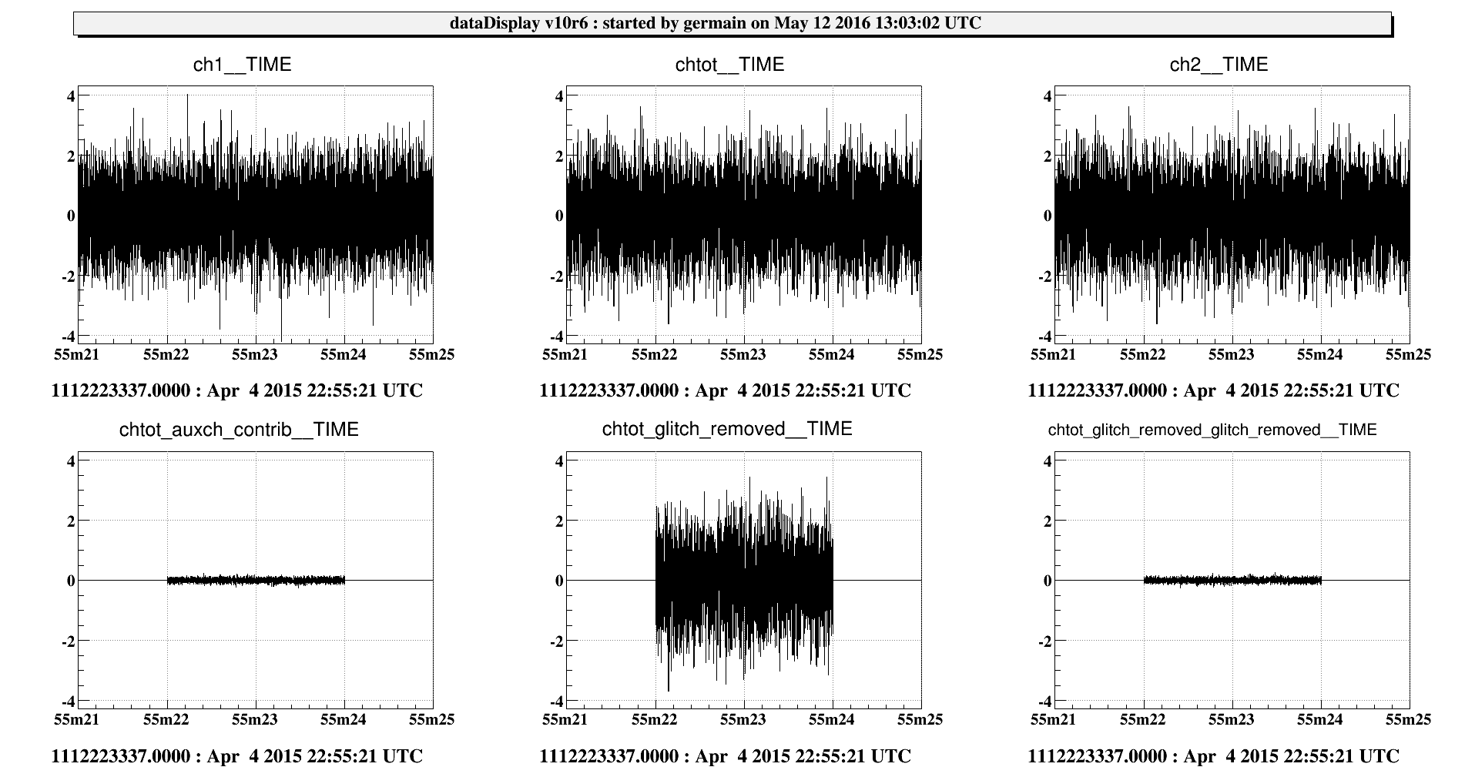
gaussian noise
Main channel
ch1
gaussian noise
SilenteC
chtot
gaussian noise
Contributions
Cleaned channel
(Main ch. - Contrib.)
Residuals
(Cleaned ch. - gaussian noise)

Slide 8
gaussian noise
Main channel
ch1
gaussian noise
SilenteC
chtot
gaussian noise
Contributions found :
ch1 < 0,4%
Contributions
Cleaned channel
(Main ch. - Contrib.)
Residuals
(Cleaned ch. - gaussian noise)

Slide 9
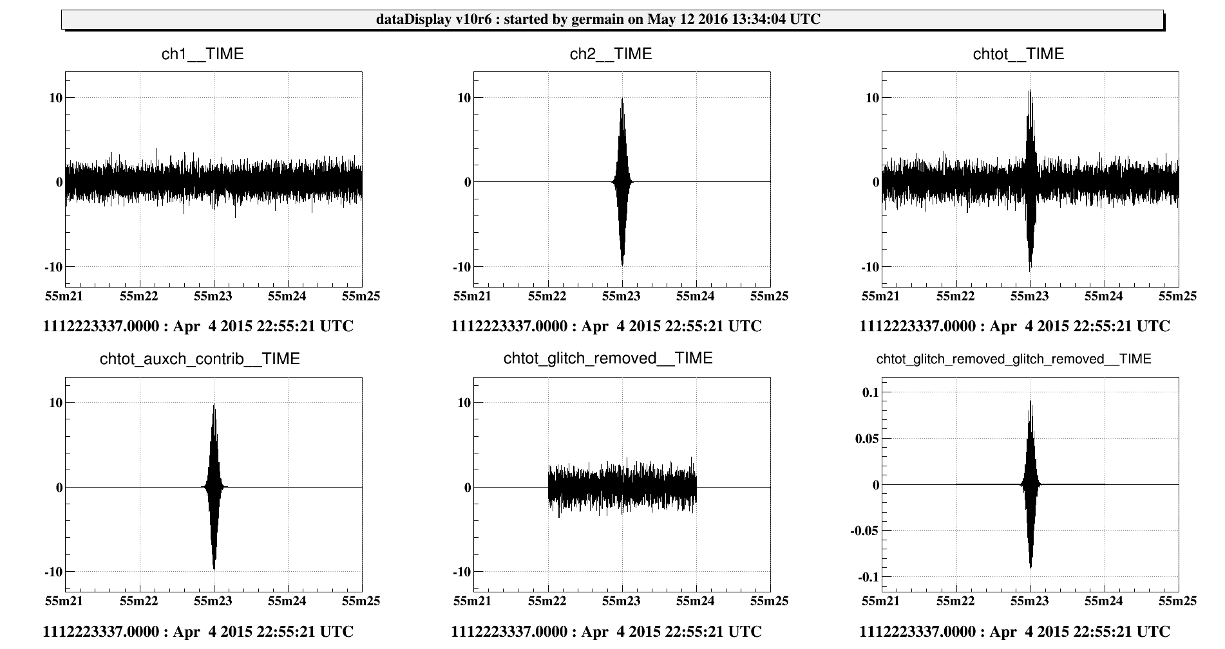
glitch
Main channel
ch1
gaussian noise
ch2
glitch A=10
SilenteC
chtot
gaussian noise + ch2
Contributions
Cleaned channel
(Main ch. - Contrib.)
Residuals
(Cleaned ch. - gaussian noise)

Slide 10
glitch
Main channel
ch1
gaussian noise
ch2
glitch A=10
SilenteC
chtot
gaussian noise + ch2
Contributions found :
ch2 → 65%
Contributions
Cleaned channel
(Main ch. - Contrib.)
Residuals
(Cleaned ch. - gaussian noise)

Slide 11
glitch
Main channel
ch1
gaussian noise
ch2
glitch A=10
SilenteC
chtot
gaussian noise + ch2
Contributions found :
ch2 → 65%
SilenteC
on the Cleaned ch.
Contributions
Cleaned channel
(Main ch. - Contrib.)
Residuals
(Cleaned ch. - gaussian noise)

Slide 12
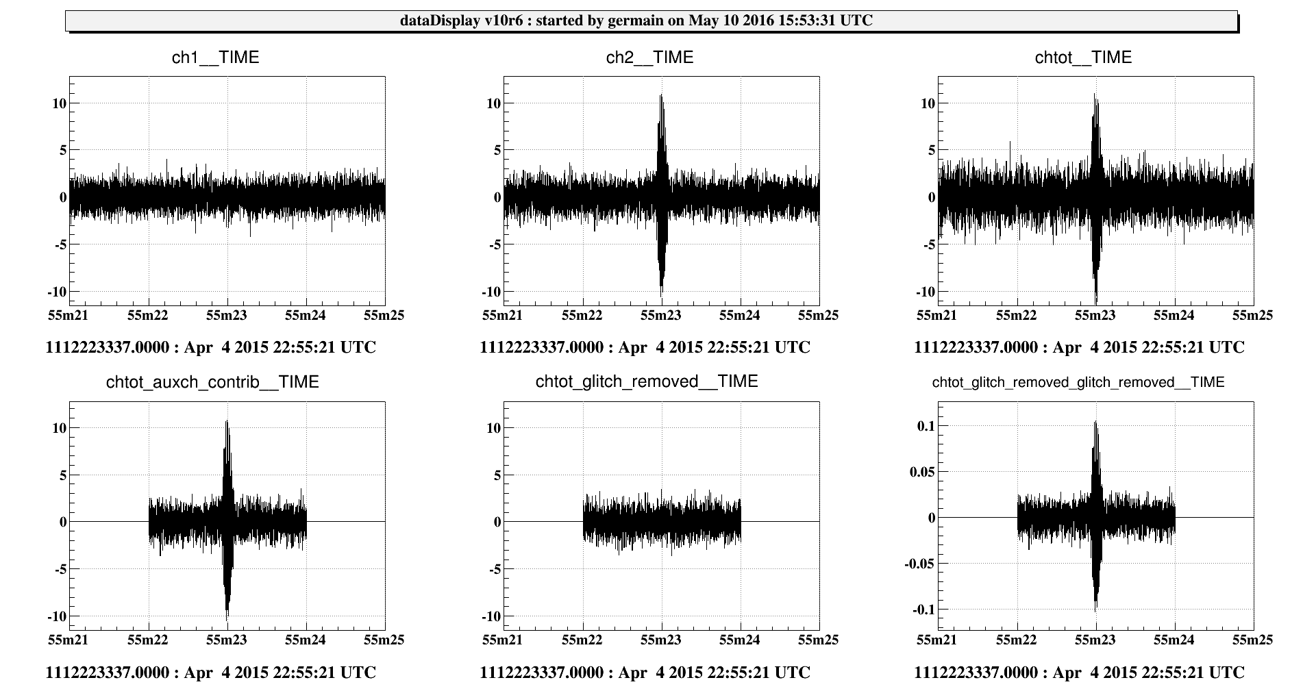
glitch + gaussian noise
Main channel
ch2
glitch A=10 + gaussian noise
ch1
gaussian noise
SilenteC
chtot
gaussian noise + ch2
Contributions
Cleaned channel
(Main ch. - Contrib.)
Residuals
(Cleaned ch. - gaussian noise)

Slide 13
glitch + gaussian noise
Main channel
ch2
glitch A=10 + gaussian noise
ch1
gaussian noise
SilenteC
chtot
gaussian noise + ch2
Contributions found :
ch2 → 74%
Contributions
Cleaned channel
(Main ch. - Contrib.)
Residuals
(Cleaned ch. - gaussian noise)

Slide 14
glitch + gaussian noise
Main channel
ch2
glitch A=10 + gaussian noise
ch1
gaussian noise
SilenteC
chtot
gaussian noise + ch2
Contributions found :
ch2 → 74%
SilenteC
on the Cleaned ch.
Contributions
Cleaned channel
(Main ch. - Contrib.)
Residuals
(Cleaned ch. - gaussian noise)

Slide 15
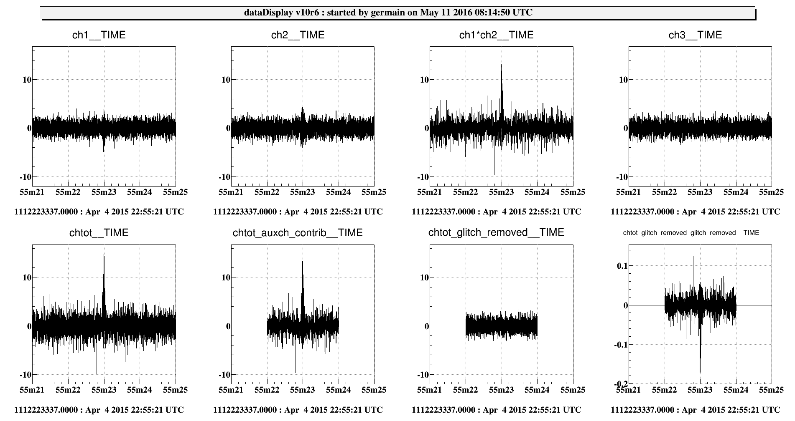
product of channels: glitch + gaussian noise
ch3
gaussian noise
ch1
glitch A=3,3 + gaussian noise
ch2
glitch A=3 + gaussian noise
SilenteC
chtot
gaussian noise + ch1*ch2
Main channel
Contributions
Cleaned channel
(Main ch. - Contrib.)
Residuals
(Cleaned ch.
- gaussian noise)

Slide 16
product of channels: glitch + gaussian noise
ch3
gaussian noise
ch1
glitch A=3,3 + gaussian noise
ch2
glitch A=3 + gaussian noise
SilenteC
chtot
gaussian noise + ch1*ch2
Contributions found :
ch1*ch2 → 62%
Main channel
Contributions
Cleaned channel
(Main ch. - Contrib.)
Residuals
(Cleaned ch.
- gaussian noise)

Slide 17
product of channels: glitch + gaussian noise
ch3
gaussian noise
ch1
glitch A=3,3 + gaussian noise
ch2
glitch A=3 + gaussian noise
SilenteC
chtot
gaussian noise + ch1*ch2
Contributions found :
ch1*ch2 → 62%
SilenteC
on the Cleaned ch.
Main channel
Contributions
Cleaned channel
(Main ch. - Contrib.)
Residuals
(Cleaned ch.
- gaussian noise)

Slide 18
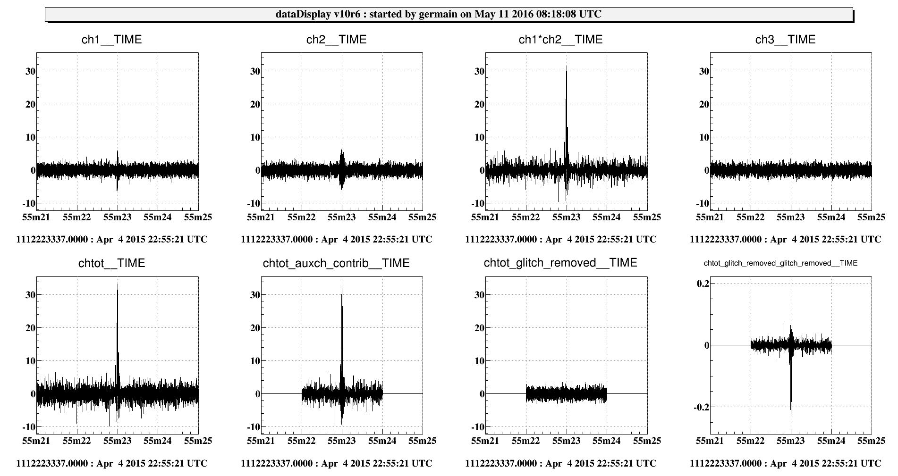
product of channels: loud glitch + gaussian noise
ch3
gaussian noise
ch1
glitch A=6 + gaussian noise
ch2
glitch A=5 + gaussian noise
SilenteC
chtot
gaussian noise + ch1*ch2
Main channel
Contributions
Cleaned channel
(Main ch. - Contrib.)
Residuals
(Cleaned ch.
- gaussian noise)

Slide 19
product of channels: loud glitch + gaussian noise
ch3
gaussian noise
ch1
glitch A=6 + gaussian noise
ch2
glitch A=5 + gaussian noise
SilenteC
chtot
gaussian noise + ch1*ch2
Contributions found :
ch1*ch2 → 82%
Main channel
Contributions
Cleaned channel
(Main ch. - Contrib.)
Residuals
(Cleaned ch.
- gaussian noise)

Slide 20
product of channels: loud glitch + gaussian noise
ch3
gaussian noise
ch1
glitch A=6 + gaussian noise
ch2
glitch A=5 + gaussian noise
SilenteC
chtot
gaussian noise + ch1*ch2
Contributions found :
ch1*ch2 → 82%
SilenteC
on the Cleaned ch.
Main channel
Contributions
Cleaned channel
(Main ch. - Contrib.)
Residuals
(Cleaned ch.
- gaussian noise)

Slide 21
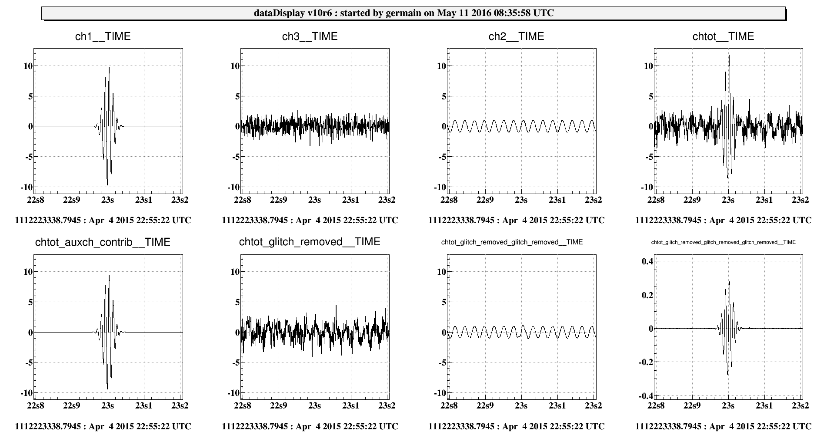
glitch & line
ch3
gaussian noise
Main channel
ch1
glitch A=10
ch2
line A=1
SilenteC
chtot
gaussian noise + ch1 + ch2
Contributions
Cleaned channel
(Main ch. - Contrib.)
Residuals
(Cleaned ch.
- gaussian noise)
After Residuals
(Residuals – line)

Slide 22
glitch & line
ch3
gaussian noise
Main channel
ch1
glitch A=10
ch2
line A=1
SilenteC
chtot
gaussian noise + ch1 + ch2
Contributions found :
ch1 → 26%
Contributions
Cleaned channel
(Main ch. - Contrib.)
Residuals
(Cleaned ch.
- gaussian noise)
After Residuals
(Residuals – line)

Slide 23
glitch & line
ch3
gaussian noise
Main channel
ch1
glitch A=10
ch2
line A=1
SilenteC
chtot
gaussian noise + ch1 + ch2
Contributions found :
ch1 → 26%
SilenteC
on the Cleaned ch.
Contributions
Cleaned channel
(Main ch. - Contrib.)
Residuals
(Cleaned ch.
- gaussian noise)
After Residuals
(Residuals – line)

Slide 24
glitch & line
ch3
gaussian noise
Main channel
ch1
glitch A=10
ch2
line A=1
SilenteC
chtot
gaussian noise + ch1 + ch2
Contributions found :
ch1 → 26%
SilenteC
on the Cleaned ch.
Contributions
Cleaned channel
(Main ch. - Contrib.)
Residuals
(Cleaned ch.
- gaussian noise)
After Residuals
(Residuals – line)
SilenteC on the Residuals

Slide 25
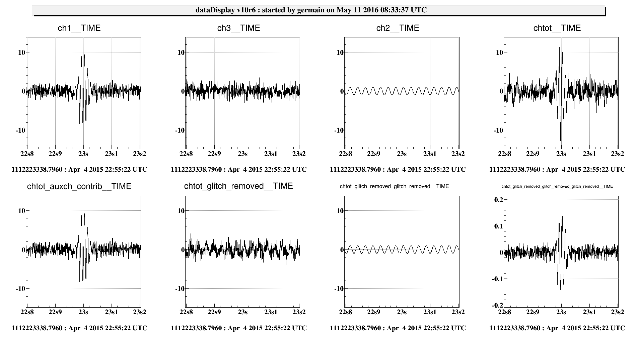
glitch + gaussian noise & line
ch3
gaussian noise
Main channel
ch1
glitch A=10 + gaussian noise
ch2
line A=1
SilenteC
chtot
gaussian noise + ch1 + ch2
Contributions
Cleaned channel
(Main ch. - Contrib.)
Residuals
(Cleaned ch.
- gaussian noise)
After Residuals
(Residuals – line)

Slide 26
glitch + gaussian noise & line
ch3
gaussian noise
Main channel
ch1
glitch A=10 + gaussian noise
ch2
line A=1
SilenteC
chtot
gaussian noise + ch1 + ch2
Contributions found :
ch1 → 50%
Contributions
Cleaned channel
(Main ch. - Contrib.)
Residuals
(Cleaned ch.
- gaussian noise)
After Residuals
(Residuals – line)

Slide 27
glitch + gaussian noise & line
ch3
gaussian noise
Main channel
ch1
glitch A=10 + gaussian noise
ch2
line A=1
SilenteC
chtot
gaussian noise + ch1 + ch2
Contributions found :
ch1 → 50%
SilenteC
on the Cleaned ch.
Contributions
Cleaned channel
(Main ch. - Contrib.)
Residuals
(Cleaned ch.
- gaussian noise)
After Residuals
(Residuals – line)

Slide 28
glitch + gaussian noise & line
ch3
gaussian noise
Main channel
ch1
glitch A=10 + gaussian noise
ch2
line A=1
SilenteC
chtot
gaussian noise + ch1 + ch2
Contributions found :
ch1 → 50%
SilenteC
on the Cleaned ch.
Contributions
Cleaned channel
(Main ch. - Contrib.)
Residuals
(Cleaned ch.
- gaussian noise)
After Residuals
(Residuals – line)
SilenteC on the Residuals

Slide 29
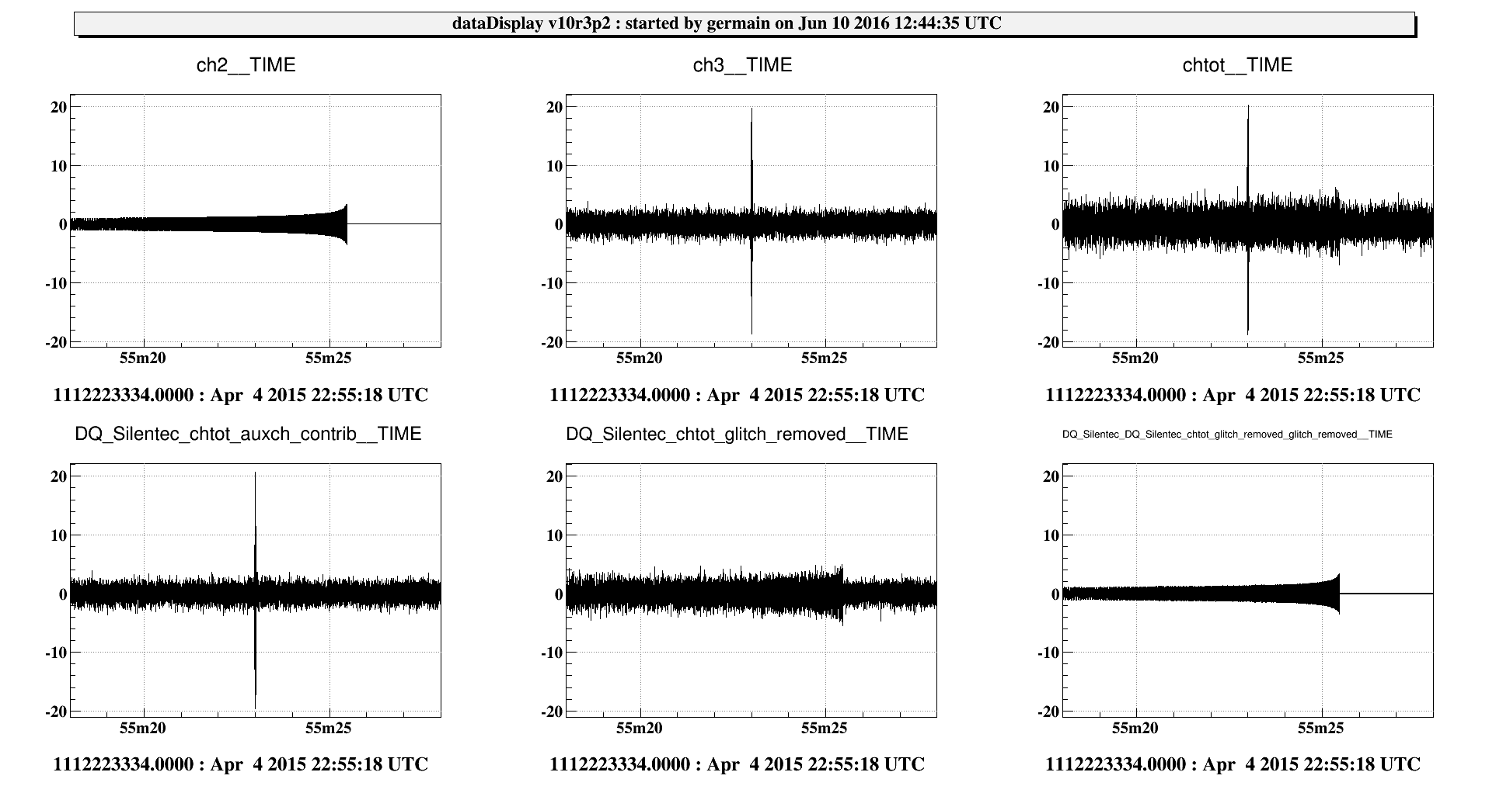
glitch + chirp
Main channel
ch3
glitch A=20 + gaussian noise
ch2
BBH chirp
SilenteC
chtot
gaussian noise + ch2 + ch3
Contributions
Cleaned channel
(Main ch. - Contrib.)
Residuals
(Cleaned ch. - gaussian noise)

Slide 30
glitch + chirp
Main channel
ch3
glitch A=20 + gaussian noise
ch2
BBH chirp
SilenteC
chtot
gaussian noise + ch2 + ch3
Contributions found :
ch3 → 78%
Contributions
Cleaned channel
(Main ch. - Contrib.)
Residuals
(Cleaned ch. - gaussian noise)

Slide 31
glitch + chirp
Main channel
ch3
glitch A=20 + gaussian noise
ch2
BBH chirp
SilenteC
chtot
gaussian noise + ch2 + ch3
Contributions found :
ch3 → 78%
SilenteC
on the Cleaned ch.
Contributions
Cleaned channel
(Main ch. - Contrib.)
Residuals
(Cleaned ch. - gaussian noise)

Slide 32
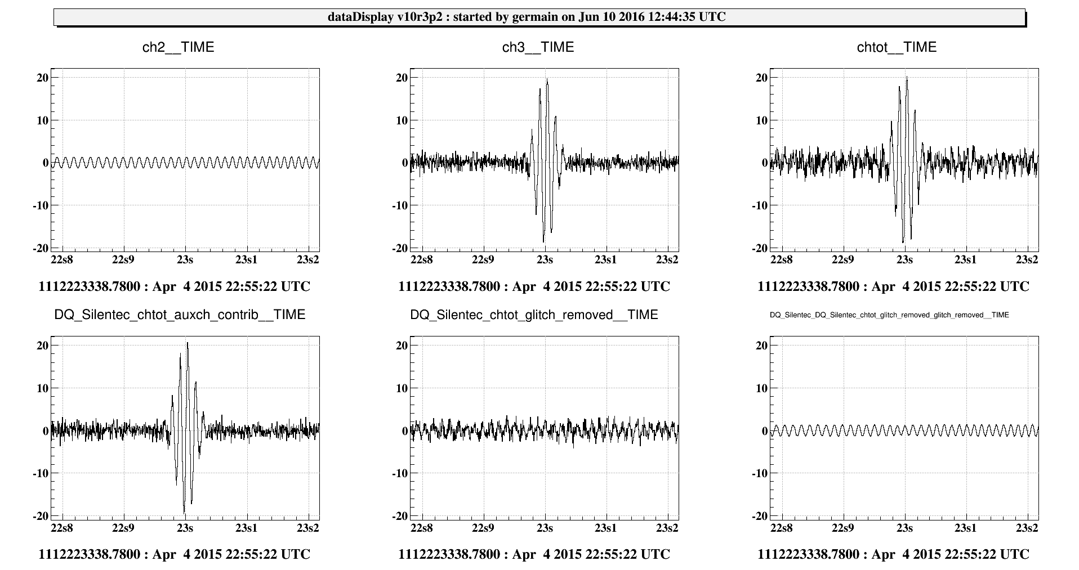
Zoom: glitch + chirp
Main channel
ch3
glitch A=20 + gaussian noise
ch2
BBH chirp
SilenteC
chtot
gaussian noise + ch2 + ch3
Contributions found :
ch3 → 78%
SilenteC
on the Cleaned ch.
Contributions
Cleaned channel
(Main ch. - Contrib.)
Residuals
(Cleaned ch. - gaussian noise)

Slide 33
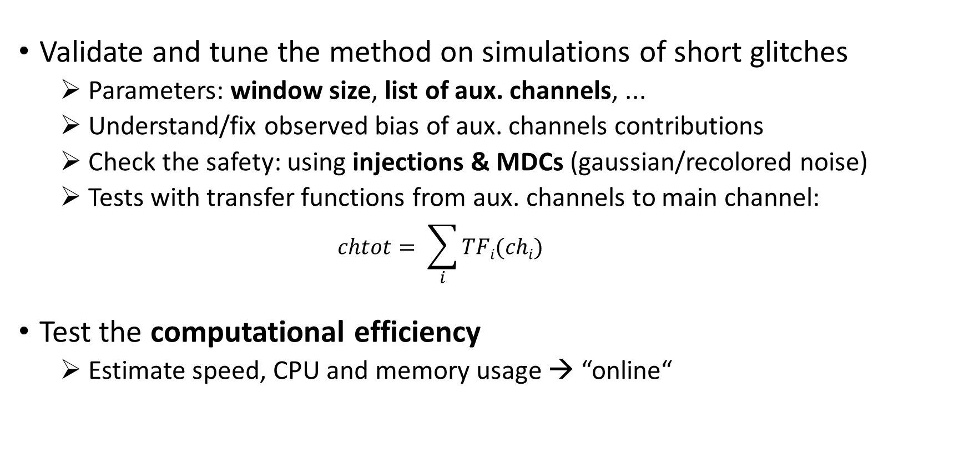
Next steps
Validate and tune the method on simulations of short glitches
  Parameters: window size, list of aux. channels, ...
  Understand/fix observed bias of aux. channels contributions
  Check the safety: using injections & MDCs (gaussian/recolored noise)
  Tests with transfer functions from aux. channels to main channel:
    $$chtot= \sum_{i}{TFi(chi)}$$
Test the computational efficiency
  Estimate speed, CPU and memory usage → “online“

