Slide 1
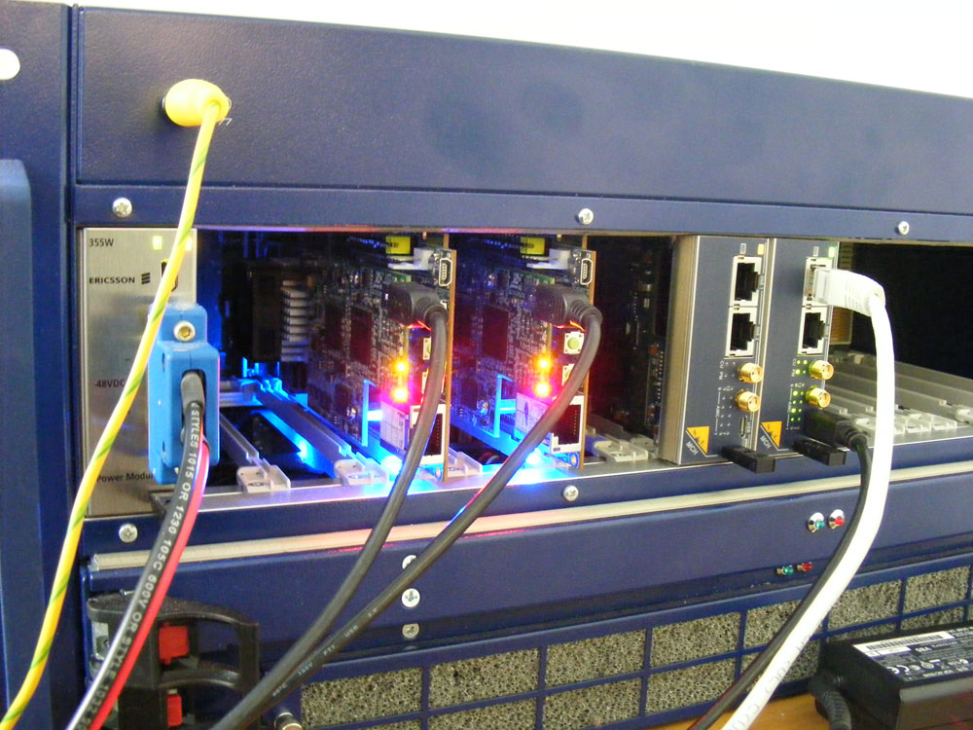


Super Attenuator
Control System

Slide 2
Main Participants
D. Passuello (INFN staff)
A. Gennai (INFN staff)
C. Magazzu (INFN staff)
M. Bitossi (INFN Fellowship, end Oct 2013)
A. Kutynia (Poland, end 2013 – possible 6 months extension)
V. Boschi (Univ. of Pisa & INFN – EGO fellowship)
G. Ballardin (EGO Staff) – Software
EGO Electronics Group (Cabling, Racks, ...)

Slide 3
Local Control Units
CD
DSP
Accel
DSP
CD
DSP
Accel
DSP
CD
DSP
Bottom Stage
LVDT
DSP
Top Stage
CD
DSP
LVDT
DSP
CD
DSP
CD
DSP
CD
DSP
CD
DSP
LVDT
DSP
DSP
LVDT
DSP
5 free slots
DSP
GbE / Optical Link
3 free slots
SRIO

Slide 4
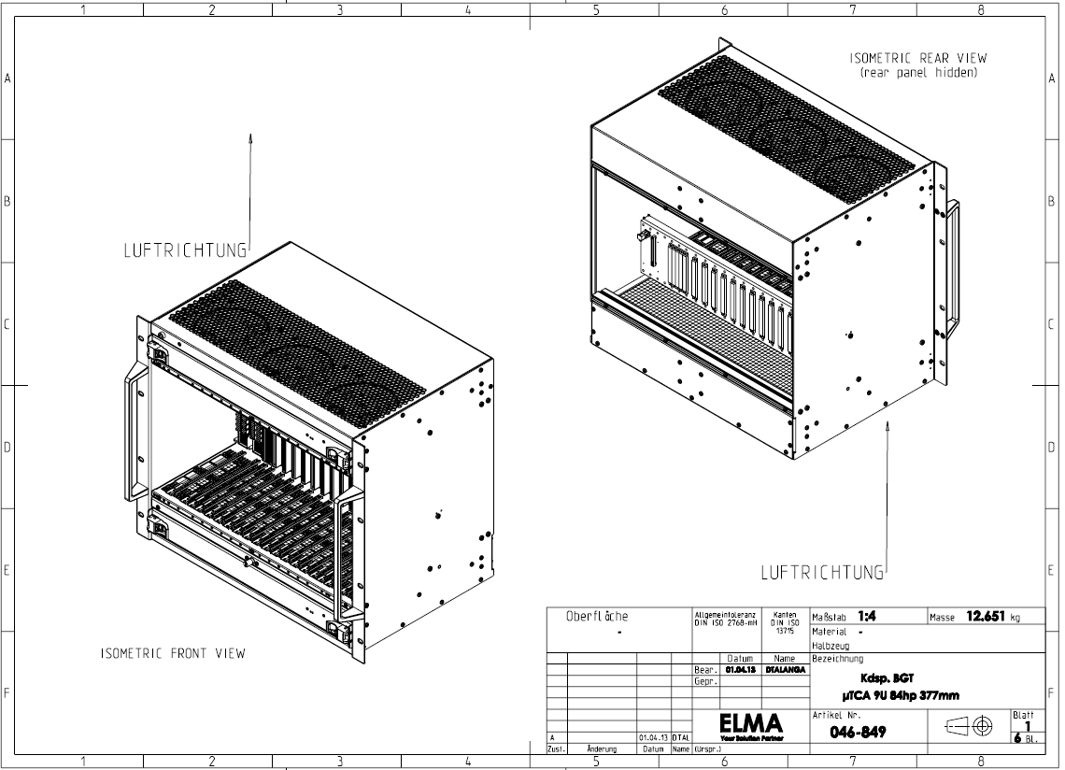

Crates
ELMA customized a TCA.4 crate
Expected delivery (2 pcs): July 19th, 2013

Slide 5
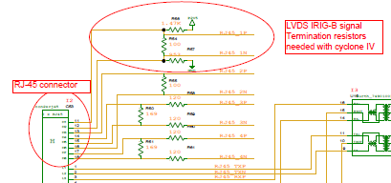
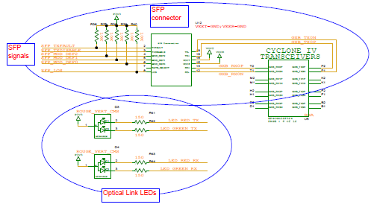
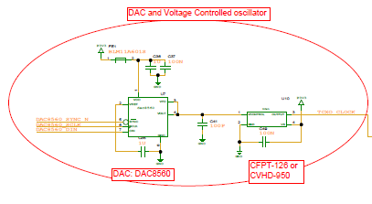
Modules
Timing + Optical Interface (design by LAPP Annecy) were integrated on board. A formal agreement will follow soon
Optical Link(by courtesy of LAPP)
Timing (by courtesy of LAPP)
Integration forced some change in components placement and a partial reassignment of Cyclone IV pins with subsequent PCB new routing (M. Bitossi).

Slide 6
Software
Design (and some development) of high level control software started (G. Ballardin).
TANGO is preliminary framework choice.
TANGO is an object oriented distributed control system using CORBA (synchronous and asynchronous communication) and zeromq (event based communication) and is being actively developed as a collaborative effort between the Alba,Anka, Desy, Elettra, ESRF, FRM II, MAX-IV, Solaris and Soleil institutes.
DSP Compiler work is in progress (D. Passuello)

Slide 7
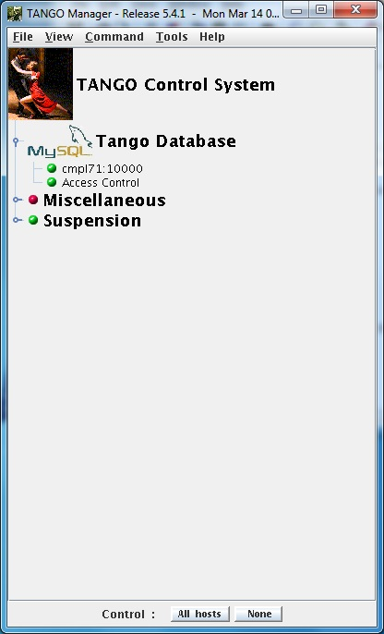
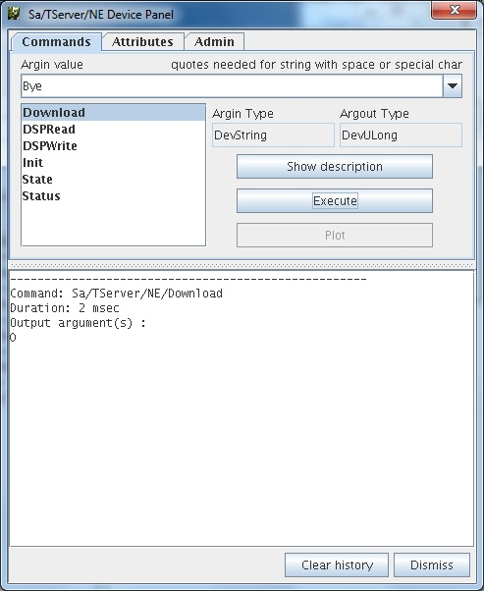
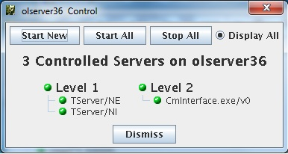
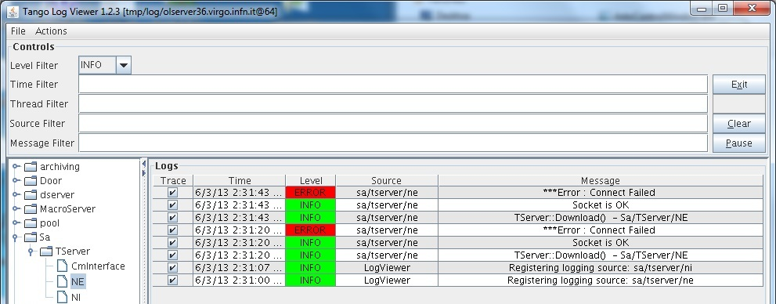

Slide 8
Software (II)
Tango Client
Cm Interface
We will not use Cm within Suspension Control System but will keep on maintaining a Cm command interface
TANGO Bus
Tango Server
Tango Server
DSP will run a server based on TCP/IP sockets
DSP
DSP

Slide 9
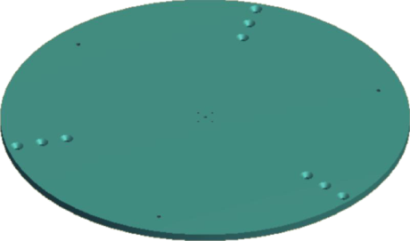
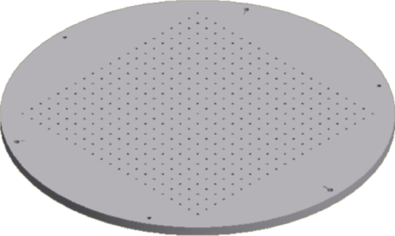
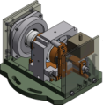
Tiltmeter (i.e. Gyroscope)
A test facility was set up and we ran some preliminary test (V.Boschi , A.Kutynia, C. Magazzu) – Mechanical design by A. Basti
The testing table has been then equipped with 3 LVDTs and 3 Coil-magnet actuators, disposed in the standard pinwheel configuration, plus an horizontal accelerometer placed in the center of the table.
Table is controlled by DSP implementing a LQG 3x3 controller based on a Kalman estimator.
10 cm
1.8 m
HRG
Accell
LVDT
Magnet

Slide 10
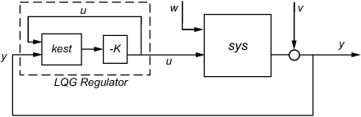
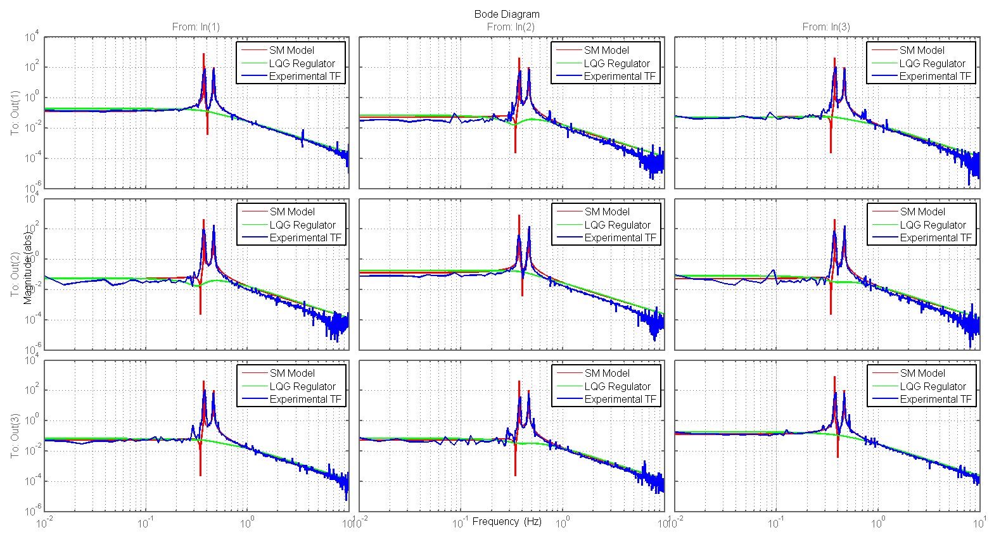
LQG Controller (V. Boschi)
LVDT1, LVDT2, LVDT3
Kalman filter
COIL1, COIL2, COIL3
SimMechanics model tuned on experimental TFs
State feedback gain
LVDT1/COIL1
LVDT2/COIL1
LVDT3/COIL1
LVDT1/COIL2
LVDT2/COIL2
LVDT3/COIL2
LVDT1/COIL3
LVDT2/COIL3
LVDT3/COIL3

Slide 11
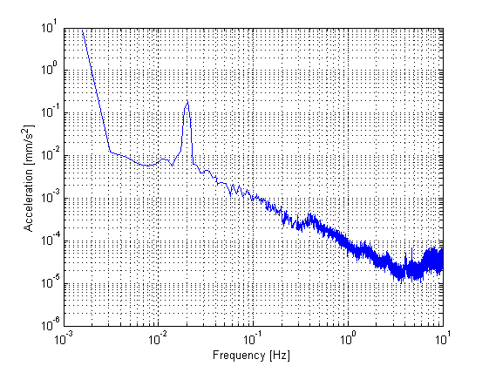
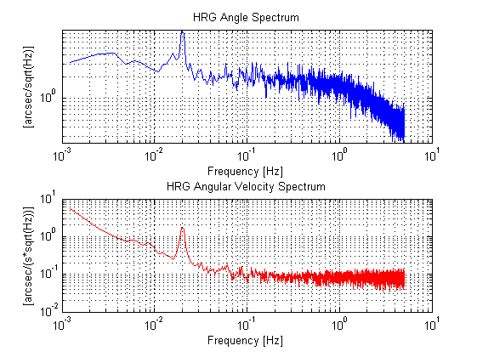
Preliminary Results (DRAFT)
Angle output (bandpass 7mHz -> 1.27Hz)
20 mHz sine wave as seen by accelerometer (30 urad rms)
Expected nominal ground tilt noise is in the order of 30e-9/f rad/sqrt(Hz)
Angle rate output (lowpass 26mHz)

