Slide 1
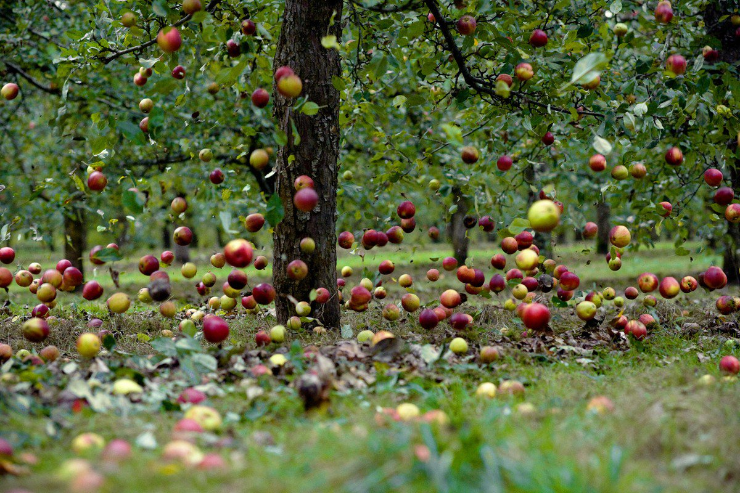
Virgo evolutions
Jo van den Brand
Spokesperson of Virgo Collaboration
Nikhef and VU University Amsterdam, jo@nikhef.nl
EGO, Cascina, April 19, 2018

Slide 2







Advanced Virgo
Virgo is a European collaboration with about 280 members
Advanced Virgo (AdV): upgrade of the Virgo interferometric detector
Participation by scientists from France, Italy, The Netherlands, Poland, Hungary, Spain, Germany
20 laboratories, about 280 authors
      APC Paris
      ARTEMIS Nice
      EGO Cascina
      INFN Firenze-Urbino
      INFN Genova
      INFN Napoli
      INFN Perugia
      INFN Pisa
      INFN Roma La Sapienza
      INFN Roma Tor Vergata
      INFN Trento-Padova
      LAL Orsay – ESPCI Paris
      LAPP Annecy
      LKB Paris
      LMA Lyon
      Nikhef Amsterdam
      POLGRAW(Poland)
      RADBOUD Uni. Nijmegen
      RMKI Budapest
      Univ. of Valencia
      University of Jena
Advanced Virgo project has been formally completed on July 31, 2017
Part of the international network of 2nd generation detectors
Joined the O2 run on August 1, 2017
7 European countries
Notes:
Spain is our newest addition: Univ. of Valencia, Pinte, …

Slide 3
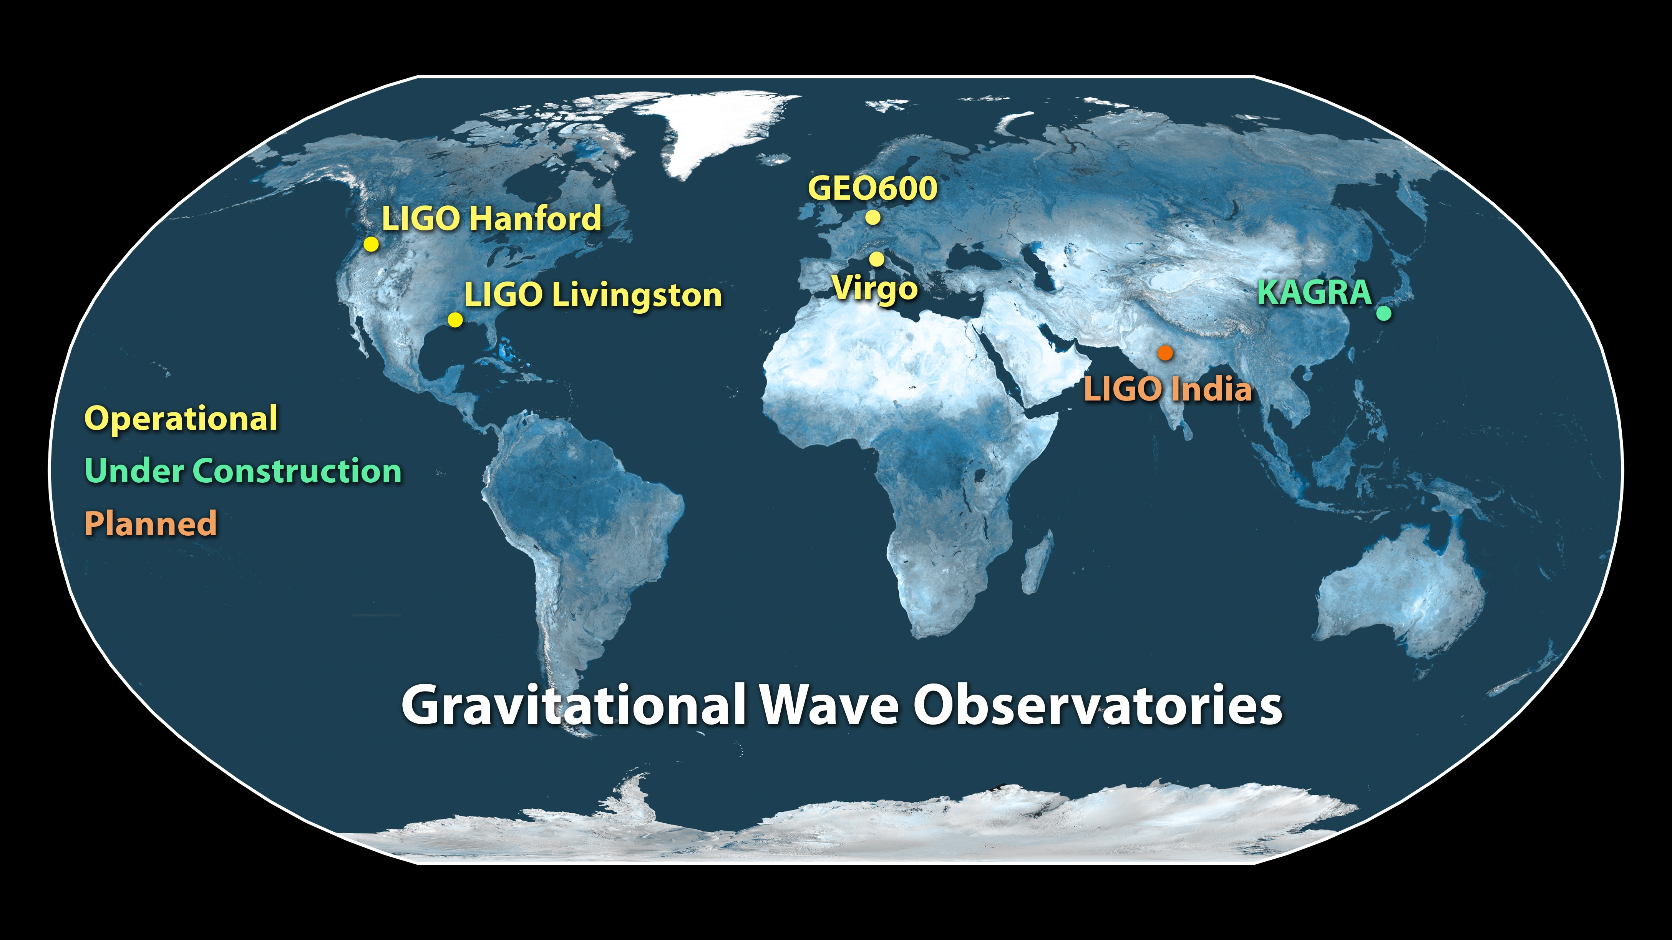
Towards a global GW research infrastructure
LSC and Virgo share data and do analysis jointly

Slide 4
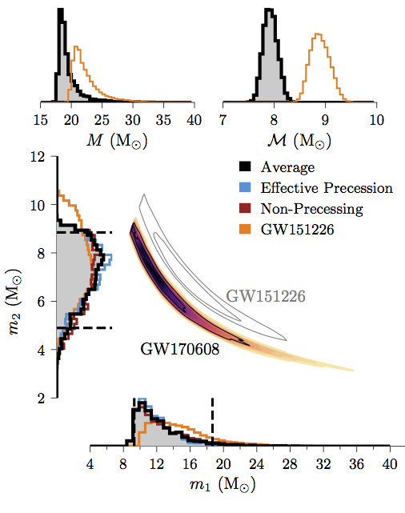
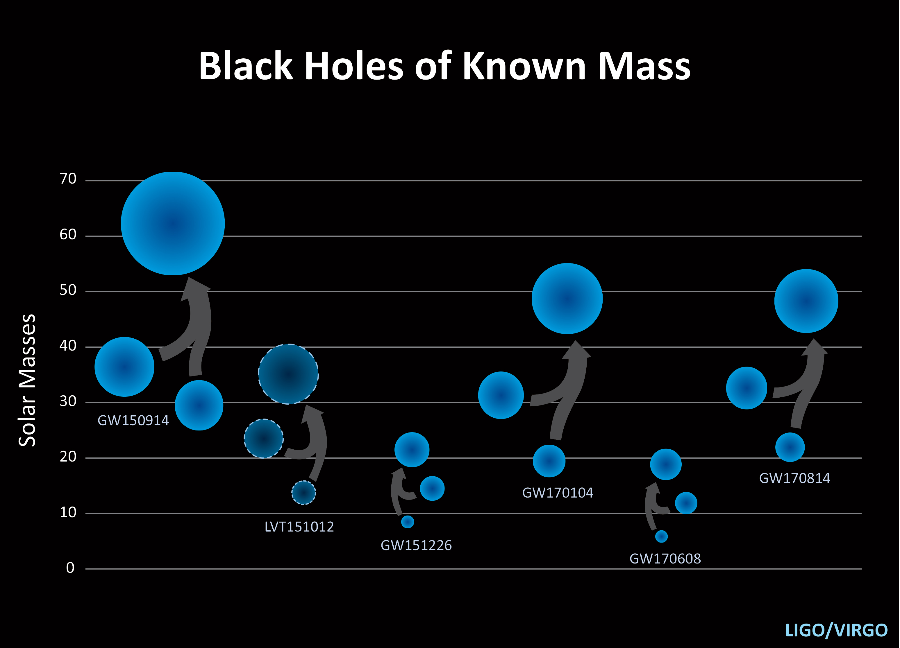
Scientific achievements: properties of black holes
Extract information on masses, spins, energy radiated, position, distance, inclination, polarization. Population distribution may shed light on formation mechanisms
  LVC reported on 6 BBH mergers
  Fundamental physics, astrophysics, astronomy, and cosmology
  Testing GR, waveforms (with matter)

Slide 5
Virgo joins LIGO in August 2017

Slide 6
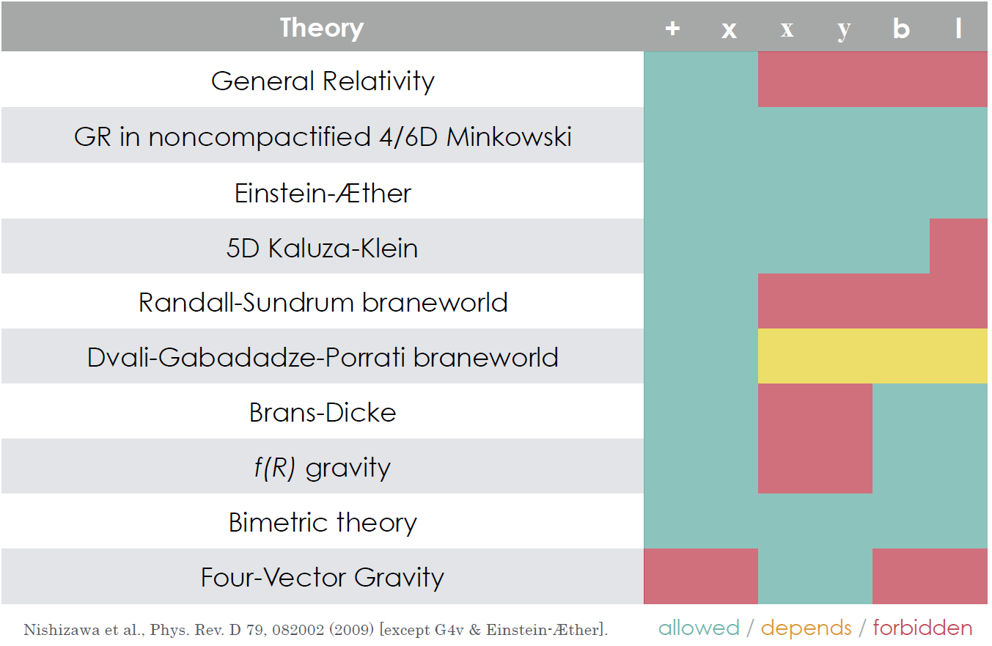
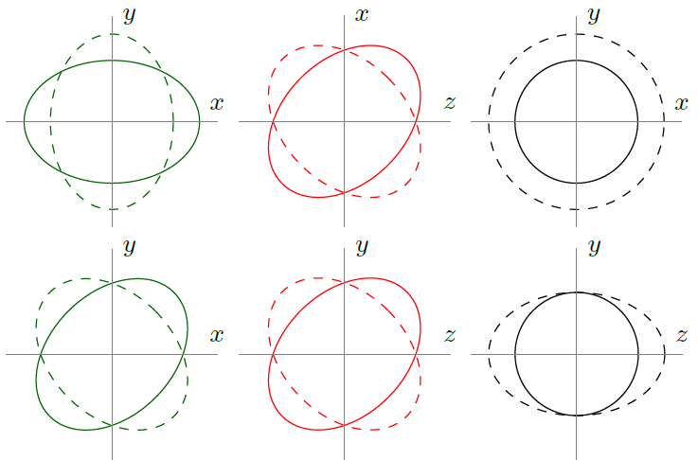
Polarization of gravitational waves
Polarization is a fundamental property of spacetime. It determined how spacetime can be deformed. General metric theories allow six polarizations. General Relativity allows two (tensor) polarizations
GR only allows (T) polarizations
General metric theories also know
vector (V) and scalar (S) polarizations

Slide 7
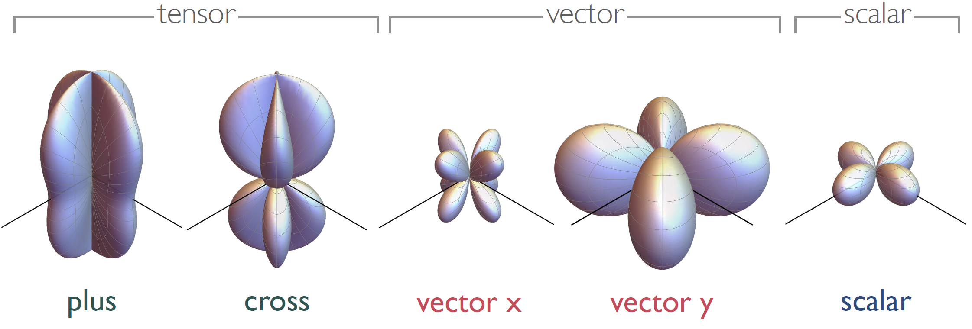
First test of polarizations of gravitational waves
According to Einstein’s General Relativity there exist only two polarizations. General metric theories of gravity allow six polarizations. GW170814 confirms Einstein’s prediction
Angular dependence (antenna-pattern) differs for T, V, S
LIGO and Virgo have different antenna-patterns
This allows for a fundamental of the polarizations of spacetime

Slide 8
First test of polarizations of gravitational waves
According to Einstein’s General Relativity there exist only two polarizations. General metric theories of gravity allow six polarizations. GW170814 confirms Einstein’s prediction
Angular dependence (antenna-pattern) differs for T, V, S
LIGO and Virgo have different antenna-patterns
This allows for a fundamental of the polarizations of spacetime
  Our analysis favors tensor polarizations in support of General Relativity
  Our data favor tensor structure over vector by about a (Bayes) factor 200
  And tensor over scalar by about a factor 1000
  This is a first test, and for BBH we do not know the source position very well

Slide 9
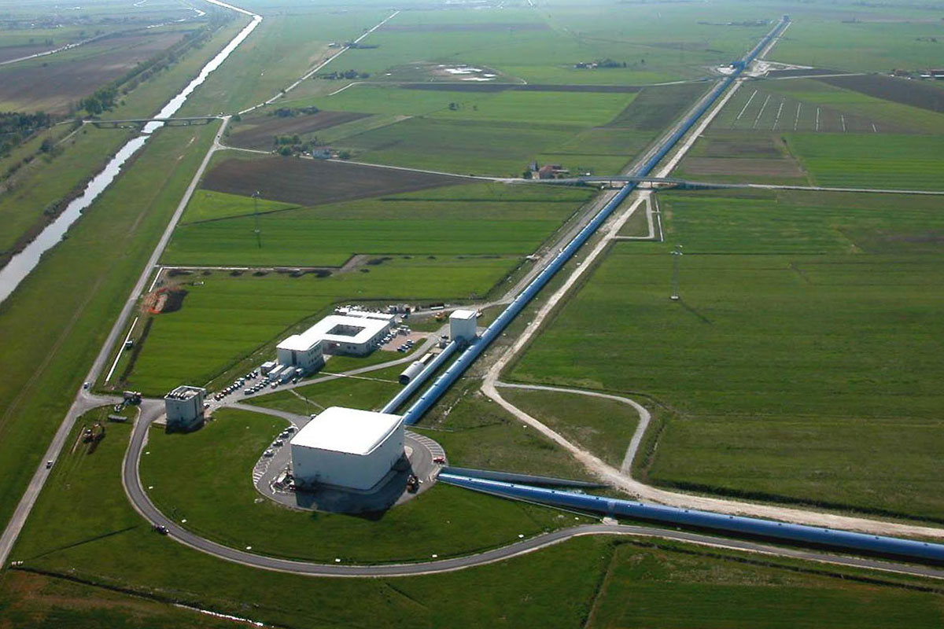
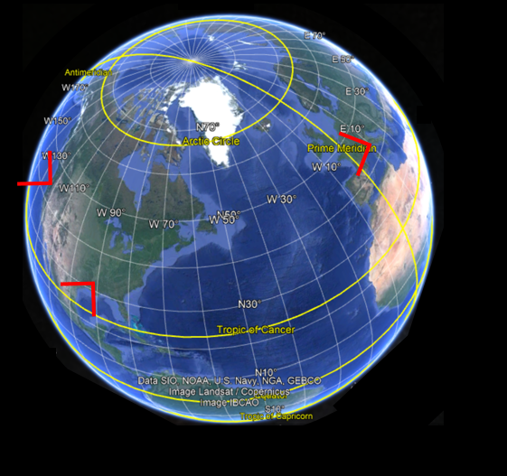
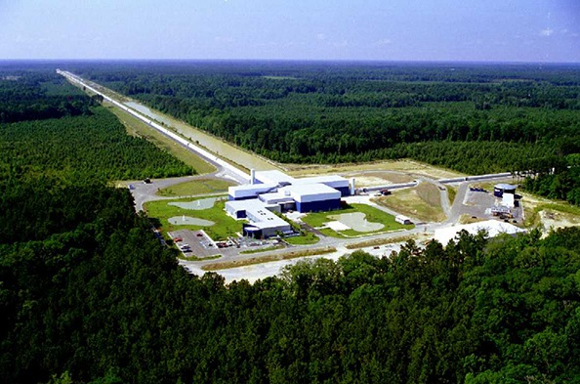
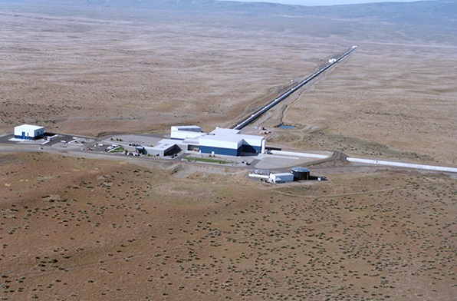
Virgo allowed source location via triangulation
GW170817 first arrived at Virgo, after 22 ms it arrived at LLO, and another 3 ms later LLH detected it
Virgo, Cascina, Italy
LIGO, Livingston, LA
LIGO, Hanford, WA

Slide 10
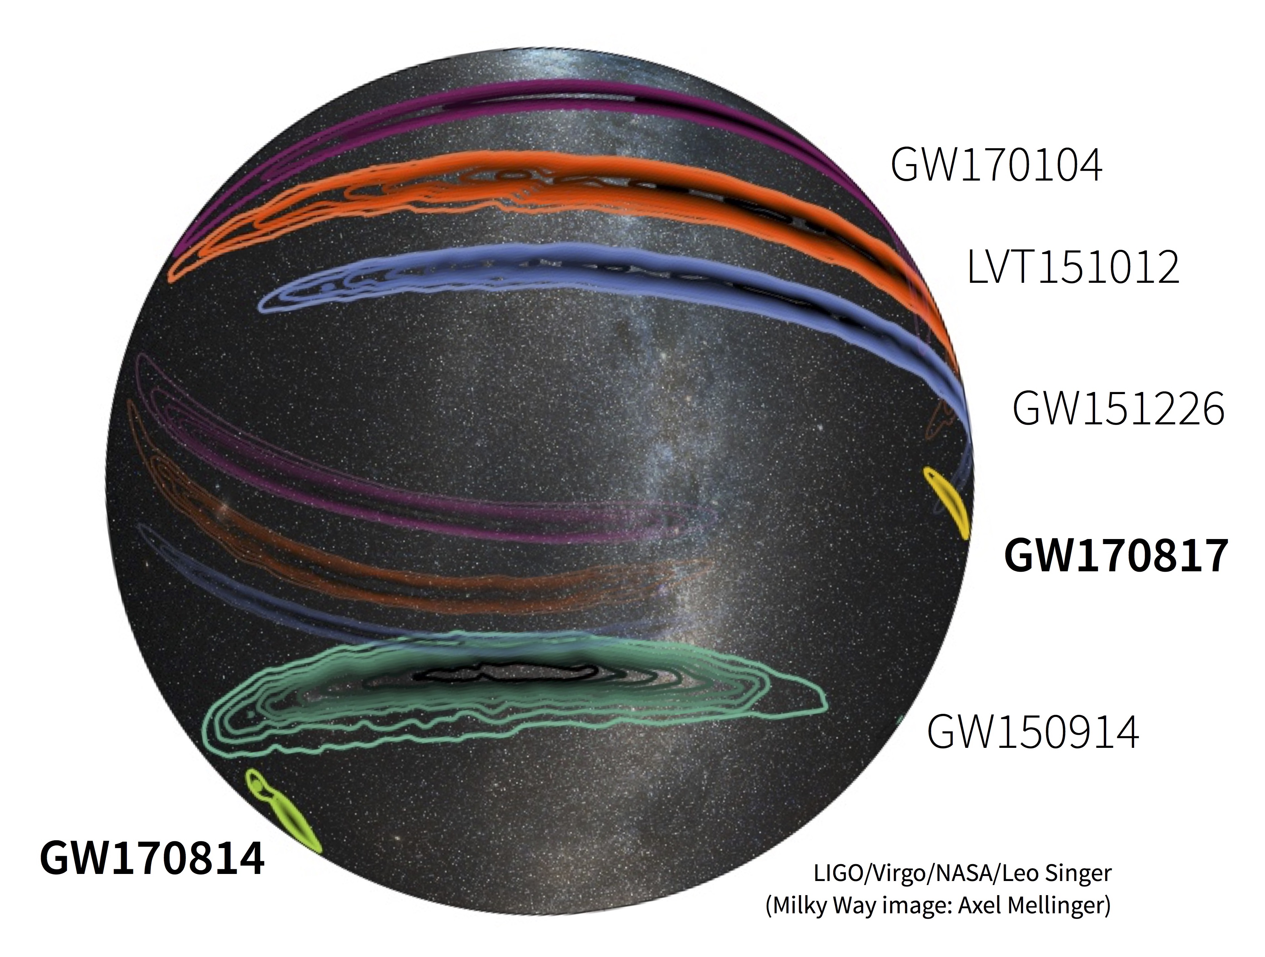
First triple detection by Virgo and LIGO
Gravitational wave traveled for almost 2 billion years through the Universe and hit Earth first at lat. 44.95 degr S, long 72,97 degr W, Puerto Aysen, Chili. The source was in the constellation Eridanus

Slide 11
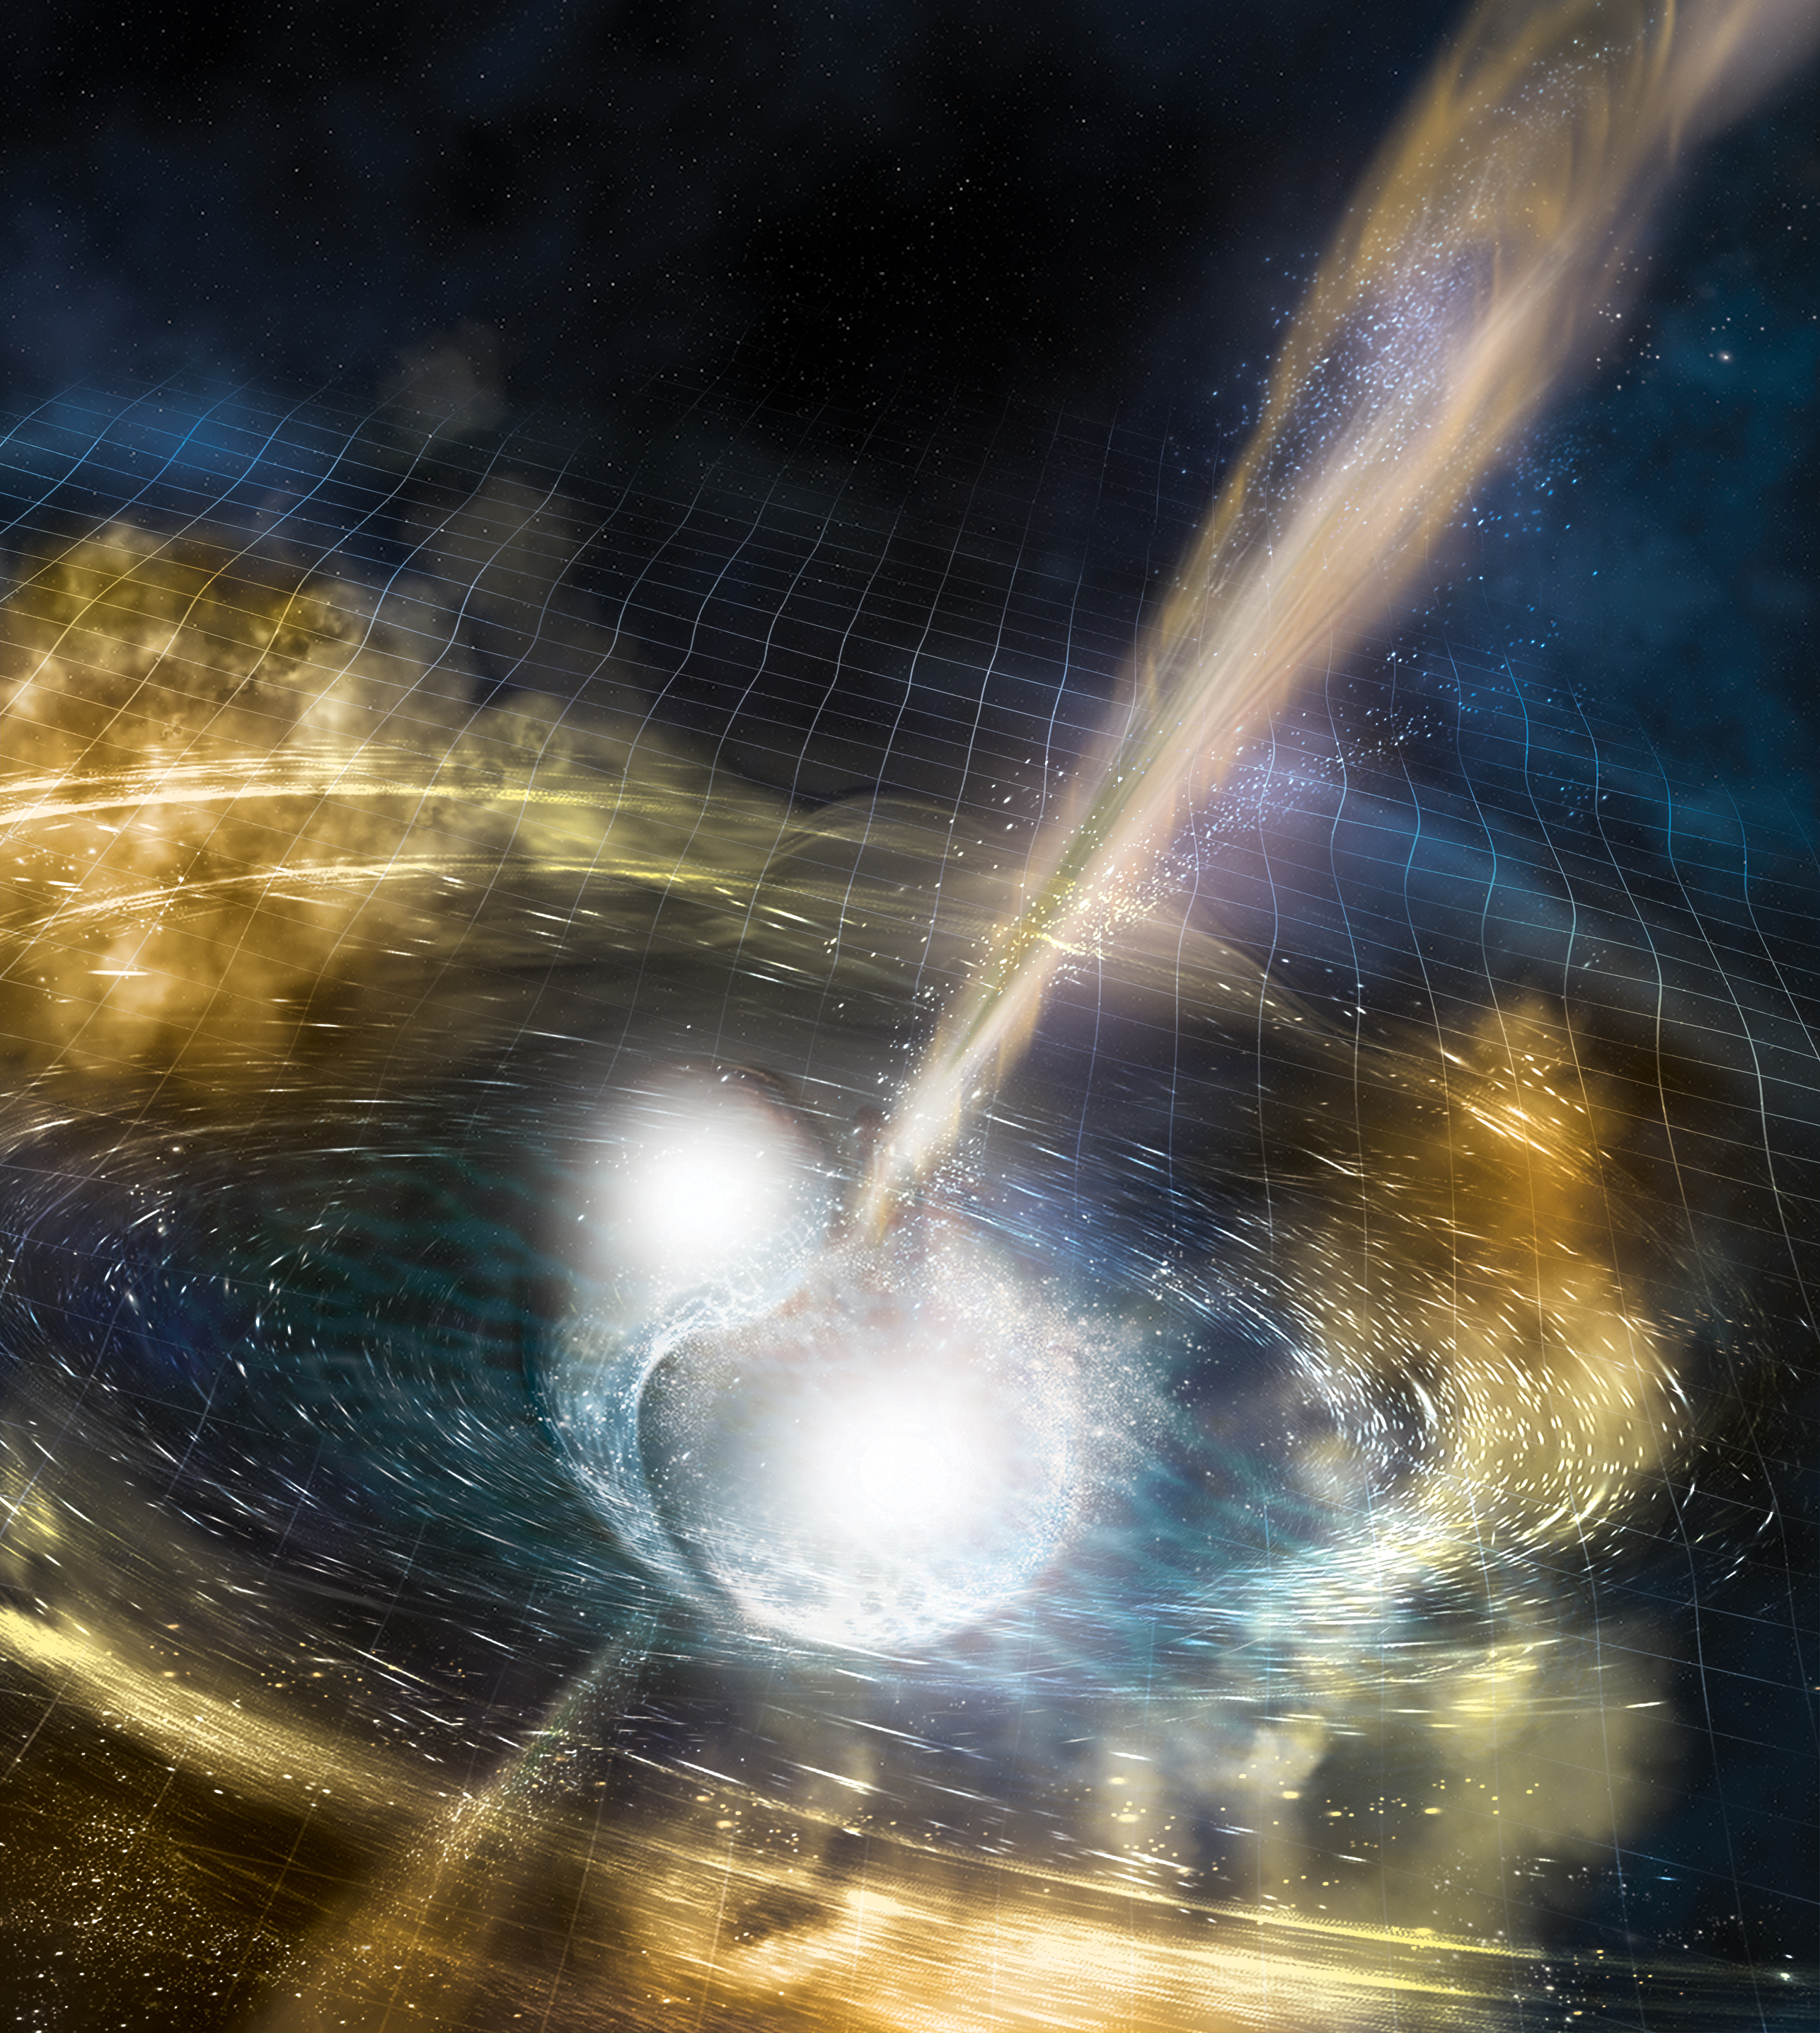
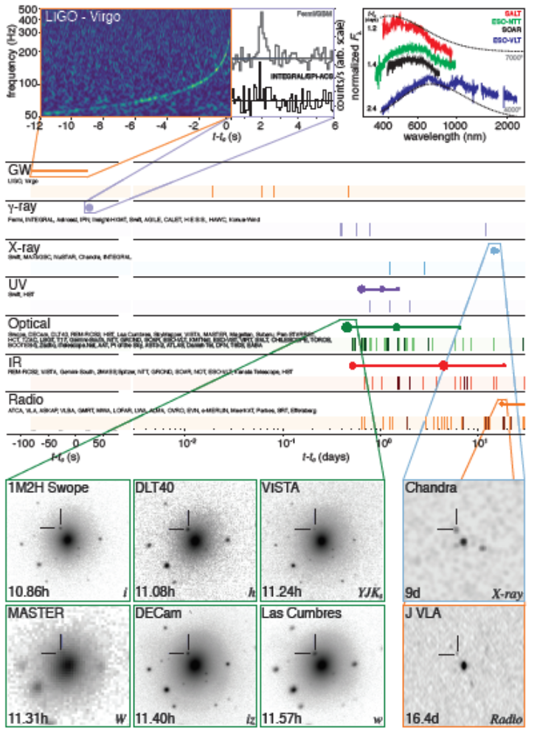
GW170817: start of multi-messenger astronomy with GW
Many compact merger sources emit, besides gravitational waves, also light, gamma- and X-rays, and UV, optical, IR, and radio waves, as well as neutrino’s or other subatomic particles. Our three-detector global network allows identifying these counterparts

Slide 12
Our science is limited by the sensitivity of our instruments

Slide 13
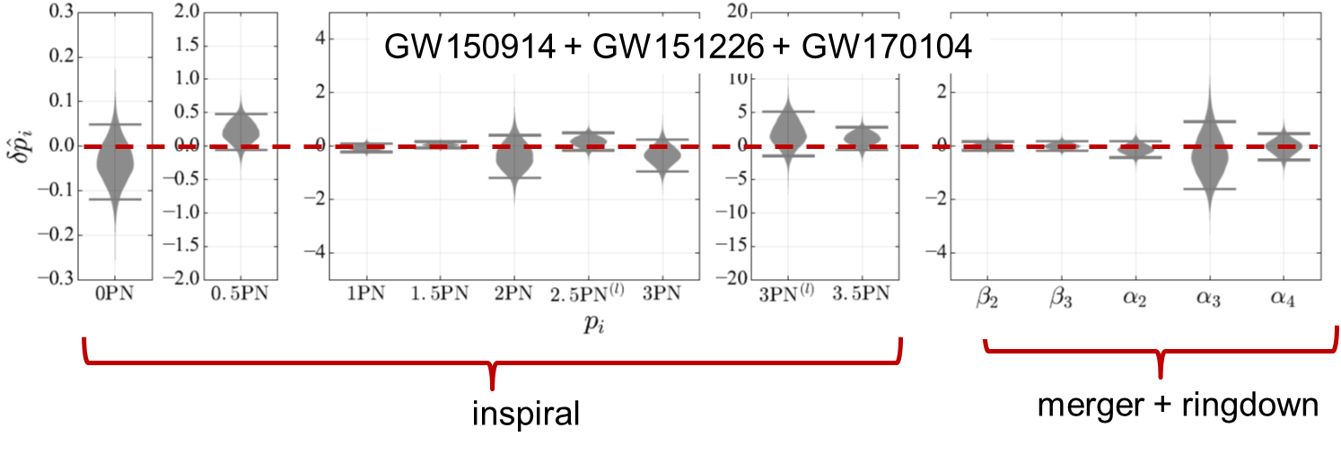
Precision tests of GR with BBH mergers
Bayesian analysis increases accuracy on parameters by combining information from multiple events
Inspiral and PN expansion
Inspiral PN and logarithmic terms:
Sensitive to GW back-reaction, spin-orbit, spin-spin couplings, …
Merger terms: numerical GR
Ringdown terms: quasi-normal modes; do we see Kerr black holes?
Towards high precision tests of gravity
Combining information from multiple events and having high-SNR events will allow unprecedented tests of GR and other theories of gravity
Our collaborations set ambitious goals for the future
We need to improve:
sensitivity of our instruments over the entire frequency range
improve of data exchange with the global community (e.g. Open Public Alerts)
optimize our computing and analysis
improve our source modeling (NR)
We are not done yet!

Slide 14
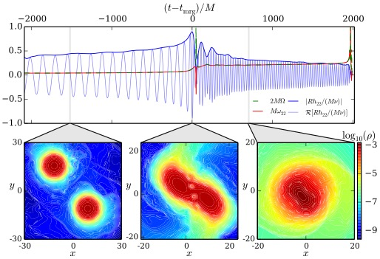
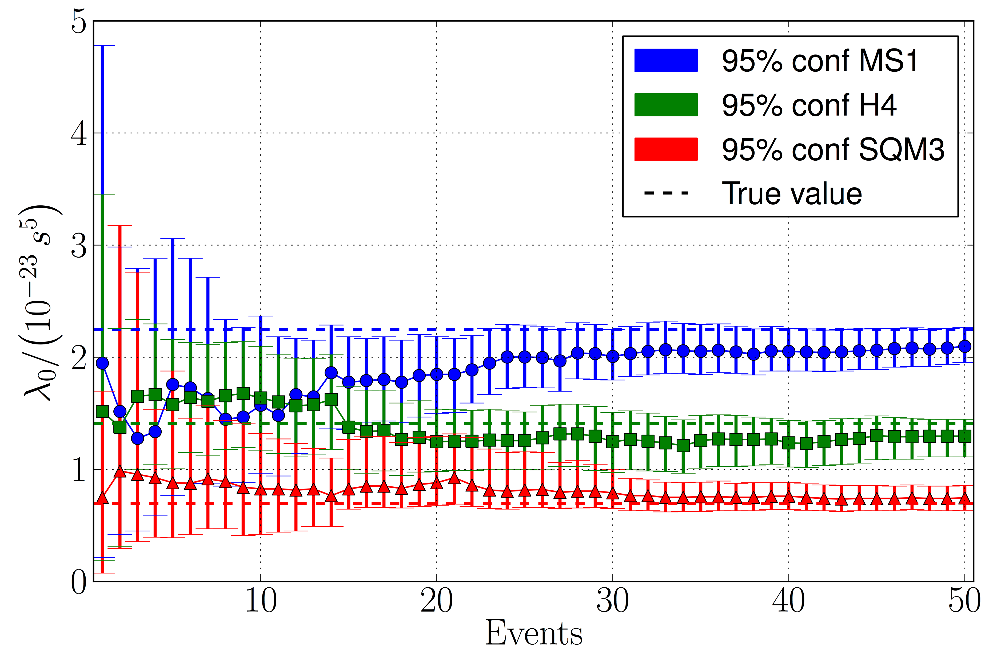
Probing the structure of neutron stars
Tidal effects leave their imprint on the gravitational wave signal from binary neutron stars. This provides information about their deformability. There is a strong need for more sensitive detectors
  Gravitational waves from inspiraling binary neutron stars
    When close, the stars induce tidal deformations in each other
    These affect orbital motion
    Tidal effects imprinted upon gravitational wave signal
    Tidal deformability maps directly to neutron star equation of state
  Measurement of tidal deformations on GW170817
    More compact neutron stars favored
    “Soft” equation of state
  LIGO + Virgo, PRL 119, 161101 (2017)
  Bernuzzi, Nagar, Font, …

Slide 15
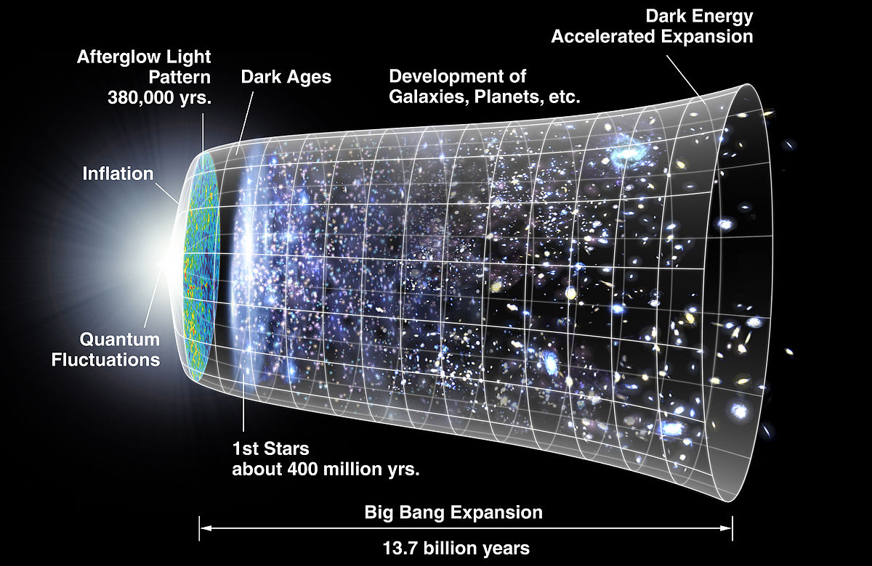
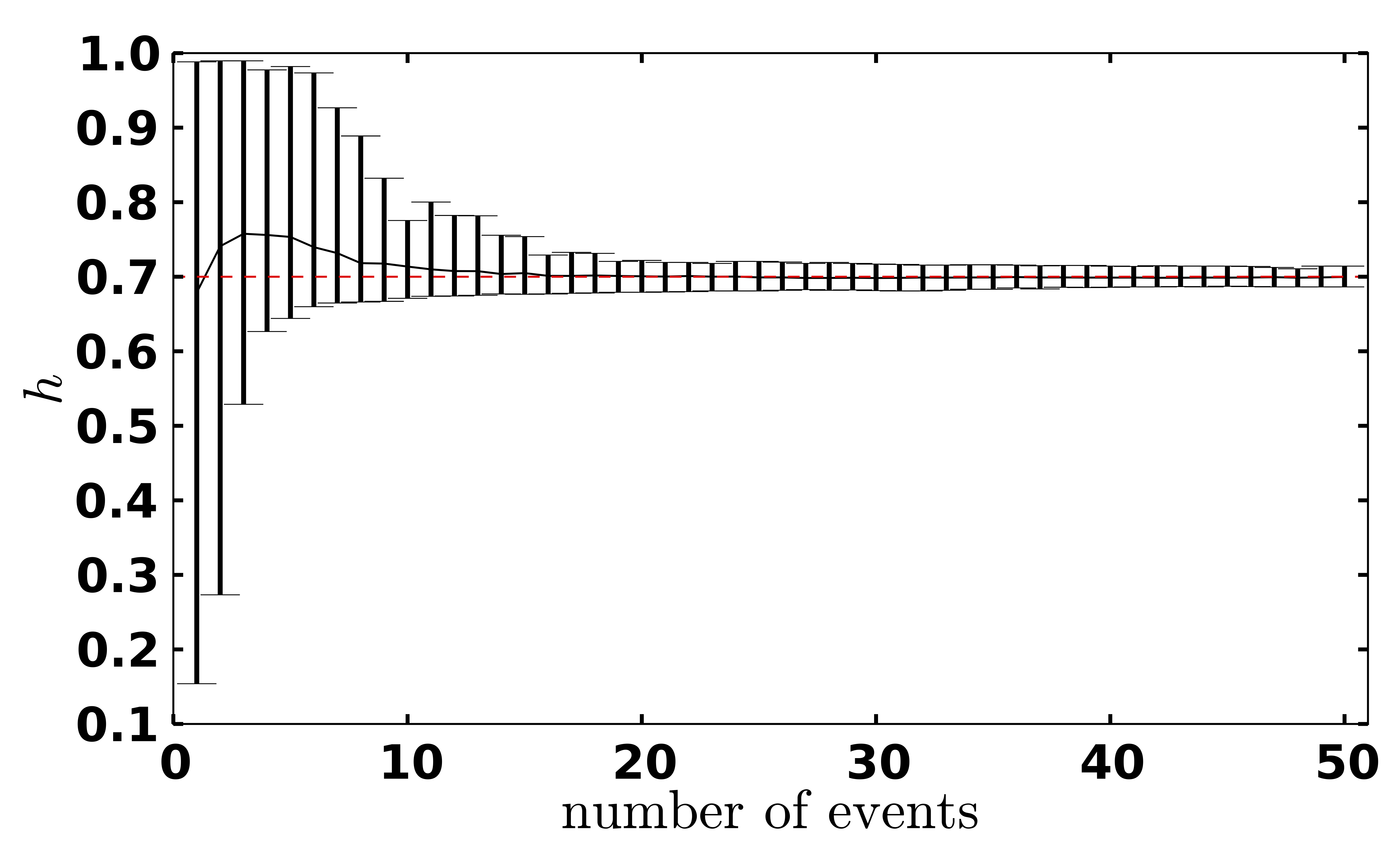
A new cosmic distance marker
A few tens of detections of binary neutron star mergers allow determining the Hubble parameters to about 1% accuracy
  Measurement of the local expansion of the Universe
  The Hubble constant
    Distance from GW signal
    Redshift from EM counterpart (galaxy NGC 4993)
  LIGO+Virgo et al., Nature 551, 85 (2017)
  GW170817
  One detection: limited accuracy
  Few tens of detections with LIGO/Virgo will be needed to obtain O(1%) accuracy
  Del Pozzo, PRD 86, 043011 (2012)
  Third generation observatories allow studies of the Dark Energy equation of state parameter

Slide 16
Scientific impact of gravitational wave science
Multi-messenger astronomy started: a broad community is relying of detection of gravitational waves
Fundamental physics
Access to dynamic strong field regime, new tests of General Relativity
Black hole science: inspiral, merger, ringdown, quasi-normal modes, echo's
Lorentz-invariance, equivalence principle, polarization, parity violation, axions
Astrophysics
First observation for binary neutron star merger, relation to sGRB
Evidence for a kilonova, explanation for creation of elements heavier than iron
Astronomy
Start of gravitational wave astronomy, population studies, formation of progenitors, remnant studies
Cosmology
Binary neutron stars can be used as standard “sirens”
Dark Matter and Dark Energy
Nuclear physics
Tidal interactions between neutron stars get imprinted on gravitational waves
Access to equation of state
LVC will be back with improved instruments to start the next observation run (O3)

Slide 17
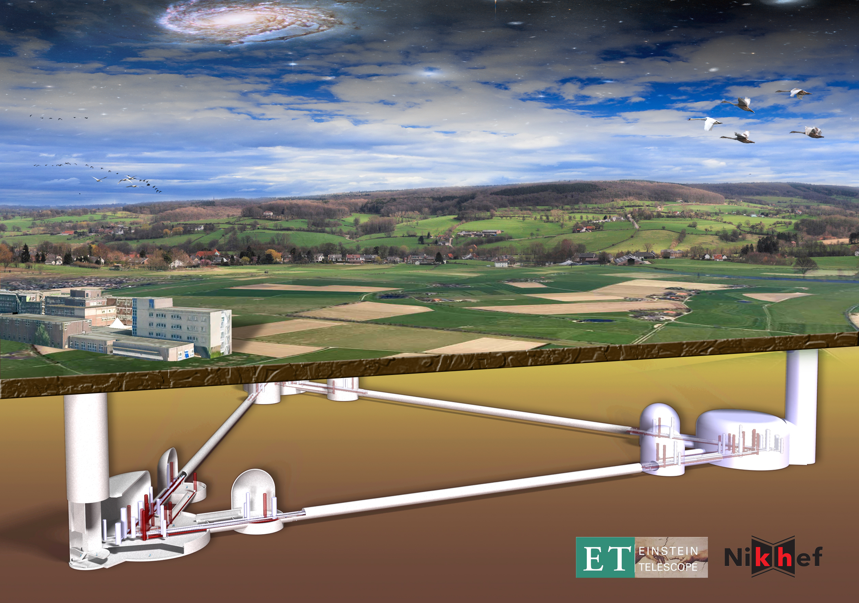

Einstein Telescope
The next gravitational wave observatory
Coordinated effort with US for a global 3G network …
Conceptual Design Study
Notes:
I understand that such infrastructure is costly, but besides science, there is other spin-off to society

Slide 18
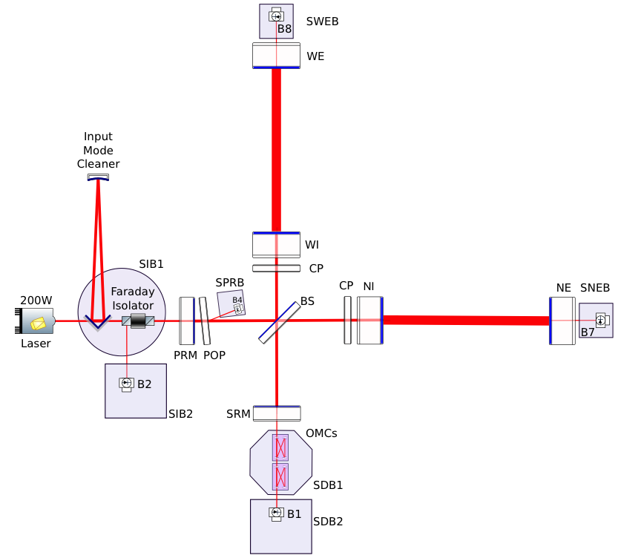
Advanced Virgo design
Advanced Virgo started operation on August 1, 2017. It features many improvements with respect to Virgo and Virgo+
  For 2017 and 2018
  Larger beam: 2.5x larger at ITMs
  Heavier mirrors: 2x heavier
  Higher quality optics: residual roughness < 0.5 nm
  Improved coatings for lower losses: absorption < 0.5 ppm, scattering < 10 ppm
  Reducing shot noise: arm finesse of cavities are 3 x larger than in Virgo+
  Thermal control of aberrations: compensate for cold and hot defects on the core optics:
  ring heaters
  double axicon CO2 actuators
  CO2 central heating
  diagnostics: Hartmann sensors & phase cameras
  Stray light control: suspended optical benches in vacuum, and new set of baffles and diaphragms to catch diffuse light
  Improved vacuum: 10⁻⁹ mbar instead of 10⁻⁷ mbar

Slide 19
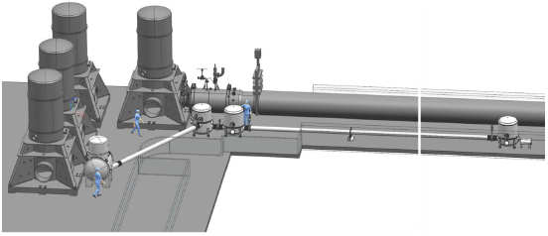
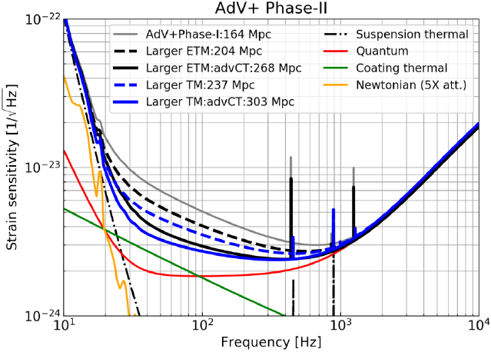
AdV+ as the next incremental step forward in sensitivity
AdV+ is the European plan to maximize Virgo’s sensitivity within the constrains of the EGO site. It has the potential to increase Virgo’s detection rate by up to an order of magnitude
AdV+ features
  Maximize science
  Secure Virgo’s scientific relevance
  Safeguard investments by scientists and funding agencies
  Implement new innovative technologies
  De-risk technologies needed for third generation observatories
  Attract new groups wanting to enter the field
Upgrade activities
  Tuned signal recycling and HPL: 120 Mpc
  Frequency dependent squeezing: 150 Mpc
  Newtonian noise cancellation: 160 Mpc
  Larger mirrors (105 kg): 200-230 Mpc
  Improved coatings: 260-300 Mpc

Slide 20
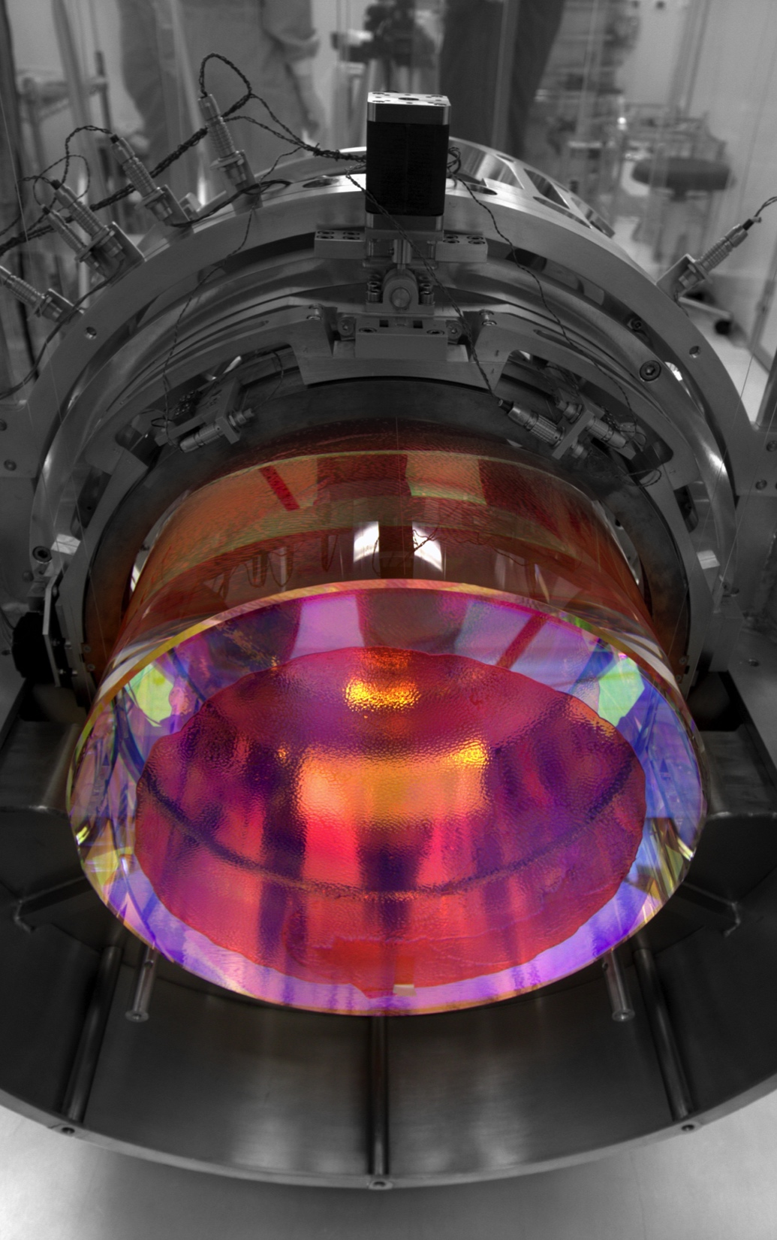
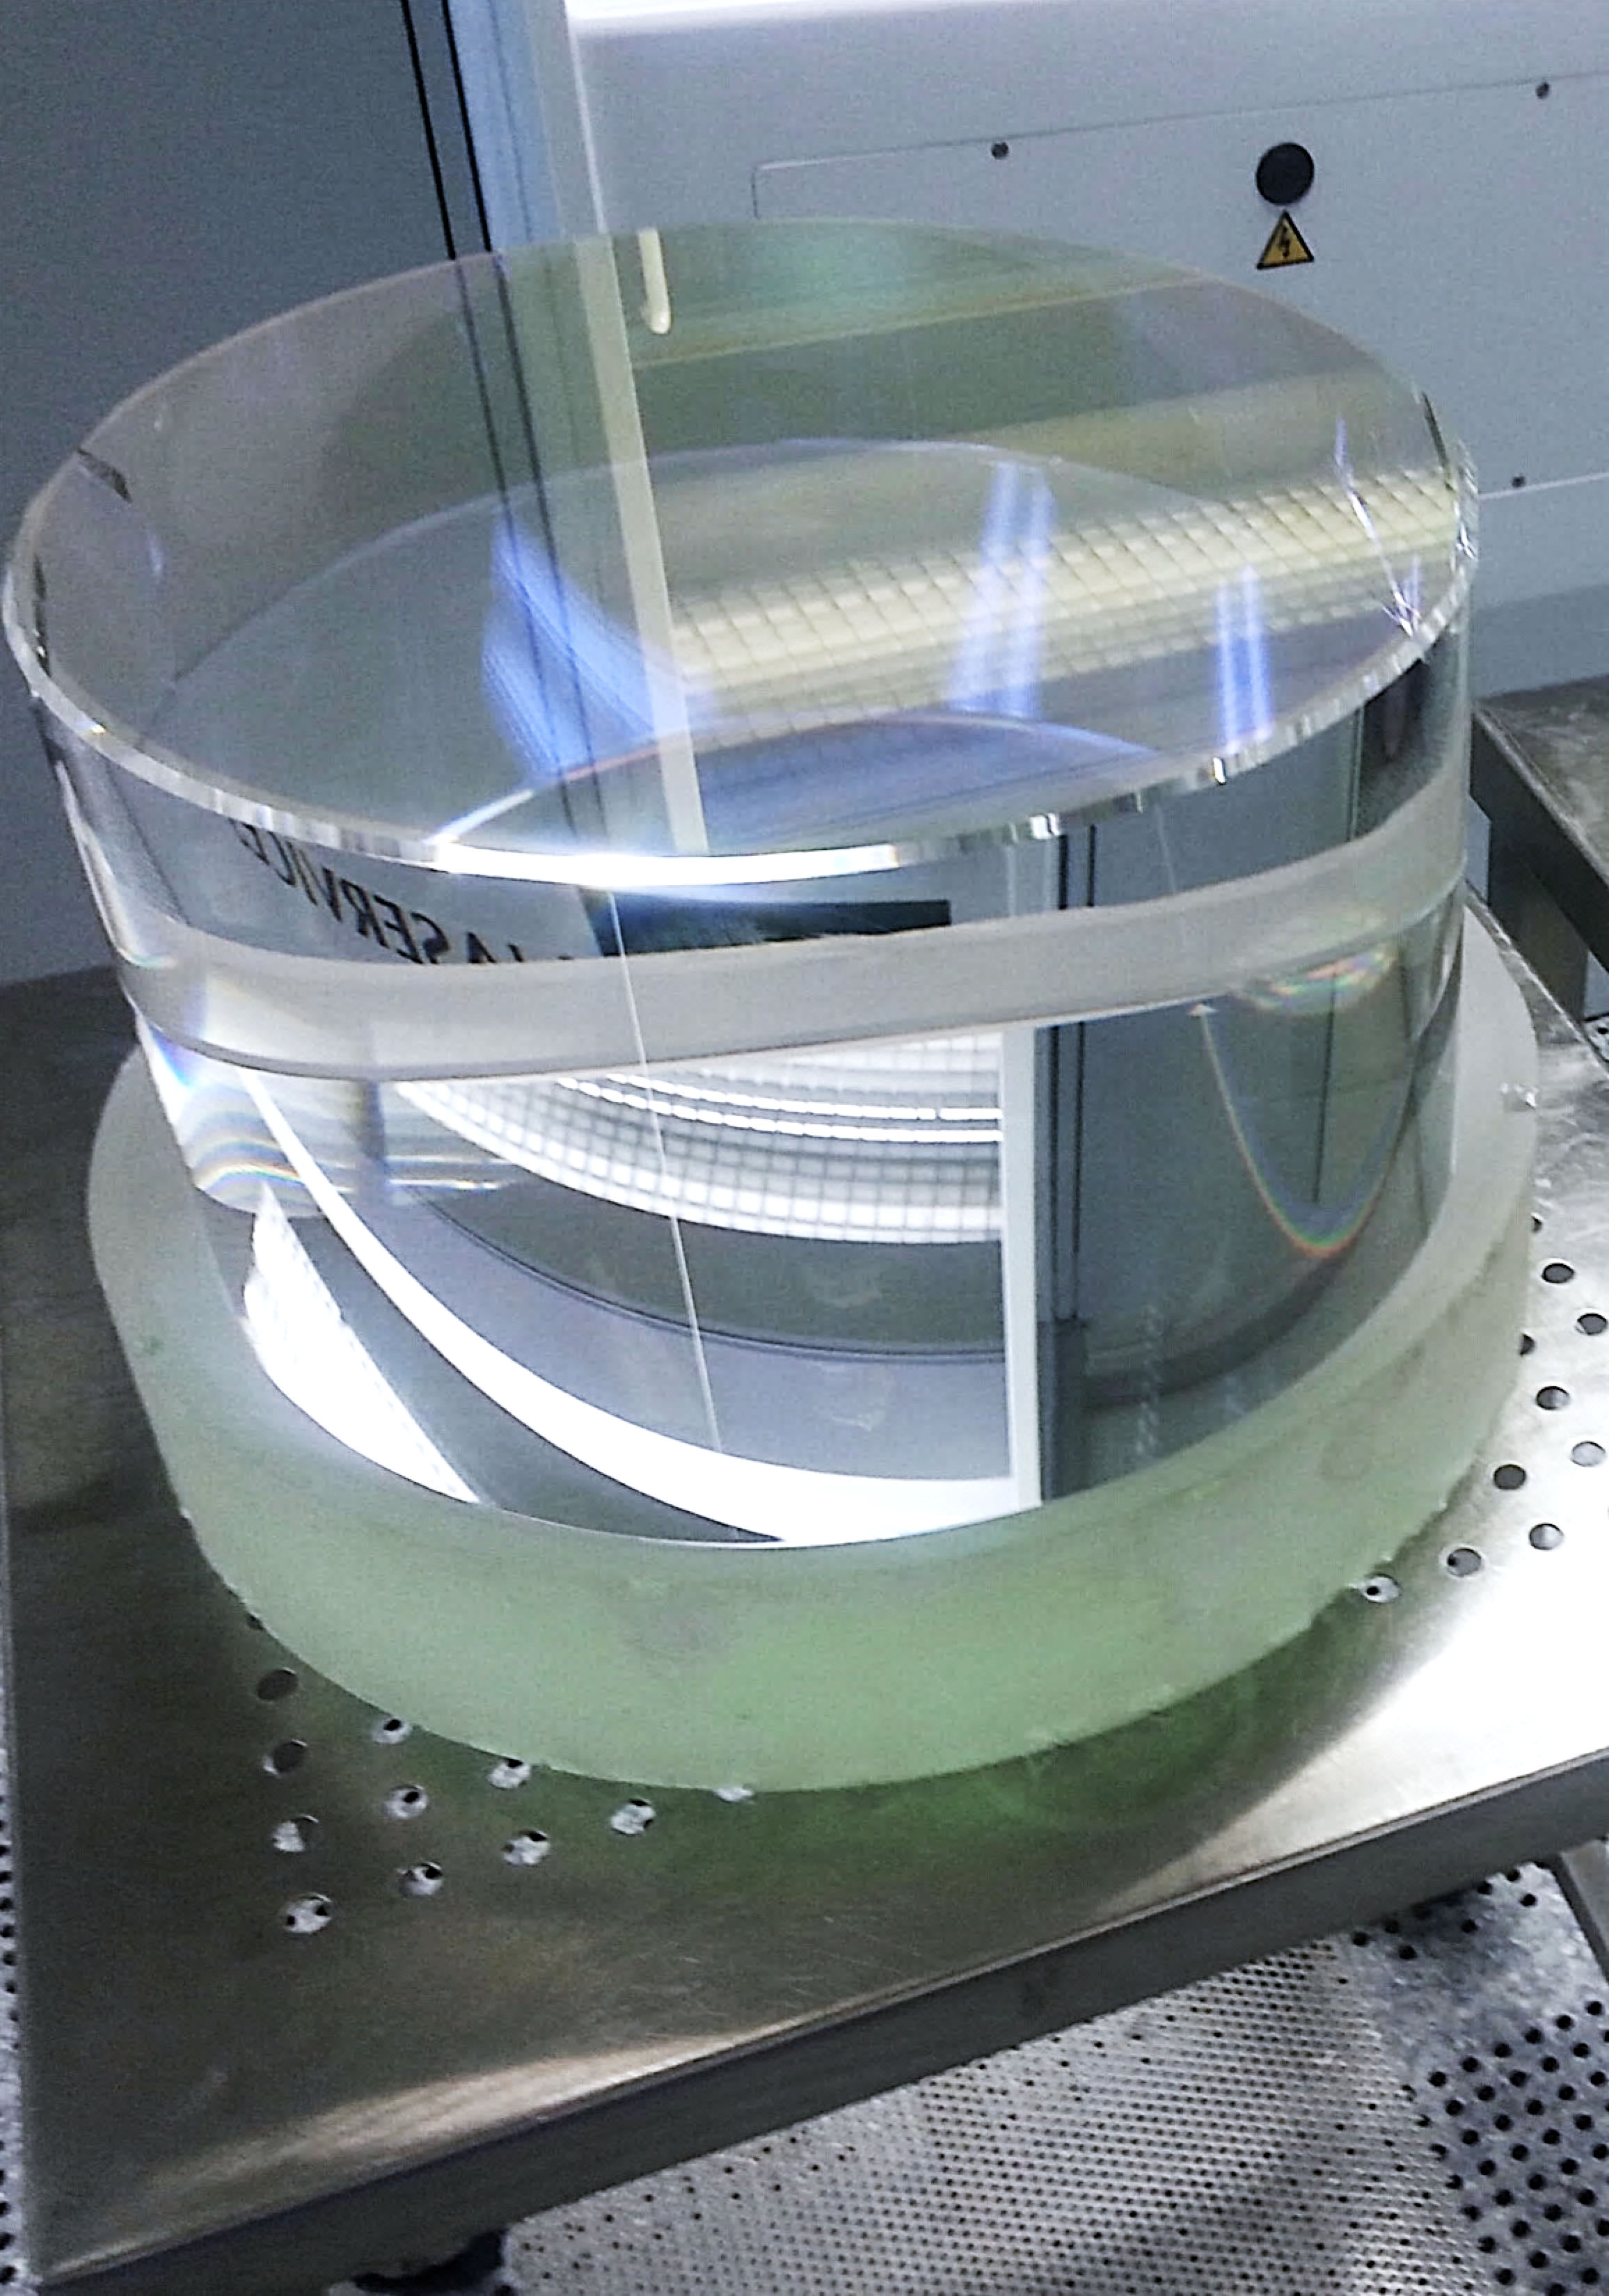
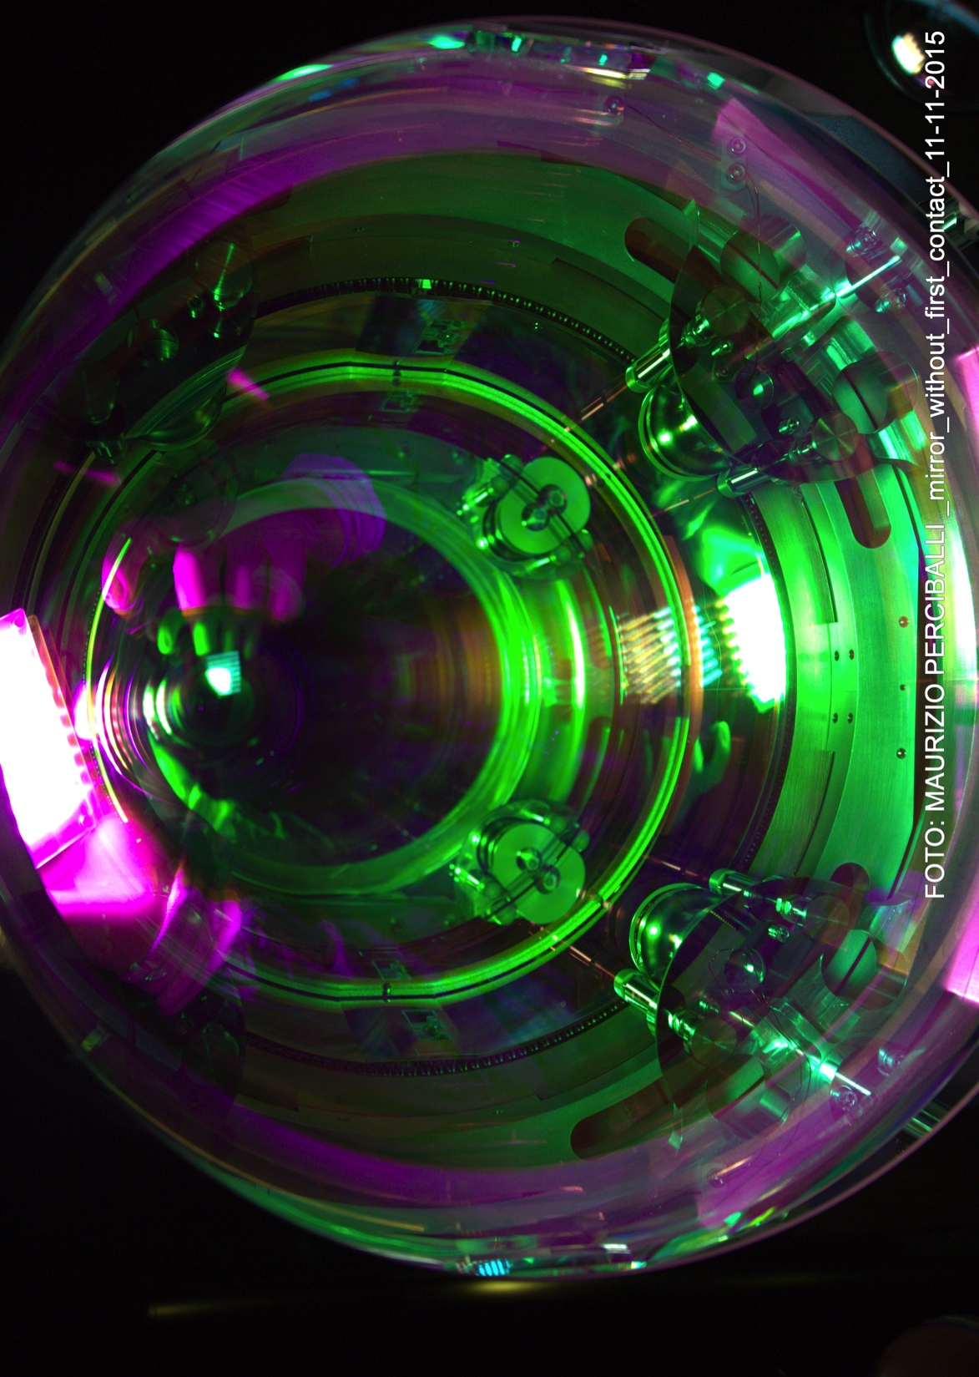
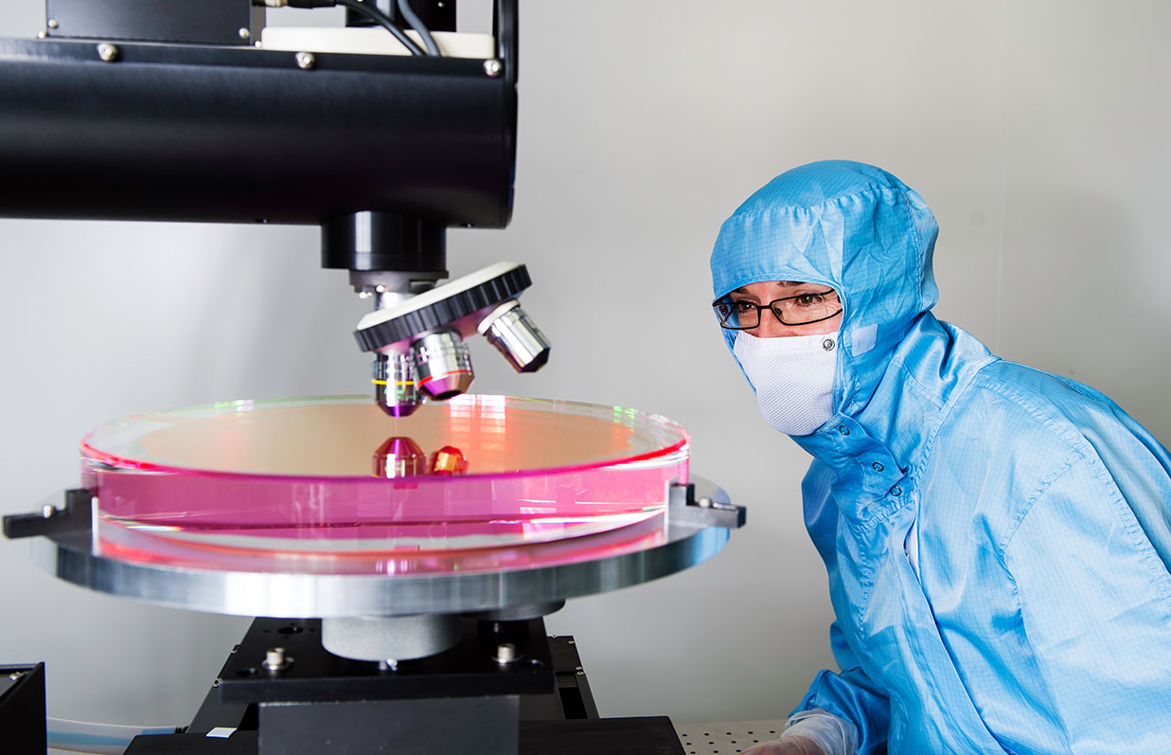
AdV+ upgrade and extreme mirror technology
Laboratoire des Matériaux Avancés LMA at Lyon produced the coatings used on the main mirrors of the two working gravitational wave detectors: Advanced LIGO and Virgo. These coatings feature low losses, low absorption, and low scattering properties
Features
Flatness < 0.5 nm rms over central 160 mm of mirrors by using ion beam polishing (robotic silica deposition was investigated)
Ti:Ta₂O₅ and SiO₂ stacks with optical absorption about 0.3 ppm
Expand LMA capabilities for next generation
LMA is the only coating group known to be capable of scaling up
LMA
Notes:
City of diameter 20 km to flatness of normal human hair (70 um)
Thermal noise in the bulk, reduce pendulum thermal noise
Internal mechanical losses determine amplitude of thermal noise
Titania doped tantala: mixture of TiO2 and Ta2O5
Crystalline materials, sapphire and silicon, have poor thermo-elastic properties at room temperature

Slide 21
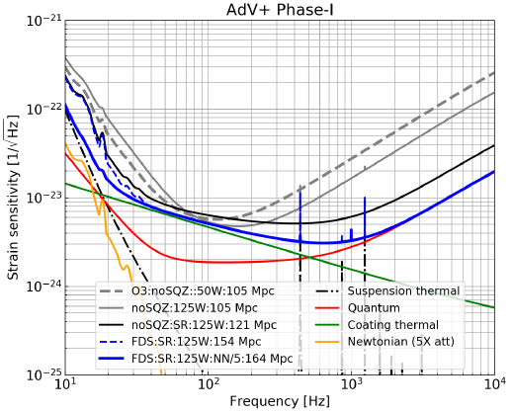
Phase I
Quantum noise will be tackled after the O3 science run in Phase I: laser power will be increased to 200 W, and frequency dependent squeezing installed. Also tuned signal recycling and NN subtraction
Power increase
All in-fiber 200 W laser system for 125 W after the IMC
Foreseen as part of AdV
Tuned signal recycling: 120 Mpc
Install SR mirror
Control addition DOF (auxiliary lasers?)
Frequency dependent squeezing: 150 Mpc
Squeezed light source and filter cavity
Newtonian noise cancellation: 160 Mpc
Seismic sensor networks
50 W
125 W
+ SR
+ FDS
+ NN

Slide 22
Phase II
Reduce thermal noise: modify optical design of the Fabry-Perot arms to accommodate larger beams and heavier test masses
Larger mirrors
Diameter: 550 mm, thickness: 200 mm, mass: 105 kg
Scenario 1: ETM-only → 200 Mpc
Scenario 2: full upgrade → 230 Mpc
Coating research
Factor three reduction in CTN
Scenario 1: ETM-only → 260 Mpc
Scenario 2: full upgrade → 300 Mpc
Grand Coater upgrade
Many activities
Vacuum, infrastructure
Payloads and superattenuators
Aberration control

Slide 23
AdV+ to be carried out in parallel with LIGO’s A+ upgrade
Five year plan for observational runs, commissioning and upgrades
2019
2020
2021
2022
2023
2024
2025
2026
Virgo AdV+ Proposed upgrade plan
Observing Run O3 (> 60 Mpc)
Design, infrastructure preparation for AdV+
Install signal recycling (AdV) and frequency dependent squeezing (AdV+)
?
Observing Run O4 (> 120 Mpc)
Install AdV+ large mirror upgrades
AdV+ commissioning
Observing Runs
LIGO A+ Upgrade plan (see LIGO-G1702134)
A+ fabrication
Install A+ upgrades
A+ integration into chambers
A+ commissioning
Completion AdV+ and A+
Note: duration of O4 has not been decided at this moment
AdV+ is part of a strategy to go from 2nd generation to Einstein Telescope

Slide 24
Summary and outlook
AdV+ is part of our strategy towards 3G and optimizes Europe’s transition from 2nd generation to Einstein Telescope. In parallel R&D calls should be issued
Virgo exploitation
Do the best possible science with the global LVC network: improve our instruments
AdV+
  Secure Virgo’s scientific relevance
  Safeguard investments by scientists and funding agencies
  Implement new innovative technologies
  De-risk technologies needed for third generation observatories
  Virgo as gateway to 3G: attract new groups wanting to enter the field
Vigorous R&D program to develop key technologies
  Allow our scientists to work towards improved low-frequency sensitivity; open R&D calls
Foster our ties with Astronomy and HEP community
  Facilitate open public alerts to optimize multi-messenger astronomy
  Gravity is a fundamental interaction with most important open scientific issues
  Involve Virgo scientists in upcoming EU HEP Strategy discussion

Slide 25
Back-up slides

Slide 26
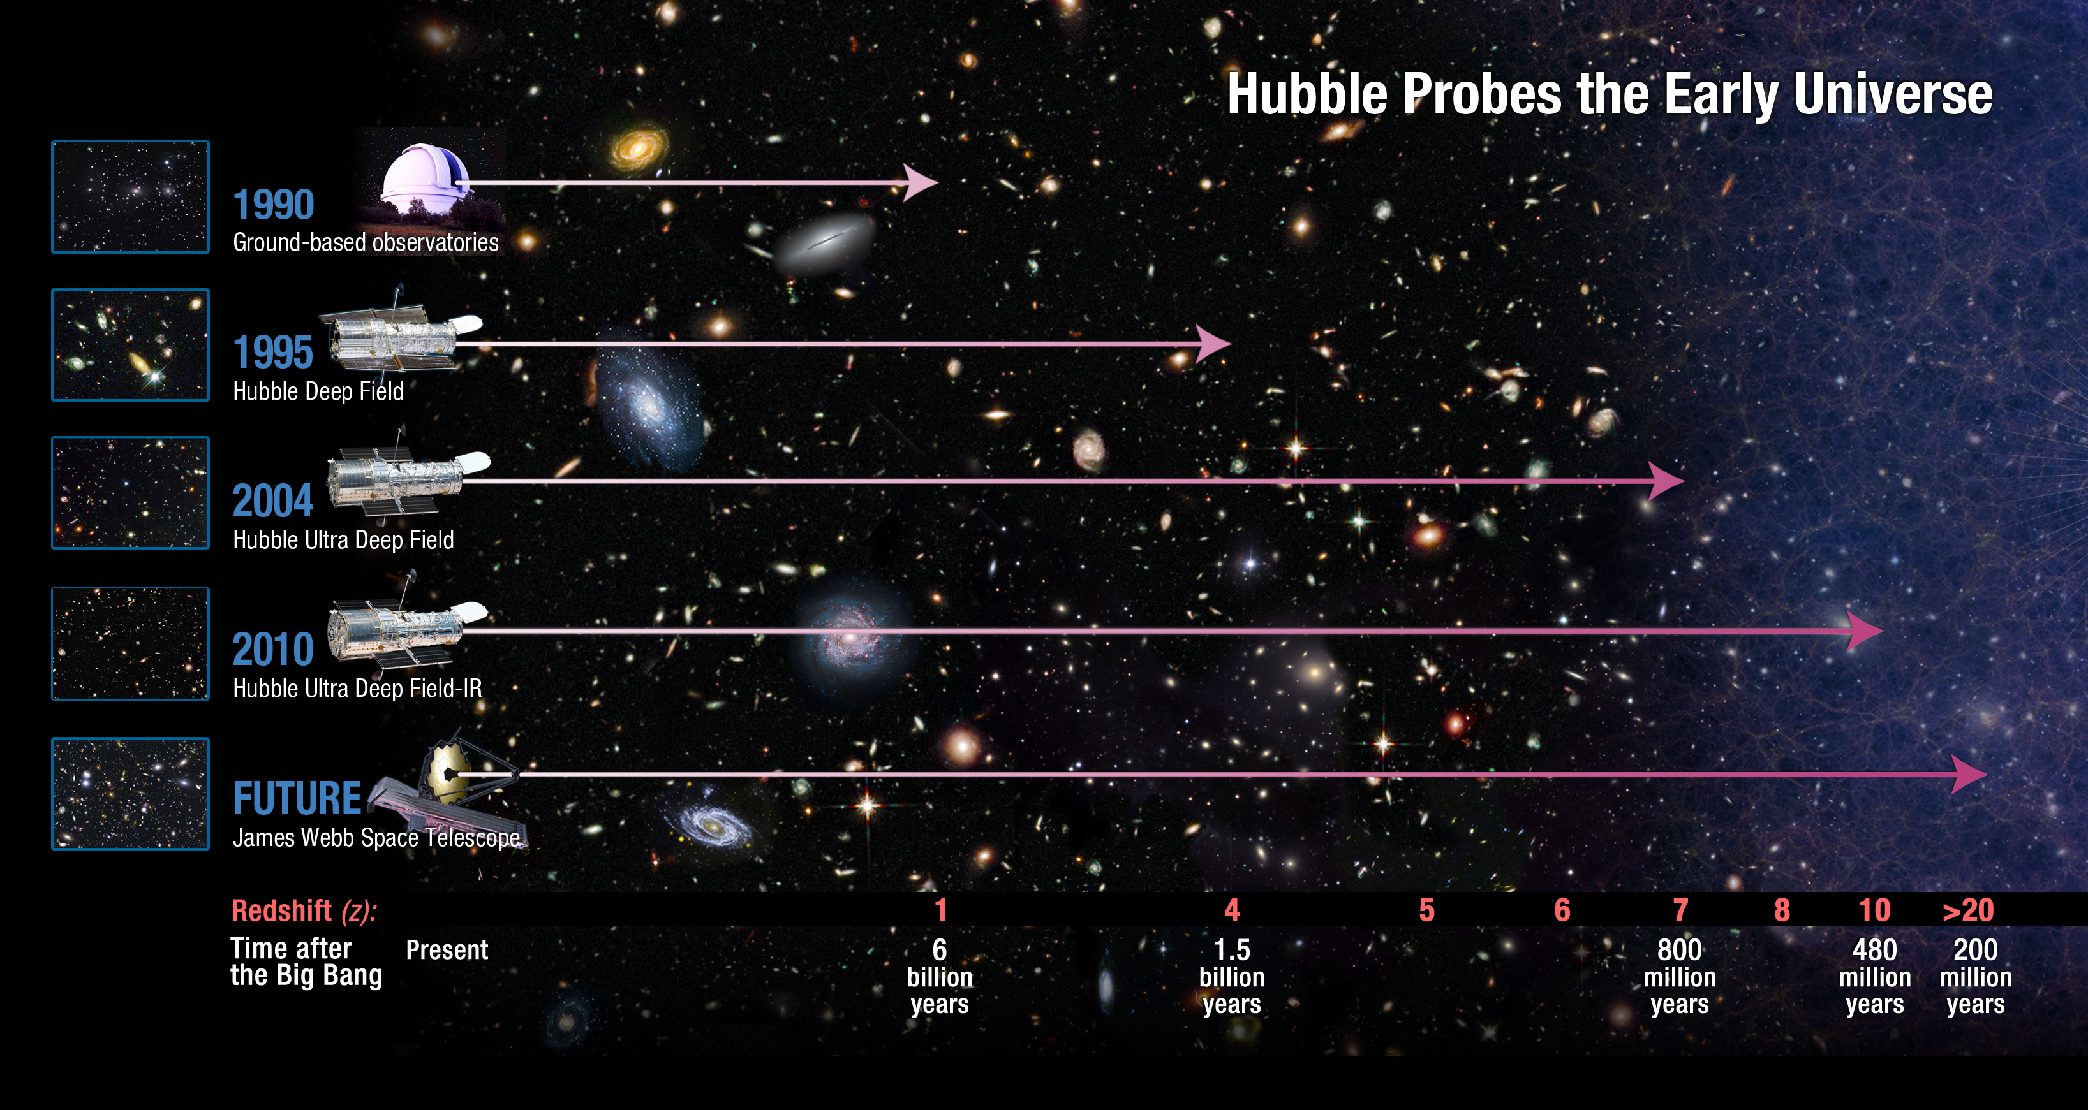
Einstein Telescope: observing all BBH mergers in Universe
This cannot be achieved with existing facilities and requires a new generation of GW observatories
We want to collect high statistics (e.g. millions of BBH events), high SNR, distributed over a large z-range (z < 20)
This allows sorting data versus redshift, mass distributions, etc. Early warning, IMBH, early Universe, CW, …
z = 0.2

Slide 27
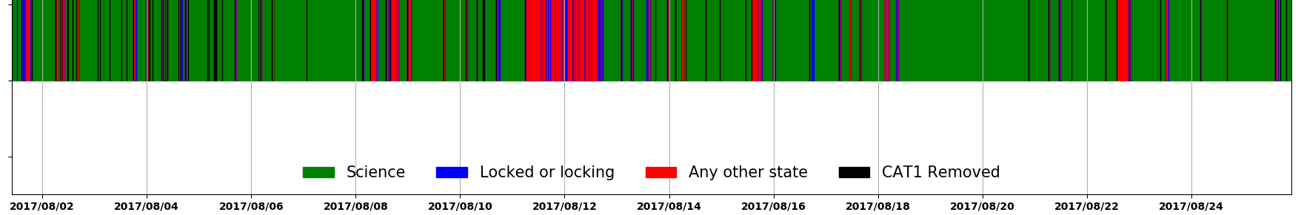
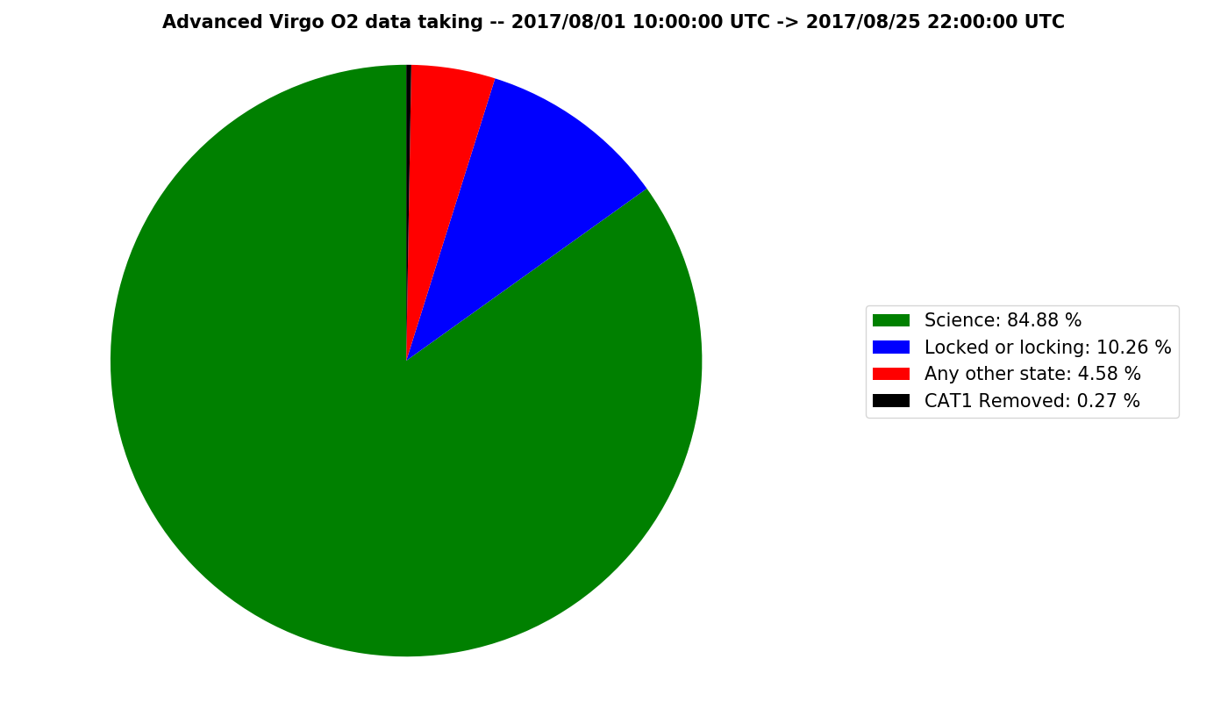
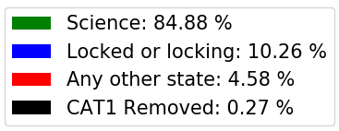
Adequate exploitation funds are required
The global LIGO-Virgo network is our detector. The European Virgo detector has an obligation to carry its weight in the network of gravitational wave detectors
Virgo highlights of O2 run
Longest stable lock stretch (# 39064) was 69 hours
BNS range up to 28.2 Mpc
Virgo science duty cycle was about 85%
Added scientific value of Virgo in the network
Increased data set LH → LH + LV + HV + LHV
Increase of sky coverage
Improvement of sky location of sources
Measurement of GW polarization
Improvement in distance measurement
Three-fold coincidence for increased robustness
Improvement in parameter estimation
Resources needed to enable
Commissioning Virgo to design sensitivity
Running EGO as a professional GW observatory
Future perspective for our young and promising scientists

Slide 28
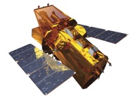
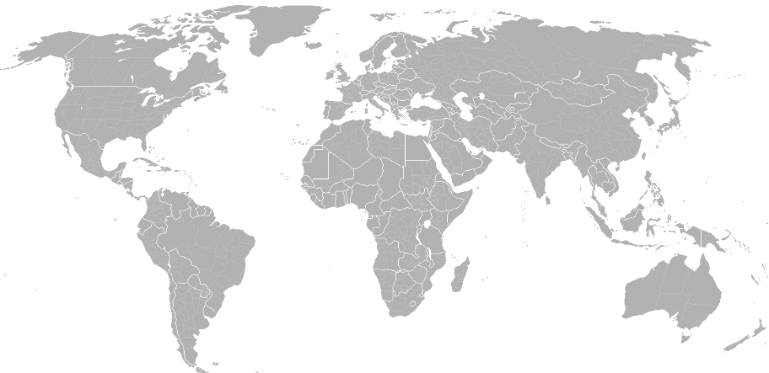
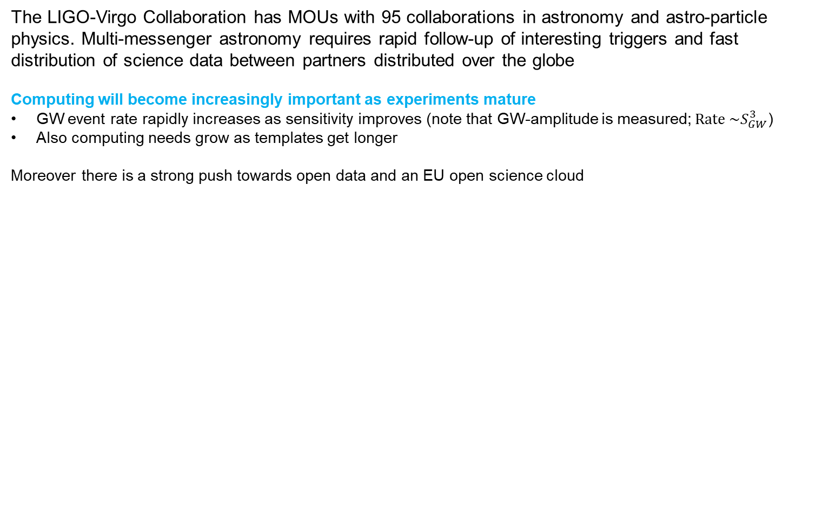
Resources should be dedicated to allow MMA computing
The LIGO-Virgo Collaboration has MOUs with 95 collaborations in astronomy and astro-particle physics. Multi-messenger astronomy requires rapid follow-up of interesting triggers and fast distribution of science data between partners distributed over the globe
Computing will become increasingly important as experiments mature
GW event rate rapidly increases as sensitivity improves (note that GW-amplitude is measured;$Rate \sim S_{GW}^{3}$)
Also computing needs grow as templates get longer
Moreover there is a strong push towards open data and an EU open science cloud
LIGO Hanford
KAGRA
Virgo
LIGO Livingston
LIGO-India
Send info
to observers
Transfer data
Validate
(data quality, etc.)
Swift: NASA E/PO, Sonoma State U., Aurore Simonnet
Analyze data, identify triggers,
infer sky position
Trigger database
GW data
Select event candidates
Estimate background

