Slide 1
8th EGO/Virgo
Biathlon Relay Run
June 26, 2012 – 19:00
2
3
4
1
3

Slide 2
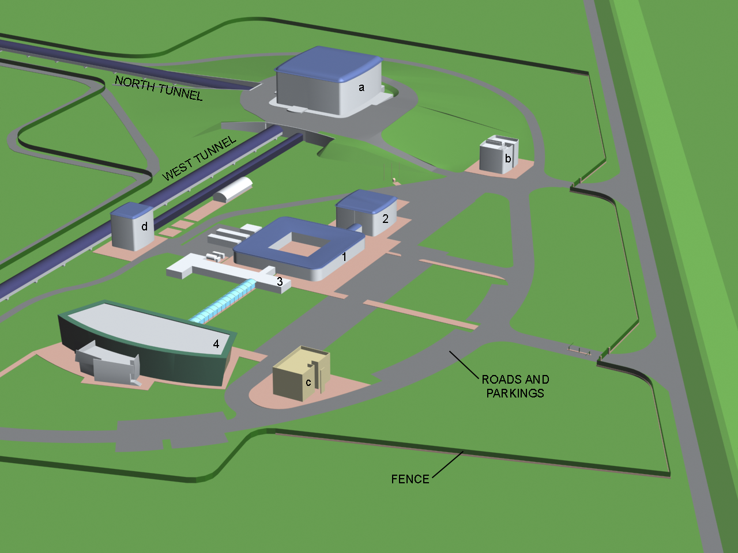
Start
Finish

Slide 3
Agenda
Tuesday, June 26, 2012
18.50
2 km runners go (walking) to 1 km N
A Control Officier (by car) and bikers go to 3.00 km N
19.00
START
A Control Officier and 3km runners go (by car) to 3.00 km W
19.Xx
COs come back from NE and WE

Slide 4
 | 1 km | 2 km | 6 km bike | 3 km
The Flying Dutchmen | Kristen Zych | Mathieu Blom | Mark Beker | Adriaan ter Braack
LAPP et al. | C.N. Colacino | P-F Cohadon | Loic Rolland | Bruno Lieunard
Black PearlTeam | Philippe Benoit | Giuseppe DiBiase | F. Carbo- gnani | Frederic Richard
PartenoPisa | Luciano DiFiore | Enrico Calloni | Niccolo’ Grilli | Gabriele Vajente
2
4
3
1

Slide 5
BIATHLON 2012
TEAMS | DISTANCE

