Slide 1
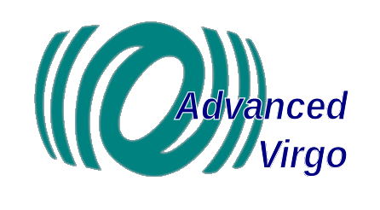
PAYLOAD CONTROL ACTUATORS, open issues
E. Majorana
15-05-2014

Slide 2
F7➔ Marionette issues
Sensitivity
(E.M. noise)
Sensitivity
(Actuation noise)
Duty cycle
Safety (heat)
Smaller magnets
(8 actuators)
DAC noise
Max Force and
act-noise mitigation
T/Max current
F7➔ Mirror
Lock Acquisition
Local Control
Calibration
Safety (heat)
Smaller magnets
(small force locking
demonstrated)
Operation
towards locking
and unlock recovery
Max Force and
act-noise mitigation
T/Max current

Slide 3
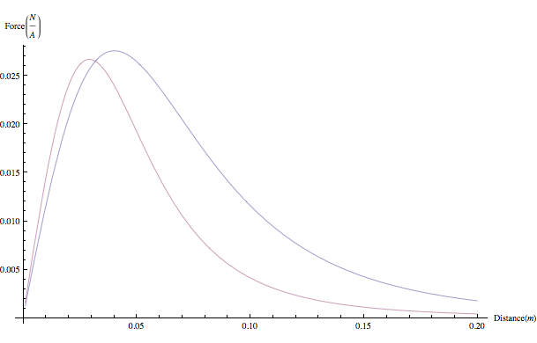
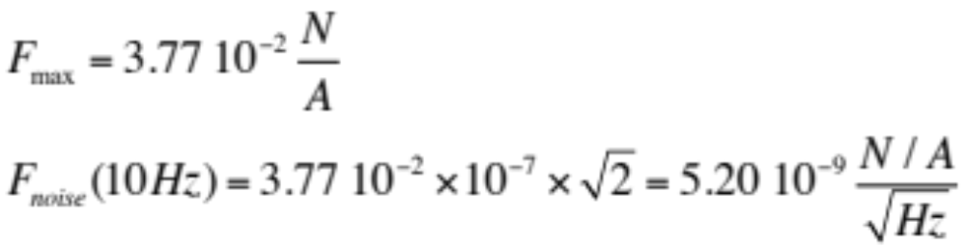
F7➔ Marionette
Max force /unit-current / payload using 2 coils to actuate z
Actuation noise
(Gennai, VIR-0006B-09)

Slide 4
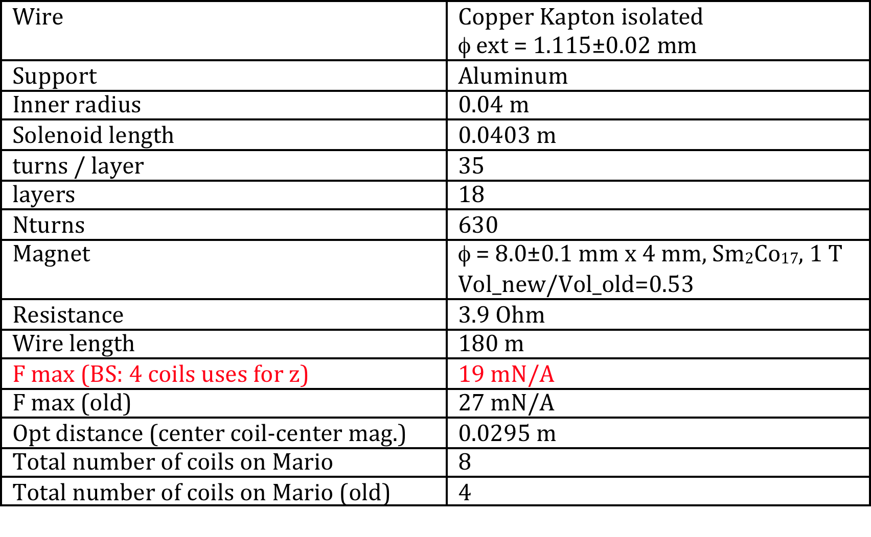
F7➔ Marionette
Max force /unit-current / payload using 2 coils to actuate z
Actuation noise
(Gennai, VIR-0006B-09)

Slide 5
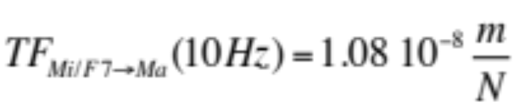
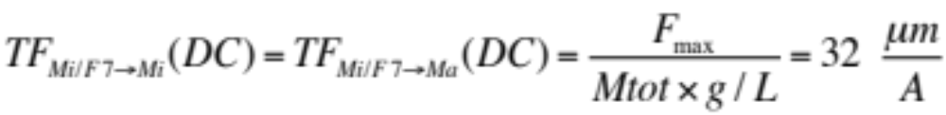
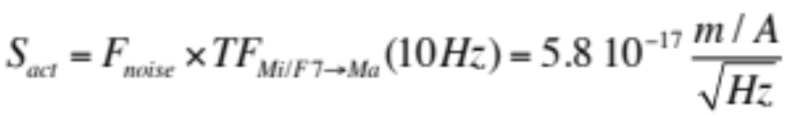
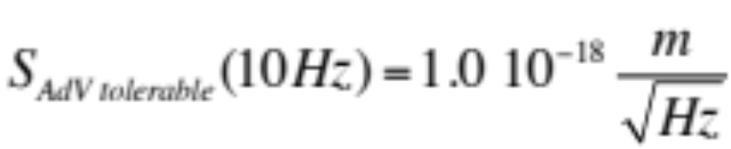
(Ruggi)
Ex: using 0.5 A ➔ 16 μm
According to Virgo experience (without suspension ID improvements) ~ OK,
1 A would be safer to prevent small earthquakes.
A factor ~2 can be recovered using V+ magnets, but then we might have have
larger E.M. noise coupling risk (TBD)
60 !
(check)

Slide 6
Actuation noise and its mitigation:
(4000 attenuation factor of actuation noise @ 10 Hz)
Virgo experience: II ord shaping 1-10 Hz ➔ a factor 100 (Gennai, feasibility to be studied)
I ord filter on Marionette X 1/3 attenuation through series resistor, that means we have operated with reduced Fmax (~10 um/A) already.
STD conditions (suspension ID as in V+) 3 μm max allows to operate and resist towards the transient to HP in case of small earthquakes.
Step-by-step actuation noise shaping through coil drivers, probably useful also in AdV
Other issues: outgassing in case of HW/SW failures
(8 coils are hosted in the lower vacuum chamber)
Urgent evaluation needed. Experimental ? Simplified Model ? (Dattilo,Pasqualetti)
The LN resistor config be used as a protection. If the failure occurs meanwhile we are in HP?
Temporized Automatic switch to LN after a given elapsed (safe) time electronic/SW (Gennai, under study)

Slide 7
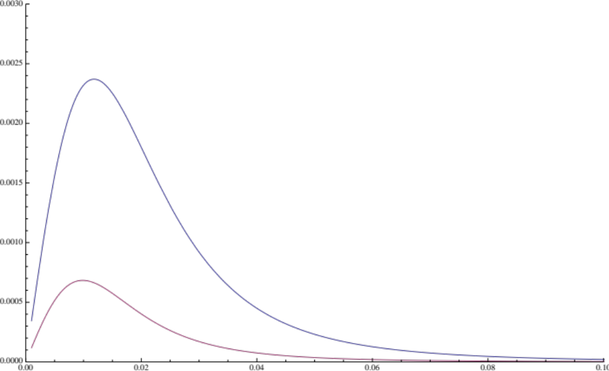
F7➔ Mirror
Force[N/A]
Similar to V+ but 3.6 times weaker actuation,
and the mirror mass is two times larger
Distance [m]

Slide 8
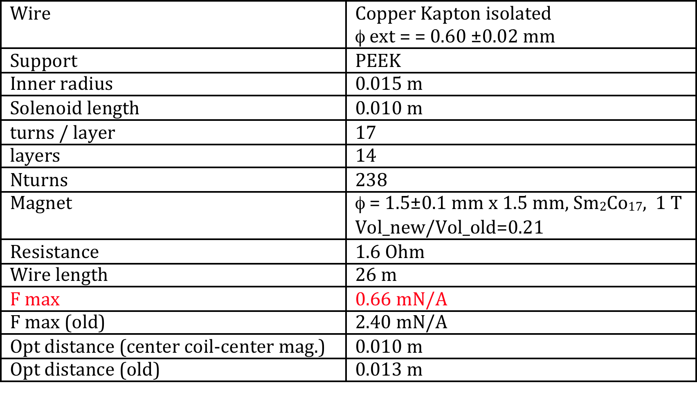
F7➔ Mirror
Local control, reallocation OK (tested), E.M. noise impact minimized
Main issues:
Heating, similar problem to marionette actuator (note the heat is dissipated conductively on F7) (Dattilo)
Calibration amplitude (Loic, Gennai), hardly achievable using new coils (10^-11 m @ 1kHz !)
after experimental test of heating we will derive a Dt max time for calibration application.
it is hard to replace the magnets on the mirror after installation.

Slide 9
Conclusions
1) The coils of payload system do exist (4-5 months - ~ 22kE)
2) Actuation force was designed to be reduced (0.54) WRT V+ for F7➔Ma upon the experience of the max force required, but assuming max current 1 A possible.
3) Possibility to start with stronger magnets for F7➔Ma:
force 1.9 times larger (feasible), on-fly change with installed payloads under study
4) Possibility to start with stronger magnets Max actuation force for F7➔Mi is significantly smaller (low force locking possible)
5) Fundamental electronics:
Given the situation the electronics group will assist in the most suitable decisions towards the suitable decisions meant to meet AdV noise requirements: step-by-step probably reasonable.
6) Test of coil heating performed as soon as possible for both F7➔Ma, F7➔Mi coils:
no problem using STD currents as 100-200 mA. The case of failure heating must be prevented through safety systems (SW/HW). Normally the LowNoise operation should be the STD operation

