Slide 1
VIR-0237A-15
Advanced Virgo dataDisplay
tutorial
D. Verkindt
11th of May 2015

Slide 2
Choose input files and do time plots
Connect online and do FFT plots
Configuration file
Main browser features
Edit plots parameters
Use ROOT and dataDisplay features
Use reference plots
Tools and options

Slide 3
Choose input files
and
do time plots

Slide 4
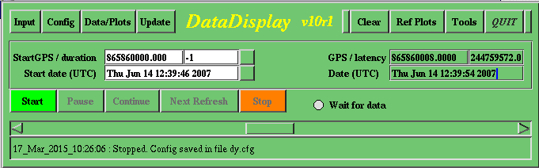
First, type “dataDisplay” in an Xterm window
A mainpanel window should appear

Slide 5
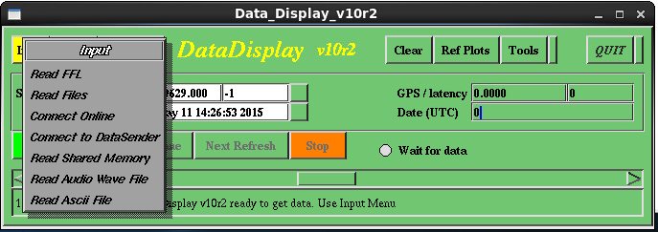
Click on “Inputs” and Choose “Read FFL”
Read data from ffl files which points to frame formatted data files
Read data from frame formatted data files
Read data online by connecting to one of the online data providers
Read data online from a shared memory
Read data from an audio file (only one channel)
Read data from an ascii file properly formatted [time, sample value] (only one channel)

Slide 6
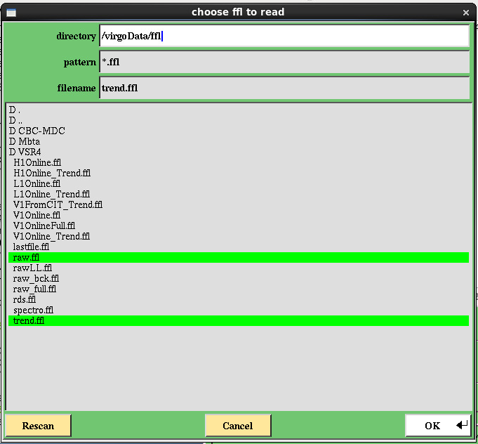
A list of files should appear
Choose “raw.ffl” and “trend.ffl”
Click on “OK” or press “Enter” on the keyboard

Slide 7
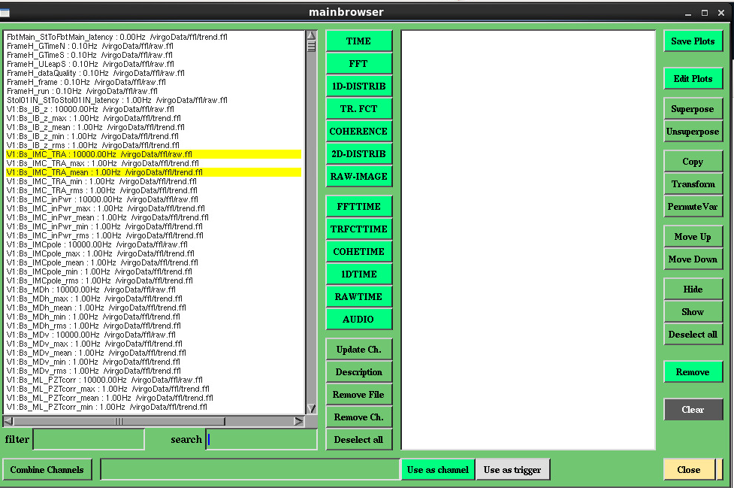
The mainbrowser panel should appear, with a list of channels, some taken from raw.ffl, some taken from trend.ffl
Select a couple of channels in the list

Slide 8

Click on “TIME” button
Two time plots are created
Select them and click on “Superpose”

Slide 9
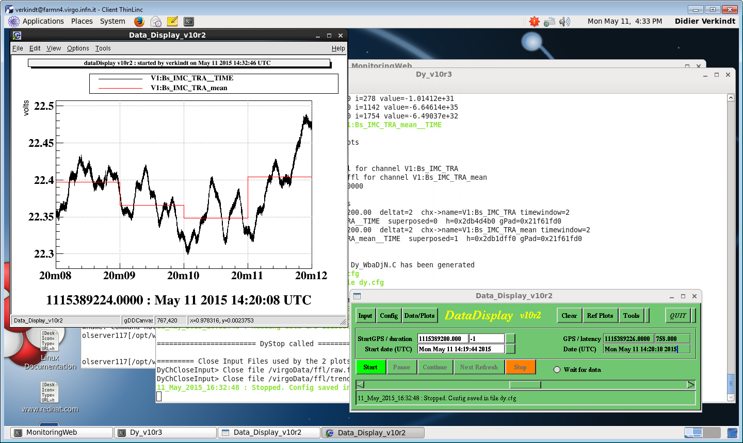
Choose a start date on the mainpanel
And click on “Start”
To read data and do the plots
Remove the panel displaying the plots
GPS time, latency and UTC date of the data read
Info line about last activity of the dataDisplay
When you push this button, dataDisplay do not stop when reaching end of data file and wait for new data

Slide 10
A window should appear containing the time plot of the two channels, superposed
On the X axis is shown the UTC time
With time origin indicated in a string below the plot

Slide 11
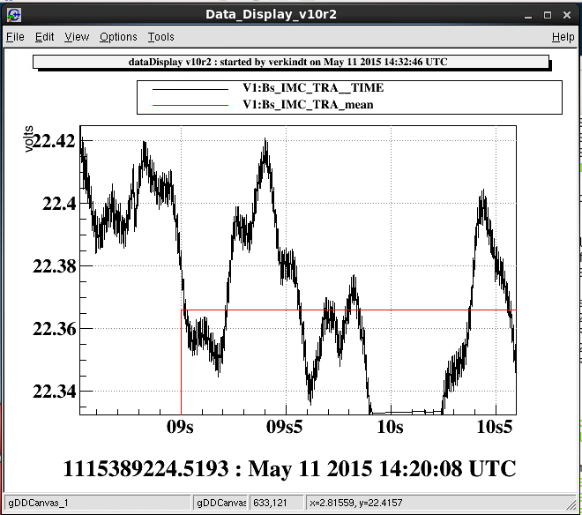
Once you have pressed “Stop” button, you can modify the plot using the various ROOT features or the additional features introduced by dataDisplay
Use the mouse to select a zoom on X or Y axis
Use the right button of the mouse to list the features you can use

Slide 12
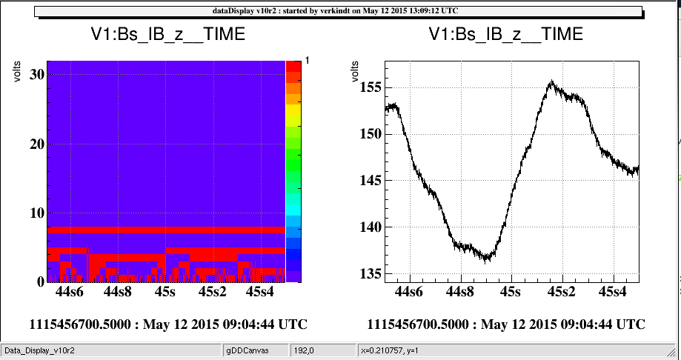
You can also visualize the bits of the data samples
(see “Edit TIME plot” section)

Slide 13
Connect online
and
do FFT plots

Slide 14
First, type “dataDisplay”
A mainpanel window should appear

Slide 15
Click on “Inputs” and Choose “Connect online”
Read data from ffl files which points to frame formatted data files
Read data from frame formatted data files
Read data online by connecting to one of the online data providers
Read data online from a shared memory
Read data from an audio file (only one channel)
Read data from an ascii file properly formatted [time, sample value] (only one channel)

Slide 16
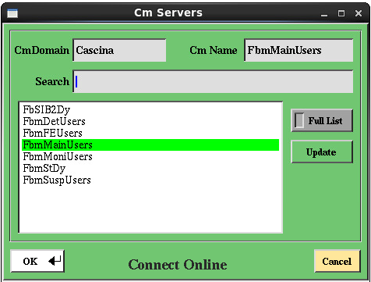
A list of data providers should appear
Choose one of them
Click on “OK” or press “Enter” on the keyboard
Next steps are the same as in the previous section
(just choose FFT instead of TIME plots in the mainbrowser)

Slide 17
Configuration file

Slide 18
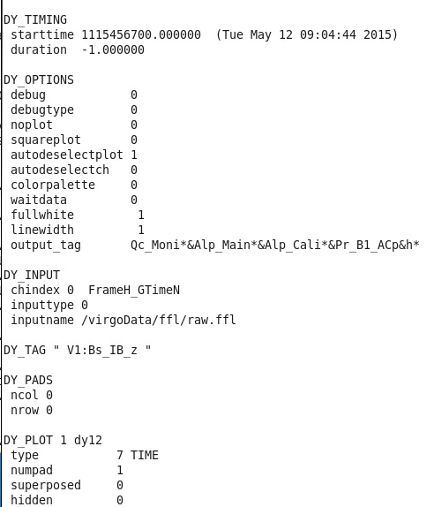
Each time you click “Start”, a configuration file is
written on disk, containing all the parameters used by the dataDisplay.
Default name is “dy.cfg”
You can save and load configuration files.
You can also start the dataDisplay with a configuration file provided as first argument : dataDisplay dy.cfg
Menu to save or load configuration files

Slide 19
Mainbrowser features
Click on the mainpanel button “Data and Plots” to get the mainbrowser panel
The mainbrowser panel allows
to select channels
to create plots for those channels
to search for channels
to combine channels to create new channels
to manipulate plots or edit plot parameters

Slide 20
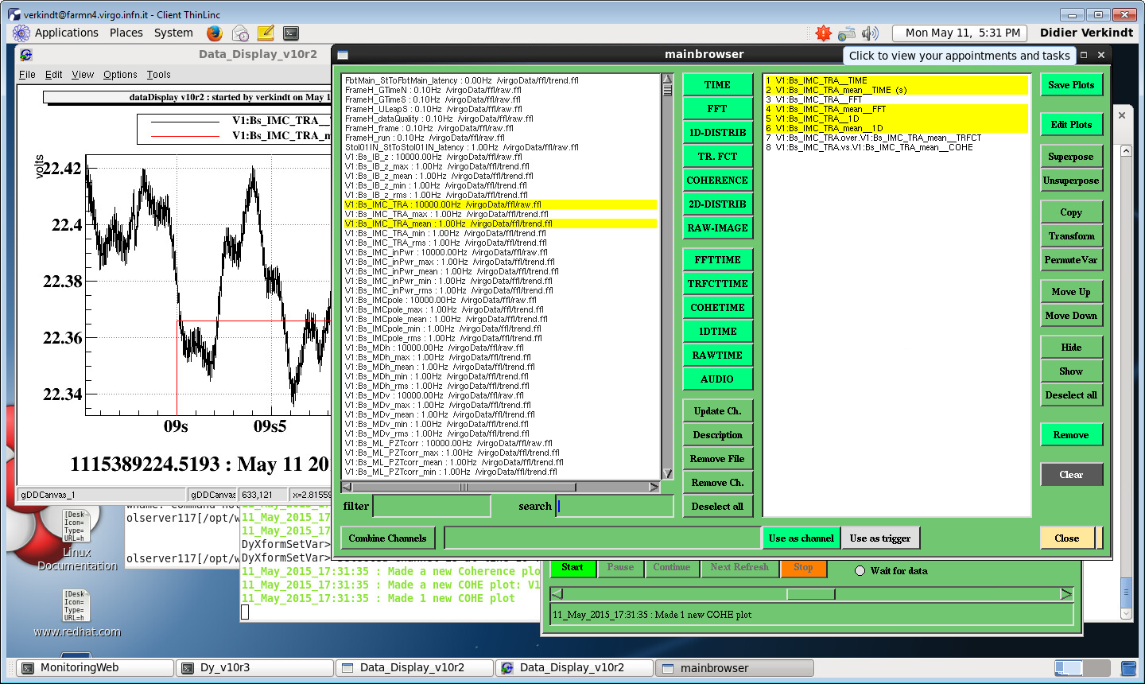
A set of buttons allows to act on the plots without editing them
Superpose the plots selected
Create a copy of the plots selected
Transform the plots selected into an other type
Permute the channels of a TRFCT, COHE or 2D plot
Remove the selected plots
Remove all the plots

Slide 21
A set of buttons allows to act on the plots without editing them
Save the plots in a ROOT file
Move the selected plots up and down in the list
Do not show the selected plots

Slide 22
A set of buttons allows to create plots of different types
Create a TIME plot for each channel selected
Create a FFT plot for each channel selected
Create a 2D plot for each couple of channels selected
Create an audio file for each channel selected

Slide 23
A set of buttons allows to manage channels list
Update channels list according to most recent data available
Remove all the channels coming from the same inputs as the channels selected
Get the description of the channels selected
Remove the channels selected
Sort channels according to a filter. For instance *IMC*
Search for a given channel name

Slide 24
A set of buttons allows to create new channels, by using standard C operators on existing channels
Use the combination of channels as a trigger (not yet ready)
Modify channels combination acccording to your needs
Create the new channel
Create a default combination of the channels selected

Slide 25
Edit the
plots parameters

Slide 26
Select the plots you want to edit
Click on “Edit Plots” button
→ Only plots of the same type as the last one selected will be edited

Slide 27
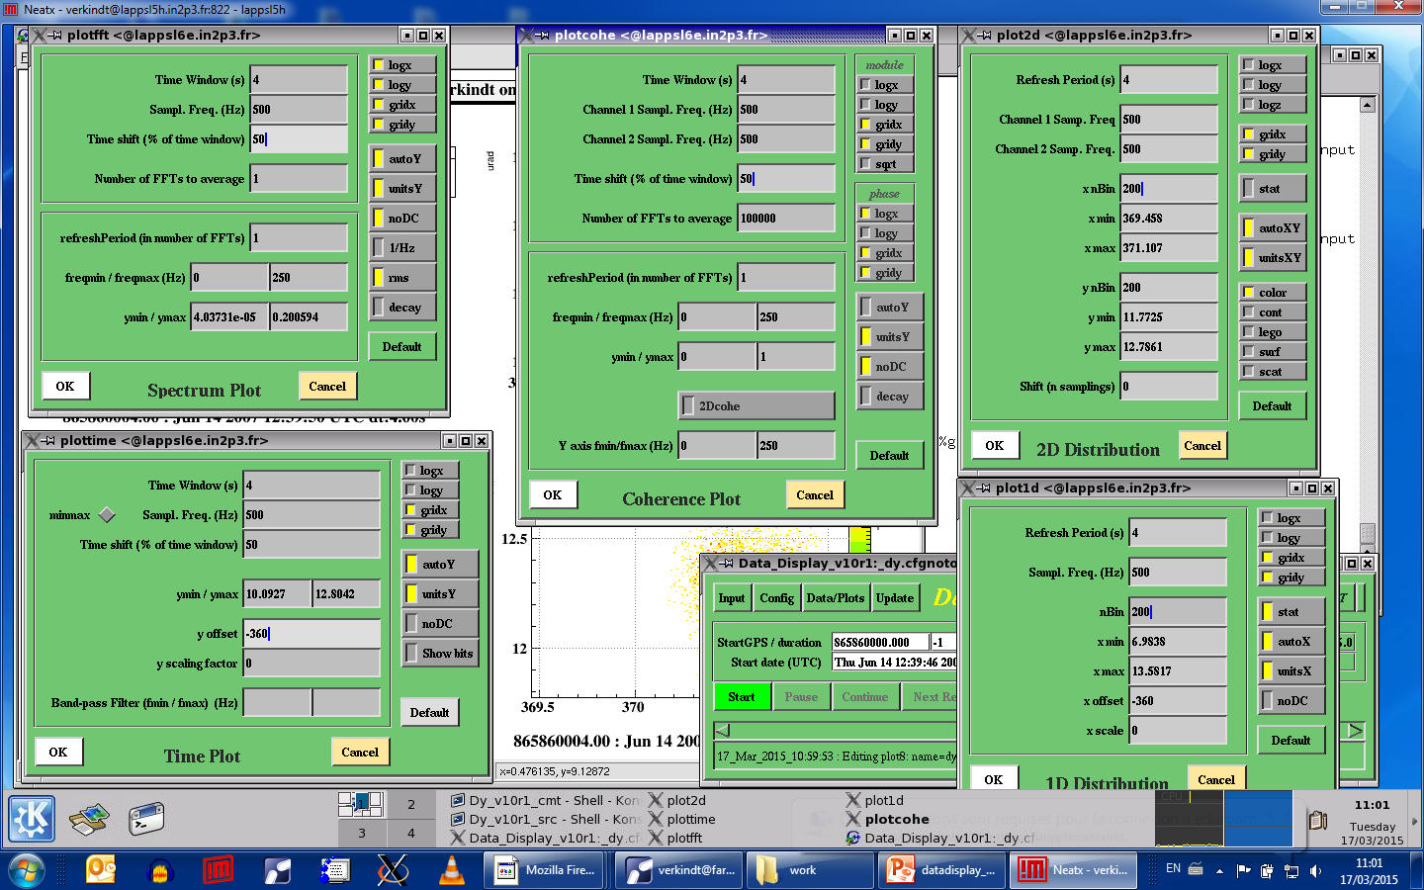
Editing the parameters of TIME plot
Default values are:
Chosen to shown 2000 samplings of data
Or identical to last already existing TIME plot
Auto scale the Y axis instead of using the ymin and ymax values
Read data by bunches of x % of the time window size
Calibrate data values on Y axis
Apply an offset and a scaling factor to the data
Remove DC component
Show data values on Y axis as bits ON and OFF
Apply a pass-band filter on the data

Slide 28
Editing the parameters of FFT plot
Auto scale the Y axis instead of using the ymin and ymax values
Compute FFT on this time window
Calibrate data values on Y axis
Between two FFT computations, increment data reading by x % of the time window size
Use 1/Hz instead of 1/sqrt(Hz) units
Add a curve showing the rms vs frequency
Refresh the plot only every N FFT computations
Use a moving average of FFTs
Show only spectrum between fmin and fmax

Slide 29
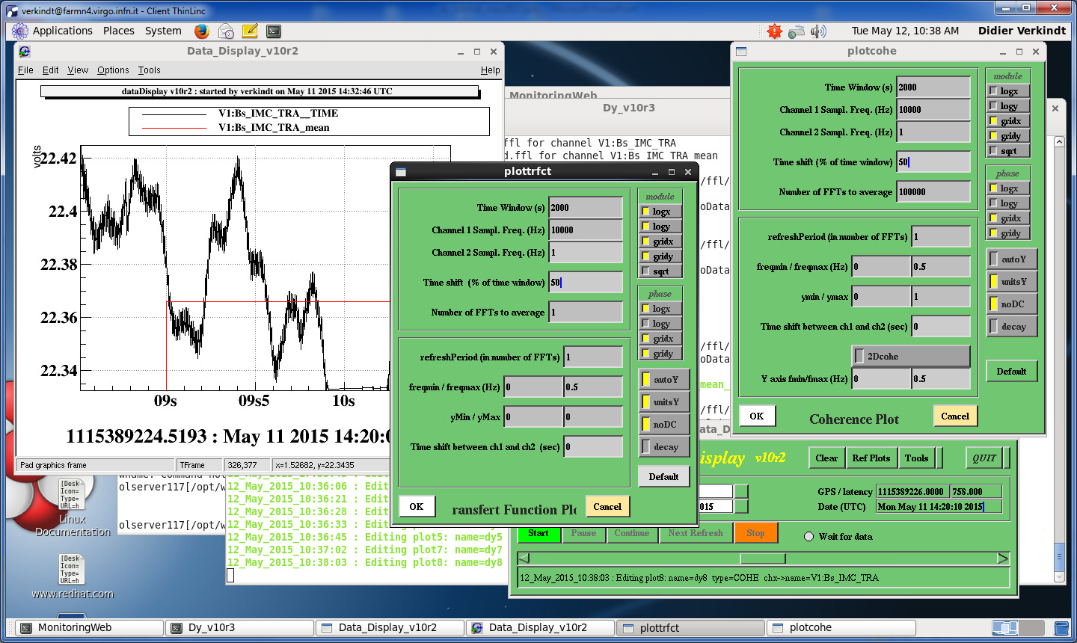
Editing the parameters of COHERENCE plot
Compute FFT on this time window
Between two FFT computations, increment data reading by x % of the time window size
Use square root of coherence module
Refresh the plot only every N FFT computations
Set a time shift between channel 1 and channel 2
Show only spectrum between fmin and fmax
Show a bicoherence plot (2D plot)
Show Y axis only between fmin and fmax in case of a bicoherence plot

Slide 30
Editing the parameters of TRFCT plot
Compute FFT on this time window
Between two FFT computations, increment data reading by x % of the time window size
Use square root of transfert function module
Refresh the plot only every N FFT computations
Set a time shift between channel 1 and channel 2
Show only spectrum between fmin and fmax

Slide 31
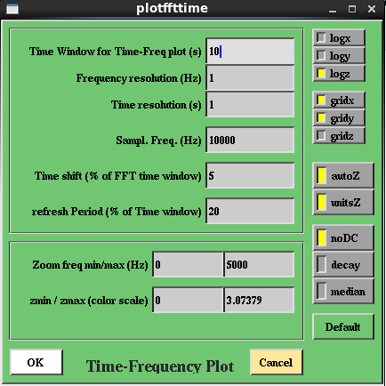
Editing the parameters of FFTTIME plot
Time window over which spectrogram is shown
Frequency resolution of the spectrogram (determine the time window in which FFTs are done
Auto scale the Z axis instead of using the zmin and zmax values
Between two FFT computations, increment data reading by x % of the time window size
Calibrate data values on Z axis
Remove DC component
Use a moving average of FFTs
Refresh the plot only every N FFT computations
Normalize spectrogram with a median value
Show only spectrum between fmin and fmax

Slide 32
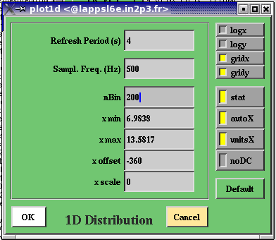
Editing the parameters of 1D plot
Read data by bunches of 4 seconds
Show statistics on the plot
Do the distribution plot over 200 bins
Auto scale the X axis instead of using the xmin and xmax values
Apply an offset and a scaling factor to the data
Calibrate data values on X axis
Remove DC component

Slide 33
Editing the parameters of 2D plot
Read data by bunches of 4 seconds
Show statistics on the plot
Do the distribution plot over 200 bins
Auto scale the X and Y axis instead of using the xmin, xmax, ymin and ymax values
Calibrate data values on X and Y axis
Apply a shift of n samplings between channel1 and channel2
Choose a display option of the 2D plot

Slide 34
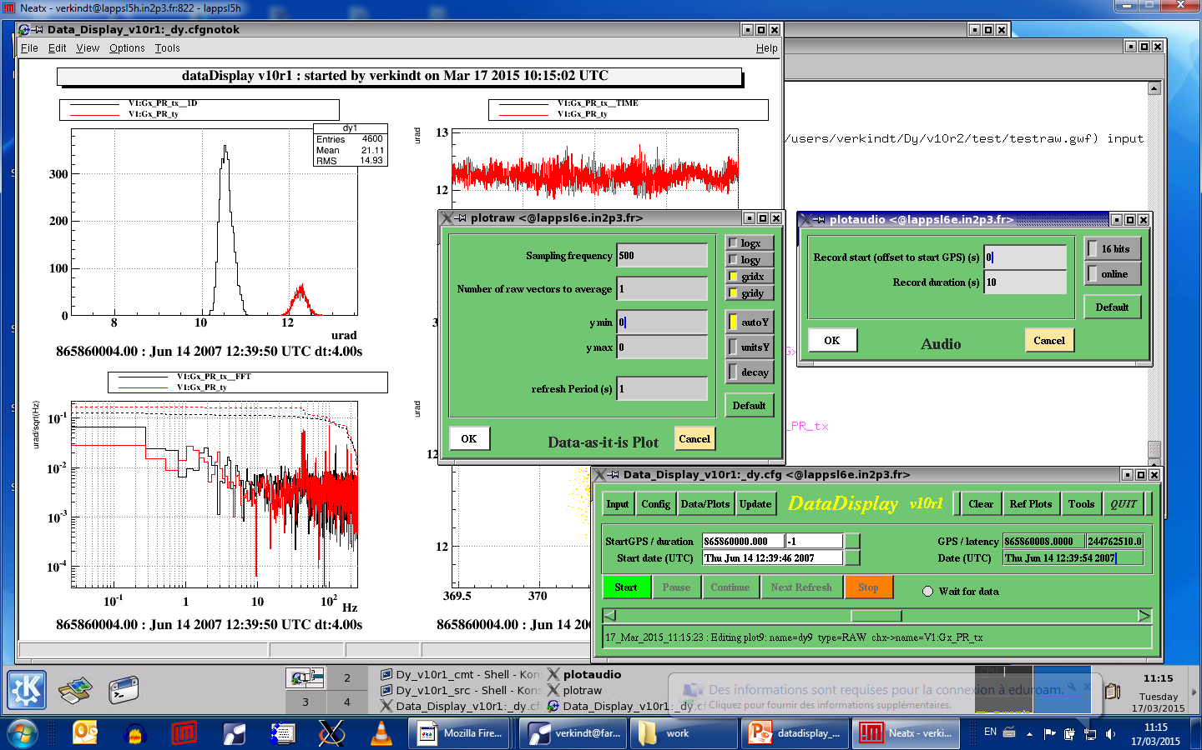
Editing the parameters of RAW plot
In this case, data are read frame by frame and each raw vector of data read is shown as it is.
Auto scale the Y axis or on Z axis
Do the distribution plot over 200 bins
Calibrate data values on Y axis (if 1 dim vector) or on Z axis (if 2 dim vector like camera images)
Periodicity of plot’s update
Use a moving average

Slide 35
Editing the parameters of AUDIO plot
Record samples over 16 bits instead of 8 bits
Record 10 seconds of data in an audio file
Provide sound online in addition to recording it on file

Slide 36
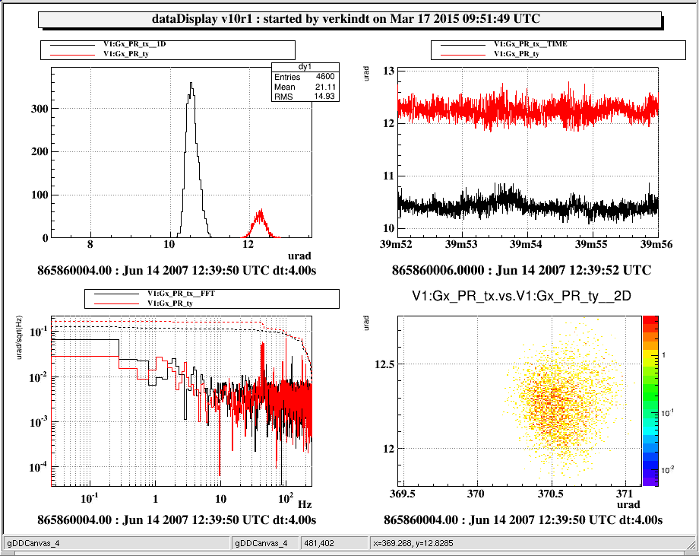
Use of ROOT and dataDisplay features
dedicated to plots

Slide 37
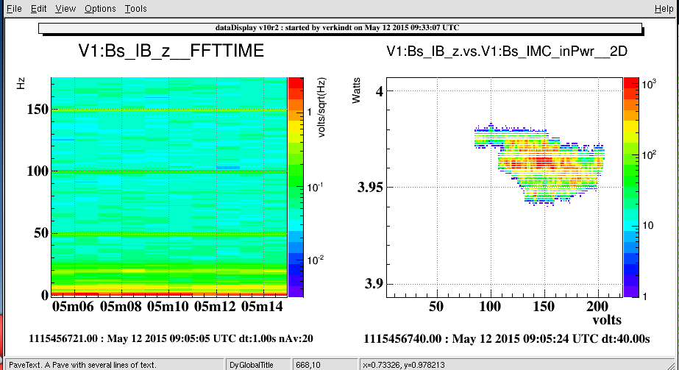

Slide 38
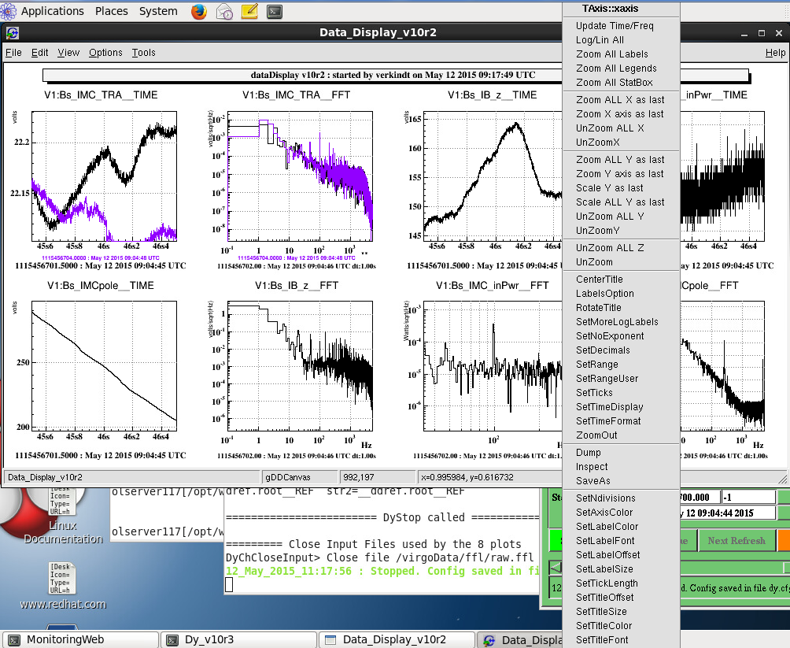
Auto scale the Y axis or on Z axis

Slide 39
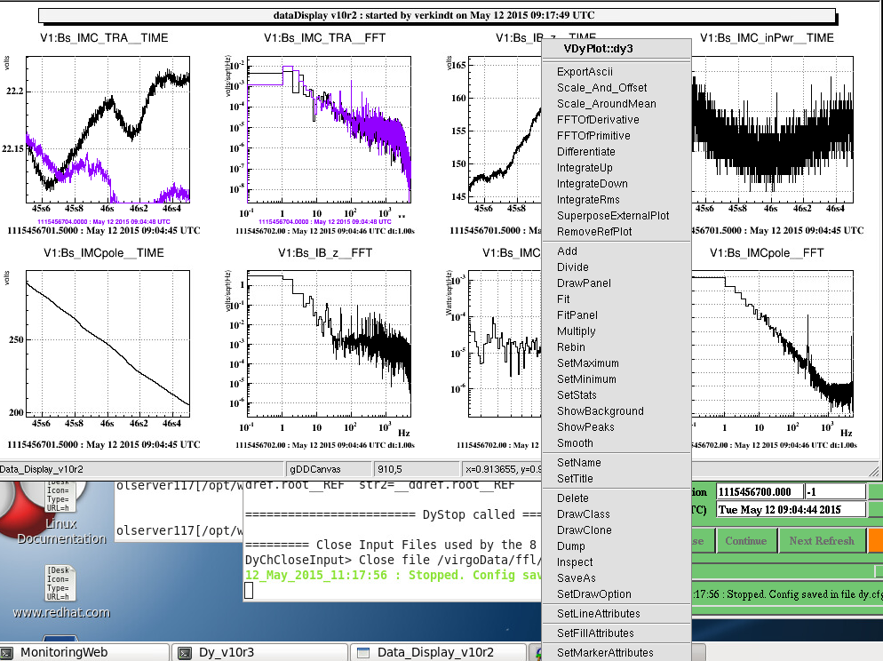
Auto scale the Y axis or on Z axis

Slide 40
Use of reference plots

Slide 41
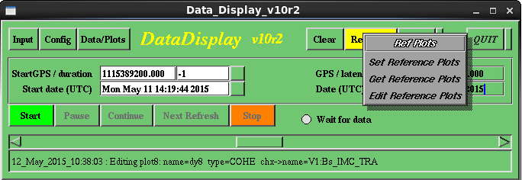
A menu “Reference plots” allows you to create a set of reference plots, to load a set of reference plots and to manage to reference plots files loaded
Save in a ROOT file the current plots
Read from a ROOT file the reference plots to be superposed to the current ones
Add, remove, change color of the reference plots

Slide 42
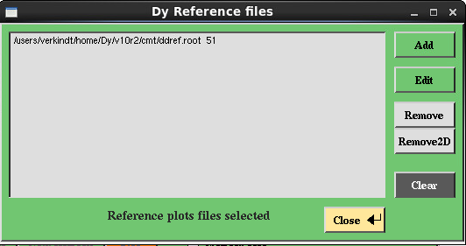
When choosing “Edit Reference Plots”, the panel below should appear
List of reference plots files loaded, with their color number
Add a reference plots files to the list
Change the color of the reference plots selected
Remove the reference plots selected

Slide 43
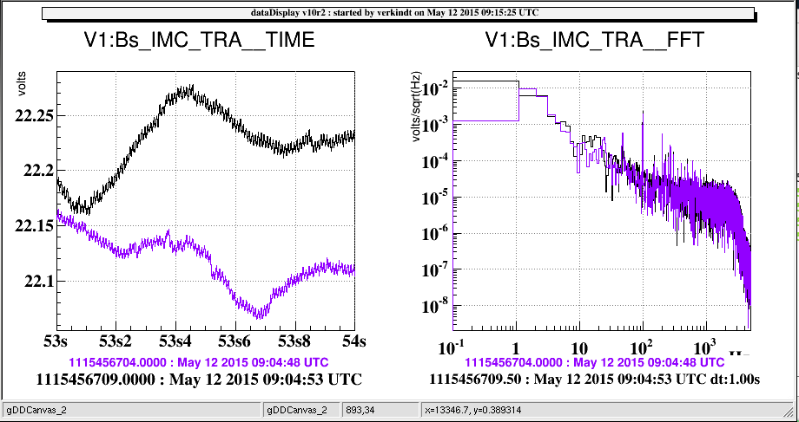
Once you “Get a Reference Plot”, the reference plots contained in the ROOT file you choose should appear, superposed to the current plots
When clicking on “Start”, the reference plots continue to be shown superposed to the current ones.
Time origin of the reference plot

Slide 44
Tools and Options

Slide 45
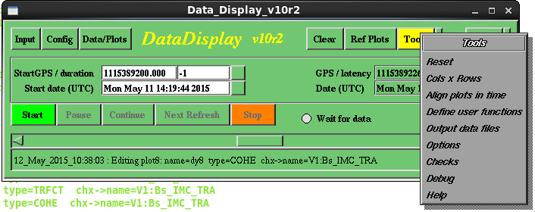
The menu “Tools” provide access to various additional tools and options
Reset all, except the list of plots
Choose the plots configuration on screen
Load a user-defined function running on data vectors
Write on disk the data read by the dataDisplay
Access to options panel

Slide 46
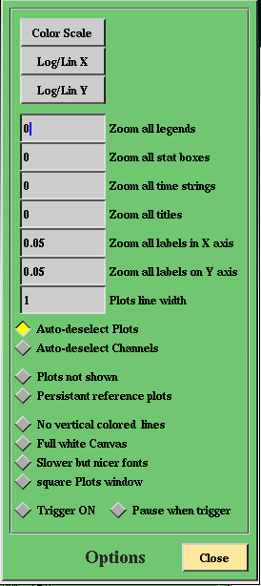
The “Options” panel provides various options about the plots display
or the mainbrowser management
The color set used in 2D plots
Set log scale or linear scale on the X axis of all the plots
Set log scale or linear scale on the Y axis of all the plots
Text size of the legends
Text size of the statistics
Text size of the time strings
Text size of the X axis
Text size of the Y axis
Width of the plots curves

Slide 47
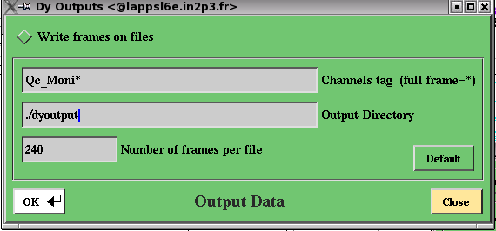
When choosing “Output data files” in the “Tools” menu, you should get the panel below, which allows to define the content and the caracteristics of the data files (frame format) written on disk.
Put this button ON if you want to write on disk the data read by the dataDisplay
List of channels to be written on disk
Directory where data files will be written
Number of frames per file

Slide 48
The menu “Tools” contains an item called “Help”.
It provides access to an Help panel
with a button to active Help balloons.
If you need more help, send an email to
verkindt@lapp.in2p3.fr
describing the problem and
telling where can be find the configuration file dy.cfg that you used

