Slide 1


The Cascina activity on squeezing
Jean-Pierre Zendri
On behalf of the squeezing team

Slide 2
Squeezing activity in Cascina
Aim: Construction of a vacuum squeezer following the AdV squeezing TDR design. Details in VIR-0411A-152
Homemade SHG
Linear single resonant OPO
Goal: 12 dB of squeezing in the audio frequency band
The construction began in the 1500W clean room in September 2015.
The main financial support is from INFN (Ge, Na, RomeI, RomeII, Pi, Pd/Tn) plus in kind support from other Virgo-Labs.
EGO support
  Logistical and services (clean room, racks, computers, network,..)
  Specific tasks (in vacuum faraday isolator, DC photodiodes, DC power supply, cabling, PZT HV drivers, resonant EOM…)
  Discussion and expertise in many fields.

Slide 3
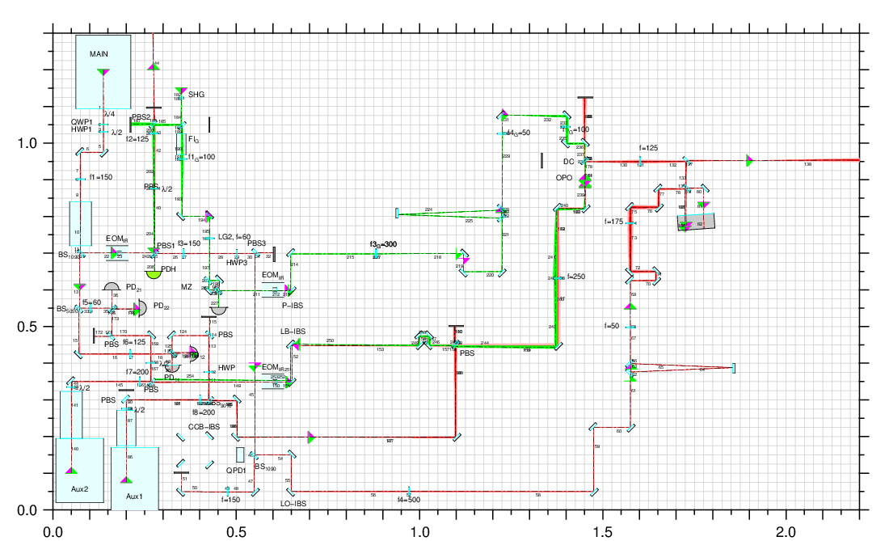
The 1500W optical layout
SHG Cavity
MC532
OPO
cavity
Mach Zhender
Homodyne
MC1064
Green Line SHG+MZ+MC532
OPO Line OPO cavity
Homodyne line MC1064+ homodyne
Other OPLL, electronics

Slide 4

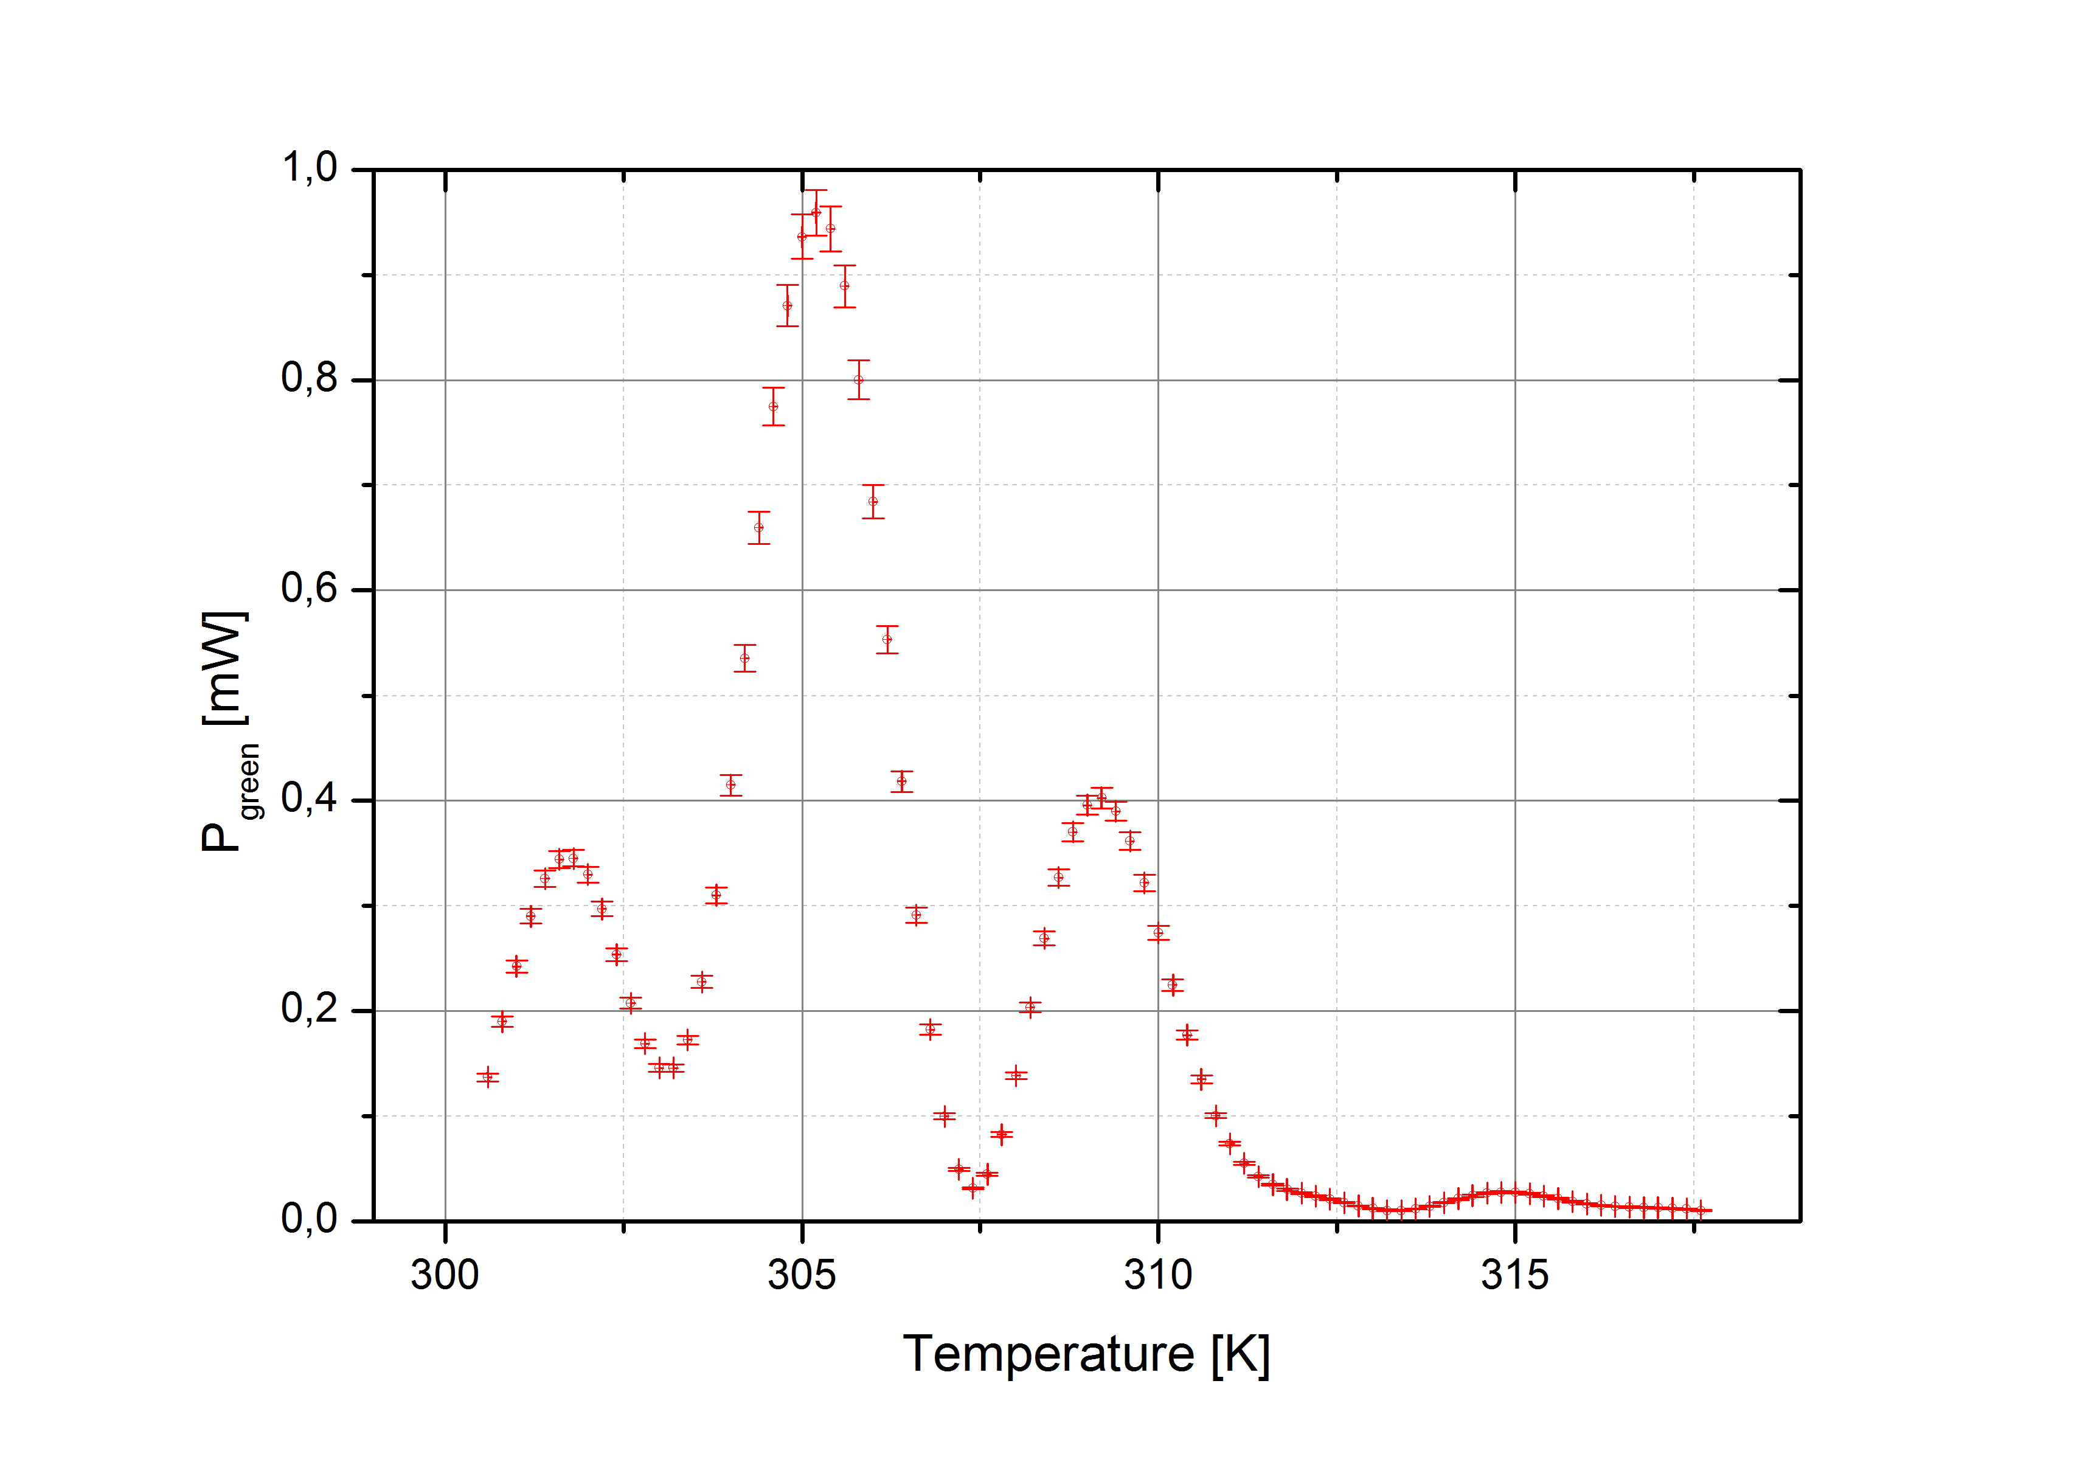
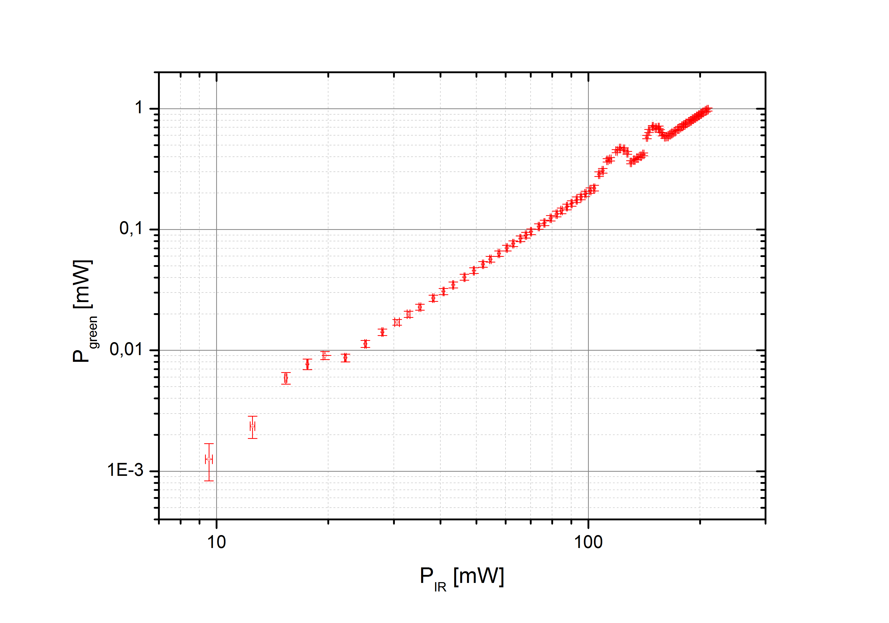
Second Harmonic Generation (SHG)
Crystal: PPKTP 9.3×1.2×1 mm
9.3 mm
AR coating
1064&532
HR coating
ROC 8 mm
n=1.8306
PPKTP
Phase matching
Double pass conversion
Best efficiency @ 305 Kelvin
Double pass efficiency <1%
Virgo Week Cascina May 4th, 2016

Slide 5
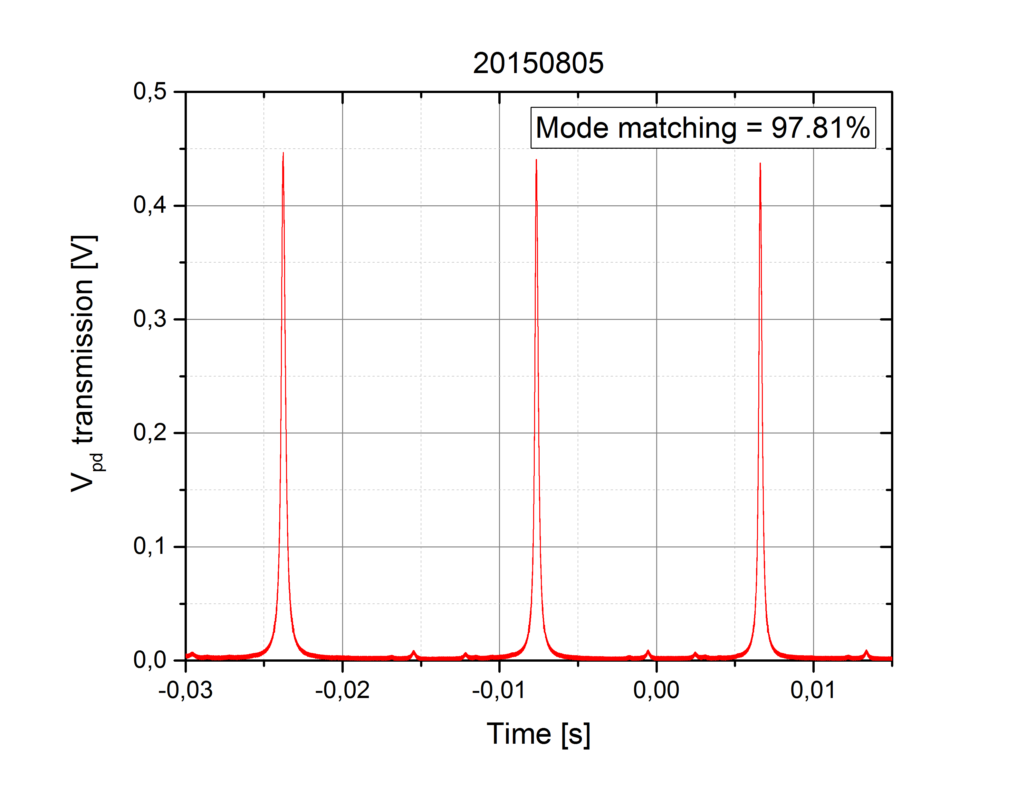
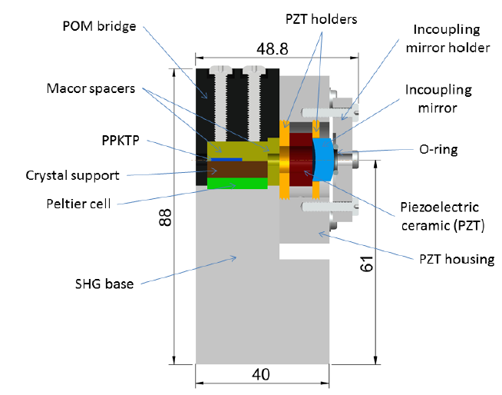
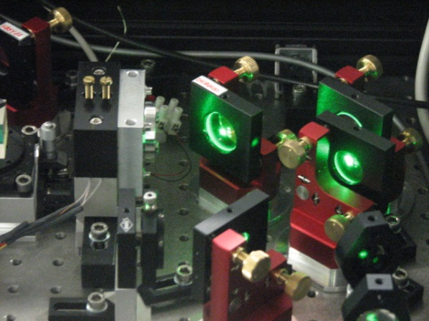
Cavity enhanced SHG
M. Leonardi
Cavity design and mode matching
Achieved Mode matching
Cavity controls
Error signal
ADC
Real time Processing
Temperature stability 1 mK rms (24 bit 100 Hz)
PDH (14 bit 20 kHz)
HV PZT driver or Peltier
DAC
NI PXI

Slide 6
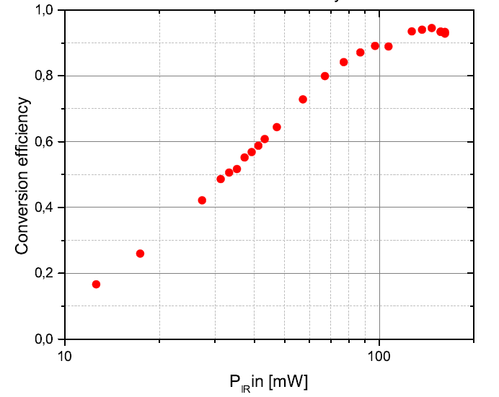
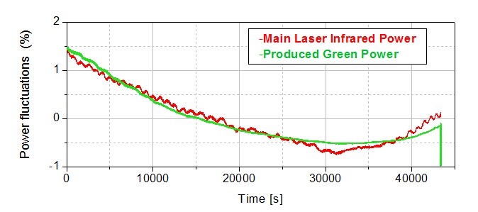
Installed SHG efficiency
M. Leonardi
The present incoupling mirror reflectivity is 92% (tested also 96%).
Convertion efficiency order of 95%
Up to 200 mW produced
At the optimal crystal temperature of 305 Kelvin
SHG goal (P_{green} >100 mW) achieved
Long term green power stability
Order of few % due to the pump laser fluctuations
Too much!! Need of stabilization of the pump

Slide 7
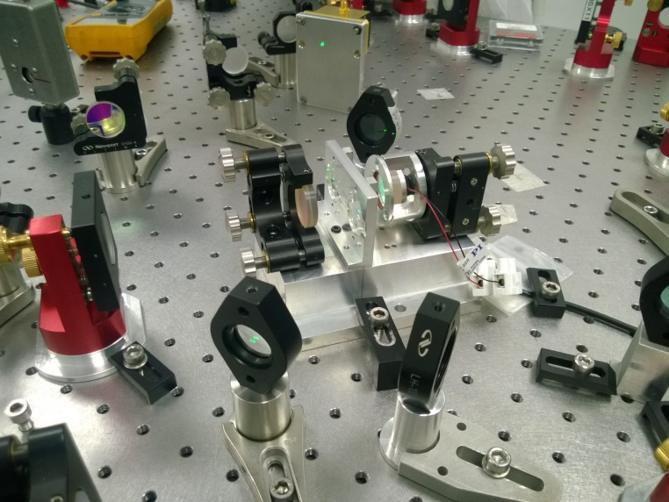
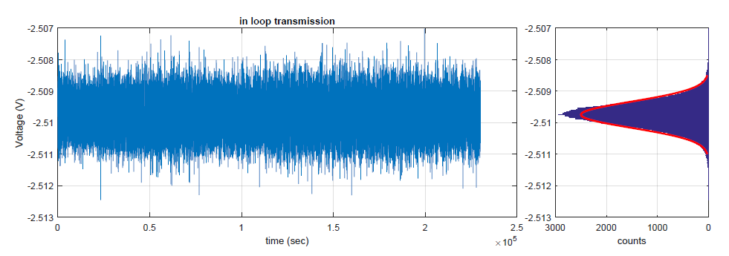
Green Power Stabilizazion: Mach-Zhender
Required a stability of at least 1%
PZT
Unbalanced MZ
Beam splitter transmittivity
T_{p} :10%
T_{s} :1%
Green Power at the MZ output
Mach Zehnder goal achieved

Slide 8
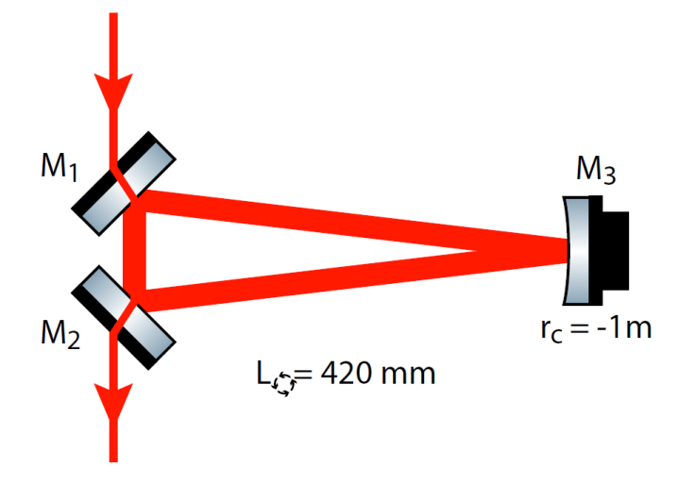
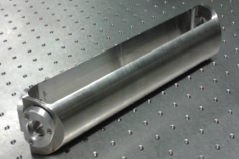
The green Mode Cleaner MC532
271 mm
Triangular cavity:
Finesse 600
FSR 514 MHz
Optical path length 582 mm
Invar
99.5%
99.98%
99.5%
The assembled MC532 is ready
the integration in the squeezer optical bench is currently under way
The green line is almost completed. SHG Ok, MZ Ok, MC532 integration this week

Slide 9
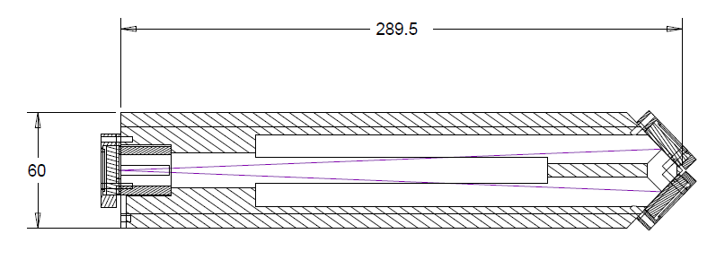
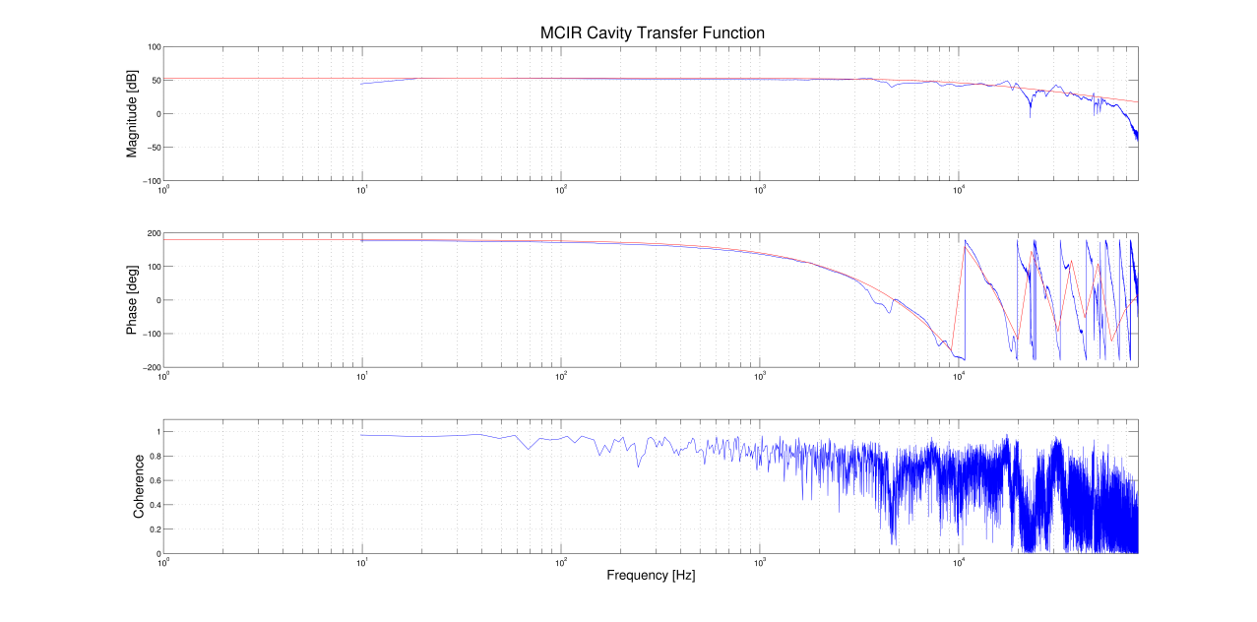
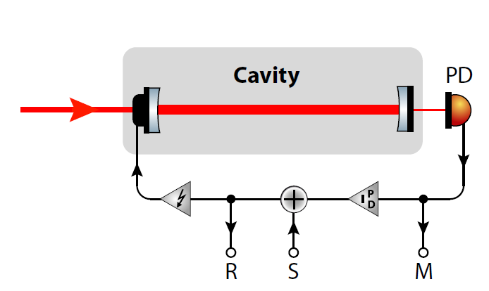
Homodyne: The IR mode cleaner
Triangular cavity:
p finesse 3000
s finesse 250
Optical lenght 582 mm
Invar
Cavity transfer function: A/B
A
white
noise
B
Installed and locked. OK

Slide 10
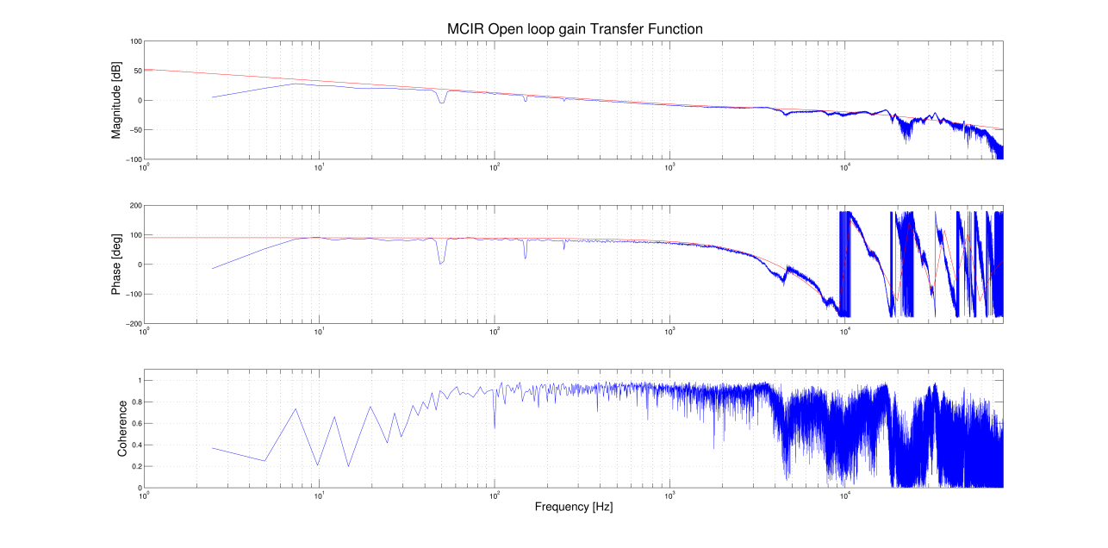
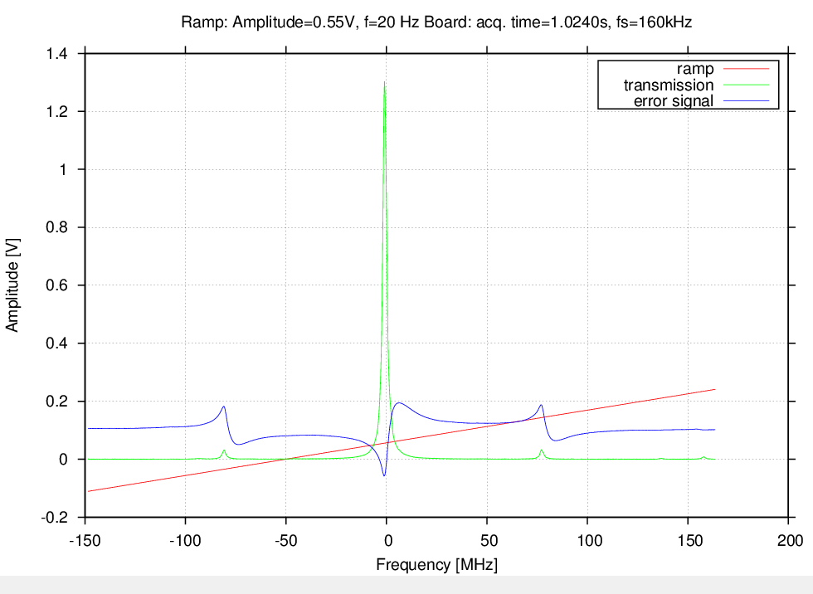
SAT ADC/DAC tested on MC1064
The commercial NI PXI has been recently substituted with the new SAT ADC/DAC (24 bit 320 kHz).
PDH with autolocking implemented
Example:
PDH Open loop gain
Error signal

Slide 11
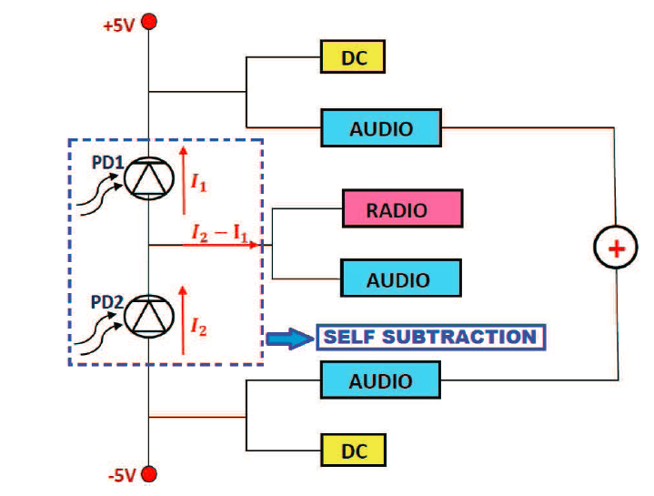
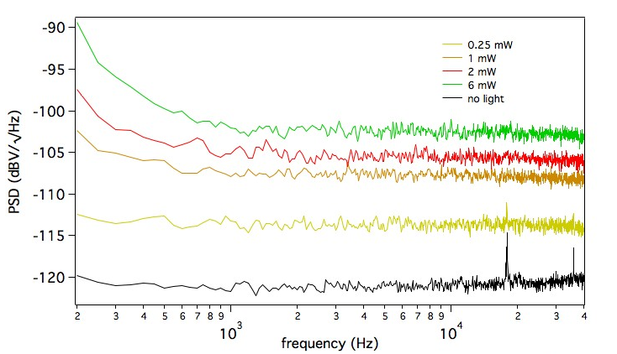
Homodyne detection
Audio frequency:
For the differential channel it is required a noise floor 15-20 dB below the shot noise limit @ Local Oscillator 1 mW
Self substraction scheme
Nominal photodiodes quantum efficiency >99%
Low noise amplifiers AD8625
Below 200 Hz noise dominated by acoustic and air flow noise
Above 200 Hz achieved the homodyne audio frequency goal

Slide 12
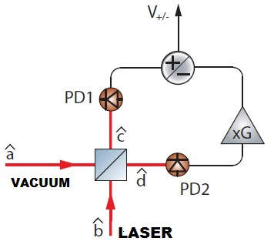
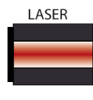

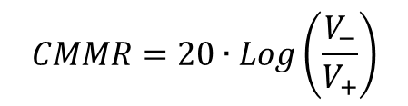
Homodyne detection
Common Mode Rejection :
$$CMMR=20∙Log\left(\frac{V_{−}}{V_{+}}\right)$$
Best achieved (in the kHz region) about 80 dB
Ok
λ/2
Pump
Mod.
Radio frequency:
  The homodyne rf line at 7 MHz still have to be tested
  7MHz is the planned Coherent control loop frequency
Homodyne line installed: Audio line Ok, rf line to be tested

Slide 13
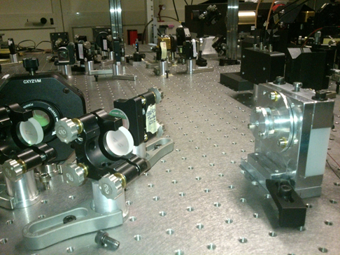
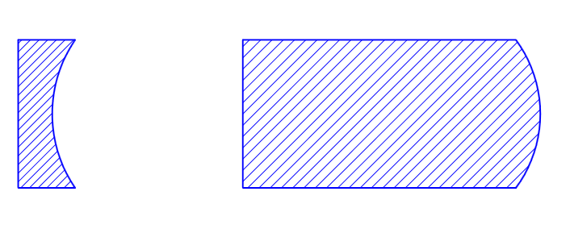
L_{C}
The OPO cavity
9.2 mm
PPKTP
92% @1064
20% @532
HR coating
ROC 12 mm
The OPO is presently the only subsystem that will incorporate superpolished optics.
The superpolished and coated (LMA) crystals and the incoupling mirrors has been delivered few weeks ago.
All the components are ready for the cavity assembly.

Slide 14


Optical Phase Locked Loop (OPLL)
3 OPPL required
Main laser | Slave laser | RF Offest
AdV main laser | Squeezer main laser | TBD | Locking the squeezer to AdV
Squeez main las. | Aux laser 1 | 20 MHz | OPO length control
Squeez main las. | Aux laser 2 | 7 MHz | Coherent control
Residual Phase jitter must be kept below 20 mrad rms
ν_{beat}
PLL
ν_{ref}
Fast: PZT
Slow: Peltier

Slide 15
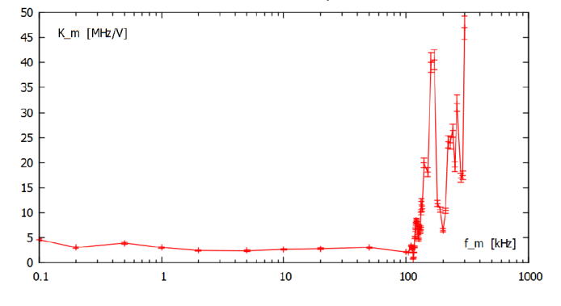
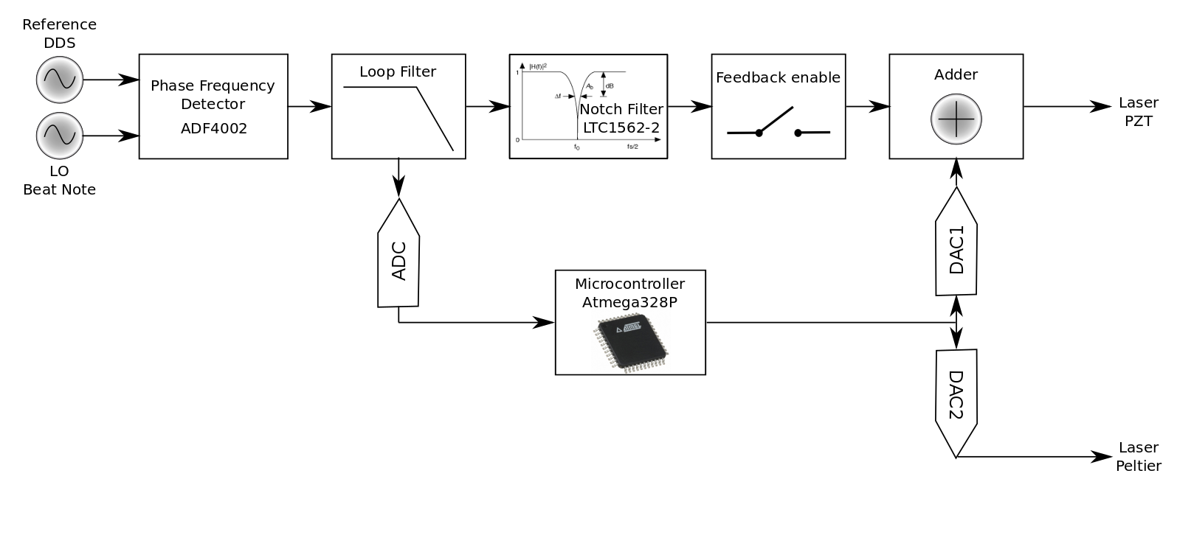
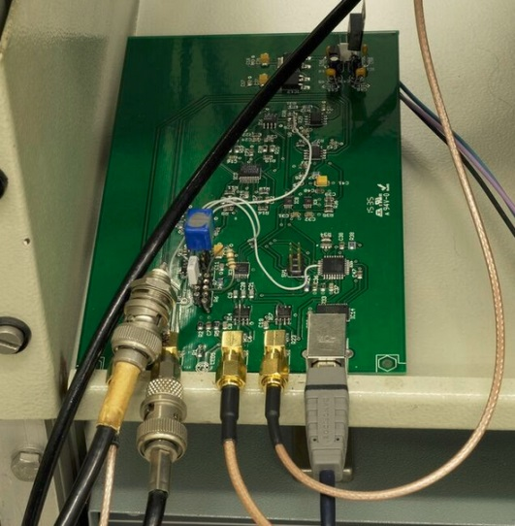


OPLL-PCB
Bandwidth limits (laser PZT resonances)
Measured $K_{m}\left(ω\right)$
for Mephisto 500NE
100 kHz unitary bandwidth can be approached using notch filters
$$υ_{laser}=υ_{0}+K_{m}{∙V}_{PZT}$$
I/O serial protocol
ADC/DAC manage
Diagnostics
Autolocking

Slide 16
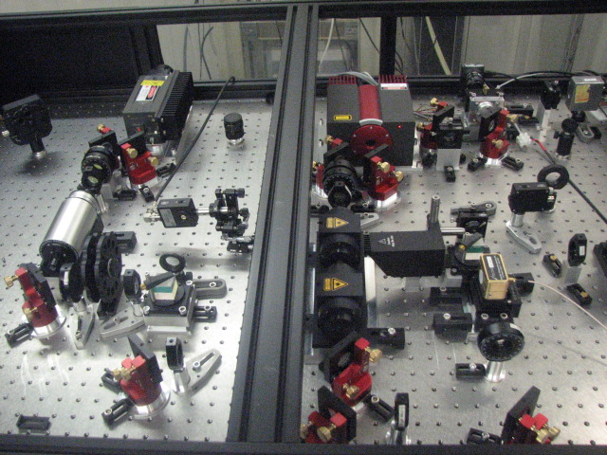
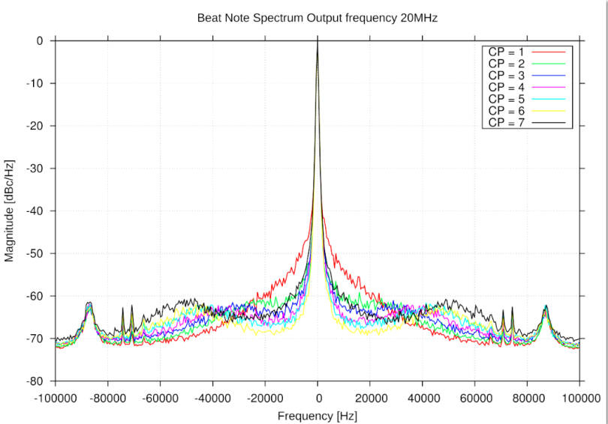
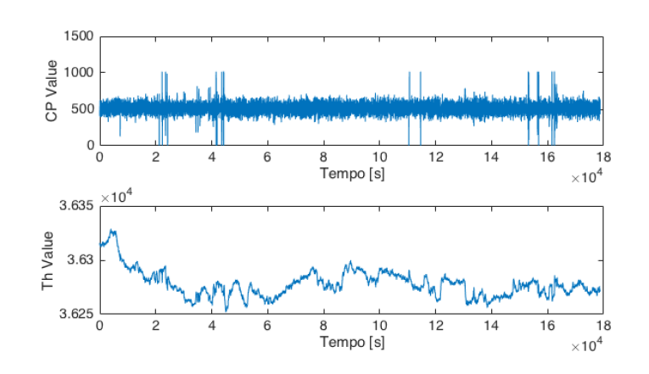
OPLL-results
Optical Phase Locked Loops between Mephisto 500 NE and lightwave
LONG term operation
Residual phase jitter 15 mrad (unitary bandwidth 45 kHz)
Long term operation
PLL electronics ready for installation

Slide 17
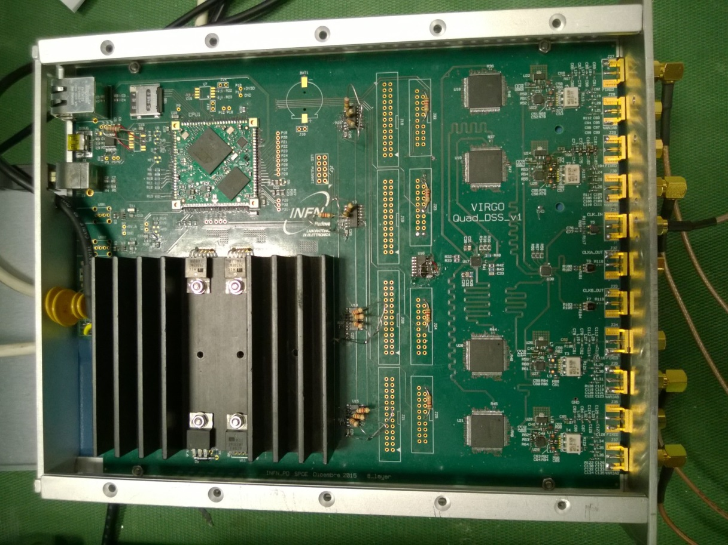
Direct Digital Synthetizer (DDS)
Needed at least 12 low noise rf channels 5÷100 MHz
USB or Ethernet
Linux embedded module
4 locked rf channels each channel has remotely selectable
amplitude (max 7 dBm)
frequency (up to 500 MHz)
phase
AD9910: 14 bit 1 GSPS
External Clock: Wenzel crystal @ 500 MHz

Slide 18
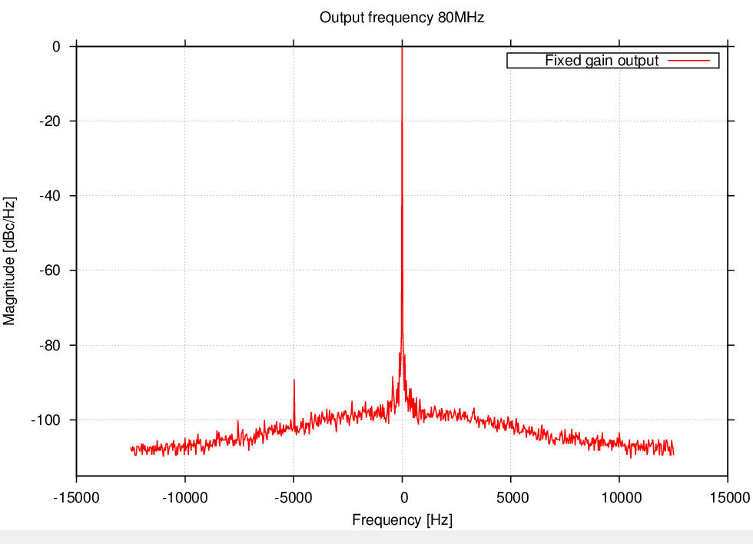
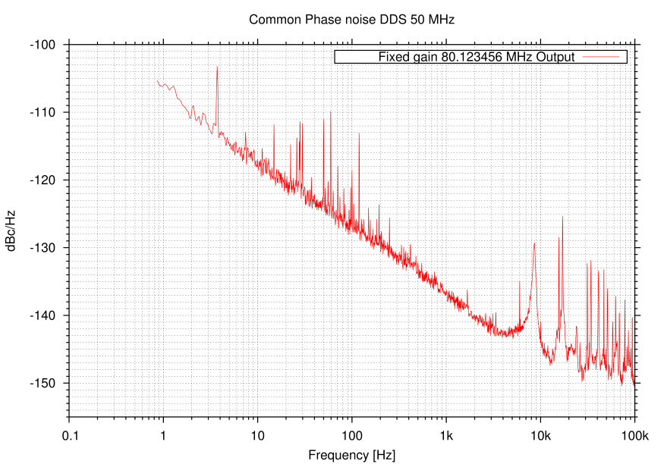
Direct Digital Synthetizer (DDS) results
Absolute phase noise
Relative phase noise
Ch_{I}
Ch_{I}
Spectrum analyser
Ch_{J}
FFT analyzer
SR540
LP
Well within our requirements

Slide 19
Summary
Status of squeezer:
Green Line
SHG | Installed
MZ | Installed
MC532 | Instal. underway
OPO line
OPO | close to be assembl.
OPL and electronic
OPLL PCB | Ready
DCC | Ready
Main Controls | Work in progress
Homodyne Line
MC1064 | Installed
Homodyne | Installed

Slide 20
Short term activity
Conclude the squeezer assembly
Draw build and install the beam dumps and absorbers
House the optical bench and the homodyne detector in a dedicated box
Choerent Control
Hardware and software improvement, cabling
Add more superpolished components
Squeezer commissioning

Slide 21
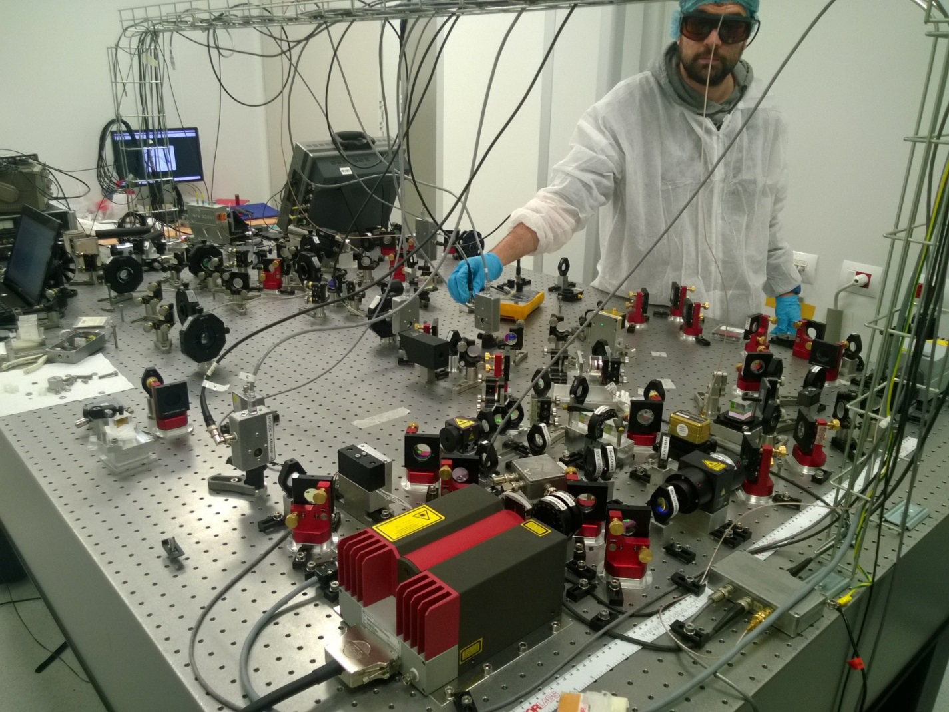
Logbook
More details in
http://slwebtest.virgo.infn.it/osl_squeezing/

