Slide 1

Virgo/EGO Outreach
06/2012

Slide 2
Outreach Group
Carlo Bradaschia (Pisa)
Elena Cuoco (EGO)
Giuseppe Di Biase (EGO)
Severine Perus (EGO)
Gabriele Vajente (Pisa)
(Federico Ferrini)

Slide 3
Site Visits
As usual since several years, every Saturday (Tuesday) 20-60 visitors
Guides:
some problem to find volunteers

Slide 4
“Una Giornata da …… Ricercatore”
3rd November 2011
40 high school students from the surrounding Tuscany spent a full day at EGO.
Divided in four groups, guided by two tutors each, they performed in turn simple experiments on subjects related to Virgo:
Seismic and acoustic measurements
Signal analysis (time domain and frequency domain)
Comparison of a pendulum with an inverted pendulum
Air refraction index changing with pressure (counting fringe drifting in a small interferometer).
At the end the best teams (according to a quiz contest) have been rewarded with a Galileoscope, a working copy of Galileo’s “cannocchiale”
Tutors: G. Balestri, A. Basti, C.B., E. Cuoco, I. Fiori, F. Paoletti, M. Tacca
In the framework of the initiative “Pianeta Galileo” by Regione Toscana

Slide 5



European Researchers’ Night
28 (and 29) September2012
EGO/Virgo answered successfully the European call as partners of
expected budget share: 2000 € TBC
www.frascatiscienza.it

Slide 6
Night 2012 program (28 and 29 September)
To See
Virgo
Tunnel
Control Room (taking data)
Interferometer (working model)
Superattenuator 1987
A real Payload
To Do
Virgo
Build your interferometer
Science
Meet the scientists (Science Cafe)
Astronomy
Observe the sky with the astronomers
Theatre
“Die Physiker” by Friedrich Duerrenmatt
at teatro Politeama, Cascina
In collaborazione con:
Comune di Cascina
Comune di Pisa
Astrofili Pisani Galileo Galilei
Regione Toscana
La Limonaia
INFN e Dipartimento di fisica
Fondazione CariPisa

Slide 7
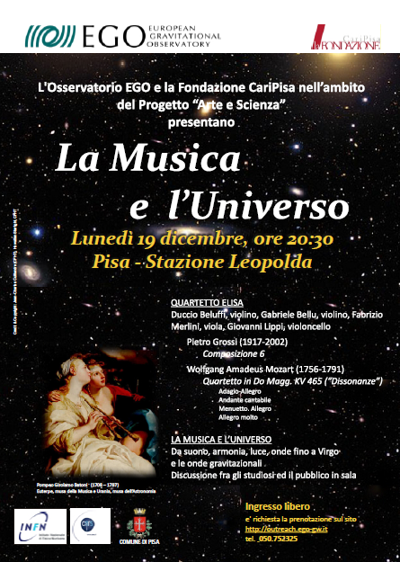

Arte e Scienza
(EGO & CariPisa)

Slide 8

Arte e Scienza
(EGO & CariPisa)
Friedrich Duerrenmatt
Die Physiker
Teatro Politeama, Cascina, 29 September, 2012

Slide 9



Slide 10
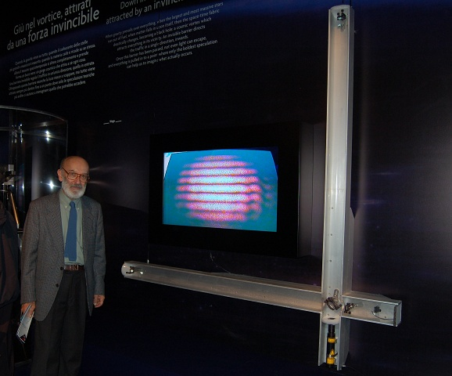
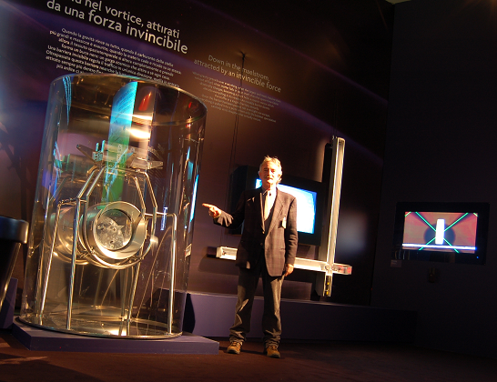

Slide 11
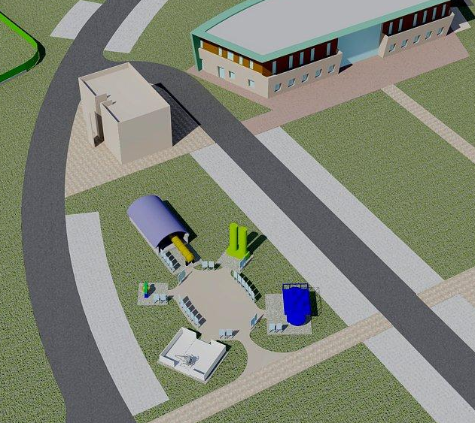
OPEN AIR MUSEUM
Near future if € from Comune di Cascina

Slide 12
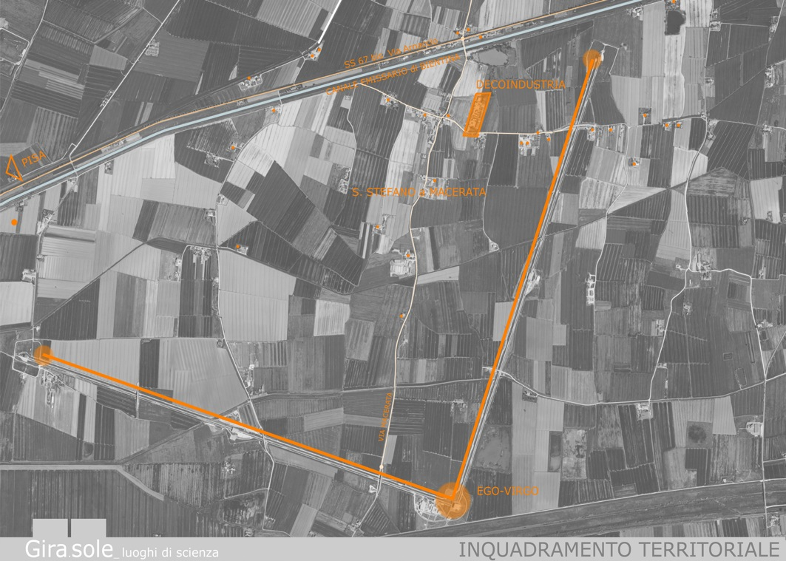
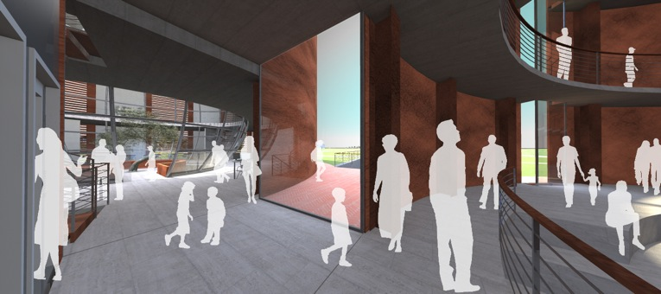
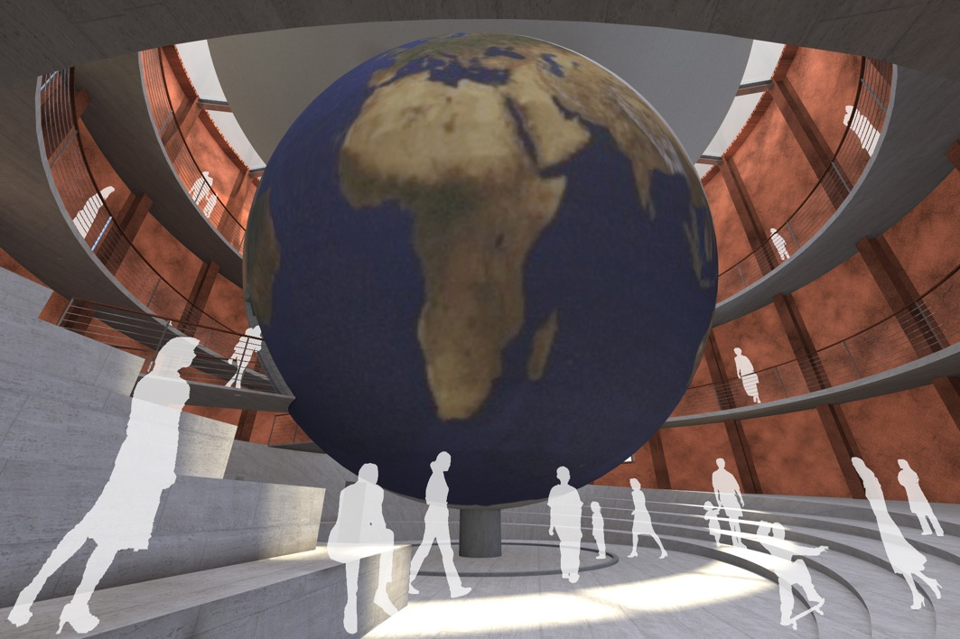
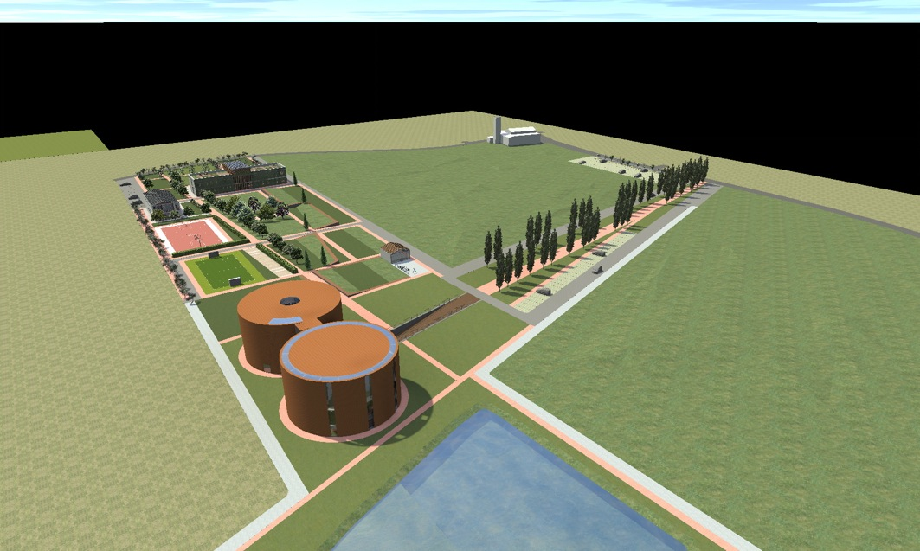
Far future if € from EU via Regione Toscana and Comune di Cascina

Slide 13
Virgo/EGO Outreach
06/2012

