Slide 1
Updating the Cryotrap readout equipment
Martin Mohan
Software Engineer
EGO

Slide 2
Outline
Objectives:
Improve the current test setup
Overview:
Current Setup
New Setup
Advantages.

Slide 3
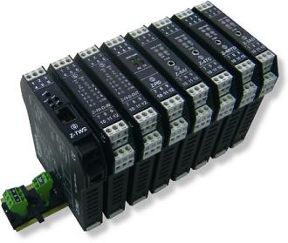
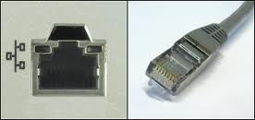

Current Setup – Direct or internet
1. Direct Connection
2. Control via internet
Ip=193.205.75.219
Ip=193.205.75.219
(modbus/tcp)
(modbus/tcp)
Ip=193.205.75.217
Ip=193.205.75.217

Slide 4
Problem and Solution
Conclusion
Problem: Can directly connect to plc or use the network but not both at once.
Solution: 2 ethernet lan ports
  Port 1 – connects to network
  Port 2 - Dedicated PC – PLC connection

Slide 5
New Setup – 2 lan ports
Direct Connection
Ip=193.205.72.219
(modbus/tcp)
Ip=193.205.75.217
192.168.101.93

Slide 6
Hardware and Software changes
Software: Very little change
1. Configure a debian machine with 2 ip addresses.
Hardware: Several solutions and the casing may need to be changed.
Buy a pc tablet with 2 lan ports and mount it on the crate. ( 1000 to 2000 euro )
Buy a rack mount p.c with 2 lan ports and a separate monitor. ( 1000 to 2000 euro )

Slide 7
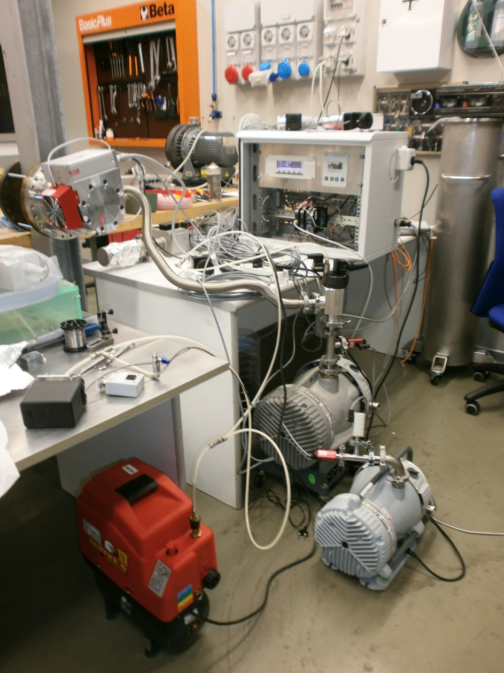
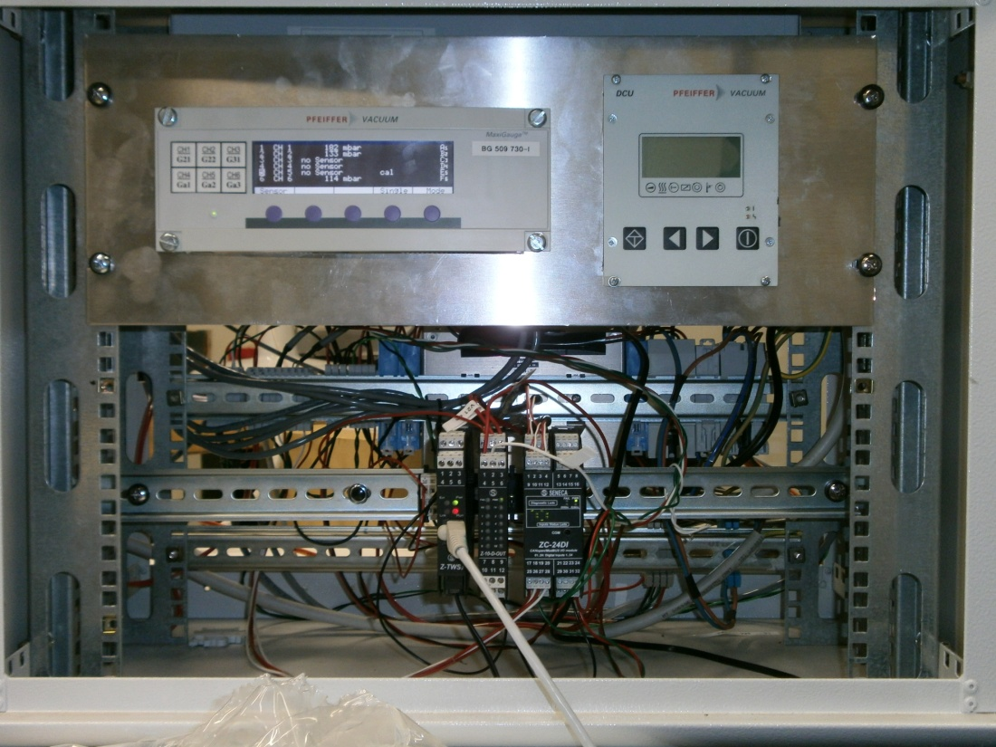
Current Tango test Setup

Slide 8
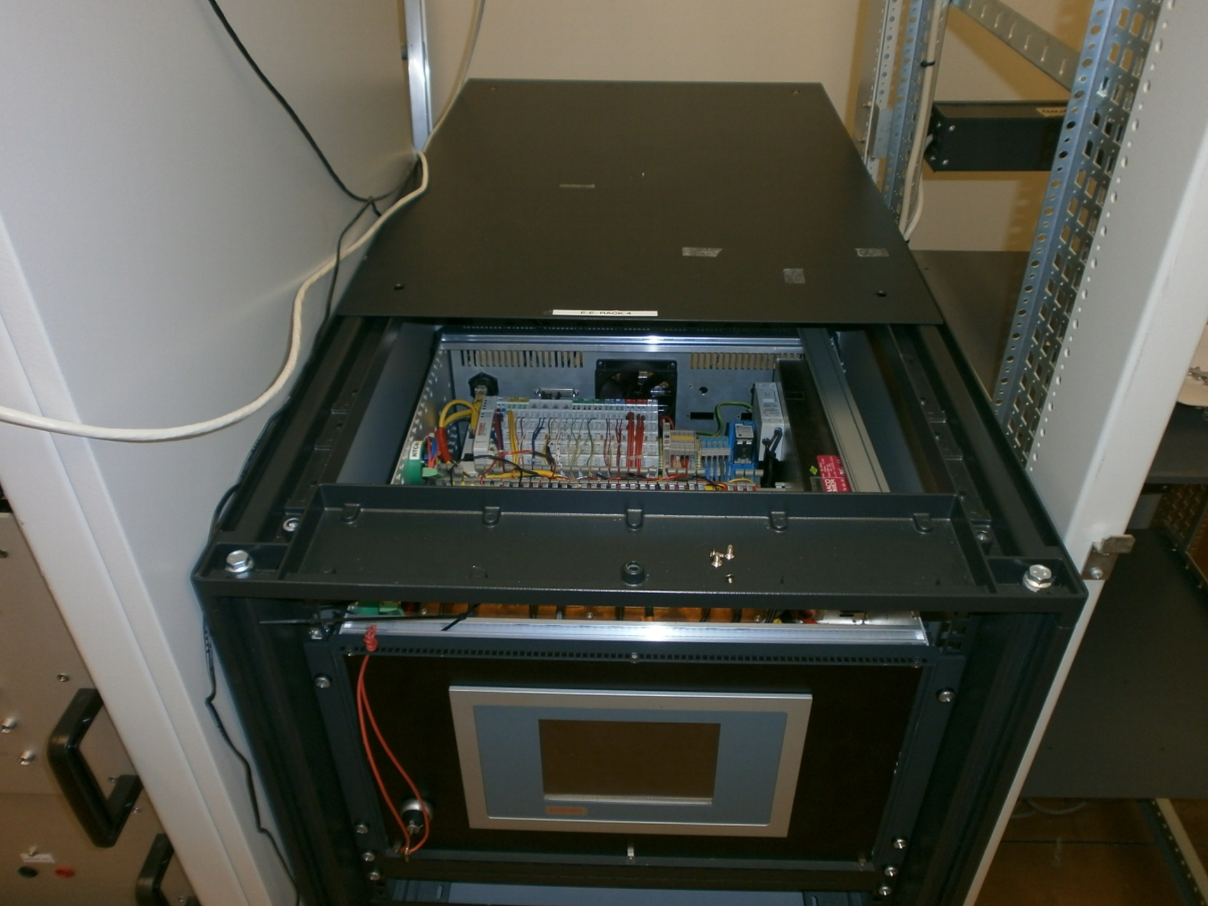
Possible future box
PLCs
Connect to
Ethernet from back.
GUI Display
On/Off
Key

Slide 9
New setup
Conclusion
General Advantages
A dedicated ip address provides secure reliable data transfer as it is not exposed to other network traffic.
This is a turn key solution. Just switch on power to see data.
Remote client requires no tango software
If tango is not installed on client.
Linux access: ssh -X 192.168.101.93
Windows access: Use secure shell
If tango client is installed on linux
Linux access: export TANGO_HOST=192.168.101.93
Windows: Set environment variable: TANGO_HOST=192.168.101.93

