Slide 1
Laser amplitude noise requirement
Jean-francois Hayau, François Bondu

Slide 2
Outline
Optickle simulation
RIN requirement for various finesse and loss asymmetries
RIN control with POBS

Slide 3
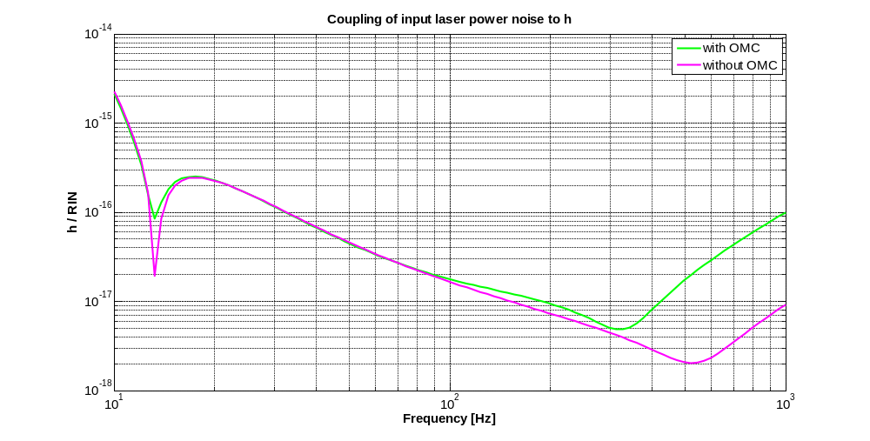
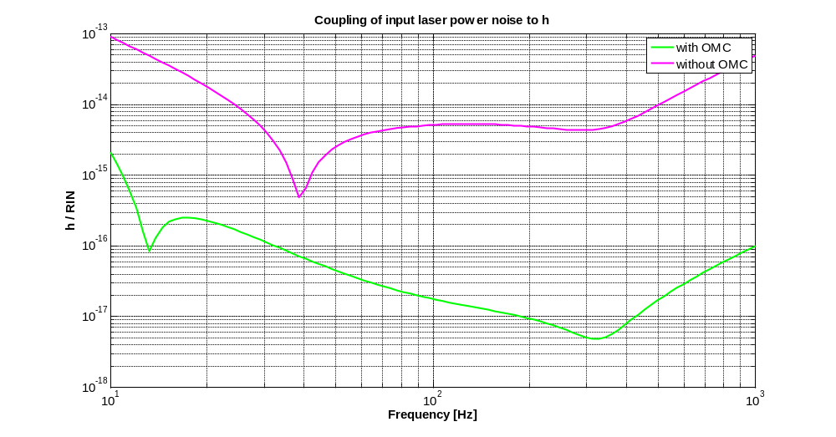
Optickle simulation
Gabriele Vajente optickle model: simulation without Input Mode Cleaner. fMod1 = 6270339.2 Hz, fMod2 = 81515709.5 Hz, fMod3 = 8360585.6 Hz ; Lcav = 2999.9 m,
Lprc = 11.953m, Delta = 0.037m, Lsrc = 11.033m, Lprbs = 5.980m.
Output mode cleaner : Finesse 200, round trip 40 cm.
=> OMC filter sidebands
=> OMC and sidebands properties have an effect on RIN requirement
Index modulation of sidebands (without OMC) /100
Noise brings by
carrier
Noise brings by sidebandes

Slide 4
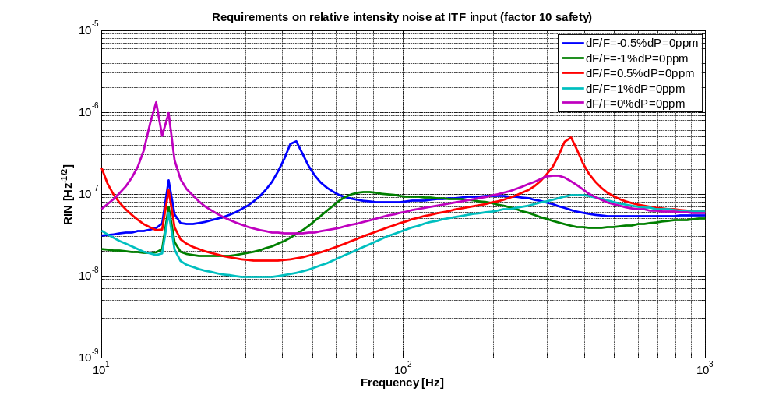
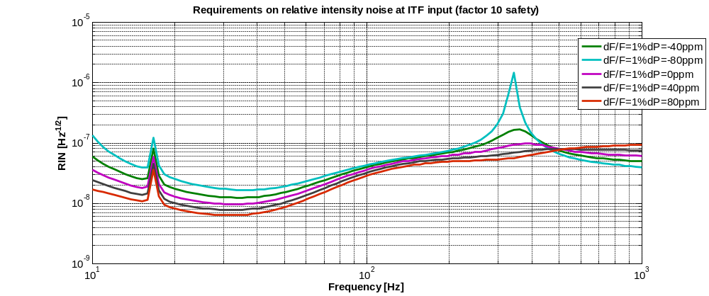
RIN requirement for various asymmetries
RIN for various finesse asymmetries (factor 10 safety)
RIN for various loss asymmetries ( @ dF=1%)
Lower RIN for finesse asymmetry of 1%

Slide 5
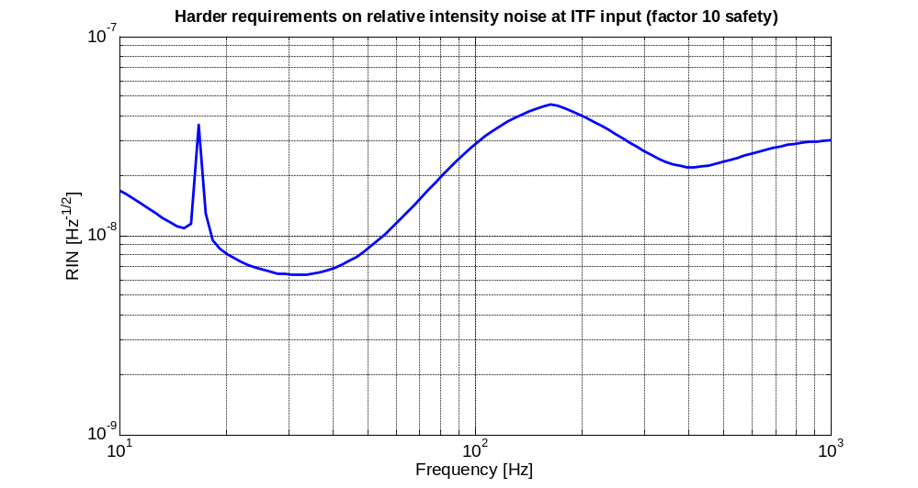
Harder RIN requirement
RIN requirement realized for various loss asymmetries (from -80ppm to 80 ppm with a step of 20ppm) and finesse asymmetries ( from -1% to 1% with a step of 0.5%) : Lower RIN is taken between the different files at each frequency => Harder RIN requirement
Noise floor at 6.10⁻⁹ .Hz^{-1/2}=> Power required for intensity noise higher than shot noise ≈ 10 mW.

Slide 6
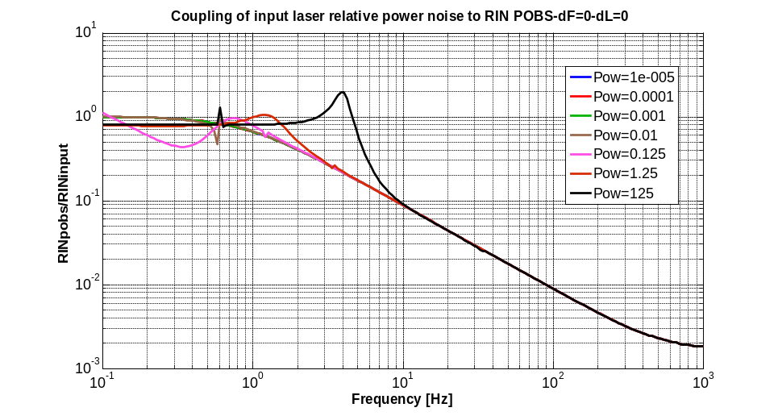
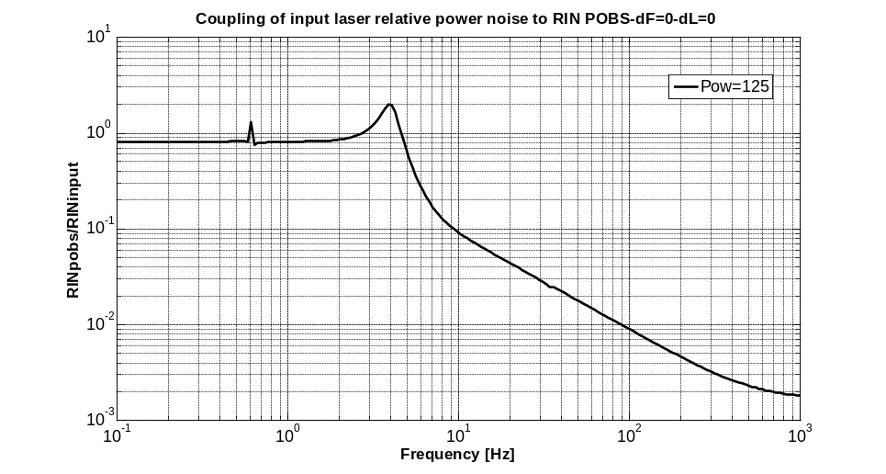
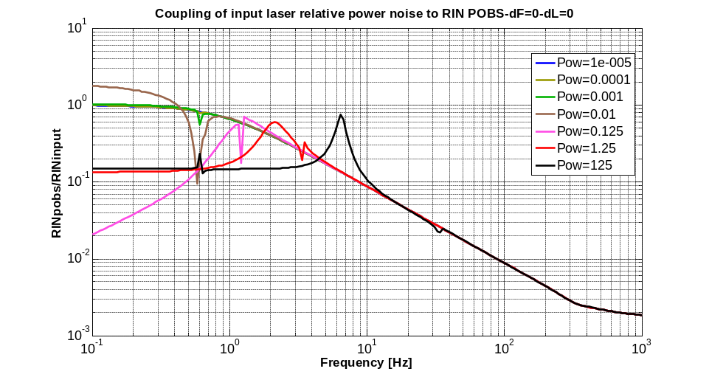
RIN control with POBS
Transfer function: RIN input to RIN on POBS
Simulation without asymmetries. => effect of radiation pressure
Simulation with asymmetries (DF=1%,DL=80ppm)
Power Recycling
Cavity ( pole of few Hz)
Power Recycling Cavity and radiation
pressure effect reduce
the transfer function

Slide 7
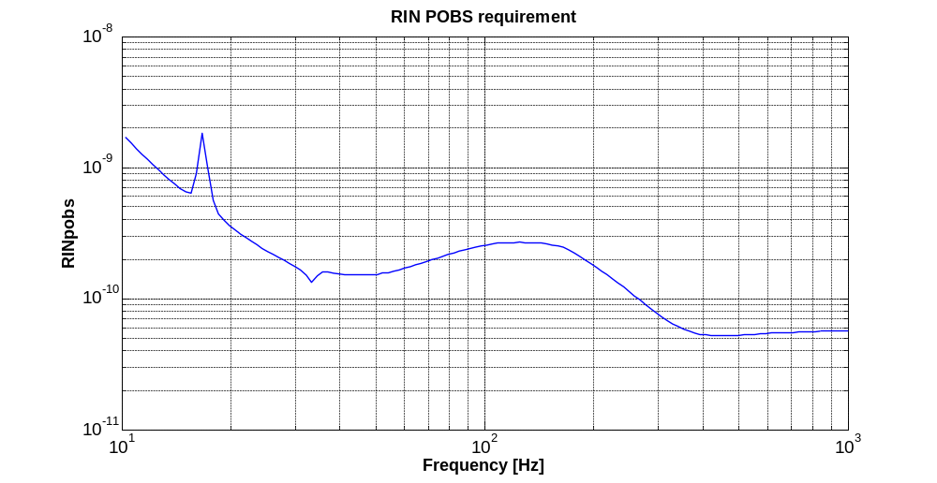
RIN requirement on POBS
Simulation with asymmetries (DF=1%,DL=80ppm) and harder RIN
=> Lower RIN requirement at 5.10⁻¹¹ .Hz^{-1/2} => Power required at the detection: 149 W

Slide 8
Conclusion
RIN requirement for various asymmetries: Harder RIN requirement
Noise floor at 6.10⁻⁹.Hz^{-1/2}
RIN control with POBS : difficult solution ( Power recycling cavity, radiation pressure effect)
Perspective: update requirement when final recycling cavity lengths.

Slide 9
Finesse definition
Loss asymmetry ∆L:
LIX=LEX= Ltot/2+∆L/4,
LIY=LEY= Ltot/2-∆L/4.
Finesse asymmetry ∆F:
FX= F*(1+∆F/2),
FY= F*(1-∆F/2).

