Slide 1
Cryotrap Control using Tango Control System
Martin Mohan
Software Engineer
EGO

Slide 2

Outline
Objectives:
Control Cryotrap using Tango
Subjects:
Who Uses Tango?
Cryotrap equipment controlled
Architecture
synoptappli
Mambo
pyTango
astor
Conclusion

Slide 3








1. Who Uses Tango?
…and several other users…
Notes:
Formal collaboration between institutes

Slide 4
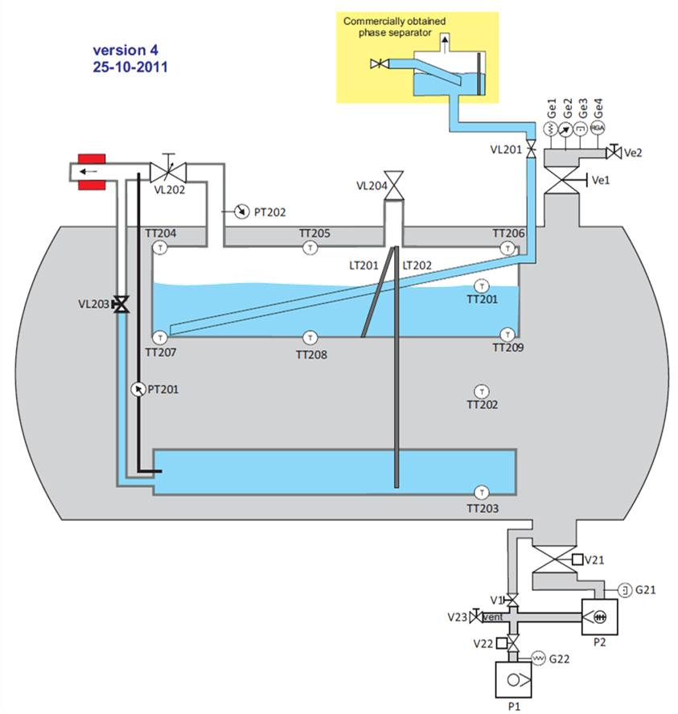
2. Cryotrap equipment controlled
Pirani
Pressure
Gauges.
(read only)
Manual and
EM valves
(read/write
v21/v22).
Turbo/Scroll pumps
(read/write)

Slide 5
3. Architecture
There are tree architecture/security levels:
Electronic (for more info Roberto Cavalieri)
PLC (Giulio Ballardin)
Software (Tango: Martin Mohan)
Software
PLC
Electronic

Slide 6
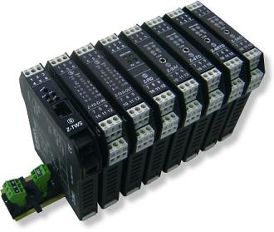

3. Architecture
Direct Connection
Control via internet
Ip=193.205.75.219
Ip=193.205.75.219
(modbus/tcp)
(modbus/tcp)
Ip=193.205.75.217
Ip=193.205.75.217

Slide 7
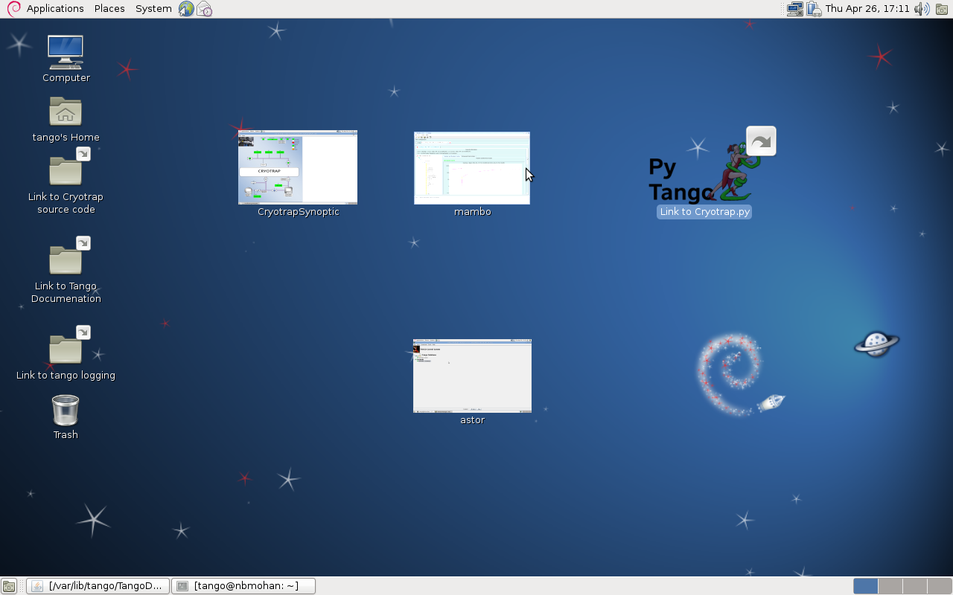
3. Architecture: Desktop View

Slide 8
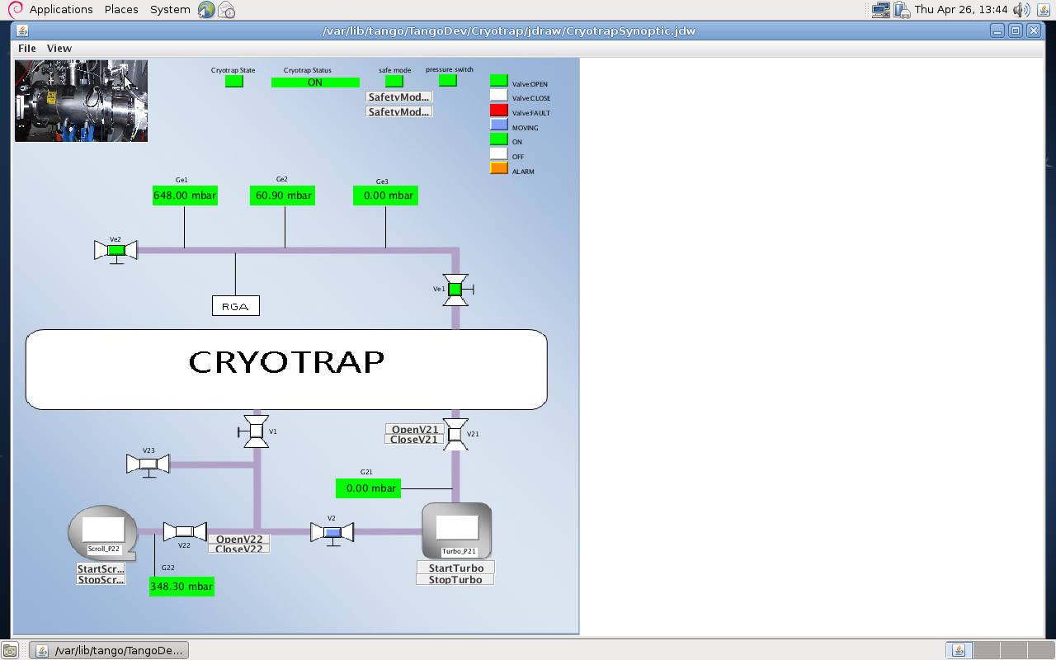
4. synopticappli
SafetyMode:
Is used to prevent users
damaging the cryotrap

Slide 9
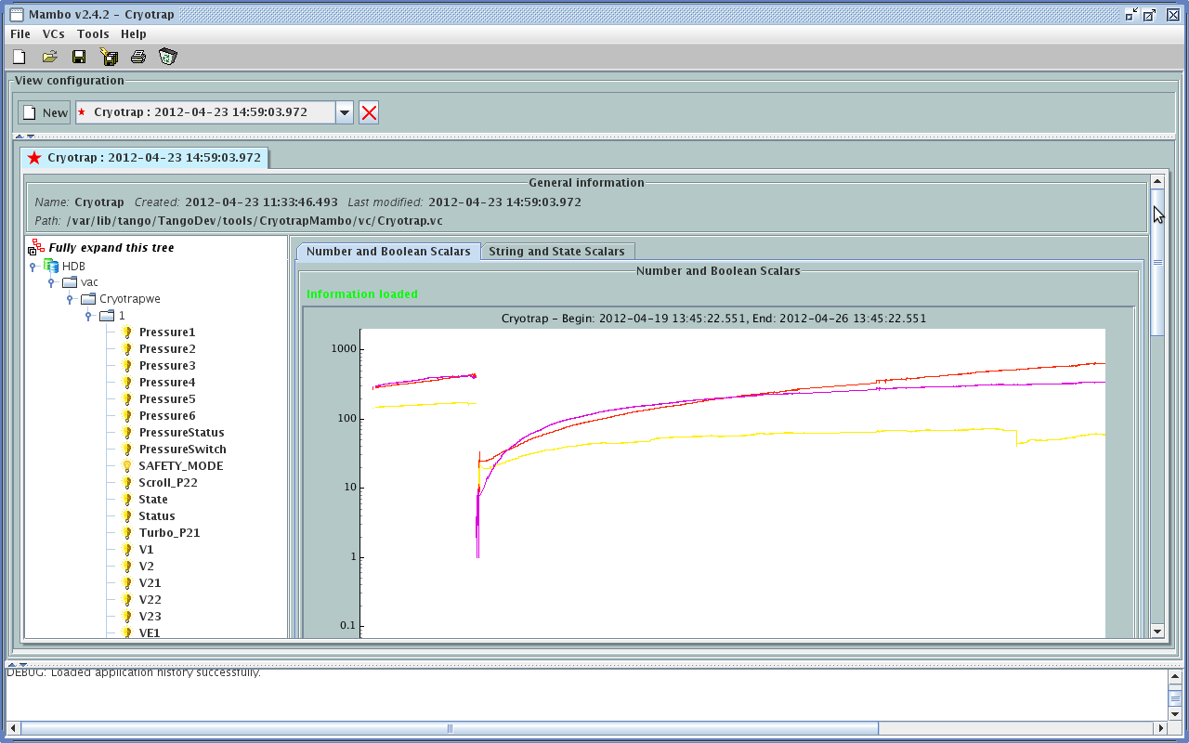
5.mambo

Slide 10
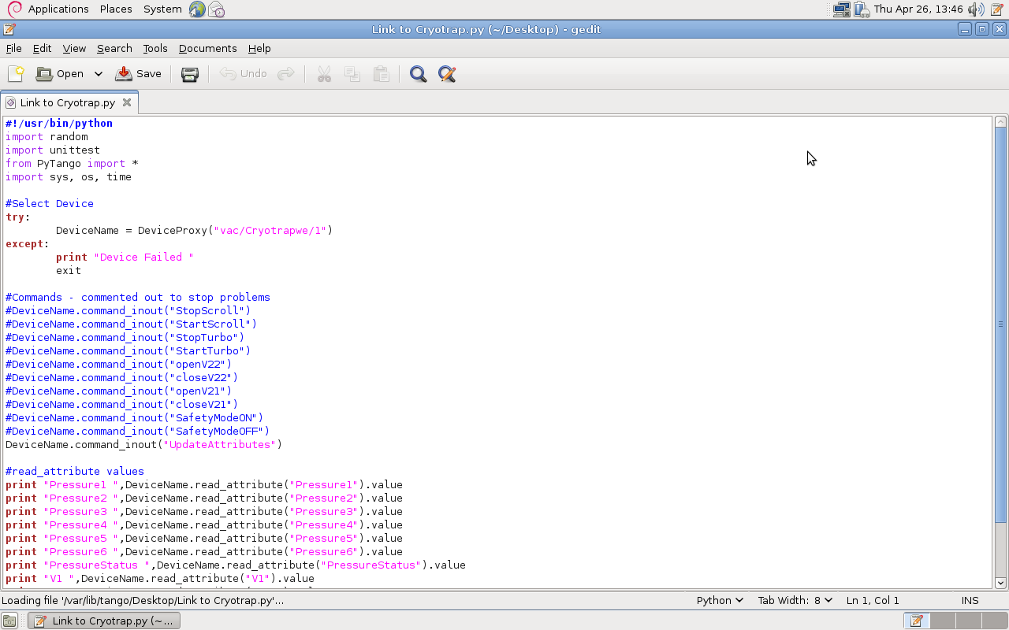
6. PyTango
C++, java and python interface
Allows automatic testing and automation
Pytango is the python interface

Slide 11
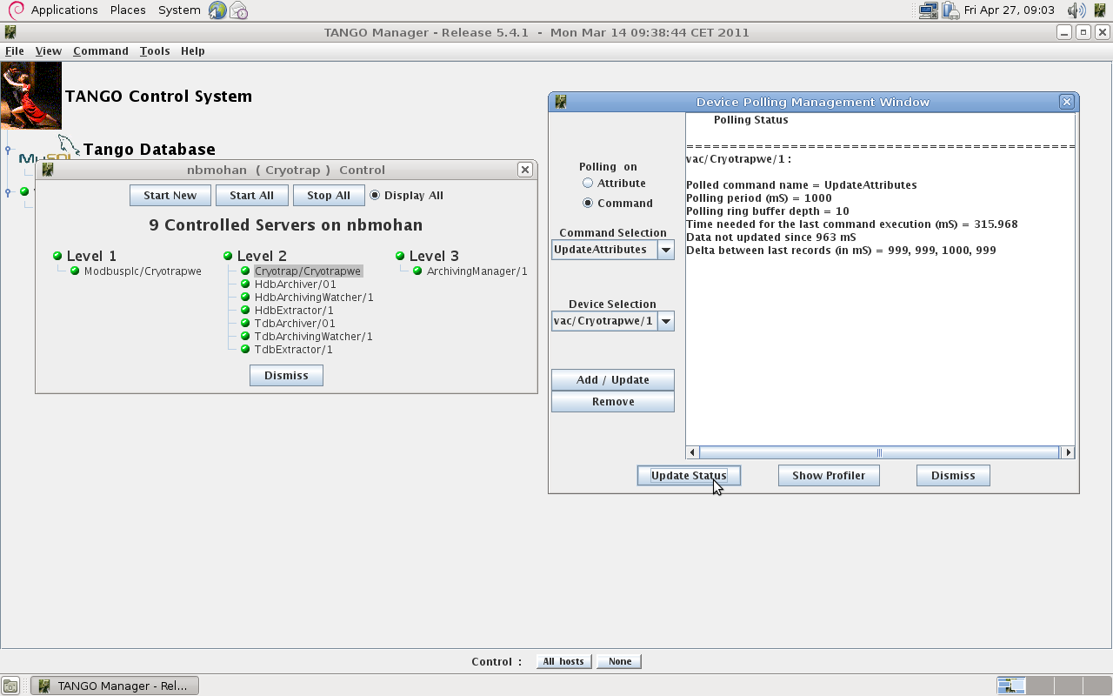
7. astor
C++, java and python interface
Allows automatic testing and automation
Pytango is the python interface
Astor is used to
Administer servers.
e.g. control polling rate

Slide 12
7. Conclusion
Conclusion
A synoptic permits an overview of Cryotrap controls.
Data is archived and displayed with mambo
Python interface allows automation of testing if desired.
Tango open source SCADA provides many other tools such as logviewer, jive (configuration),jdraw (gui builder), atkmoni (graphs), e-giga (web support).

