Slide 1
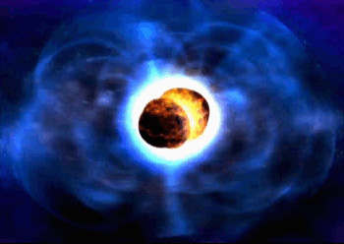
Status of Advanced Virgo
Fulvio Ricci
on behalf of the Virgo collaboration
Workshop on the LIGO-Virgo Electromagnetic Follow-up program
23-4-2015

Slide 2
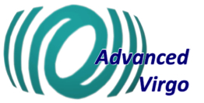
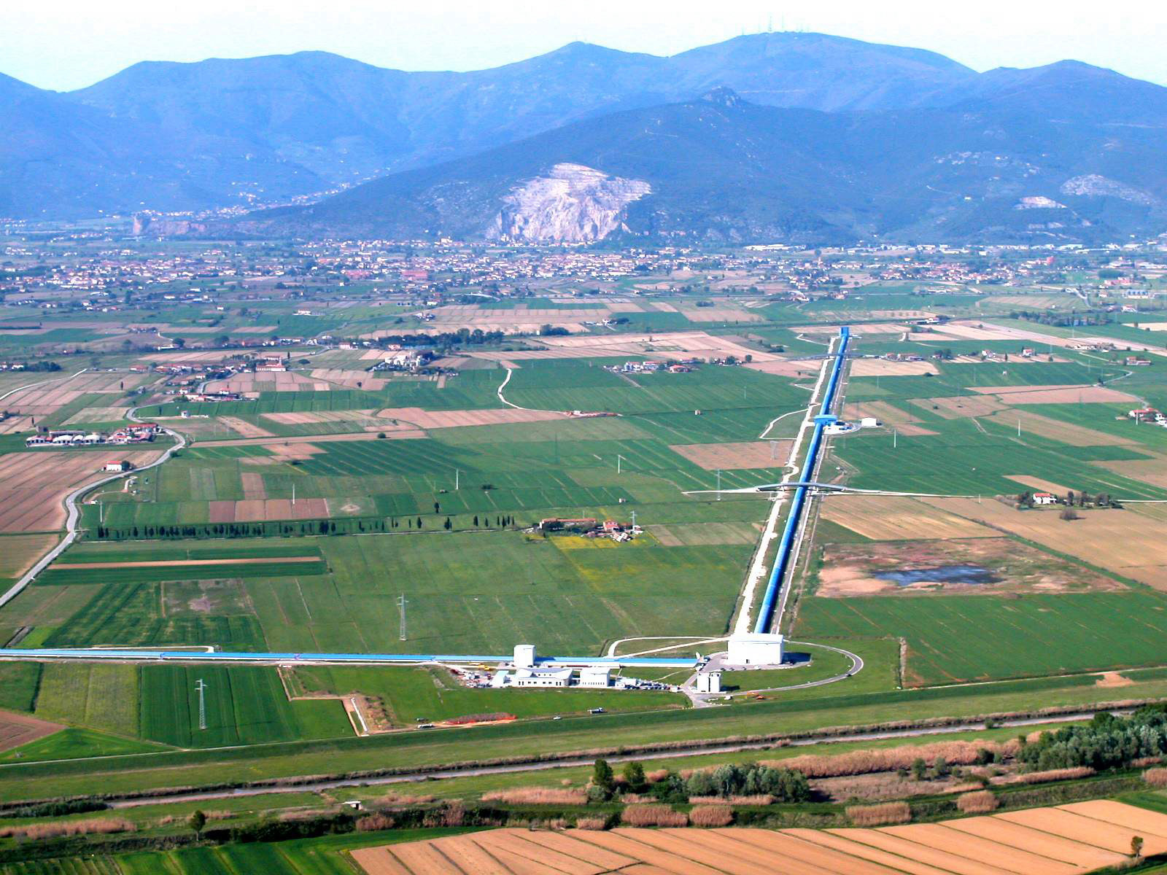
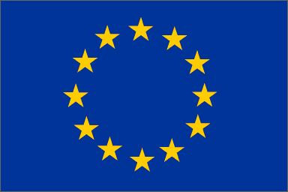





Welcome to the site of Advanced Virgo
Virgo is a the gravitational wave detector built by 11 laboratories of CNRS and INFN, which invested ~ 75 M€. It started to operate in 2003.
The Virgo collaboration is grown: at present it includes ~ 250 physicists and engineers from laboratories from France, Italy, Hungary, Nederland, Poland.
Virgo was in operation up to 2011, when we started the detector de-commissioning and the construction of Advanced Virgo

Slide 3

Advanced Virgo is hosted @
EGO director
professor Federico Ferrini
EGO is the French - Italian consortium, created in 2000 and started to operate in 2002 with the mandate to ensure
  To ensure the maintenance of the site and the related infrastructures and the long term scientific exploitation of the Virgo GW detector;
  To carry out any other research in the field of gravitation of common interest to the Members;
  To promote co-operation in the field of the experimental gravitational waves research in Europe;
  To promote R&D useful for the detection of gravitational waves.
The EGO personal is composed by are ~ 40 staffs, which are physicists, engineers, technicians and administration personnel

Slide 4
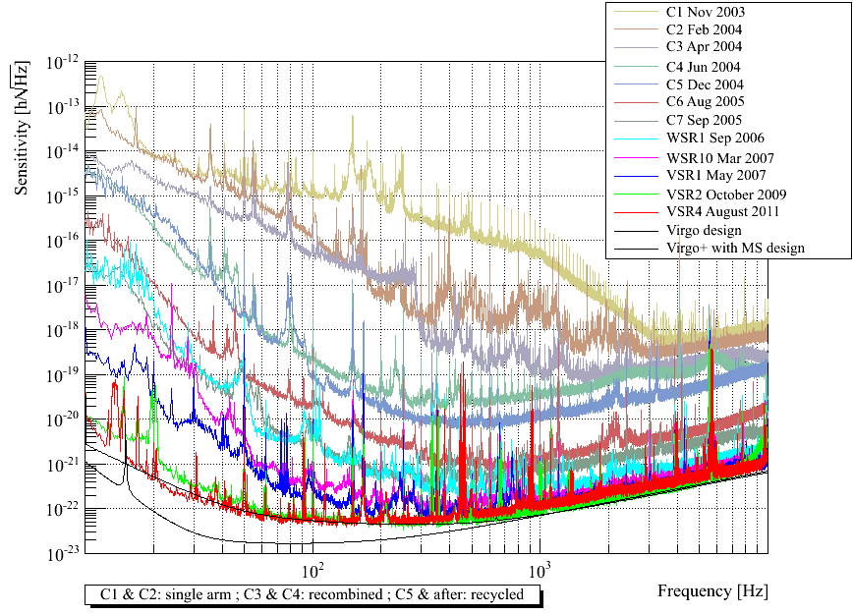
VIRGO Sensitivity improvements
The noise has been mostly understood
The 1st generation design sensitivities have been approached
closely (and somewhere exceeded upon detector upgrades)
Excellent duty cycle (~80%): reliable instruments!

Slide 5
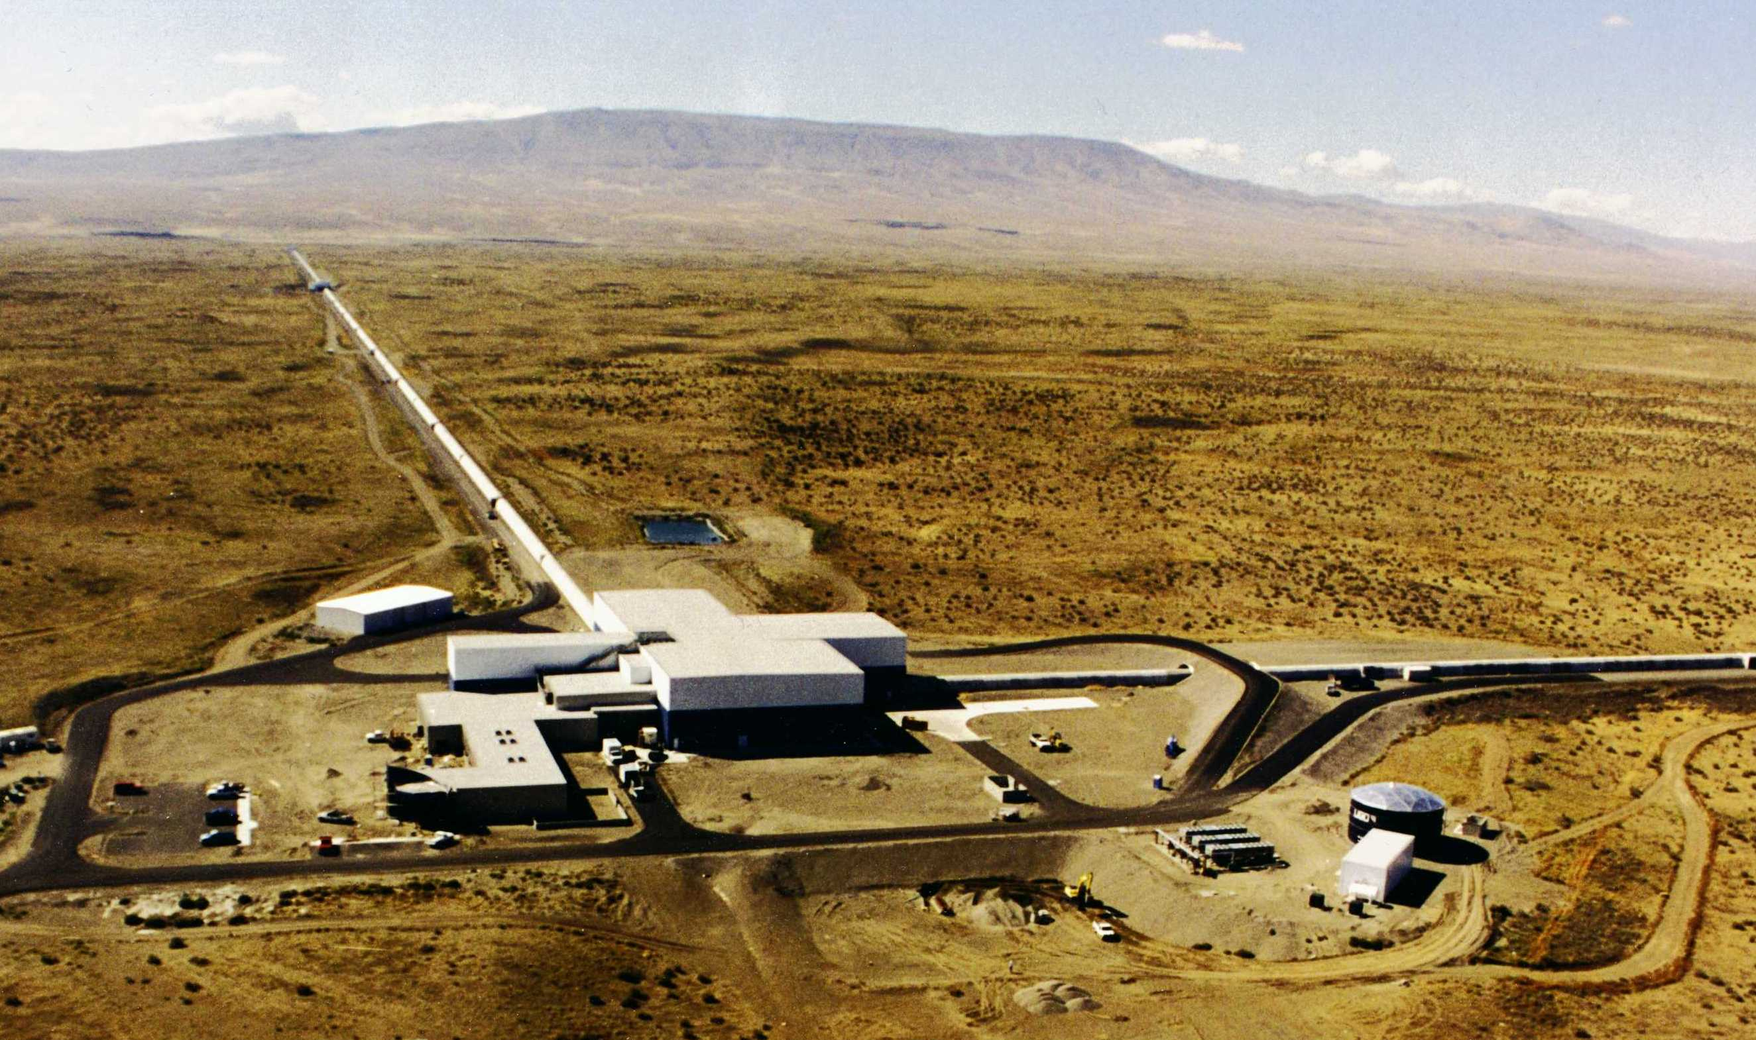

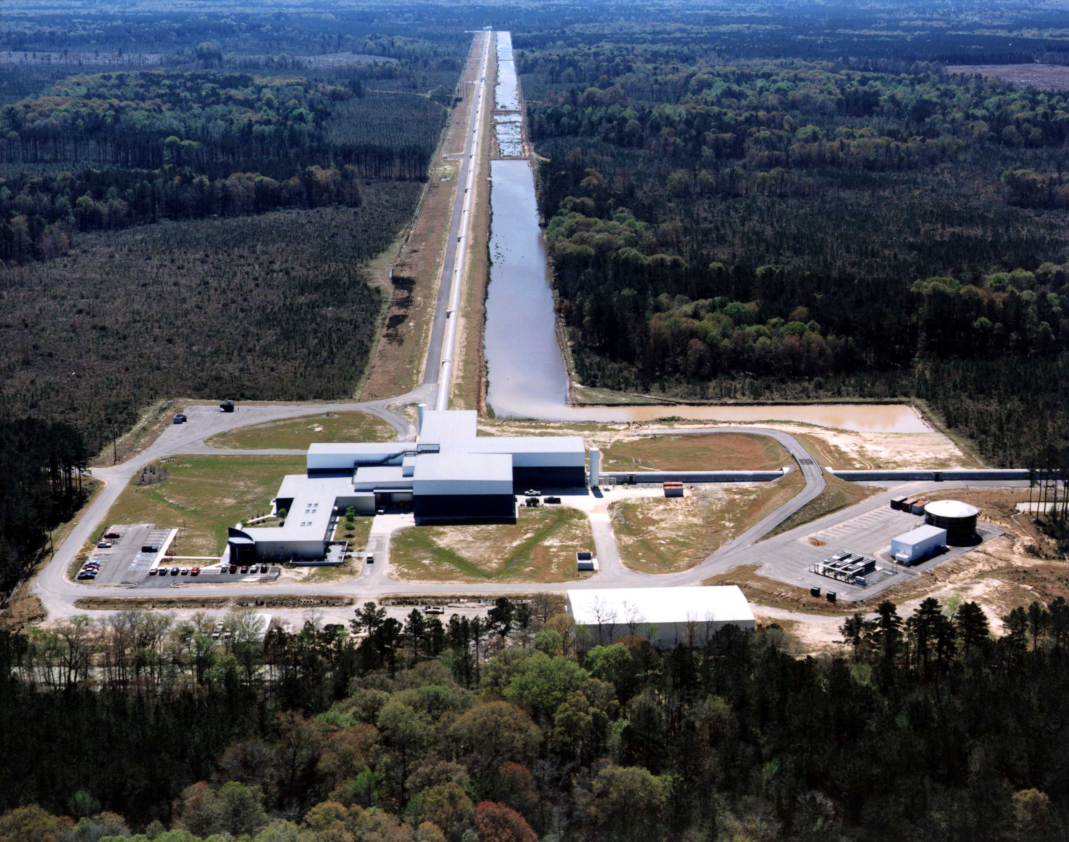
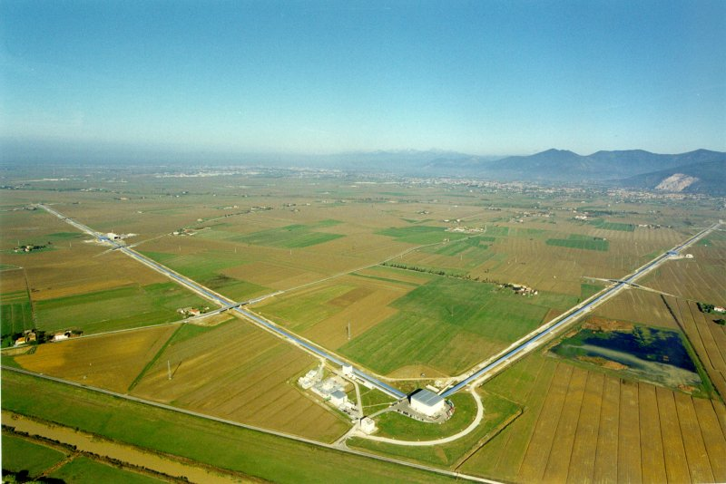
Advanced Virgo and Advanced LIGO will operate as a network
LIGO – Livingston, LA
LIGO – Hanford, WA
LH<--->V 27 ms
LH<-->LL 10 ms
LIGO – Livingstone, Lu
VIRGO, Cascina, Italy

Slide 6

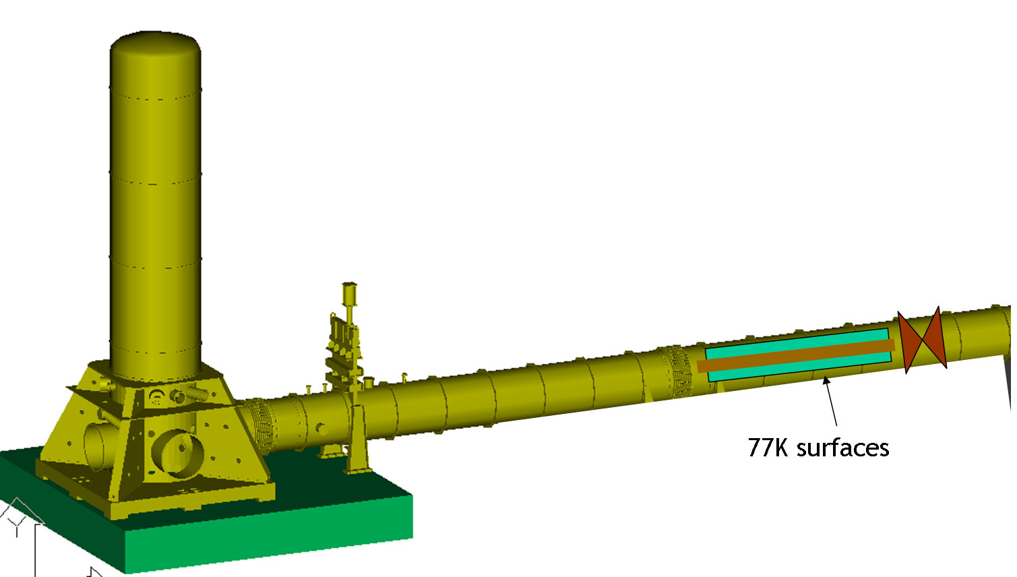
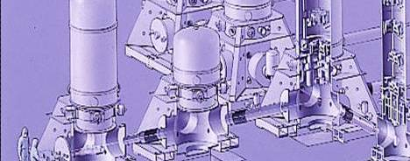
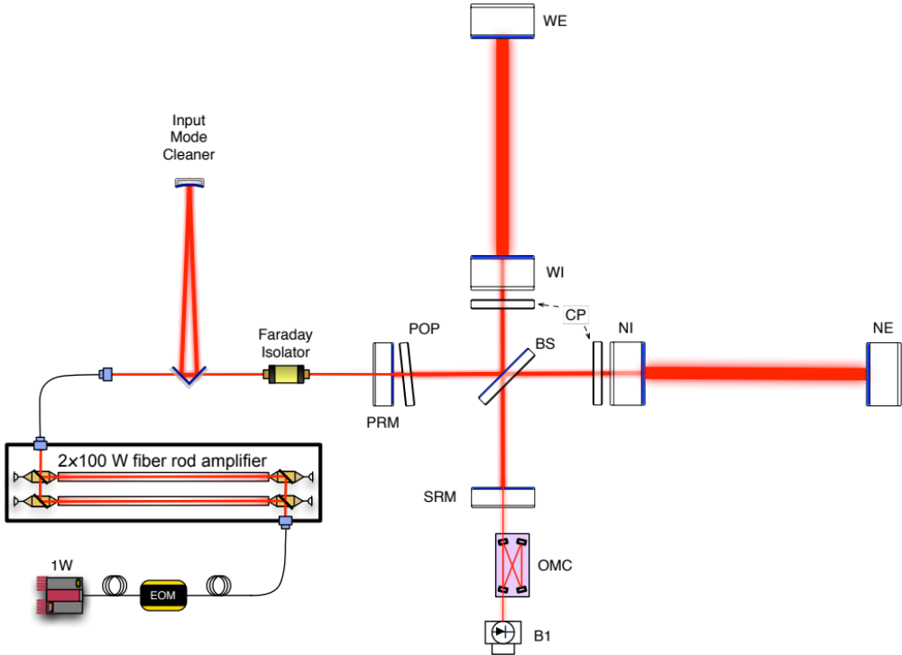
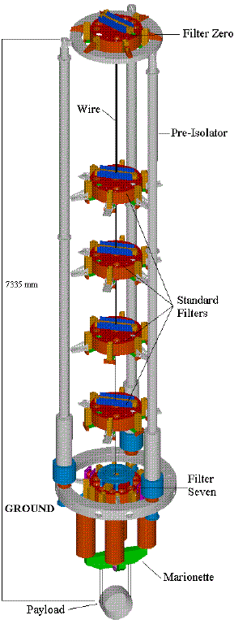
Ad Virgo in a nutshell
Large cryotraps
Larger central vacuum links
heavier mirrors
(42 kg)
high finesse
(≈1000)
new IP
tilt control
larger beam waist
signal recycling
new payload
fused silica
suspensions
high power SSL
(200 W)
DC detection

Slide 7
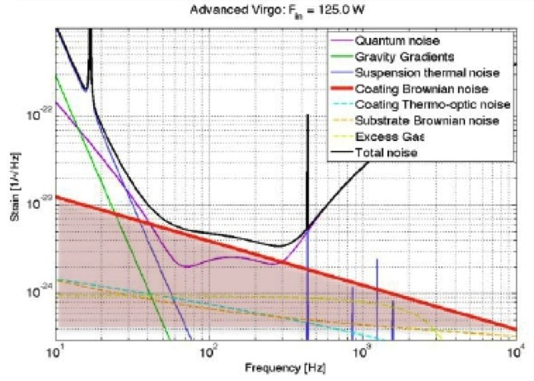
The AdV challenges
Mirror coating thermal noise is the dominating noise in the middle
frequency range (dissipation dominated by the high refractive index layer) ➔Doping Ta₂O₅ with Ti has improved it
Advanced Virgo make use of large light beams (~5cm) on the test masses ➔ Increase the size of the vacuum links/valves, BS diameter…
Higher degeneracy of the optical cavity e. m. modes requires proper management of aberrations ➔ Ultra High Optics quality and highly sophisticated active aberrations control
–

Slide 8
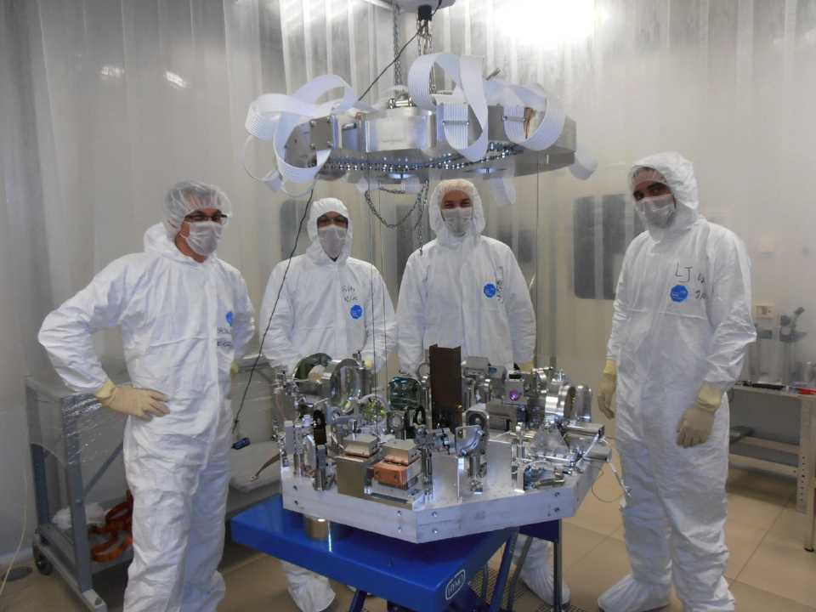
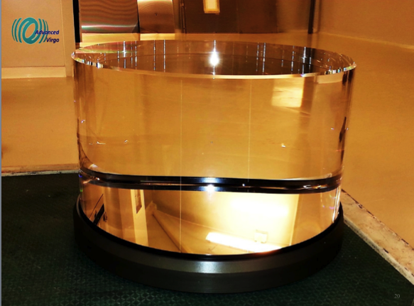
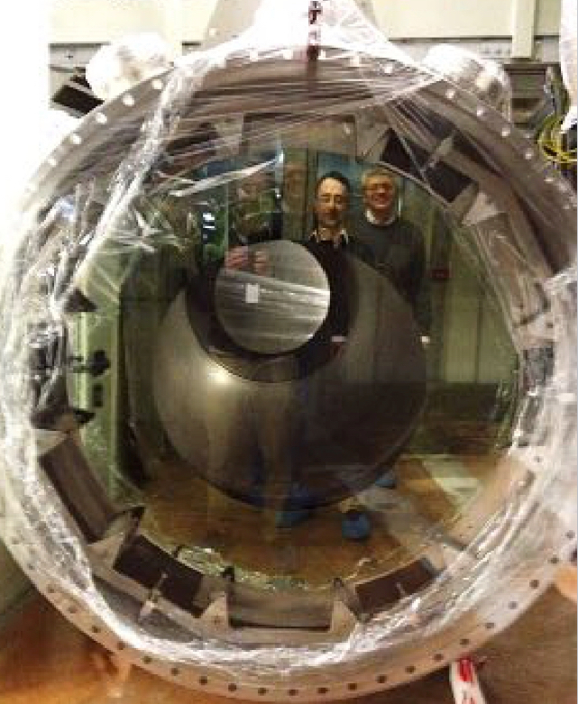
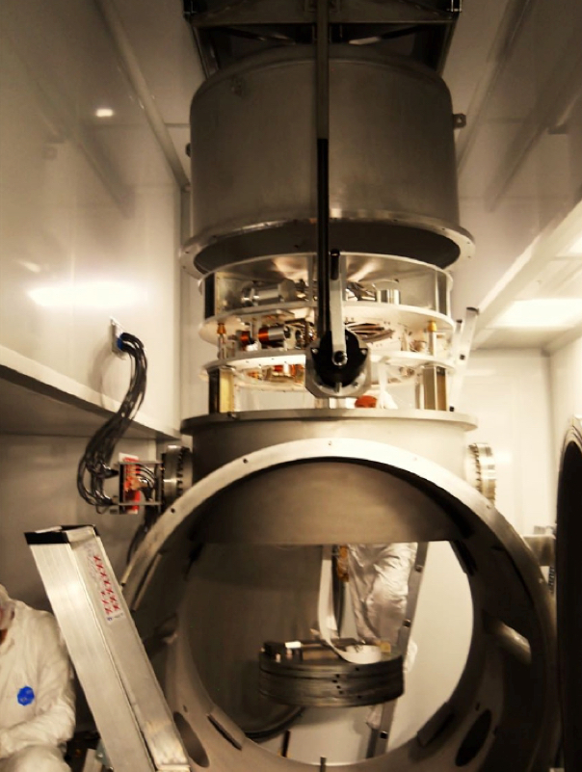
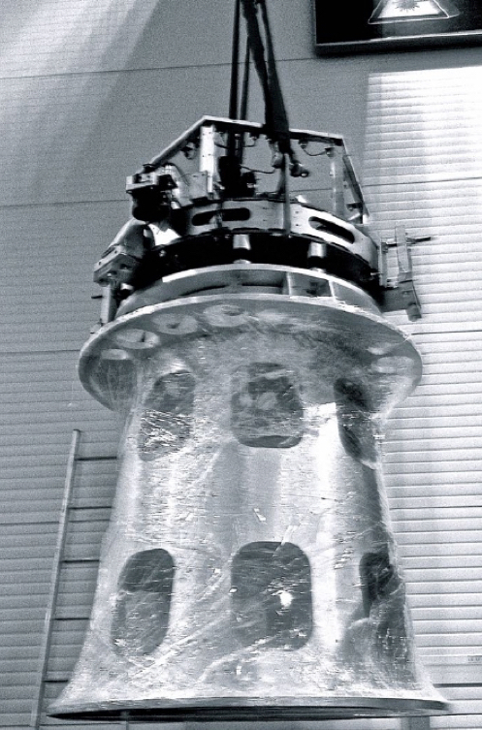
Detection bench n.1 before the installation
Input mirror
Baffles in the vacuum links for stray light control
Auxiliary vacuum chamber hosting the MSAS susp. of the detection bench n.2
Last filter of the West Input super attenuator of the seismic noise

Slide 9
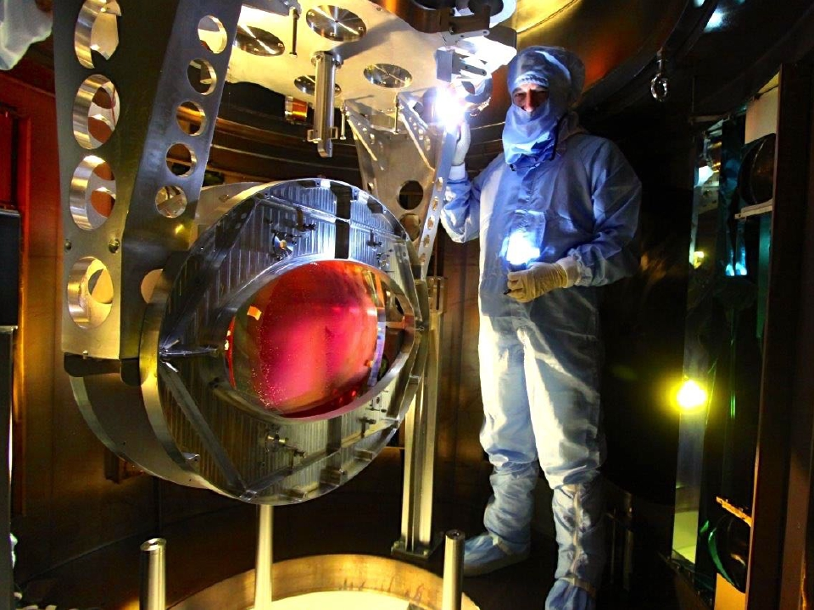
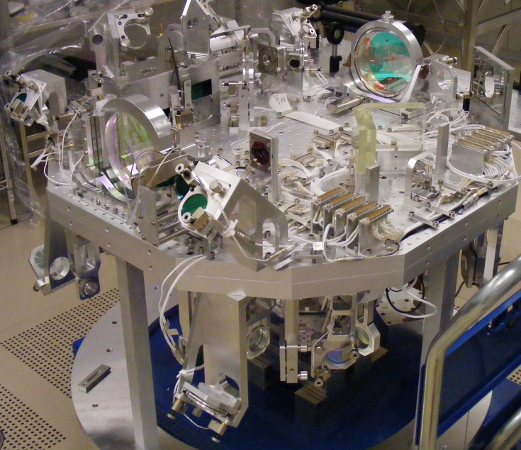
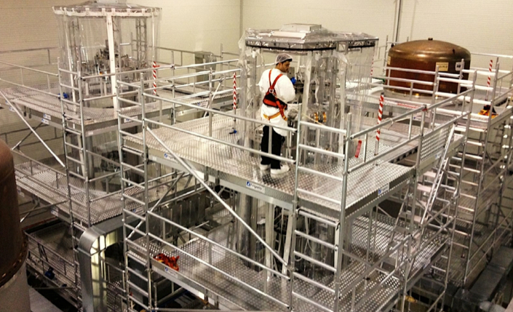
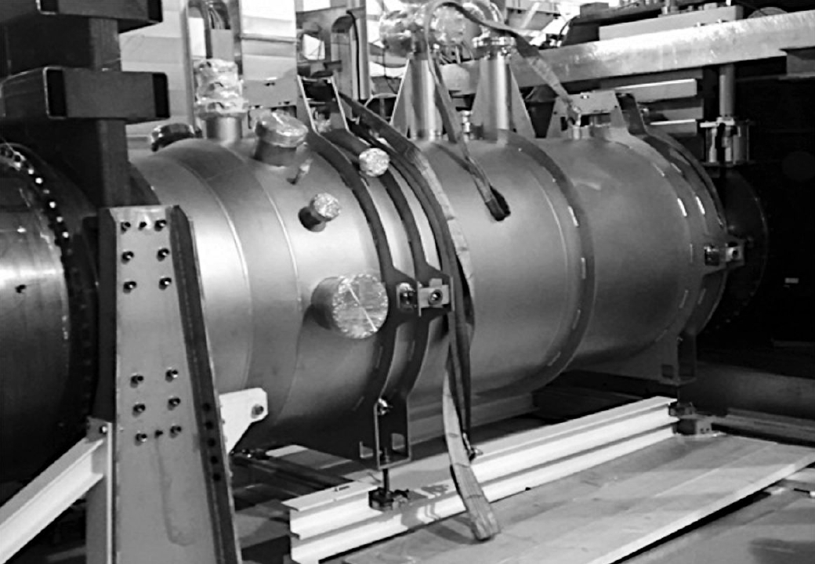
Beam splitter payload
Suspended Input benches
Seismic super attenuator
Cryotraps

Slide 10
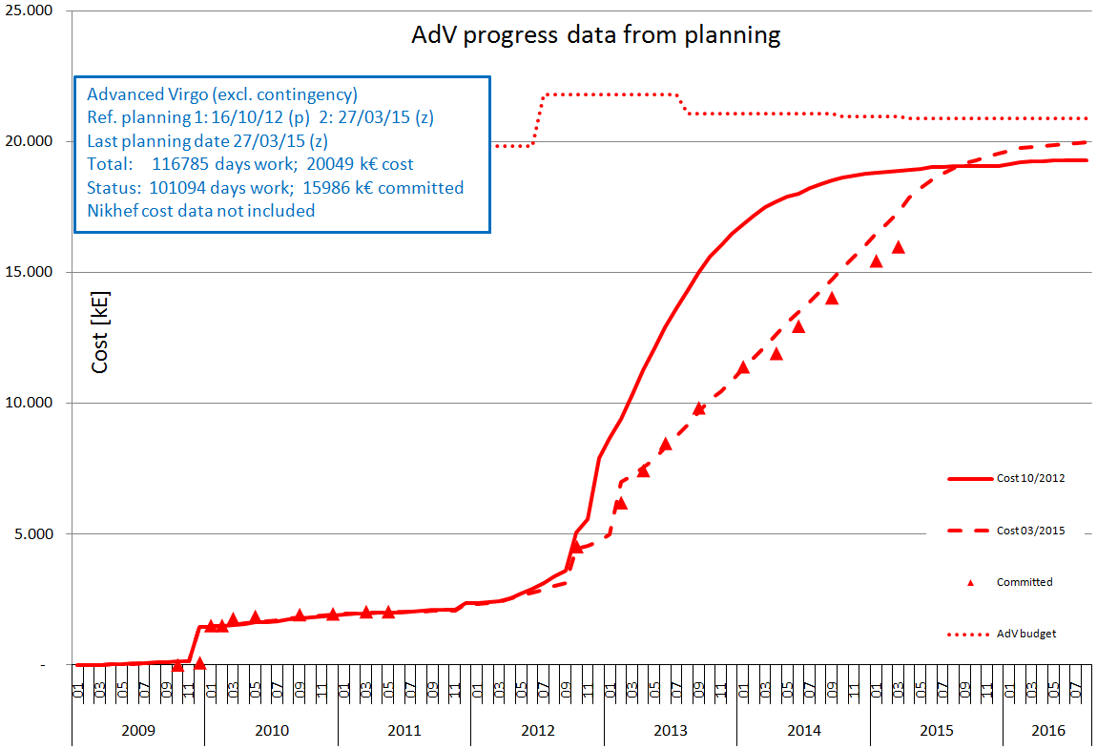
AdV Cost: commitments
750 kE
100 kE
50 kE
Doesn’t include future contingency
and the in-kind contribution of
the NIKHEF lab
(2 M€ from Nederland)

Slide 11
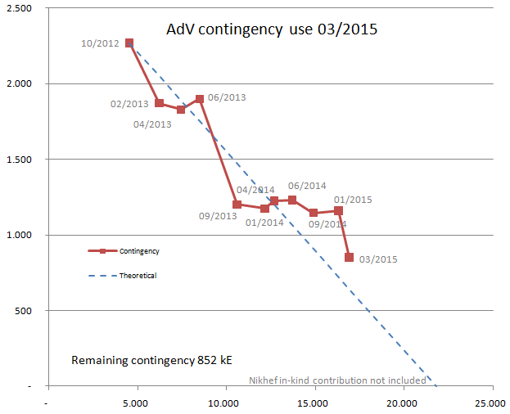
AdV project Contingency
750 kE -> fellowships
100 kE -> fellowships
PAY, SLC cost increase
50 kE -> fellowships

Slide 12
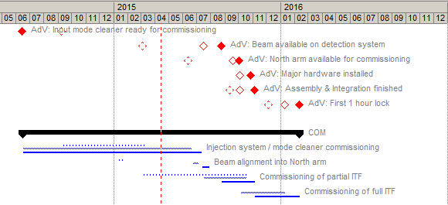
Main project milestones
03 / 2015
01 / 2015
10 / 2012

Slide 13

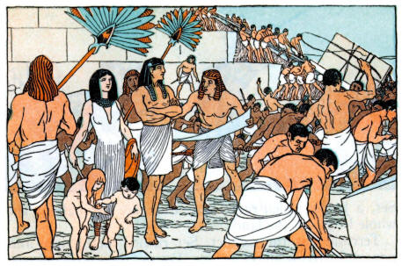

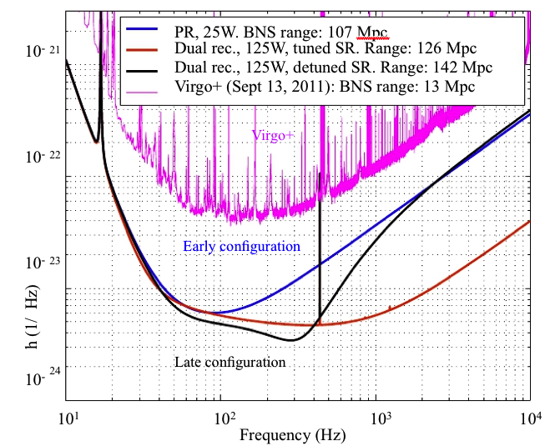
AdV conclusions
We are in the middle of the integration phase
80% of project cost committed so far
End of assembly & integration: fall 2015
Our commitment: join LIGO in O2, the 2016 science run!
54

