Slide 1

Sensitivity curve document
Michele Punturo
INFN Perugia

Slide 2
Status pre-TDR
The AdV sensitivity computation based on
  GWINC (matlab package developed by LIGO)
  Only “fundamental” noises
  No residual seismic noise computation (in the AdV implementation)
  LIGO Seismic noise model
  Other noises partially customized to the AdV design, but specifications still not frozen by the TDR

Slide 3

Activities & Current Status
Giovanni asked to me review the code and to assure its compliance with the AdV design (request made official by the VSC)
The logic of the action has been
  To document in detail the models and the parameters used to reproduce the AdV expected sensitivity (fundamental noises)
  To assure the compliance of these models and parameters to the TDR
  To introduce the “technical noises” to avoid, in future, the dualism sensitivity curve – noise budged we suffered in Virgo/V+

Slide 4
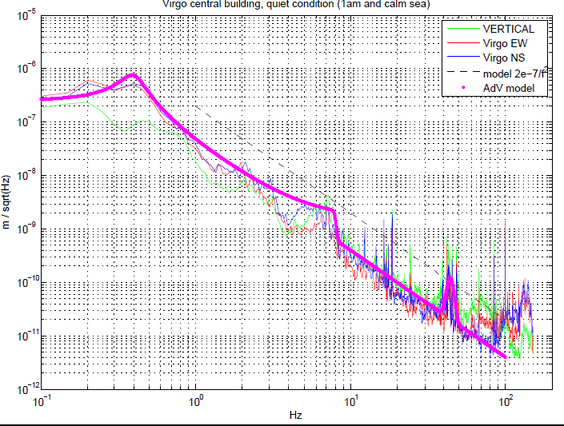
Novelties: Seism
New seismic noise model based on the seismic measurements made by I. Fiori
Possibility to mimic quiet seismic conditions

Slide 5
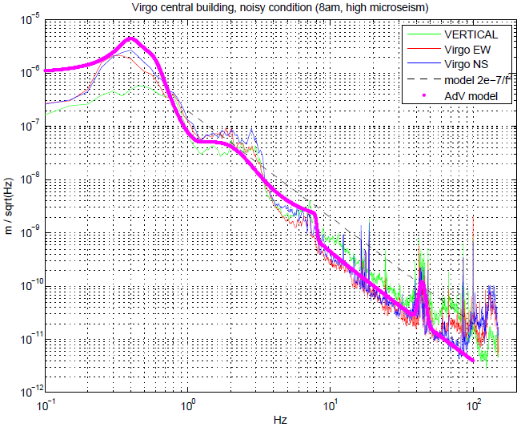
Novelties: Seism
New seismic noise model based on the seismic measurements made by I. Fiori
Possibility to mimic quiet seismic conditions
Possibility to mimic noisy seismic conditions

Slide 6
Novelties: SA filtering
SA modeling made through Octopus by P. Ruggi
Since a final design of the AdV payload is missing, SA filtering has been modeled with a V+ design (with AdV mirror masses)
A vertical-to-horizontal coupling ~ 10⁻³ has been imposed

Slide 7
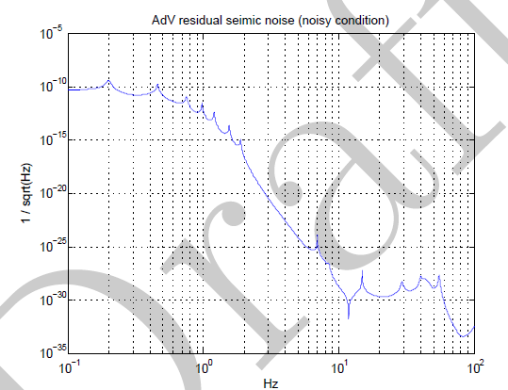
Novelties: SA filtering
SA modeling made through Octopus by P. Ruggi
Since a final design of the AdV payload is missing, SA filtering has been modeled with a V+ design (with AdV mirror masses)
A vertical-to-horizontal coupling ~ 10⁻³ has been imposed

Slide 8
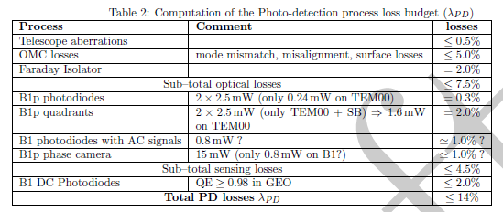
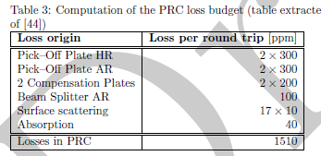
Quantum noise
Pre-existing Bonanno-Chen model untouched but great detail in the description of the optical losses, thanks to the TDR activities

Slide 9
Document and Code
The AdV sensitivity document is available on the TDS: VIR-0073B-12
  https://tds.ego-gw.it/ql/?c=8877
The AdV LaTeX and Matlab (GWINC) codes are available on the SVN repository:
  https://pub5.ego-gw.it/svn/AdvVirgo/AdVsens/GWINC_AdV/
LaTeX and Matlab codes are interconnected!

