Slide 1
Gravitational-Wave Interferometric Detectors
Antonino Chiummo – EGO
Bologna, March 10th, 2016
Email: antonino.chiummo@ego-gw.it

Slide 2
Present frame of GW detecors:
LIGO: two 4km-arm interferometers, online after a 5-years long stop for upgrading to 2nd generation (http://www.ligo.org/)
EGO-Virgo: one 3km-arm interferometer, stop operations in late 2011, planned to be back online during 2016 after upgrading to 2nd generation (http://public.virgo-gw.eu/language/en/)
KAGRA: one 3km-arm interferometer, in construction (http://gwcenter.icrr.u-tokyo.ac.jp/en/)
Indigo: one 4km-arm interferometer, approved, will use LIGO hardware (http://gw-indigo.org/tiki-index.php?page=LIGO-India)

Slide 3
Warning
This will be a “Virgo-centric” talk, but only because Virgo is the machine I know better
Virgo and LIGO technologies are very similar in principle, they only differ somewhat in implementations
Virgo and LIGO collaborations share data and information since 2004

Slide 4
Outline
14 Sep 2015: a new Era in Astronomy!
The challenge
A century-old ruler: Michelson interferometer
Meet the villain: Noise!
[Spoiler] We did it!

Slide 5
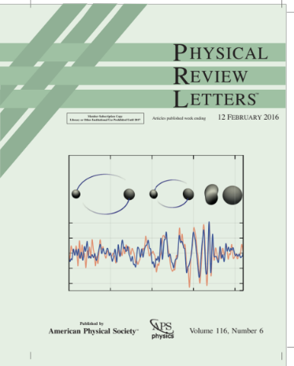
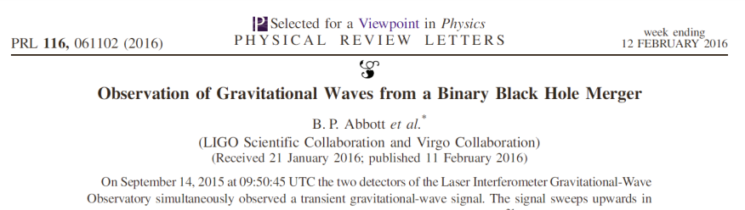
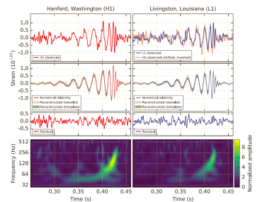
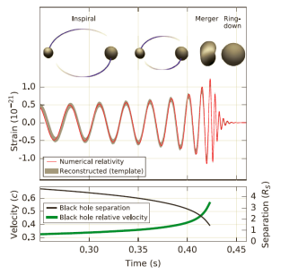
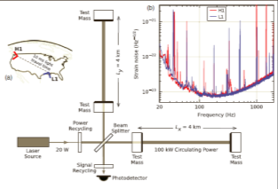
New Era in Astronomy!
14 Sep 2015: First detection of Gravitational Waves!
229,000 paper downloads from APS in the first 24 hours, servers down!
Phys. Rev. Lett. 116, 061102 (2016)
Signal detected by aLIGO interferometers

Slide 6
New Era in Astronomy!
Much ado, about what?
Let’s go back in time 100 years ago...

Slide 7
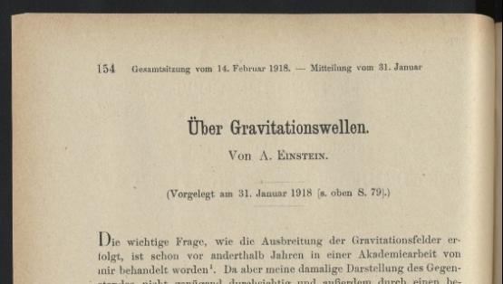
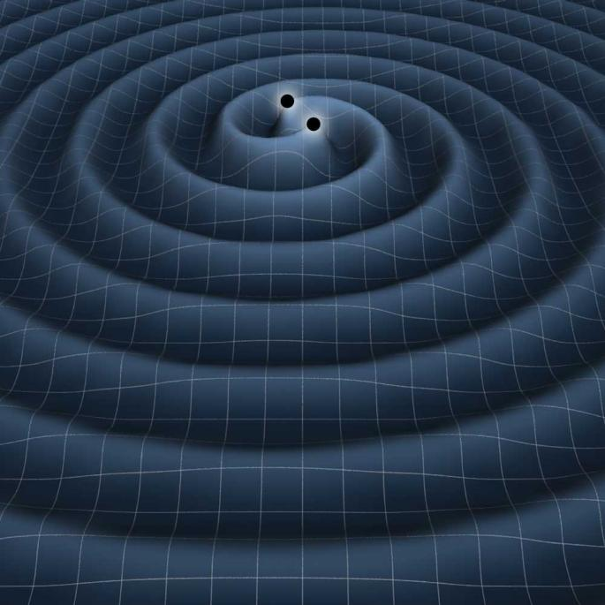
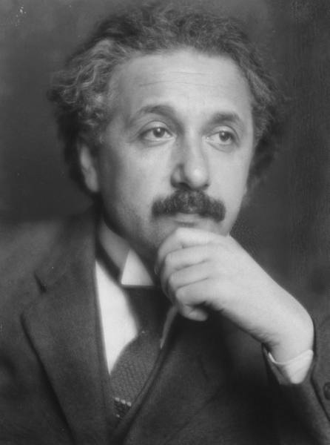
Gravitational Waves
... when Einstein firstly predicted the gravitational waves
Tiny interaction with matter:
Extremely difficult to detect
Ideal messengers from remote space-time regions
Can bring a whole new view of the Universe
What are GWs?
a consequence of General Relativity
ripples in space-time due to cosmic cataclisms
quadrupolar distortions of distances between freely falling masses

Slide 8
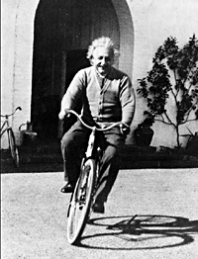
Gravitational Waves (digression)
... when Einstein firstly predicted the gravitational waves
And then changed his mind
And then again...
1916 – First paper about GW (with mistake)
1918 – First paper about GW with quadrupole formula
1937a – Doubt about GW existence, fought with Physical Review
1937b - Eventually got convinced, exact solutions for GW
Bottom line: if it took 20 years for Einstein...
You are not the only one to get confused by GWs!

Slide 9
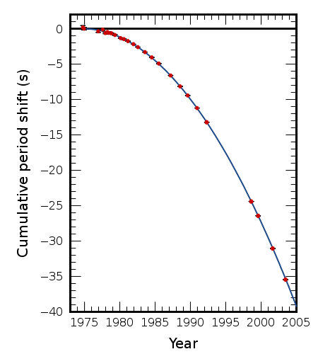
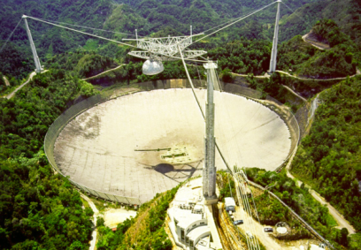
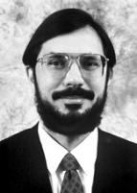
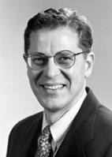
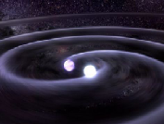
How did we know GWs exist?
Indeed...
Binary Pulsar 1913+16
GR prediction
The Nobel Prize in Physics 1993
Russell A. Hulse, Joseph H. Taylor Jr.
Ok, but how to directly detect it?
J. M. Weisberg, J. H. Taylor,
http://arxiv.org/abs/astro-ph/0407149

Slide 10
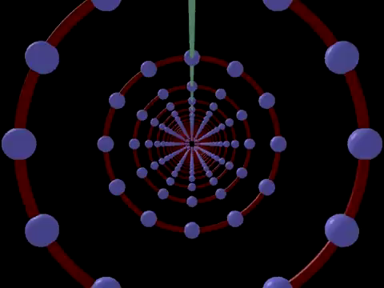
Gravitational Waves
Effect of GWs:
Squeeze and stretch the space in perpendicular directions:
strain h = ΔL/L
What is the plausible “strain”?
Even for the most tremendous events in Universe, h~10^-21

Slide 11
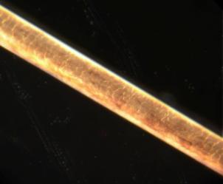
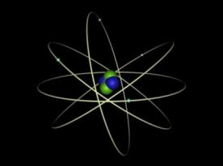
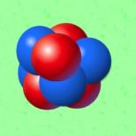
The challenge
With h = ΔL/L ~10^-21,
even with test masses L~km far apart,
displacement is ΔL~10^-18m
Reminder:
Diameter of human hair: 10^-5 m
Diameter of atom: 10^-10 m
Diameter of atomic nucleus: 10^-14 m
Diameter of proton: 10^-15 m
ΔL~10^-18m looks rather small

Slide 12
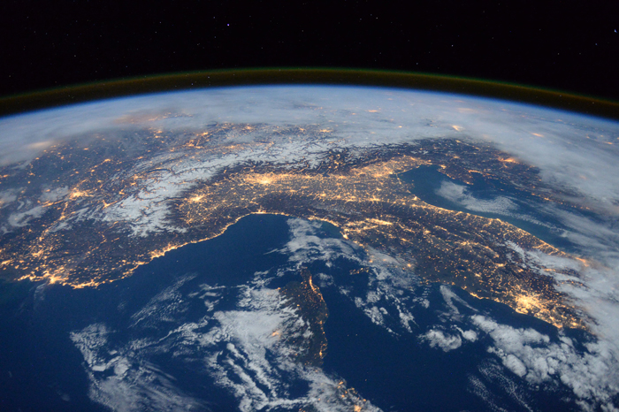
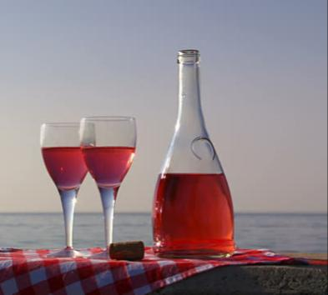
How small is “small”?
Let’s suppose you pour a glass of wine into the ocean.
What is the rise of sea-level you get?

Slide 13

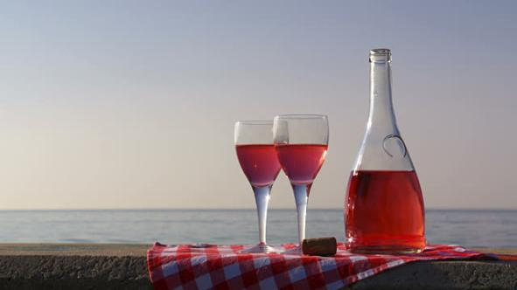
How small is “small”?
Ocean surface:
70% x 4pi x R_earth^2 =
0.7 x 4 x 3.14 x (6.37e6 m)^2
~ 3.6e14m^2
Glass volume:
~ 0.25e-3 m^3
Ocean rise:
delta_h~ V_glass/Ocean surface
~ 1e-18m
This is the kind of displacement we need to detect

Slide 14
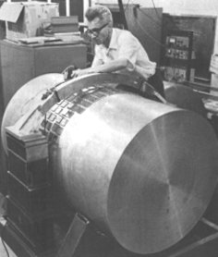
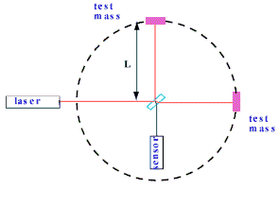
We need a (good) ruler
How to detect strain?
Joseph Weber c. 1965
Michelson interferometer
measure oscillations in mechanical resonators
measure distances between free masses
J. Weber
Phys. Rev. Lett. 18, 498

Slide 15
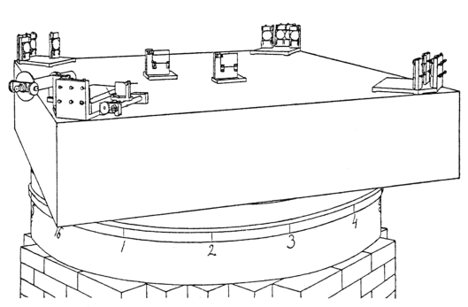
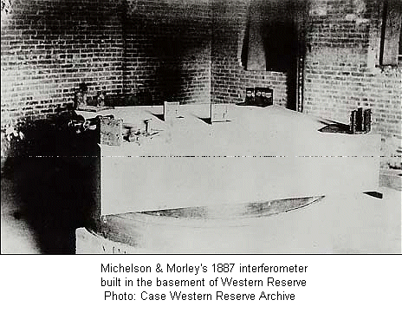
A century-old ruler
How to detect strain?
Michelson interferometer
ΔL = 0.01 λ ~10^-8m
measure distances between free masses

Slide 16
A century-old ruler
How does it work?
Michelson adjusted so that no light comes out from anti-symmetric port
GW stretches and squeezes the two arms alternatively
Wavefront takes longer to go back and forth in one of the arm than in the other
Interference at anti-symmetric port is no longer completely distructive, and light reachs the photodetector: a signal!

Slide 17
A century-old ruler
How does it work?
Credits: Marco Kraan - Nikhef

Slide 18
A century-old ruler, reloaded
How to improve sensitivity?
Very long arms
To get a larger displacement
Fabry-Perot cavity in each arm
To increase phase change
Recycle injected power
To increase input power
Recycle outgoing signal
To amplify the output

Slide 19
A century-old ruler, reloaded
How to improve sensitivity?
Credits: Marco Kraan - Nikhef

Slide 20
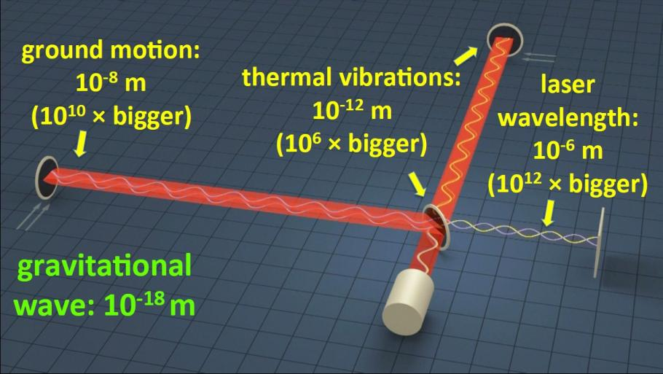
Meet the Villain: Noise!
Doesn’t matter how sensitive you are, if your noise is billions of times your signal
Credits: Stephen Fairhurst

Slide 21
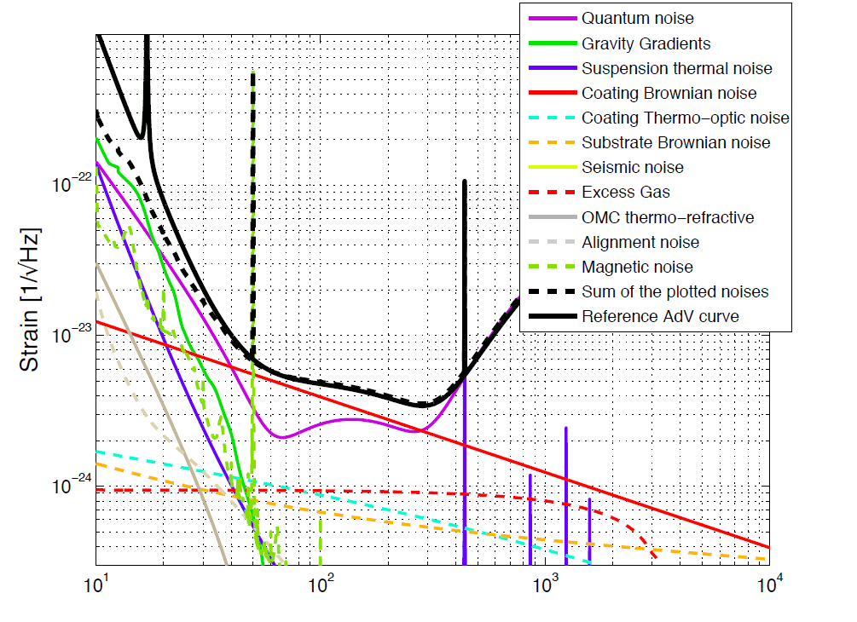
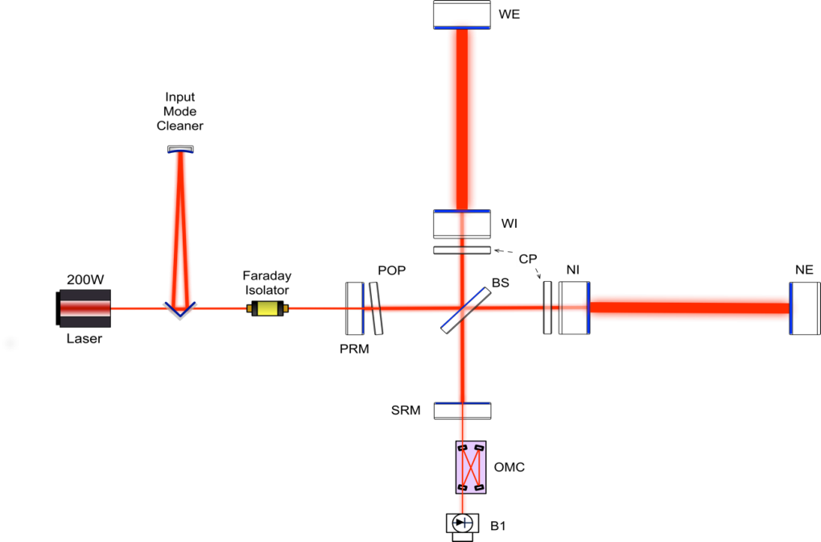
Meet the Villain: Noise!
Frequency (Hz)

Slide 22
GW Detectors - Noise
Thermal noise
(coating + suspension)
Radiation pressure fluctuation
Stray-light
Residual laser noise
Residual gas (phase noise)
Seismic vibration
Newtonian noise
EM field quantum noise

Slide 23
GW Detectors - Noise
Limiting noises at different frequency ranges:
Low-freq:
newtonian noise, seismic noise, residual technical noises
High-freq:
quantum shot-noise
Mid-freq:
thermal noise

Slide 24
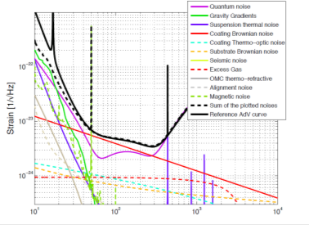
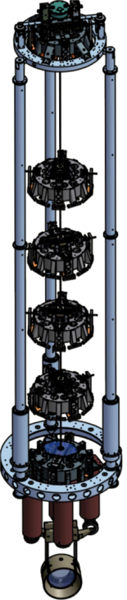
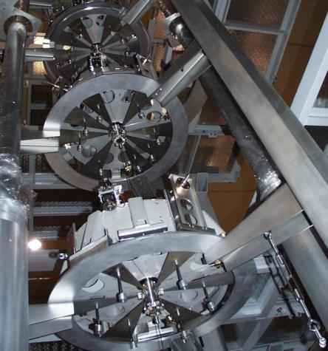
Coping with Noise
Low frequency range:
  Dominated by seismic noise
  Managed by suspending the mirrors from extreme vibration isolators (attenuation > 10^12)
  Technical noises of different nature are the real challenge in this range
  Ultimate limit for ground-based detectors:
  gravity gradient noise

Slide 25
Coping with Noise
Seismic noise
Credits: Marco Kraan - Nikhef

Slide 26
Coping with Noise
Gas pressure noise: UHV environment with pressure ~10^-9mbar
Credits: Marco Kraan - Nikhef

Slide 27
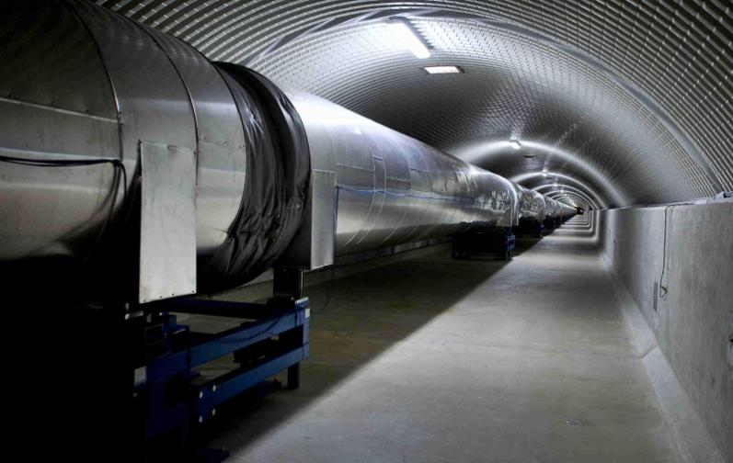
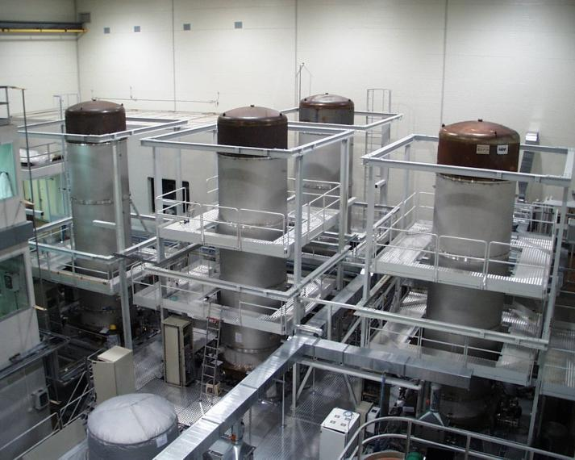
Coping with Noise
Gas pressure noise: UHV environment with pressure ~10^-9mbar

Slide 28
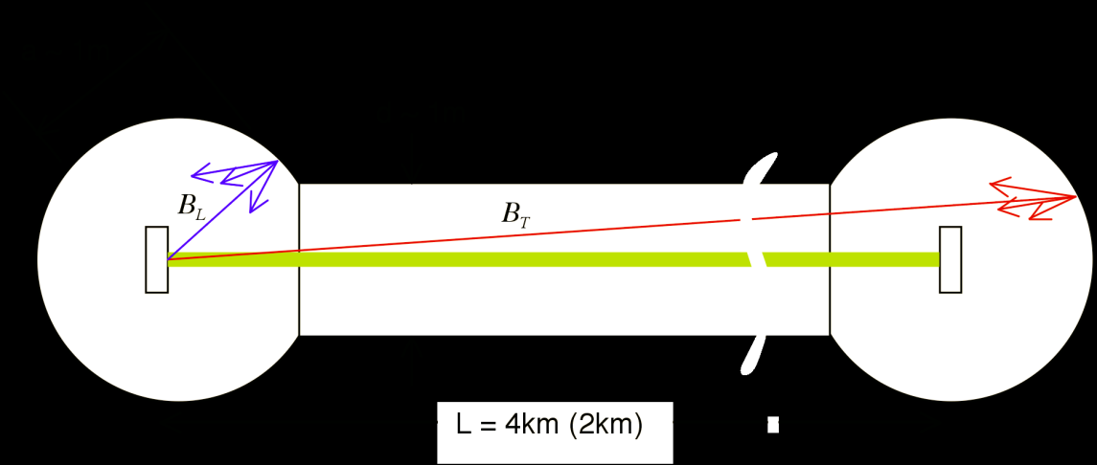
Coping with Noise
Stray-light mitigation:
  Learned form 1st generation: back-scattered light is one of the major risks towards the final sensitivity goal
  Light scattered off suspended mirror can probe vibrations of ground-connected mechanical structures and then recombine with main beam: this would bury any GW signal!
Less than 5 photons per second allowed to recombine after scattering

Slide 29
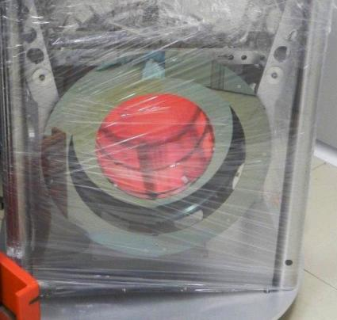
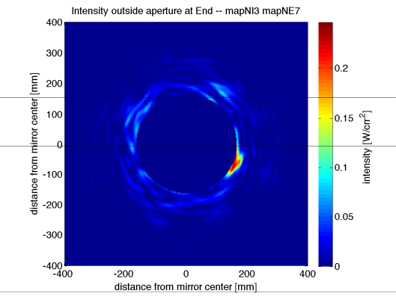
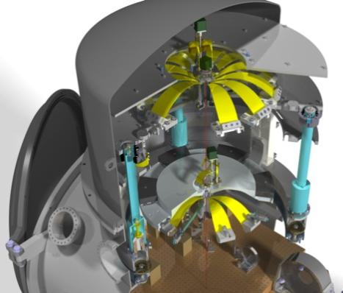
Coping with Noise
Stray-light mitigation:
  Learned form 1st generation: scattered light is one of the major risks towards the final sensitivity goal
  Large investment to mitigate it:
    Better optics quality
    Baffles to shield mirrors, pipes, vacuum chambers exposed to scattered light
    Photodiodes suspended in vacuum to isolate them from acoustic/seismic noise
    If required, control the position of the benches wrt the interferometer
    Significant simulation effort

Slide 30
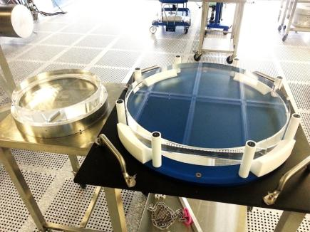
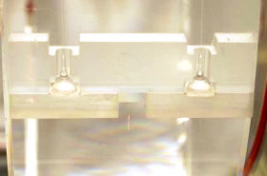
Coping with Noise
Mid frequency range:
  Dominated by thermal noise of mirror coatings and suspensions
Reduced by:
  Larger beam spot (sample larger mirror surface)
  Test masses suspended by fused silica fibers (low mechanical losses)
  Mirror coatings engineered for low losses

Slide 31
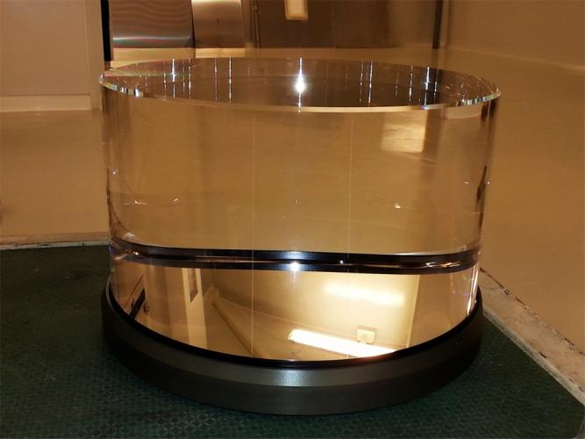

Mirrors
35cm
20cm
55cm
42Kg
Test mass mirror
Beam Splitter mirror

Slide 32
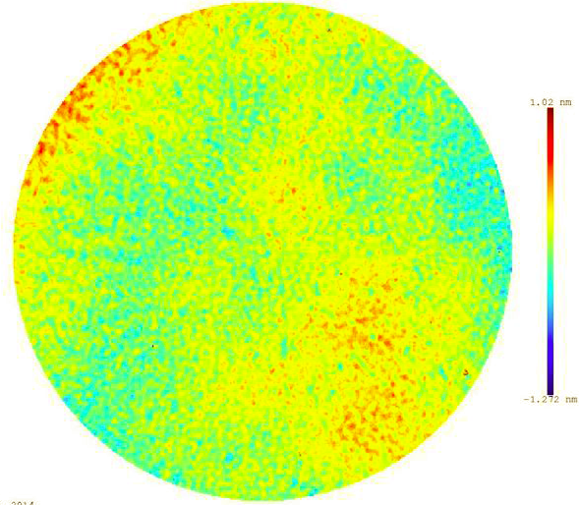

Mirrors
The surface figure of the polished test masses is such that with a mirror as large as Emilia-Romagna, highest mountains would be 1mm

Slide 33
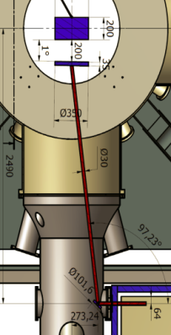
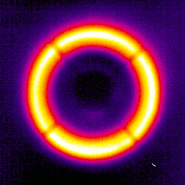
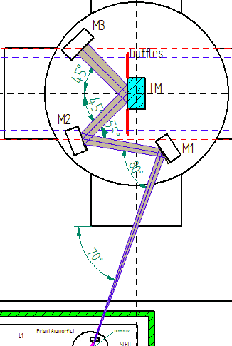
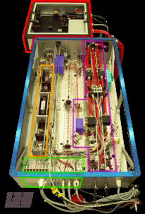
Coping with Noise
High frequency range:
  Dominated by laser shot noise.
  Improved by increasing the power:
  >100W input, ~1 MW in the cavities
Requires:
  New laser amplifiers (solid state, fiber)
  Heavy, low absorption optics (substrates, coatings)
  Sophisticated systems to correct for thermal aberrations

Slide 34
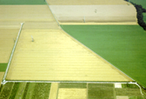
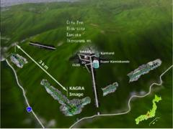
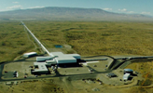
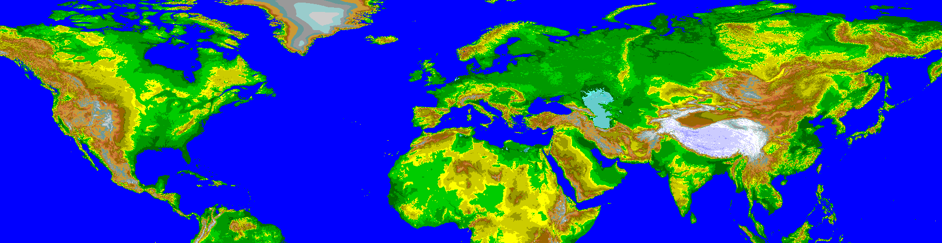
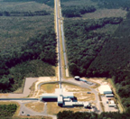


GW Detectors – The network
A world-wide effort...
aLIGO-WA
GEO-HF
KAGRA
Advanced
VIRGO - 2016
aLIGO-LA
aLIGO-India

Slide 35

GW Detectors – The network
A world-wide effort...
Identify GW source direction
Increase statistic reliability by coincident detection

Slide 36

GW Detectors - Strain
Comparison of actually measured residual strain noise
- H1, L1 are the two LIGO interferometer (upgraded to aLIGO)
- V1 is the Virgo interferometer before upgrading
- AdV: Advanced Virgo is the interferometer that will be online by the end of 2016
Credits: Daniel Hoak - aLIGO

Slide 37


Not the end of the story...
Despite all the efforts, signal still buried in noise.
How do you extract the signal from noise?
Elena Cuoco has got an answer for you...

Slide 38


Advanced Virgo
http://public.virgo-gw.eu/language/en/

Slide 39





Advanced Virgo
In a nutshell:
5 European countries
19 labs, ~200 authors
Advanced Virgo (AdV): upgrade of the Virgo interferometric detector of gravitational waves
Participated by scientists from Italy and France (former founders of Virgo), The Netherlands, Poland and Hungary
Funding approved in Dec 2009
First science data scheduled in 2016
APC Paris
ARTEMIS Nice
EGO Cascina
INFN Firenze-Urbino
INFN Genova
INFN Napoli
INFN Perugia
INFN Pisa
INFN Roma La Sapienza
INFN Roma Tor Vergata
INFN Trento-Padova
LAL Orsay – ESPCI Paris
LAPP Annecy
LKB Paris
LMA Lyon
NIKHEF Amsterdam
POLGRAW(Poland)
RADBOUD Uni. Nijmegen
RMKI Budapest
http://public.virgo-gw.eu/)

Slide 40



Thank you
The European Gravitational Observatory is a consortium of:

Slide 41



Extra-slides, effect of GW on interferometer
Taken from:
http://www.slac.stanford.edu/cgi-wrap/getdoc/ssi98-005.pdf

Slide 42


Extra-slides, effect of GW on interferometer

Slide 43
Extra-slide, further reading
Paper on the detection: LSC and VIRGO -Observation of Gravitational Waves from a Binary Black Hole Merger Phys. Rev. Lett. 116, 061102 (2016) - http://journals.aps.org/prl/abstract/10.1103/PhysRevLett.116.061102
Companion papers: https://www.ligo.caltech.edu/page/detection-companion-papers
Open data: https://losc.ligo.org/events/GW150914/
On GW detection with interferometer:P. Saulson http://www.slac.stanford.edu/cgi-wrap/getdoc/ssi98-005.pdf
On Advanced Virgo detector: The VIRGO collaboration - Advanced Virgo: a second-generation interferometric gravitational wave detector http://arxiv.org/pdf/1408.3978.pdf
On aLIGO detectors: LSC – Advanced LIGO http://iopscience.iop.org/article/10.1088/0264-9381/32/7/074001/meta
On close-future evolution of GW detectors:VIRGO, LSC - Prospects for Observing and Localizing Gravitational-Wave Transients with Advanced LIGO and Advanced Virgo http://relativity.livingreviews.org/Articles/lrr-2016-1/

