Slide 1
AdV VAC - Enlarged Links Status
Finalization of Input links and others
AdV Weekly meeting – 04 Apr 2013

Slide 2
SUMMARY
Links finalization
NI-BS link design - free discussion
Other parts to be frozen (separate order)
_ big tower flanges Ø 1000mm
_ flanges FP towers / tube

Slide 3
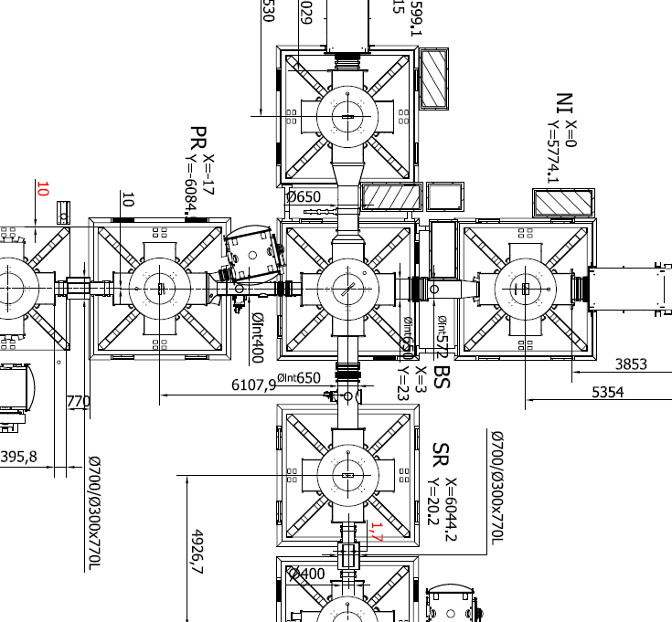
Enlarged Links Layout
optical confirmation by SLC in progress

Slide 4
INPUT-BS links to be finalized
Other links have been discussed , and can be considered ready for the RR review .
No changes have been done on SR-BS https://workarea.ego-gw.it/ego2/virgo/advanced-virgo/vac/technical-drawings/gr-7-bs-sr/03Apr2013_General_assembly_BS-SR.stp/
A few changes on PR-BS

Slide 5
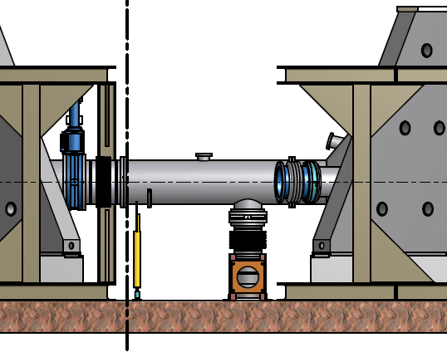
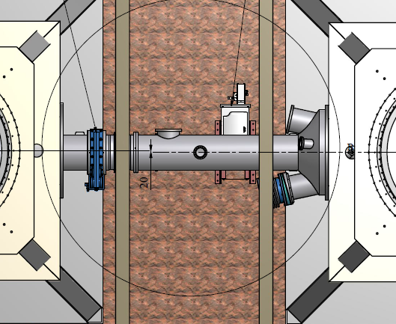
BS-PR
https://workarea.ego-gw.it/ego2/virgo/advanced-virgo/vac/technical-drawings/gr3-bs-pr/03Apr2013_General_assembly_BS-PR.stp/

Slide 6
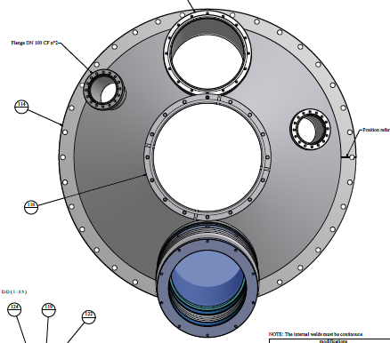
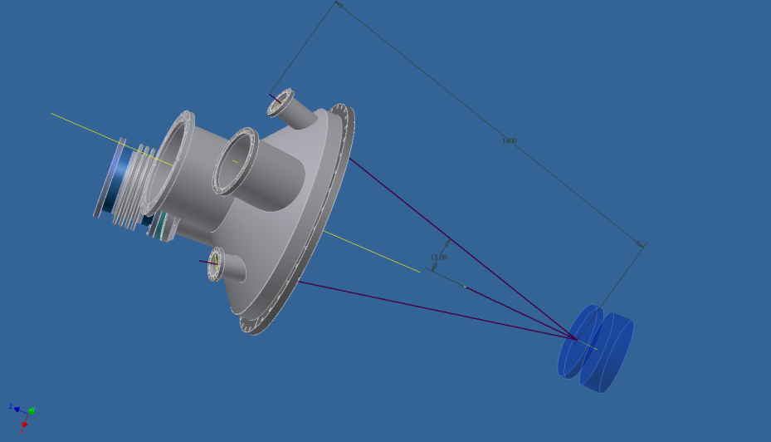
New additions on PR-BS link (PAY)
2 ports added on the POPR cone (requested by PAY)
https://workarea.ego-gw.it/ego2/virgo/advanced-virgo/vac/technical-drawings/gr3-bs-pr/Link_cone_side_PR_Gr.7.dwfx/at_download

Slide 7
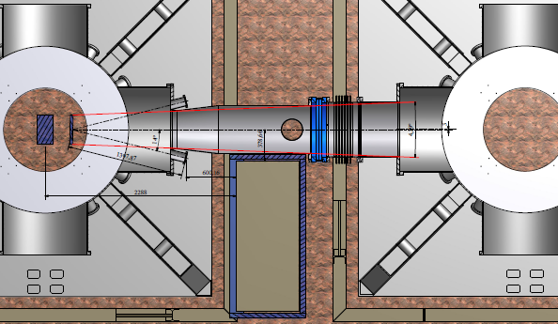
Input-BS link to be finalized
last version, to be further changed vs SLC/TCS needs

Slide 8
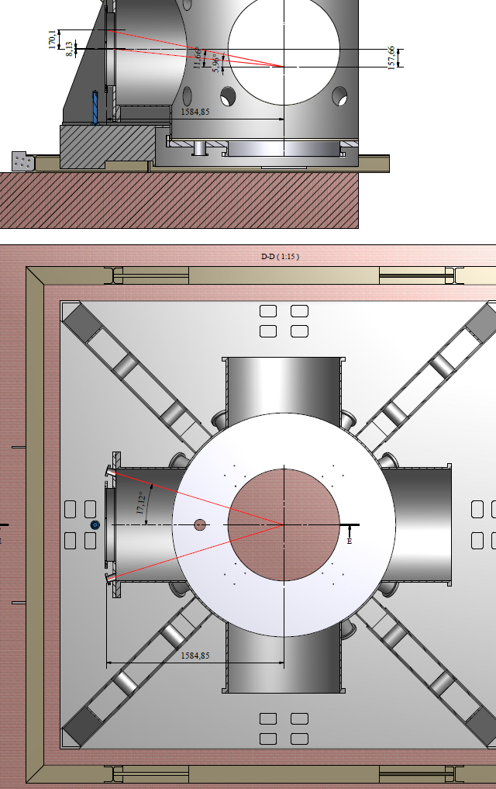
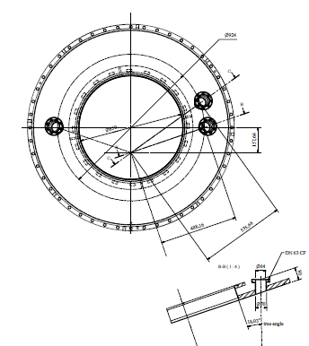
Small ports on Towers - Tube flange
Two ports , normally not used, same as for the tube-input ones
Can confirm it?

Slide 9
Small ports on BS/SR/PR flanges
proposal is to have the same two ports , normally not used, also for other towers
Can be confirmed?
These flanges are existing
These flanges are existing

Slide 10
1000mm flanges not link-related
MC: two flanges shall be replaced (W,N); existing.
INJ: one or two new flanges. The optical design is perhaps ready for the input one, plan for the other one?
FP towers: 4 new flanges needed for TCS TBC
When possible, new flanges shall be realized by modifying part of the 6 dismounted ones.
A single ‘procurement’ including the MC pipe modification sahll be done. Normally we need to order the works well before the summer to have the items in fall.

Slide 11
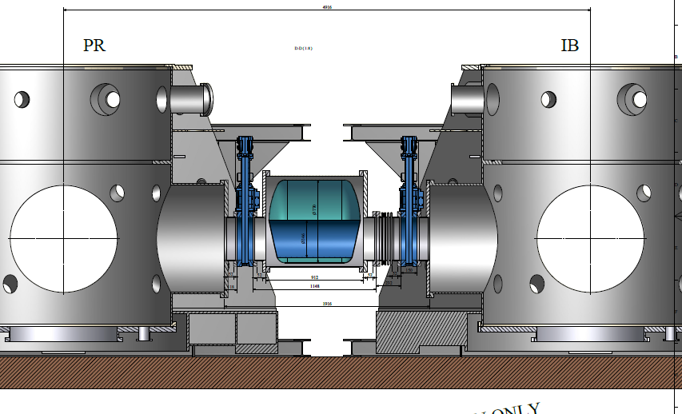
DT /IB cryotrap
Need to be discussed at one of the first DIM, to prepare the finalization

Slide 12
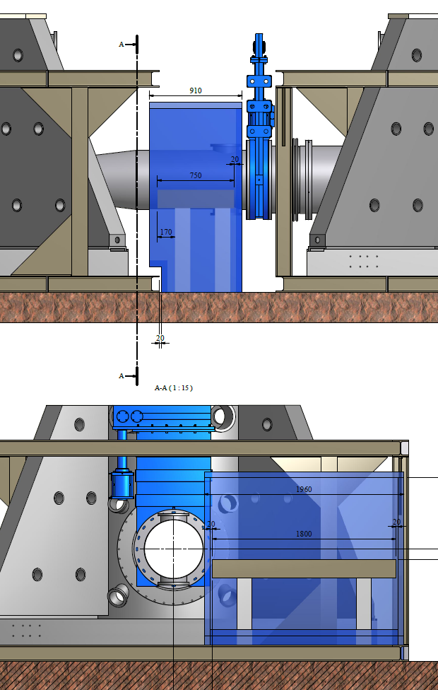

Slide 13
