Slide 1
VIR-0105A-15
Advanced Virgo dataDisplay
D. Verkindt
Detchar meeting 20th of March 2015

Slide 2
Basic requirements
Read frame formatted data offline and online, whatever their source
Input data types may be time series, camera images, spectra, DQ segments, triggers
Computation and plots refresh must be as fast as possible (optimize the code)
GUI based on a simple tool. GUI functionalities must be simple and intuitive
(optionally: fancy interface)
Provide channels combination and basic signal processing in addition to plots drawing
Provide the possibility to rerun from a saved configuration
Reliable online running, even when data are missing or corrupted

Slide 3
Many internal changes
Central engine (how to get data, how to pass them to plots) fully changed
No more frames reading, only data vectors (FrVect format)
Large cleanup of the code
Calls to Xforms APIs now regrouped into a single source code
Use of the Frv library to do most of the signal processing (thus FFTW)
Better management of plots list and channels list
Simplified management of reference plots
…

Slide 4
Use new libraries
Use ROOT library v5r34p050
Use Frame library v8r24
Use Xforms library v0r9999p2
Use Frv library v4r22p2 (thus FFTW v3r3p30)
Run under SL6 64 bits
Connects online via Cm to the FdIOServer processes that use Fd v8rXX

Slide 5
New features
Possibility to read several data files at the same time
Possibility to align plots in time (same time window, same refresh period)
All channels listed in a single browser
Use of anti-aliasing filter when resampling the data
Possibility to apply pass-band filter on data (only for TIME plot for now)
Slider available on the main panel to visit data along the X axis
Tools menu giving access to options, checks, debug, etc…
Keep waiting for new data when reading end of files
Green-washed and simplified user interface
Configuration saved in dy.cfg (new format)
Removed features
No more « Edit Clone » button
No more information about frame number
No more dump of the data
No more dd.car (and no possibility to read back old configuration files)

Slide 6
Old features kept but that you may have never used
Write on disk the input data read by the dataDisplay
Do a bi-coherence plot (coherence between signal 1 at freq1 and signal2 at freq2)
Do time plot showing the bits of values of a signal
Do 2D distribution plot with N samplings shift between the two signals
Change color scale of the 2D or time-frequency plots
Do the difference between a camera image and a reference one
Use any ANSI C mathematical function in the « Channels Operation string »
Buttons « Copy » and « Transform » for plots
Planned new features
Compute brms and pass-band filtered signals
Define a trigger condition (based on channels or on DQ segments)
Read FrEvents (MBTA) or ROOT files (Omicron)
And do plots also on events (for instance glitchgrams)
Take input data also from formatted ascii files
Superpose to data the periods when Science_Mode flag (or any DQ flag) is ON
Get information from channels database

Slide 7
Planned dataDisplay releases
Release a version Dy v10r1 in /virgoStaging area
Get users requirements and remarks, collect the discovered bugs
Do the easiest/fastest modifications and use latest release of ROOT v5 (v5r34p25)
Release a version Dy v10r2 in /virgoStaging area (in April)
Add first priority features and do mandatory fixes
Release a version v10r3 in /virgoStaging area (hopefully before june 2015)
Add other required features and fix other bugs (a never ending story…)

Slide 8
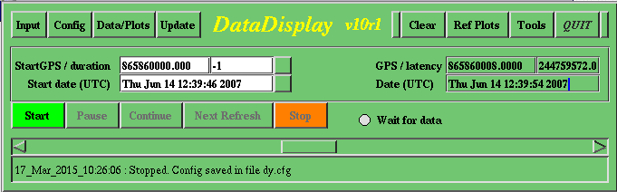
Snapshots

Slide 9
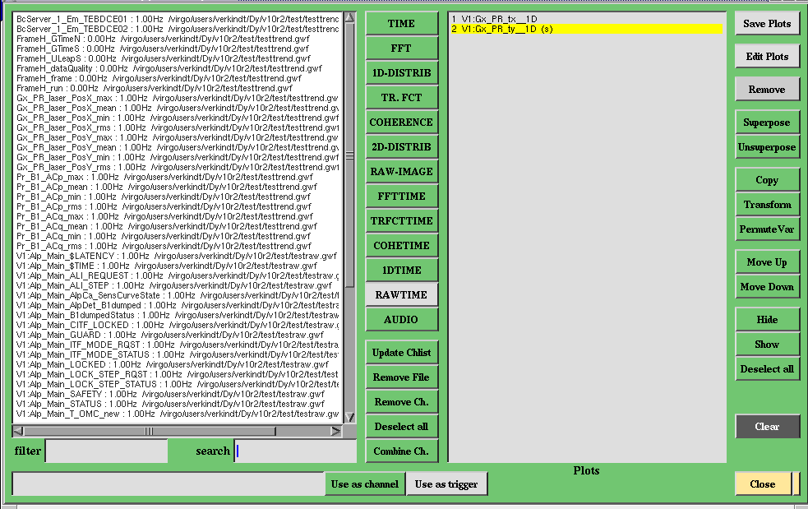
Snapshots

Slide 10
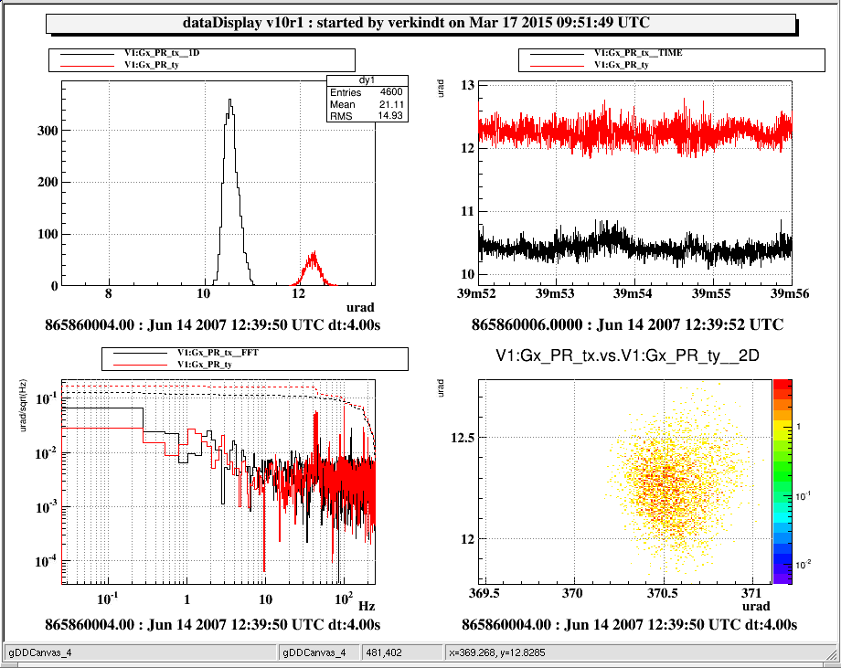
Snapshots

Slide 11
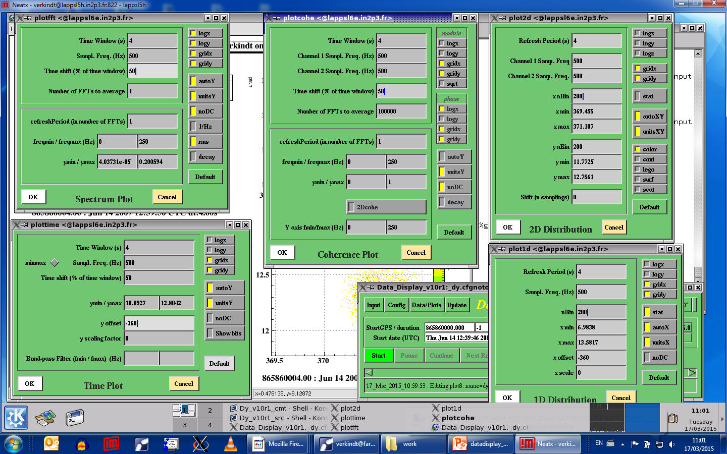
Snapshots

Slide 12
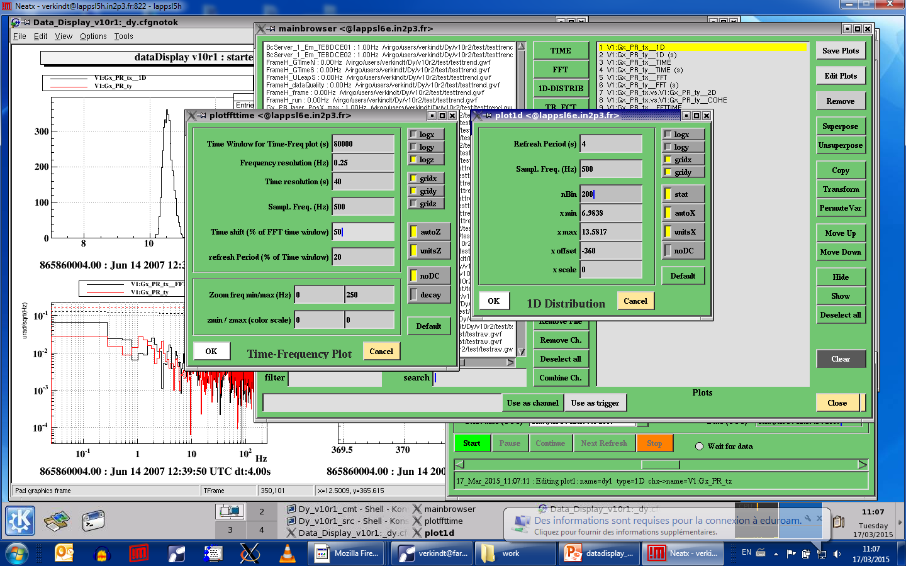
Snapshots

Slide 13
Snapshots

Slide 14
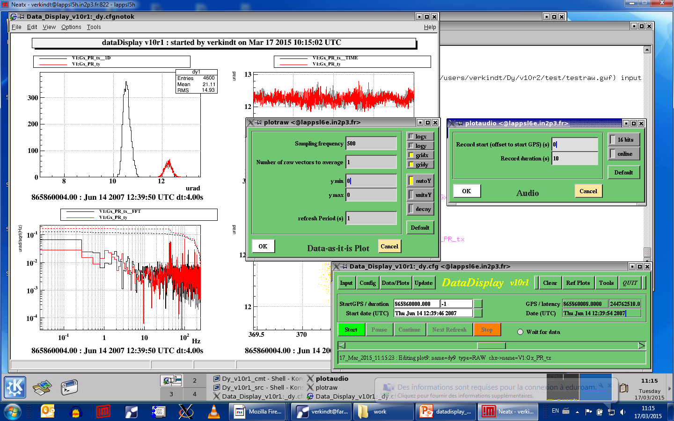
Snapshots

Slide 15
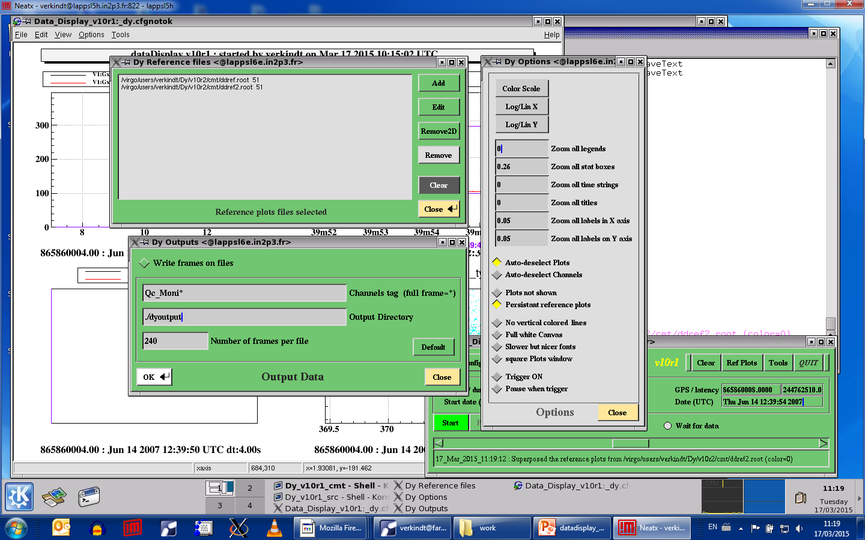
Snapshots

Slide 16
Snapshots

