Slide 1
Tango Control System and the vacuum.
(EGO experience)
Martin Mohan, Giulio Ballardin, Roberto Cavalieri and Antonio Pasqualetti
(for Nikhef,LAL and Ego vacuum teams)

Slide 2
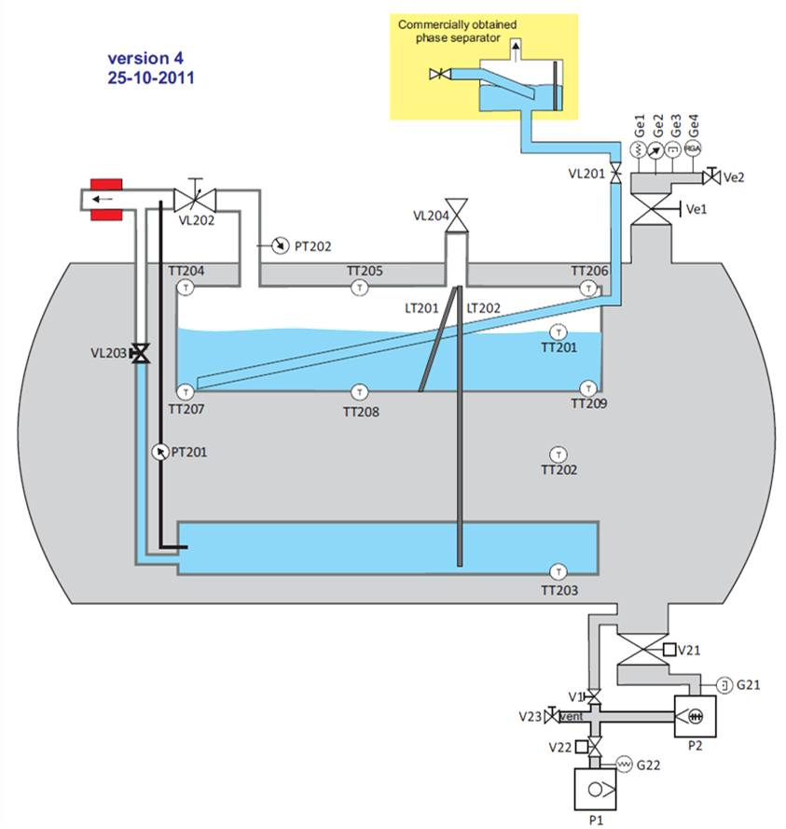
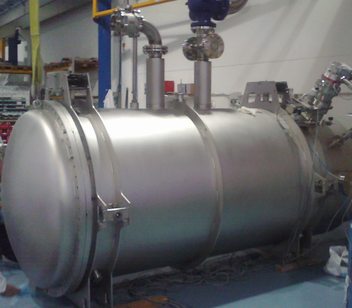
Cryotrap Equipment
Pirani
Pressure
Gauges.
Temperature
Sensors
Manual and
EM valves
Turbo/Scroll pumps

Slide 3



Objective: Control Towers+Cryotraps
Inaccurate Approximation
of layout

Slide 4
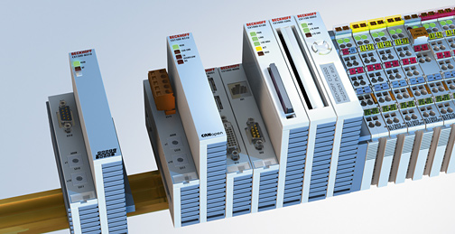
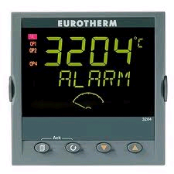
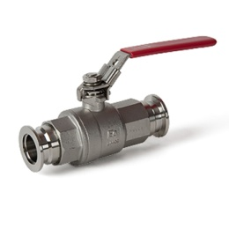
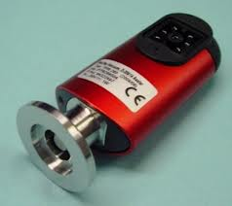
State,Temperature,Pressure stored in PLC Modbus memory
PLC (Ego: Giulio Ballardin)
Electronic (Ego: Roberto Cavalieri)
Modbus Address | Modbus Value
1 | 1
2 | 20
….. | …..
63 | 32.04
PLC
PLC
Electronics
32.04 Centigrade
Open (1)
20mbar

Slide 5
Framework/scada to control PLC
PLC Memory contains list of addresses and values
What attributes do Modbus Values represent (State, Pressure, Temperature?)
Which PLC is it? Need unique name (vac/cryotrap/web-l2-02)
Modbus Address | Modbus Value
1 | 1
2 | 20
….. | …..
63 | 32.04

Slide 6
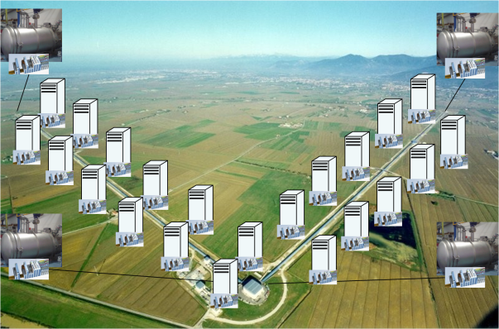
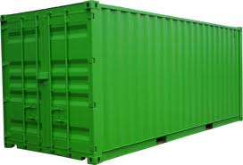



Modbus Values -> Tango Attributes
vac/cryotrap/web-l1-02
Modbus Value | Tango Attribute
1 | Valve State (1 = open)
20 | Pressure1 (mbar)
….. | …
32.04 | Temp3 (Celsius)
Modbus Address | Modbus Value
1 | 1
2 | 20
….. | …..
63 | 32.04
Tango drivers experience exists at lal and ego.

Slide 7
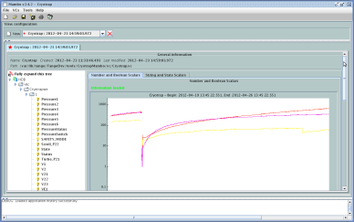
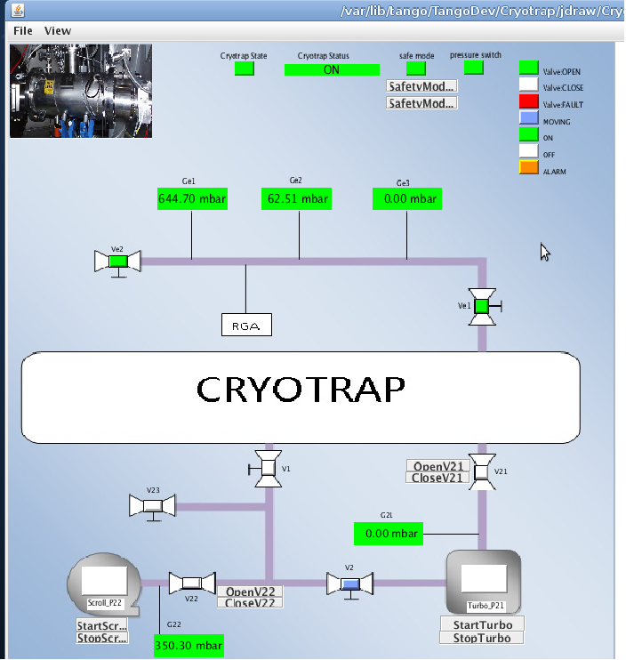

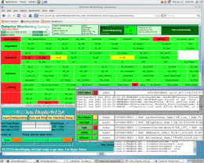


Tango is a software Framework
mambo
synoptic
Tango
Tools
C++
Java
Python
Tango Software Bus
Package values as
Tango Attributes
PLCs
Read /write
to PLC Memory
Cryotrap
Towers
Other…

Slide 8


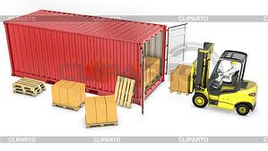
Why use a framework?
In 1956, loose cargo cost $5.86 per ton to load. Using an ISO shipping container, the cost was reduced to only .16 cents per ton.
Shipping containers all have unique names

Slide 9
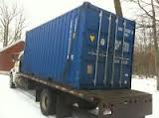
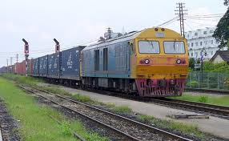

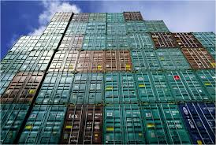

Framework tools

Slide 10
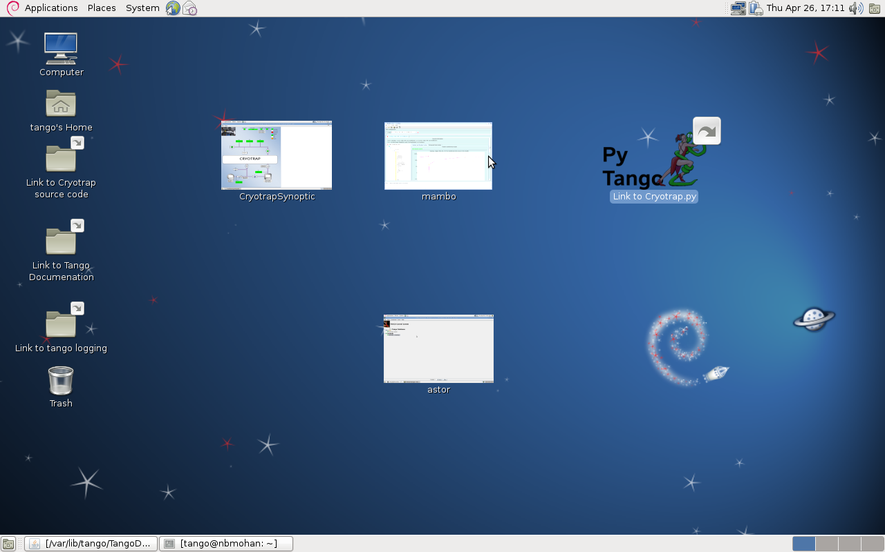
Tango Tools: Cryotrap test at Schio

Slide 11
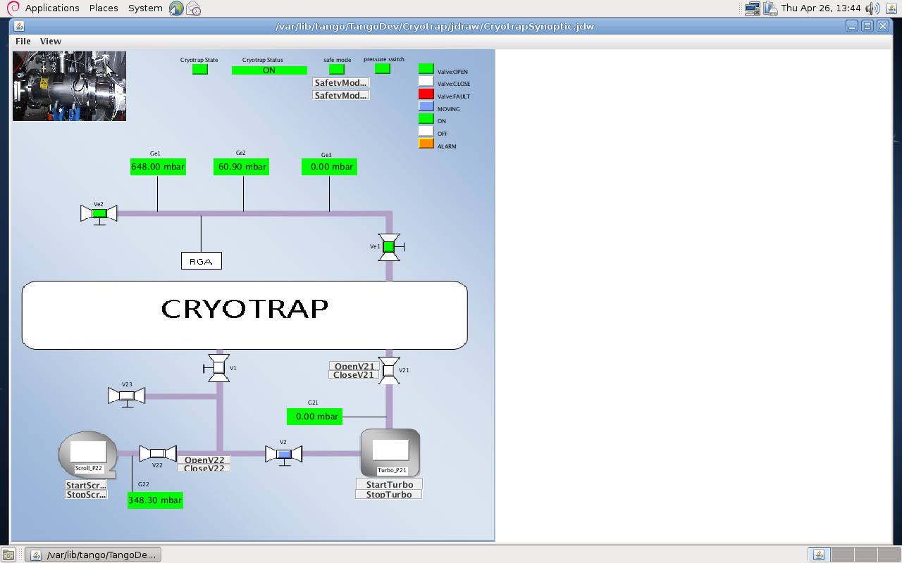
1: Synopticappli – gui control

Slide 12
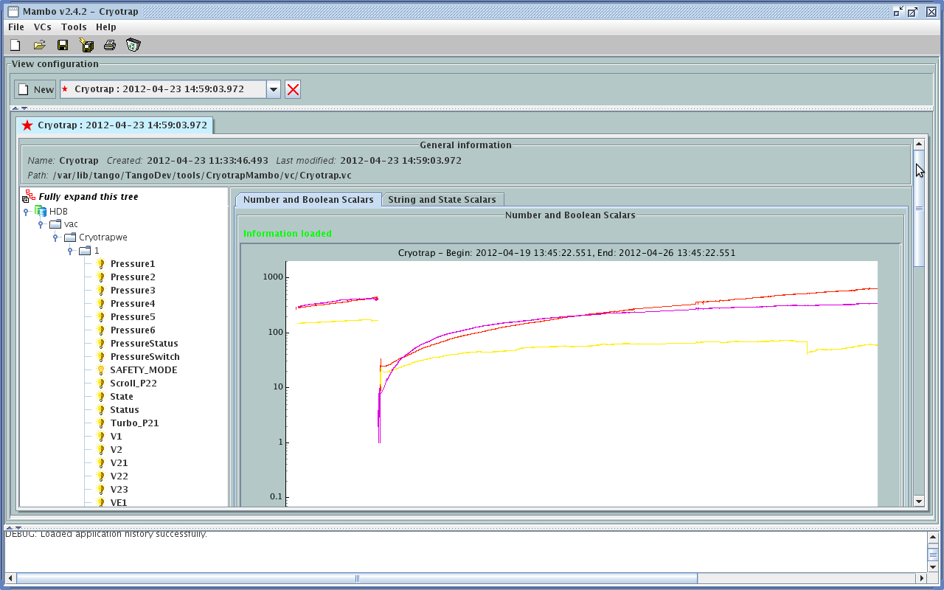
2: Mambo – Archive/display graphs
Tango DeviceName
Tango Attributes

Slide 13
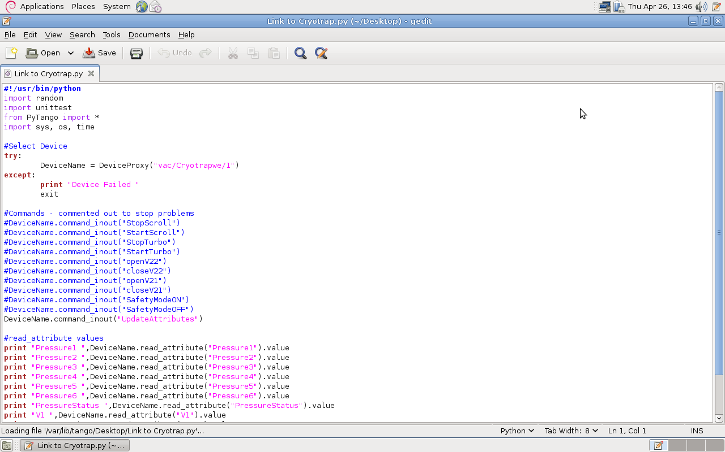
3: Python/C++/Java Interface
import PyTango
Select Tango DeviceName
Tango Attributes (print to output)

Slide 14
Install/update Tango on linux
libmodbus library and tango software is used to read PLC’s using modbus/tcp protocol.
libmodbus is available as a debian linux package
Tango software available as debian linux packages (Tango base package and some of the main Tango tools)
Typical installation commands for libmodbus/Tango on linux (debian or ubuntu).
apt-get install libmodbus-dev
apt-get install libtango7-dev

Slide 15










Who else uses Tango?
…and several other users…
Tango collaboration meet twice yearly

Slide 16
First Suggestion: Naming convention?
Use EGO building code for naming tango devices?
xxx-ly-zz
xxx -> Building
ly-> Level
zz -> Room Number
web-l1-02= West End Building (web), Level 1 (Room 02)
Tango naming (domain/name/family)
vac/cryotrap/web-l1-02
vac/tower/web-l1-02

Slide 17
NOTES
Conclusion
Agree on a formal naming policy
(e.g. vac/cryotrap/web-l2-02)?
PLC programmer provides addresses and description of values in Modbus memory.
Tested Tango drivers are available (ego and lal) to convert Modbus table to Tango attributes.
Automatic Tango installation available for linux (debian and ubuntu)
epics2tango translators exist (LIGO)
ego tools (e.g. Datadisplay) can be interfaced.
Tango collaboration support their own tools.
Tango is open source: Anyone can check the source code and no license issues.

