Slide 1

Virgo/EGO Outreach
02/2012

Slide 2
Outreach Group
Carlo Bradaschia
Elena Cuoco
Giuseppe Di Biase
Severine Perus
Gabriele Vajente
(Federico Ferrini)

Slide 3
Site Visits
As usual since several years, every Saturday (Tuesday) morning 20-60 visitors
2012: 4 visits from France
Guides:
Boschi, Bradaschia, Calloni, Carbognani, Cella, Chiummo, Cuoco, Dattilo, Day, Ferrante, Frasconi, Genin, Kasprzack, Mantovani, Marque, Paoletti, Passaquieti, Passuello, Perus, Ricci, Swinkels, Tonelli, Vajente

Slide 4



European Researchers’ Night
28 (and 29) September2012
EGO/Virgo answered (successfully?) the European call as partners of
www.frascatiscienza.it

Slide 5
Night 2012 program (23 and 24 September)
To See
Virgo
Tunnel
Control Room (taking data)
Interferometer (working model)
Superattenuator 1987
A real Payload
EXPLORER
To Do
Virgo
Build your interferometer
Science
Meet the scientists (Science Cafe)
Astronomy
Observe the sky with the astronomers
Theatre
“I Fisici”
Die Physiker – Friedrich Duerrenmatt
In collaborazione con:
Comune di Cascina
Comune di Pisa
Astrofili Pisani Galileo Galilei
Regione Toscana
La Limonaia
INFN e Dipartimento di fisica
Fondazione CariPisa

Slide 6
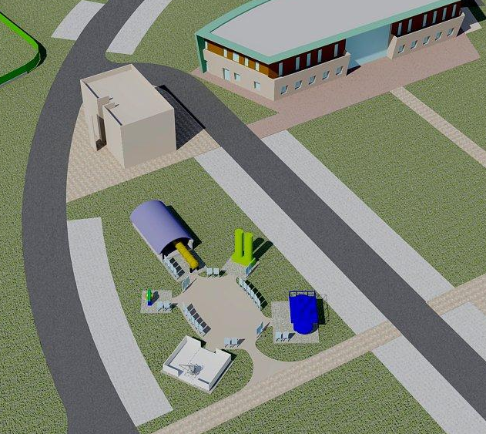
OPEN AIR MUSEUM

Slide 7
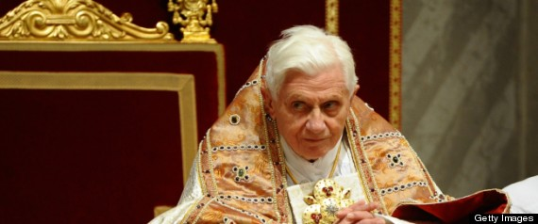
"Stories From Another World":
Vatican Organizes Science Exhibition In Pisa
By Alessandro Speciale
Religion News Service
VATICAN CITY (RNS) Nearly four centuries after the Roman Catholic Church branded Galileo Galilei a heretic for positing that the sun was the center of the universe, the Vatican is co-hosting a major science exhibition in his hometown.

