Slide 1


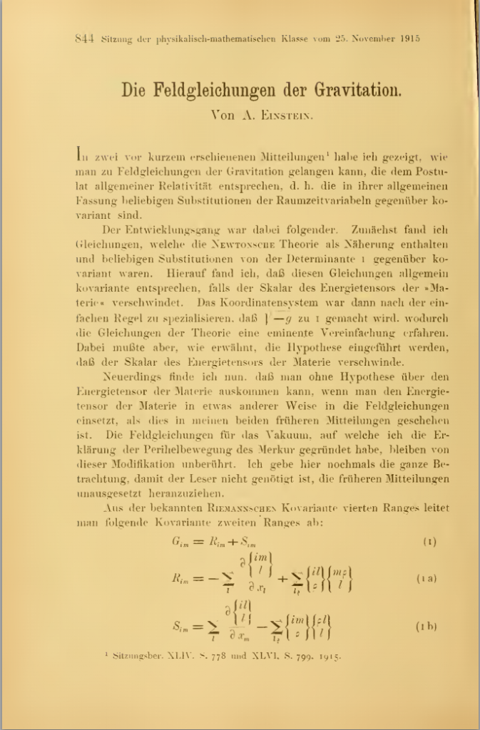
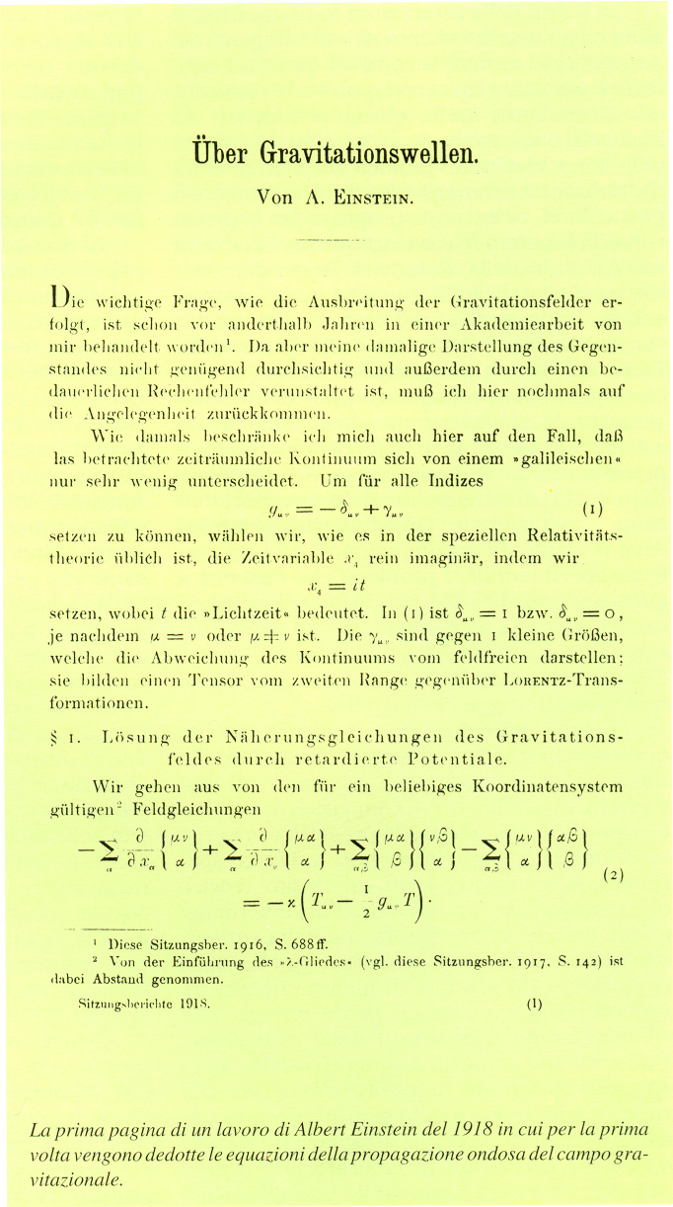
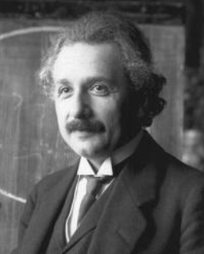
1916
1918

Slide 2
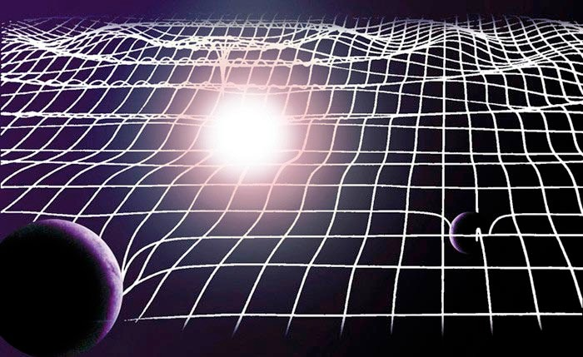

Slide 3
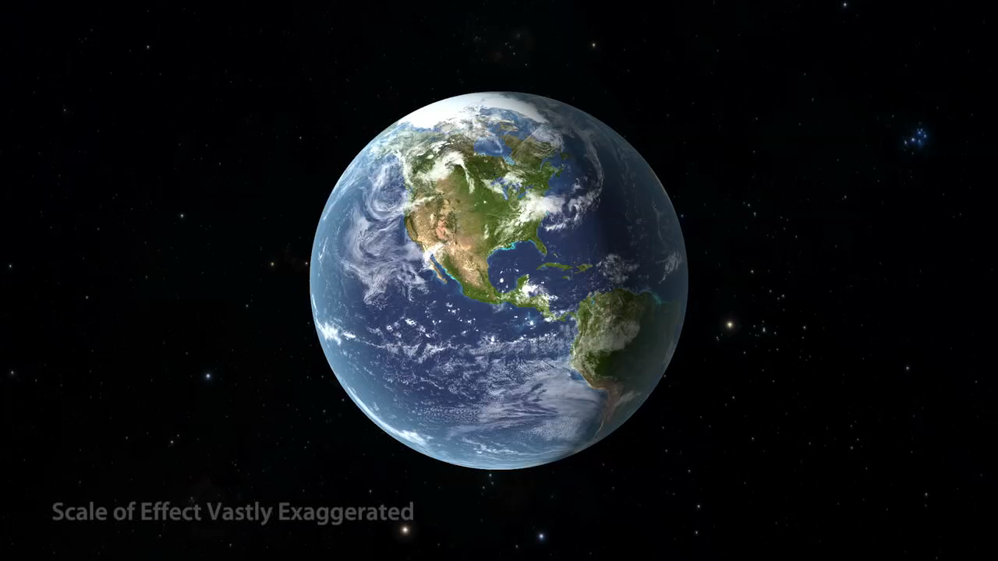
Credits to LIGO/R. Hurt

Slide 4
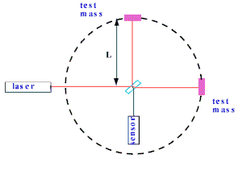
test
mass
laser
test
mass
sensor
ΔL
h =
L
Scale Effect Vastly Exaggerated

Slide 5

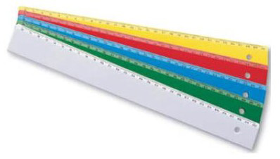

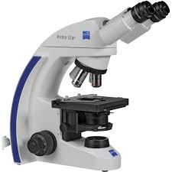
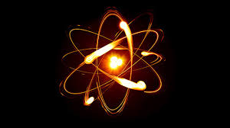
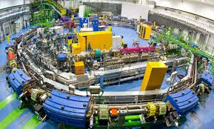
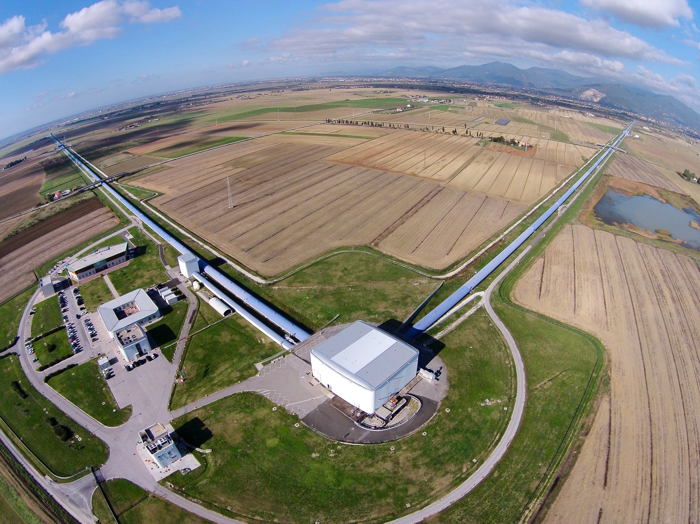
1 m
0.0001 m
10⁻⁴ m
0.0000000001
10⁻¹⁰ m
0.000000000000000001 m
10⁻¹⁸ m

Slide 6
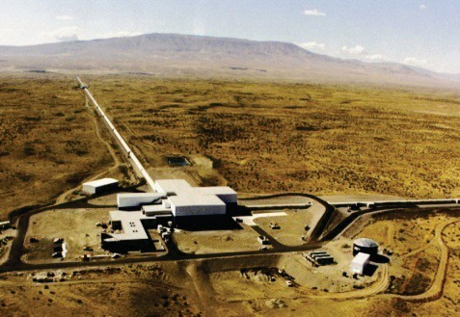
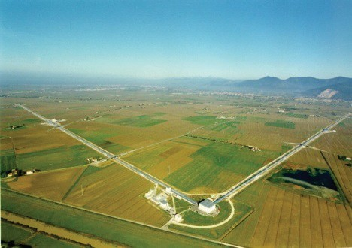
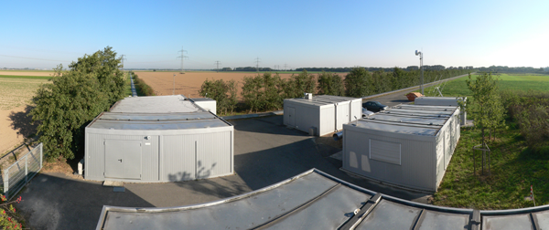
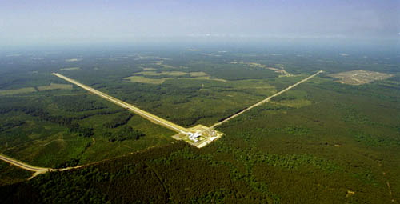
GW NETWORK SINCE 2007
H1- Hanford – Washington state
Virgo – Cascina (Pisa) – EGO site
GEO600 – Hannover - Germany
L1- Livingston – Louisiana state

Slide 7
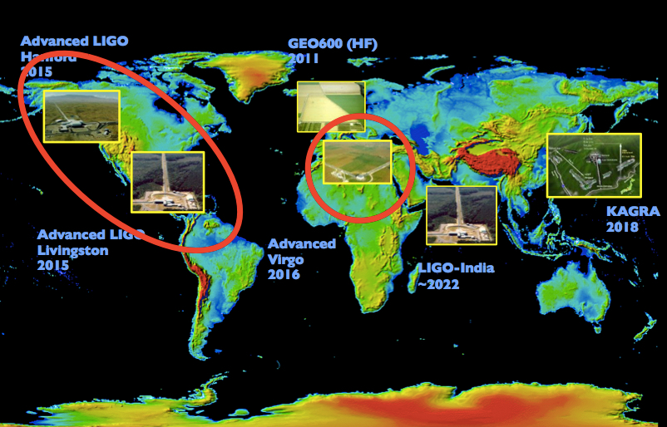

Slide 8
LIGO upgrade concluded
Advanced LIGO in action
H1- Hanford – Washington state
L1- Livingston – Louisiana state

Slide 9
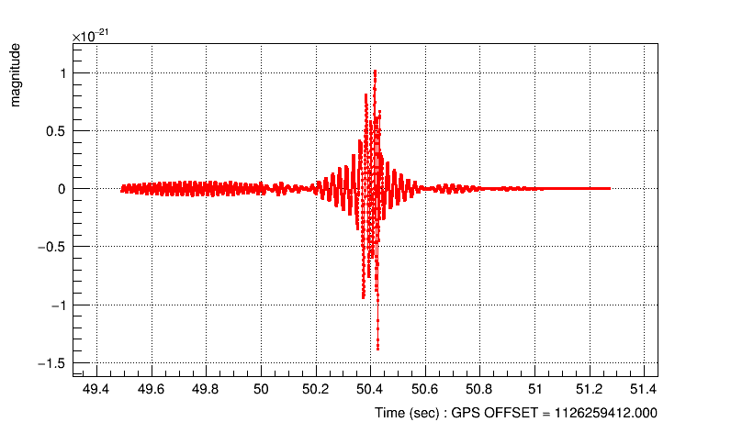
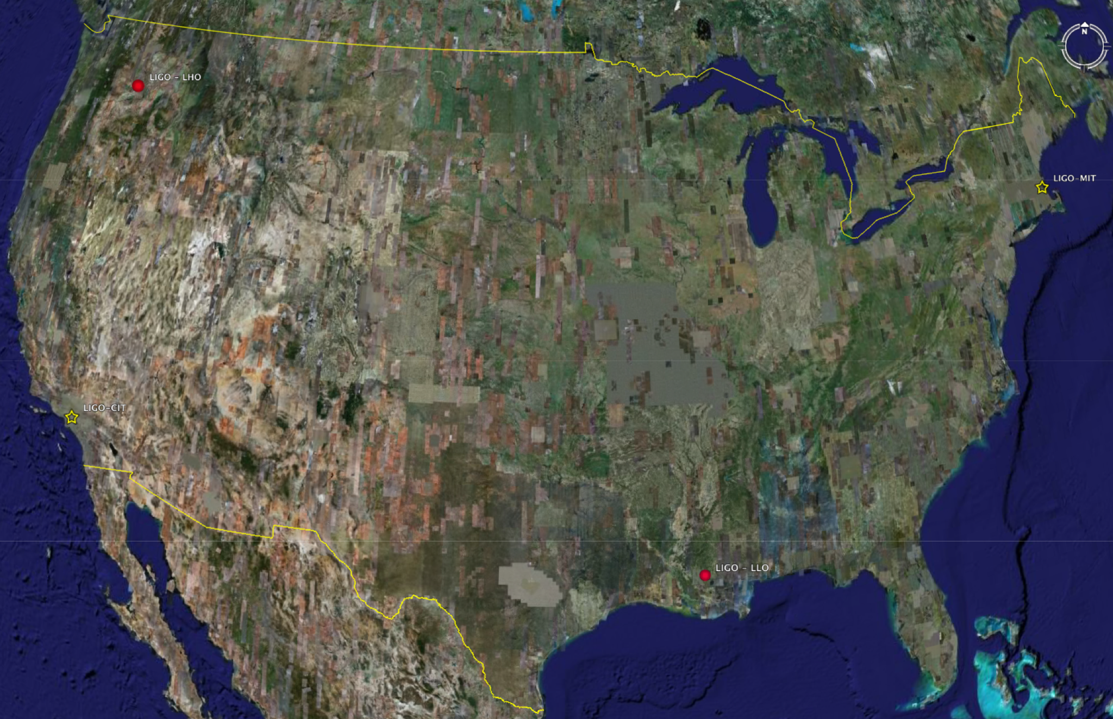
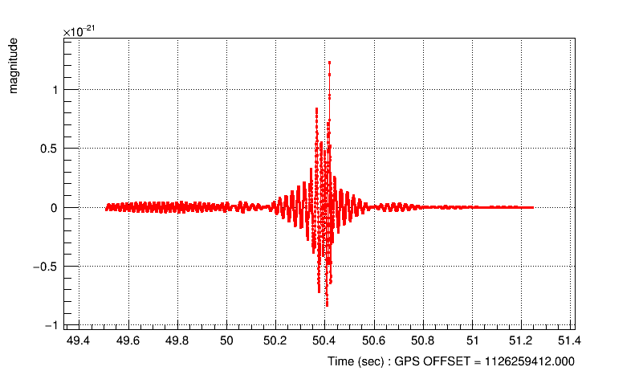
September 14, 2015 at 11:50:45 in Central European Time
Alarm reported by the on-line algorithm for generic transient search
Hanford
SNR =24
3002 km
(10 ms)
Livingston

Slide 10
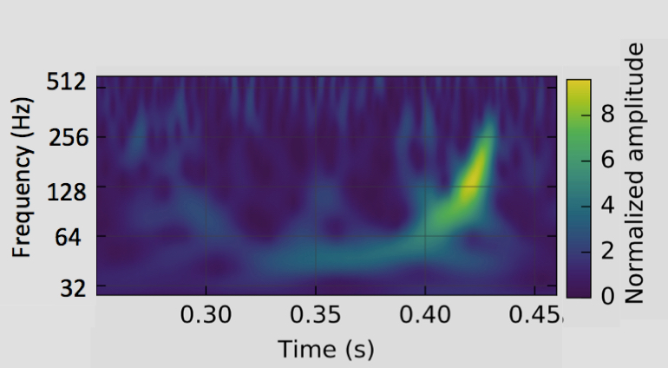
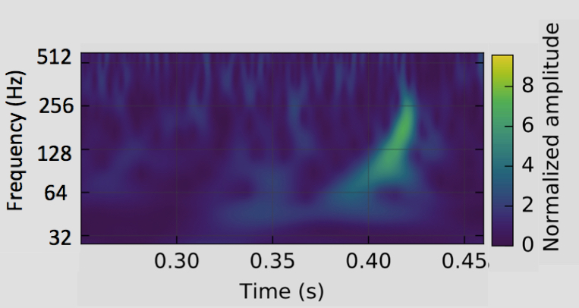
Hanford
False Alarm Rate
bound to
1
event each
203,000 year
False Alarm Probability
<
0.0000002
2 10⁻⁷
Livingston
Statistical significance
of the signal
5.1 σ
(5.1 Standard deviations)

Slide 11
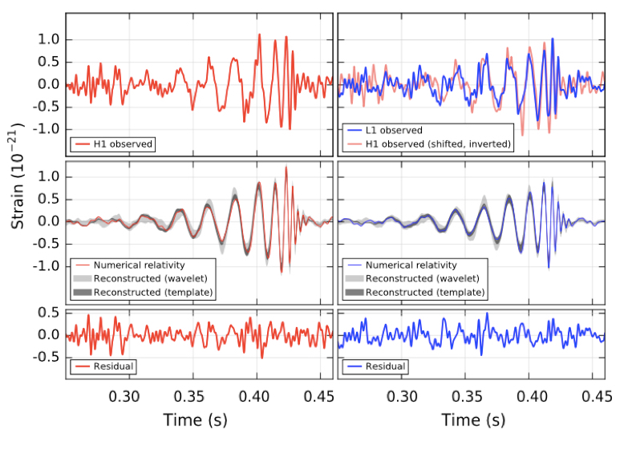
Hanford
Livingston

Slide 12
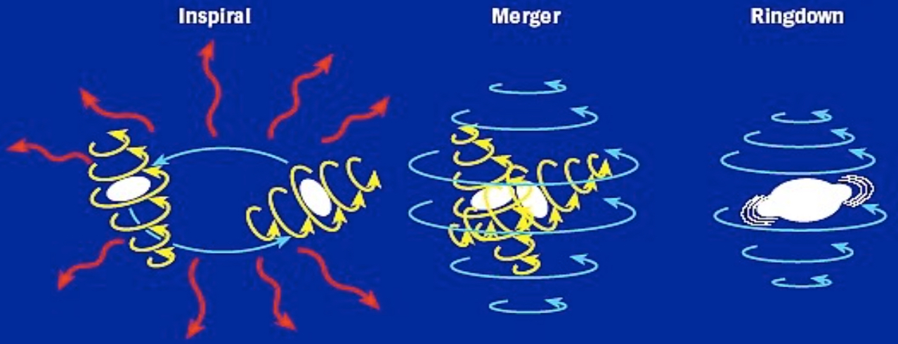
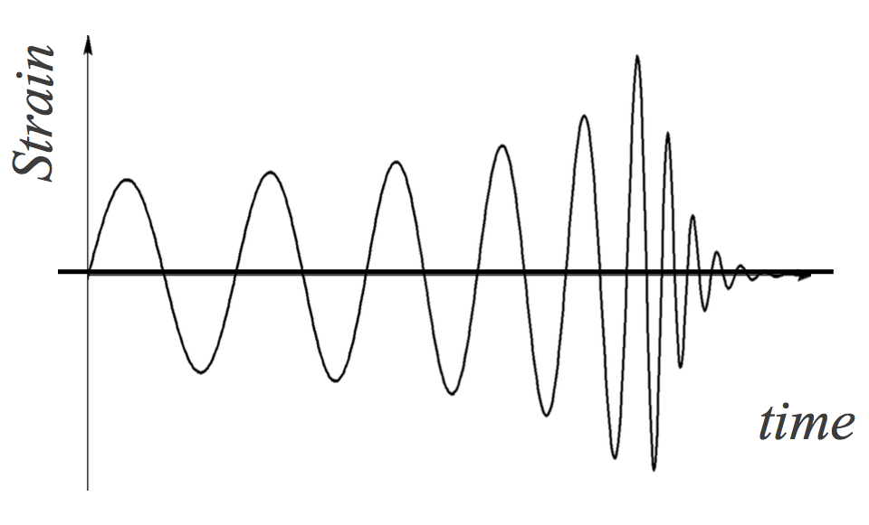
Ring down
Inspiral
Merger

Slide 13
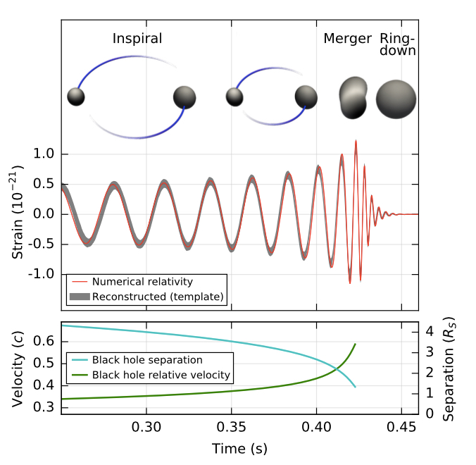

Slide 14
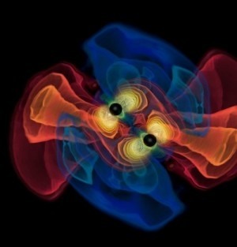
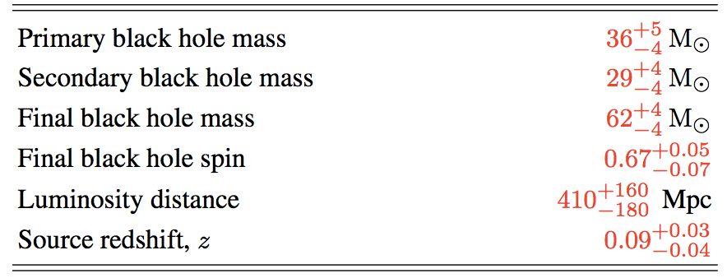
36
29
62
0.67
1.34 Glight yr
0.09

Slide 15
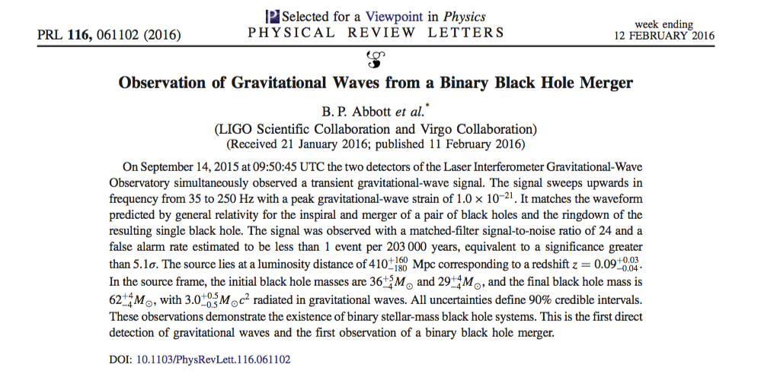
http://link.aps.org/doi/10.1103/PhysRevLett.116.061102
Published on Physical Review Letters

Slide 16
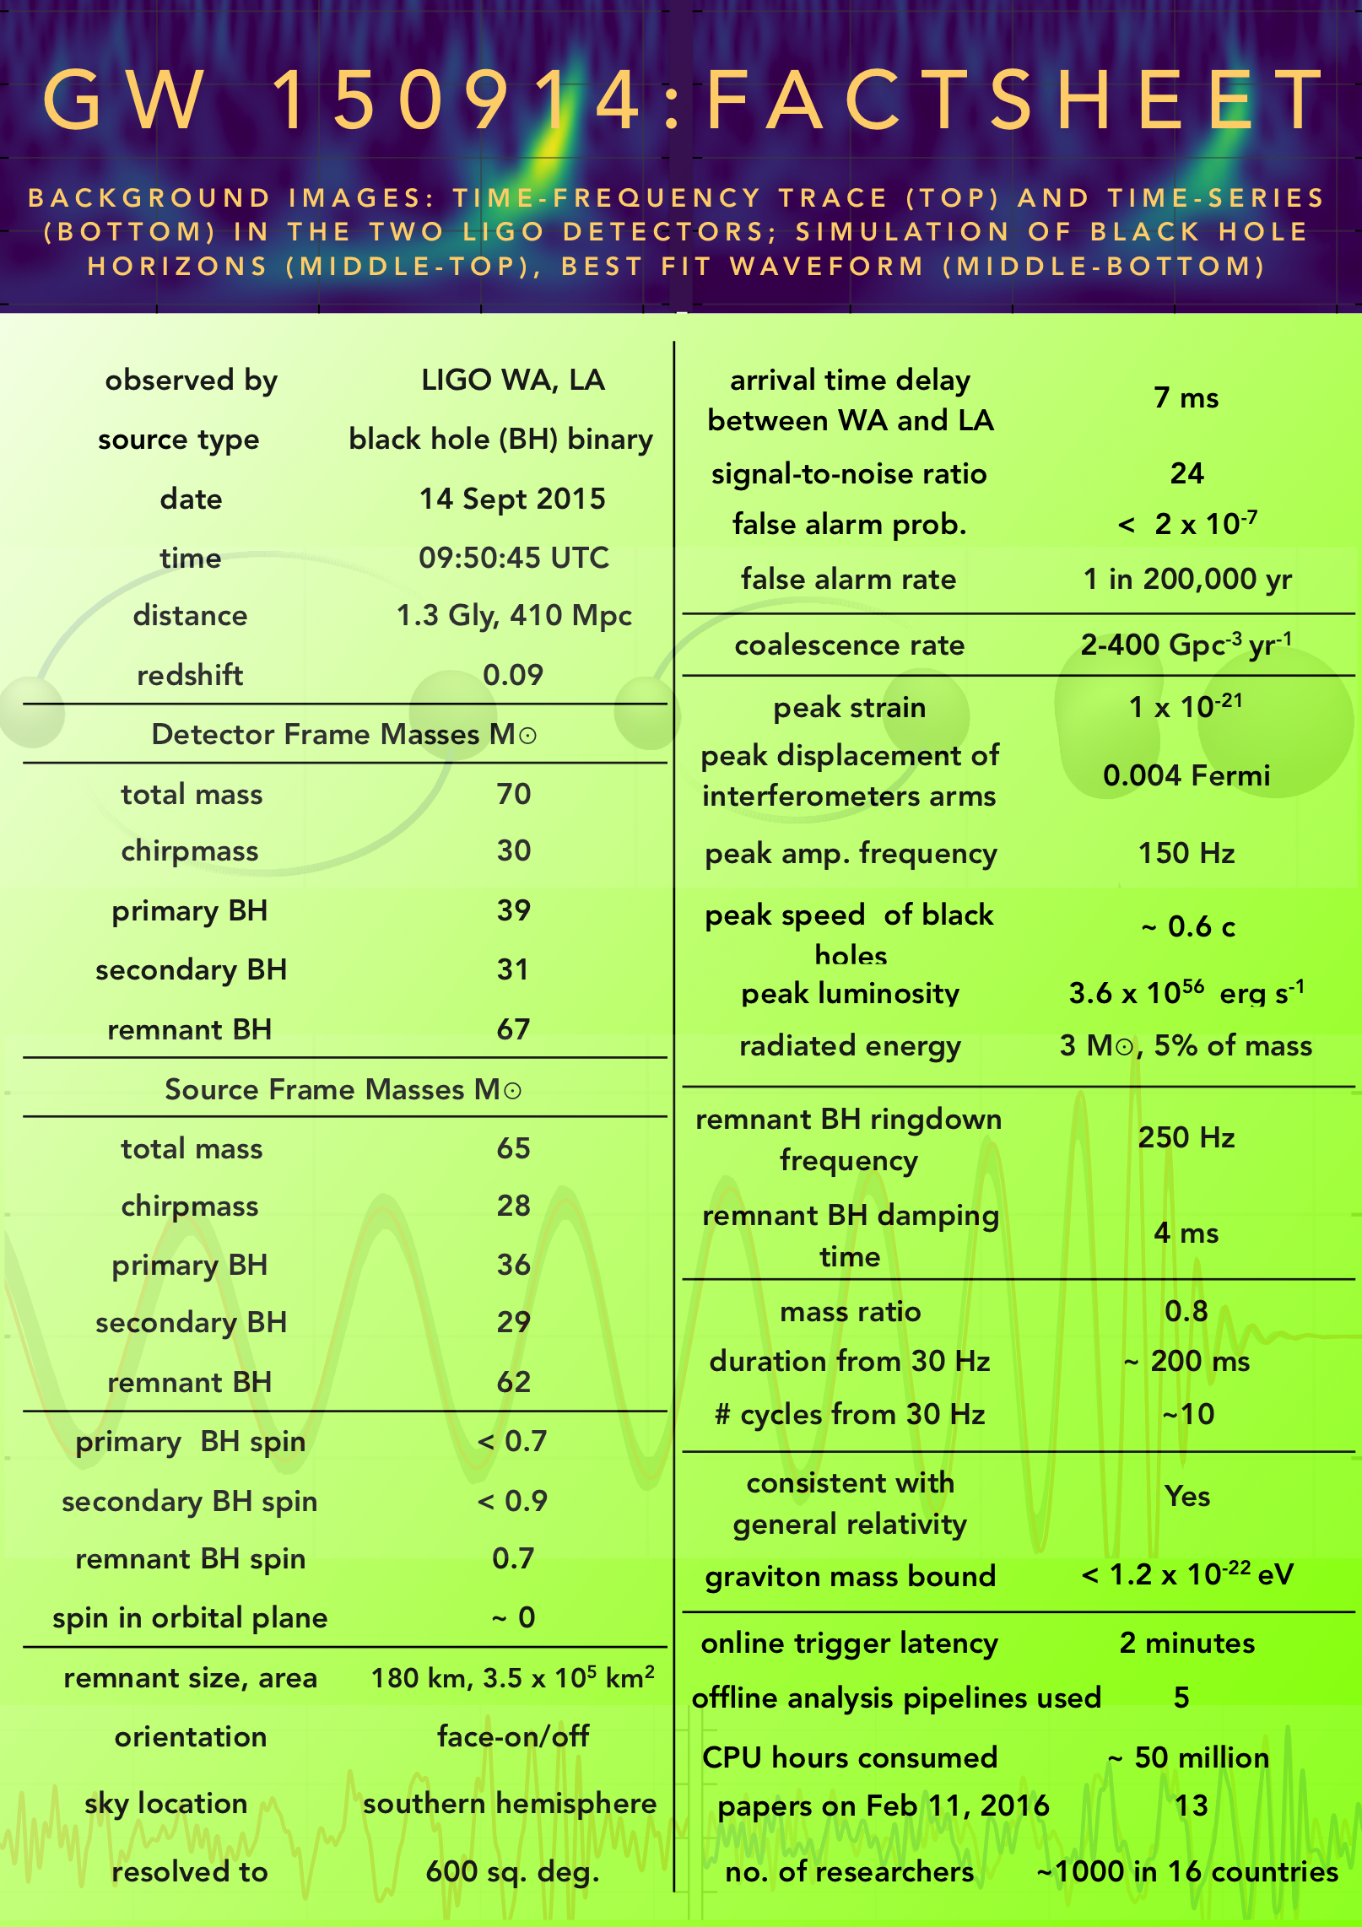

Slide 17
Extra Slides

Slide 18
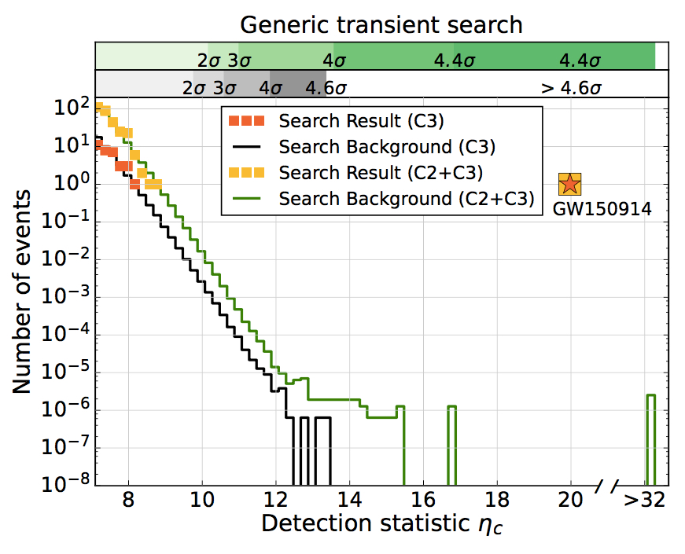

Slide 19
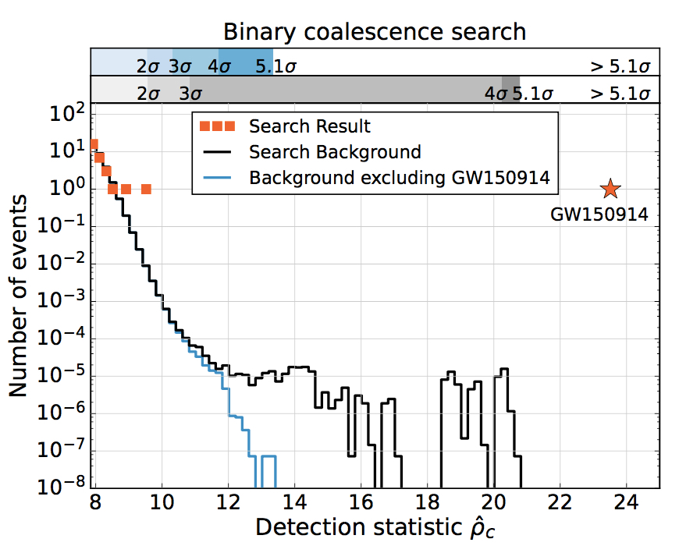

Slide 21
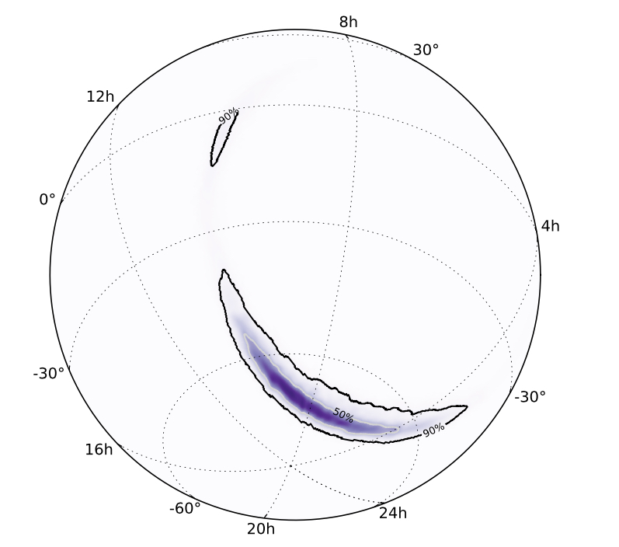
Sky Map

Slide 22
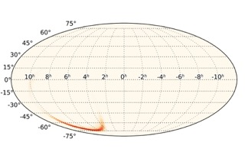

Slide 23
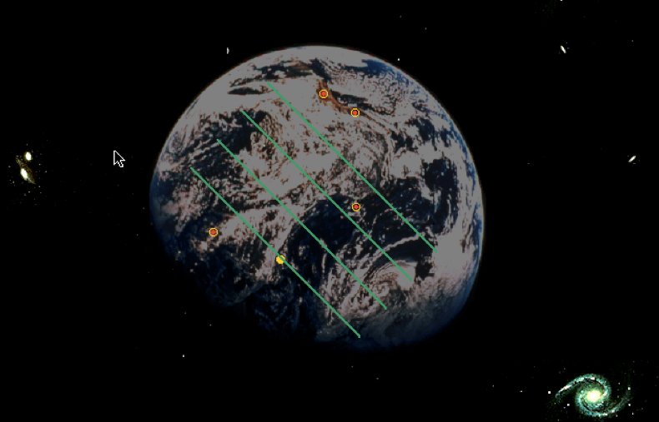
Notes:
8

