Slide 1
Acoustic noise in LaserLab, status and mitigation priority list
I.Fiori, P.Ruggi
Weekly meeting, EGO, January 31st 2012

Slide 2
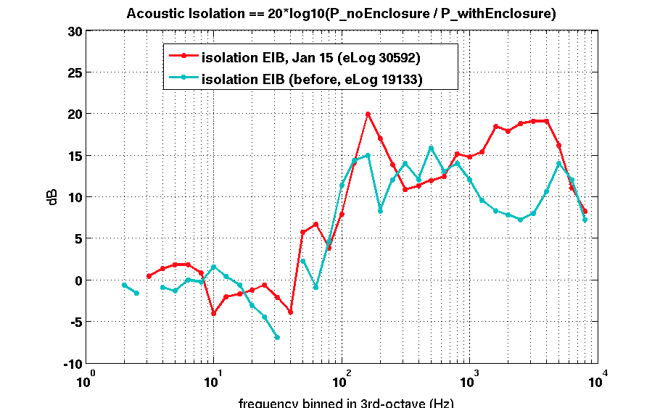
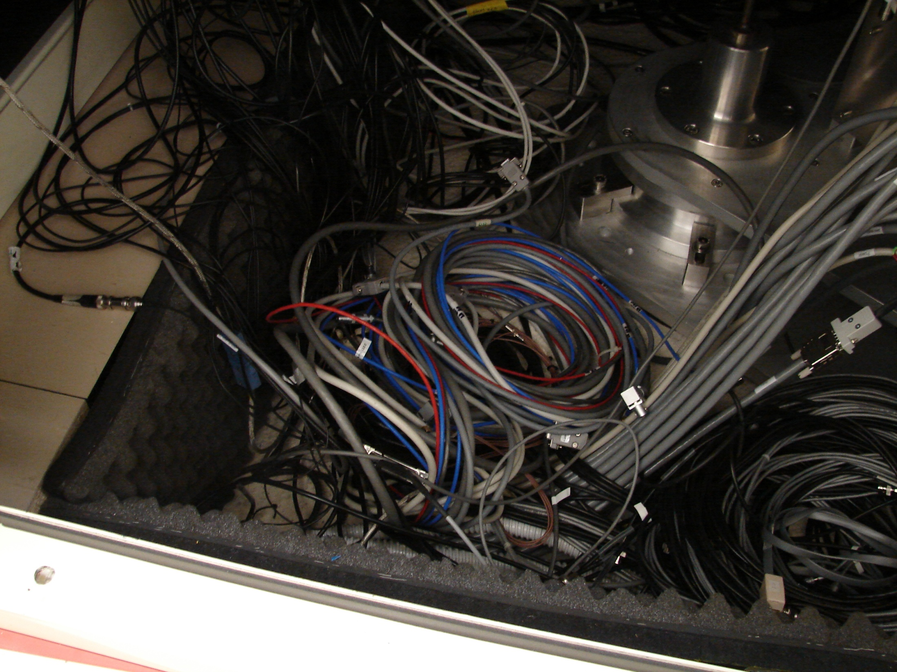
(parenthesis on Acoustic Enclosure ....
The acoustic enclosure has been put back in place after EIB-SAS installation. Only difference is that the floating floor inside the enclosure has been removed (to host EIB-SAS big leg) . A 3mm thick steel frame is added to reinforce the floor perimeter and closing the under-floor space to shield the bench from under-floor sounds and air fluxes. A rubber carpet is added to cover the frame and “seal” cable apertures → this has improved the acoustic isolation siglificantly (+6dB).
Sound isolation of the finished work is roughly the same now (red) as before (light-blue) (eLog 30592, 19133)
....)

Slide 3
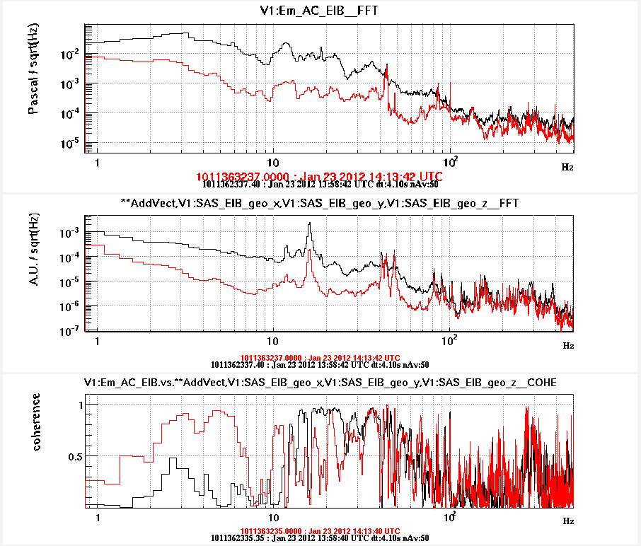
The Acoustic problem
Acoustic noise limits EIB-SAS seismic isolation performance in wide band, mechanism is sound pressure pushing on floating bench (B.Swinkels, 30585)
Seismic noise on EIB reduces roughly proportionally as acoustic noise.
Air conditioners OFF
Spectrum of
sum of three geophones
on bench,
FFT of x(t)+y(t)+z(t)

Slide 4
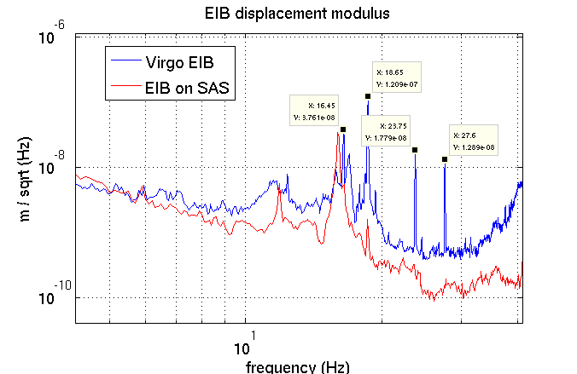
Strategy
Priority for AdV is mitigation of acoustic noise in LL, while the seismic aspect is no more a concern since EIB-SAS looks a very efficent filter for ground seism.
Mitigation work plan starts with the observation that LL room is not a silent environment, .....you can hear it!
First point is to identify sound Sources and sound Paths into LL room and mitigate them.
The “acoustic enclosure” comes as second point, one additional protection layer whose performance (presently poor) might eventually be improved.

Slide 5
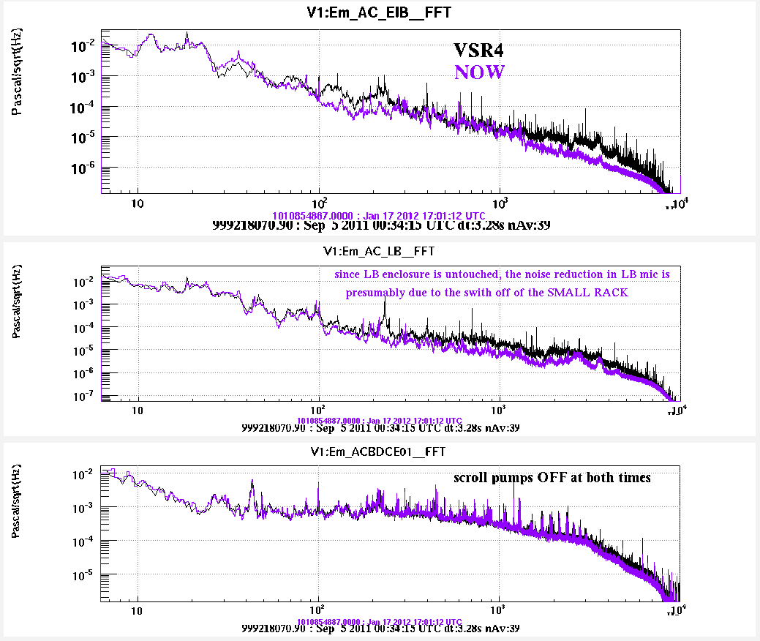
Sound sources inside LL, racks
Master Laser power supply (small rack next to LB) and possibly also Demodulation boards are relevant sources of acoustic noise above 100Hz.
Figure compares acoustic noise by the microphone at the laser bench (untouched during EIB-SAS works) in VSR4 (black) and now (purple) when sources are OFF.
..... to be confirmed, as soon as science noise condition in the hall will be recovered (Towers air conditioner off, vac pumps off).
Mic. on LASER BENCH

Slide 6
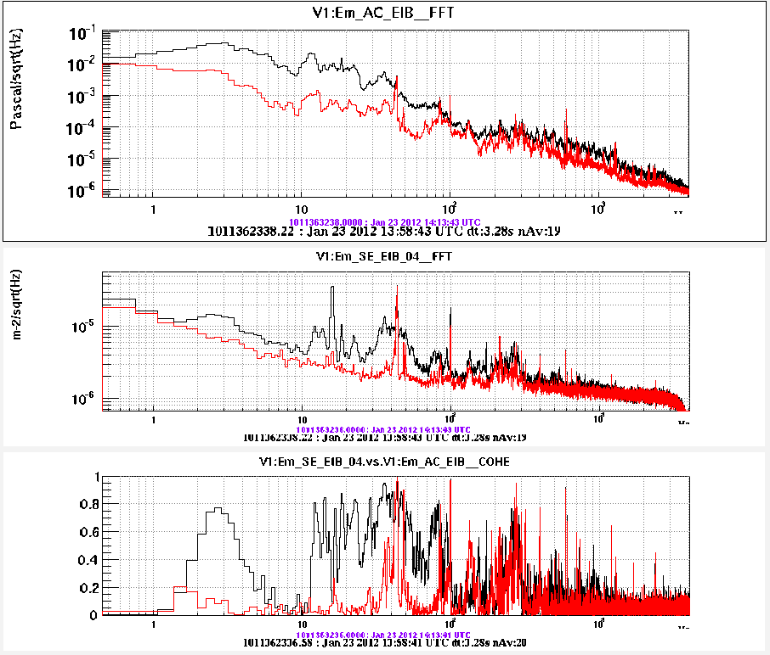
Sources inside LL:
Air conditioning of “CleanRooms”
Wide-band noise contribution , 1Hz up to kHz. Is the first source below 100Hz and the second (after racks) above 100Hz.
Noise is brougth “inside” the LL by air ducts. Indication is that under-floor is noisiest.
→ Residual noise, particularly intense at 40Hz, 100 to 300 Hz, 600Hz. What is it?
Mic. on EIB
Switch off
“CleanRooms”
air conditioning

Slide 7
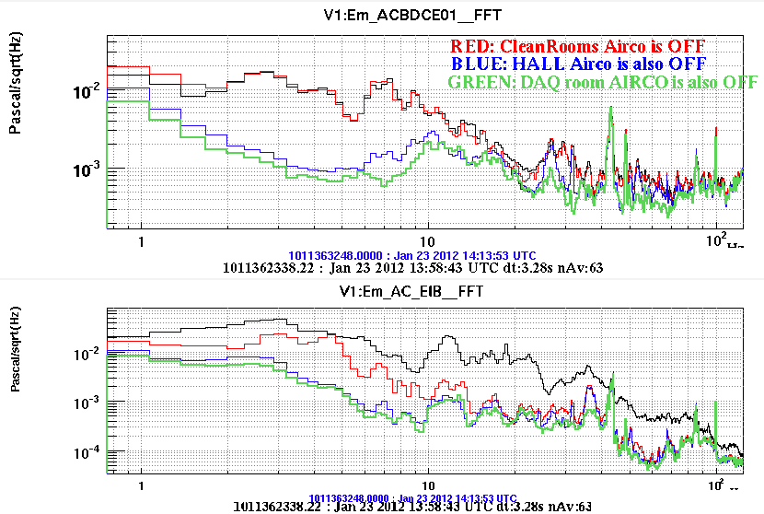
Other air conditioners?
Switched off in cascade “CleanRooms”, “Hall” and “DAQ room” aircon.
“Hall” gives some noise entering the LL below 10Hz.
“Hall” and “DAQroom” contribute a bit between 10 and 50Hz, but are not the dominant source above that.

Slide 8
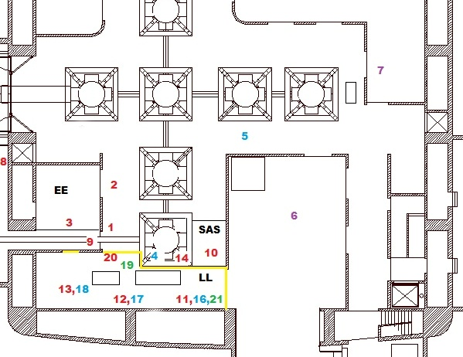
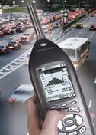
Noise mapping
Measurements with sound level meter, inside and around LL

Slide 9
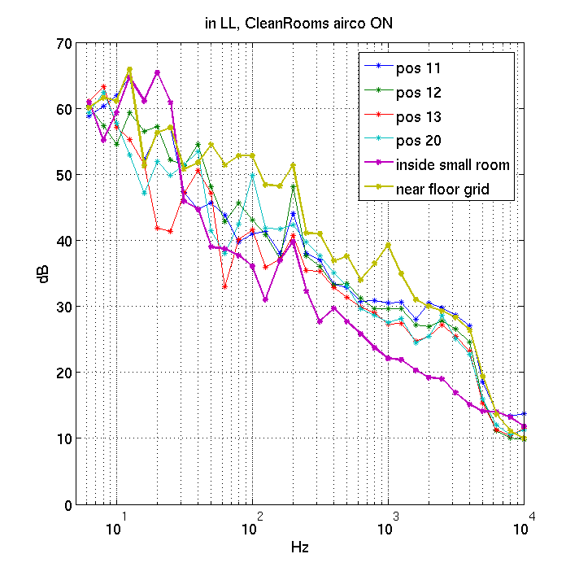
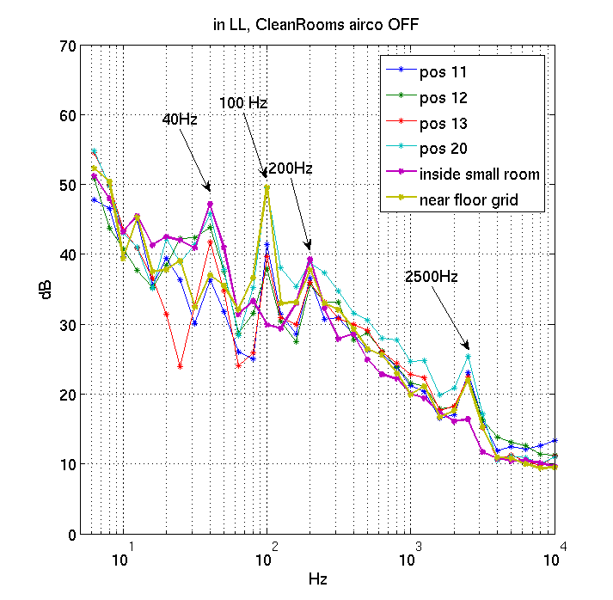
Inside LL room
Spectra with air conditioner “CleanRooms” ON (left) and OFF (right)

Slide 10
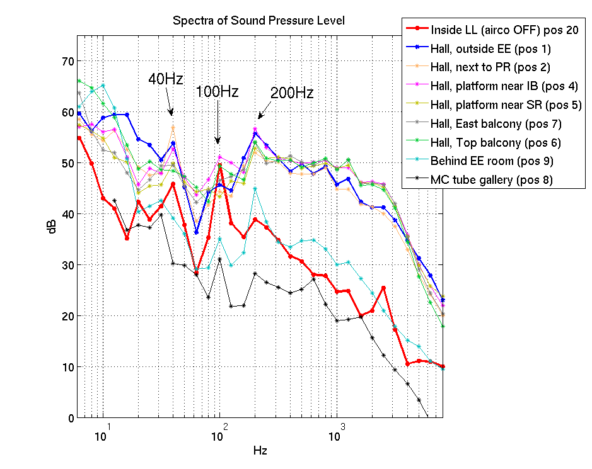
Acoustic spectra in the Hall and around LL
Hall is a loud source of acoustic noise, noise looks diffused (similar all around)
Spectral peaks in LL (red) are similar to noise in the hall, makes us suspect residual noise in LL comes from the central hall

Slide 11
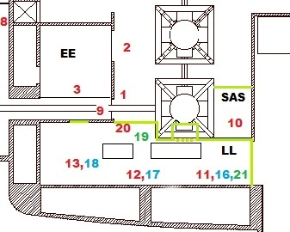
Panel-wall
Separation wall between Hall and LL is made of Parteco clean-room panels (mod : light (≈10kg/m²) and wide surface (≈20m²)
We suspect acoustic isolation is poor
Yellow line is where just panels are present, and no concrete wall behind

Slide 12
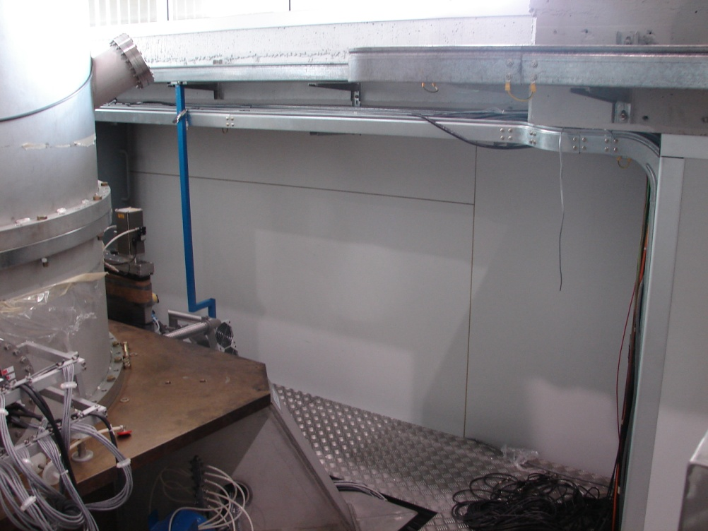
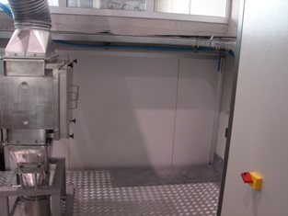
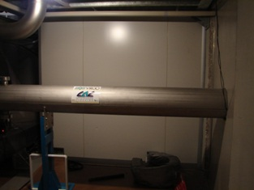

Slide 13
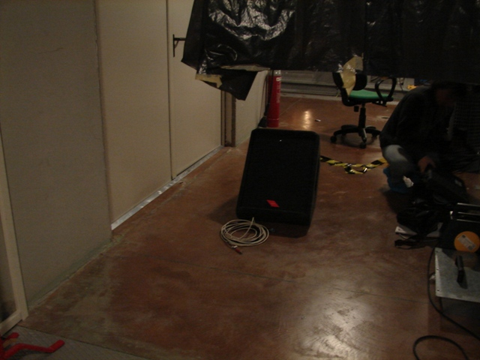
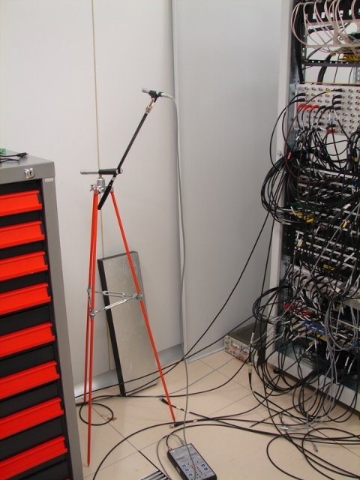
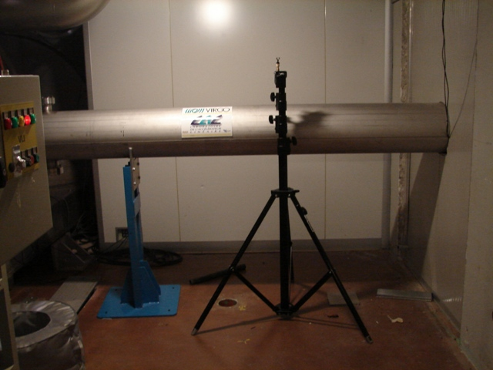
Panel-wall acoustic isolation measurement:
White noise with loudspeaker, two B&K 4190 mics one at each wall side, moved in different positions: 4 positions for LL mic + 6 positions for Hall mic.

Slide 14
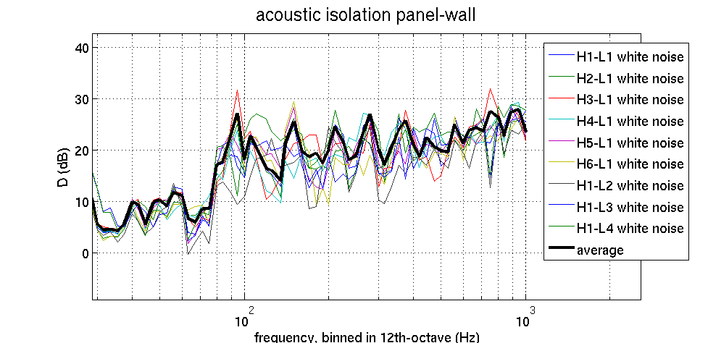
Panel-wall acoustic isolation
Roughly followed prescriptions of UNI EN ISO-140-3 “Measurement of sound insulation in buildings and of building elements”
“acoustic isolation “:
Measurement is done between 50 Hzand 1kHz (loudspeaker noise above background). Possible reverberation effects are not corrected, thus comparison with certified specs is not fear, but we can use it for noise projection.
Log #30613 for details

Slide 15
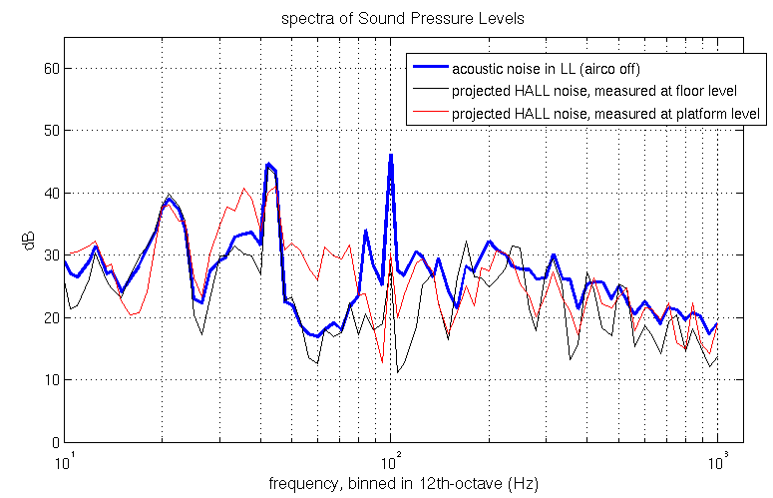
Projection
Used the measured isolation to project acoustic noise in the Hall into the LL. Blue is acoustic noise measured in the LL room, red and black are projections, using noise measured at floor level (black) and platform level (red). Platform level is a bit noisier due to close-by racks.
→ Noise inside LL seems reasonably well explained as acoustic noise from the hall entering through panel wall.

Slide 16
Mitigation priority list
Noisy cooling fans must be moved out of LL: might be a constraint on master laser cable length, must be solved or properly silence these fans;
Air conditioning of LL requires first mitigation attention. AdV design foresees LL to be separated from CleanRooms: mandatory is a careful sizing of this machine (avoid oversizing) choice of slow silent fan type, cure ducts layout to reduce air turbulence;
Improve isolation of separation wall between LL and the noisy hall. Shall aim for a more massive and rigid wall (concrete wall, of double leyer wall) and require good isolation spec at 100Hz, since high frequency isolation “comes for free”.
Acoustic enclosure shall be foreseen, as second isolation layer, possibly improved.
Reduce acoustic noise emission in the hall: in AdV the number of racks in the hall will likely double, thus it is mandatory to care about acoustic aspect, i.e. selecting more silent fans (some work done with VAC group, see for ex. VIR-0733-11) or crates using radiative cooling.

Slide 17
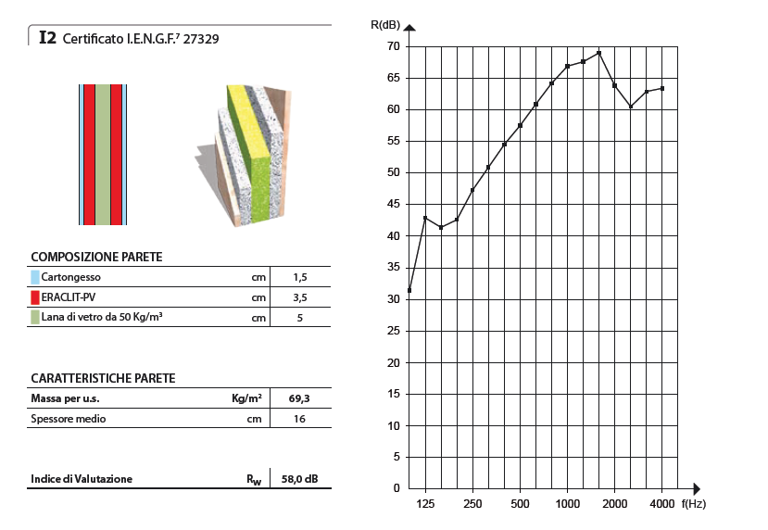
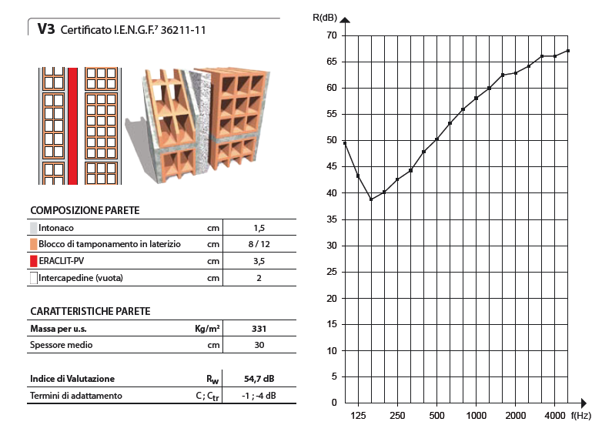
More-perfomant walls?
As a rule: we should aim for something (massive and rigid) that performs well in the ≤ 100Hz region, attenuation at higher frequencies “comes for free”.
Take specs value as upper limit, “post-operam” performances tend to be worst.
Example:
wall similar to that used for the EE room
(70 kg/m²)
Example:
double brick wall (330 kg/m²)
(might consider for some sections)

