Slide 1
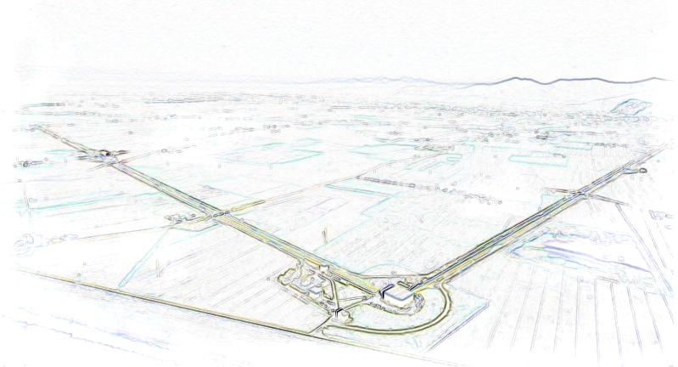
Magnetic Noise Mitigation:
Results obtained so far
AdV Weekly Meeting VIR-0016A-16

Slide 2
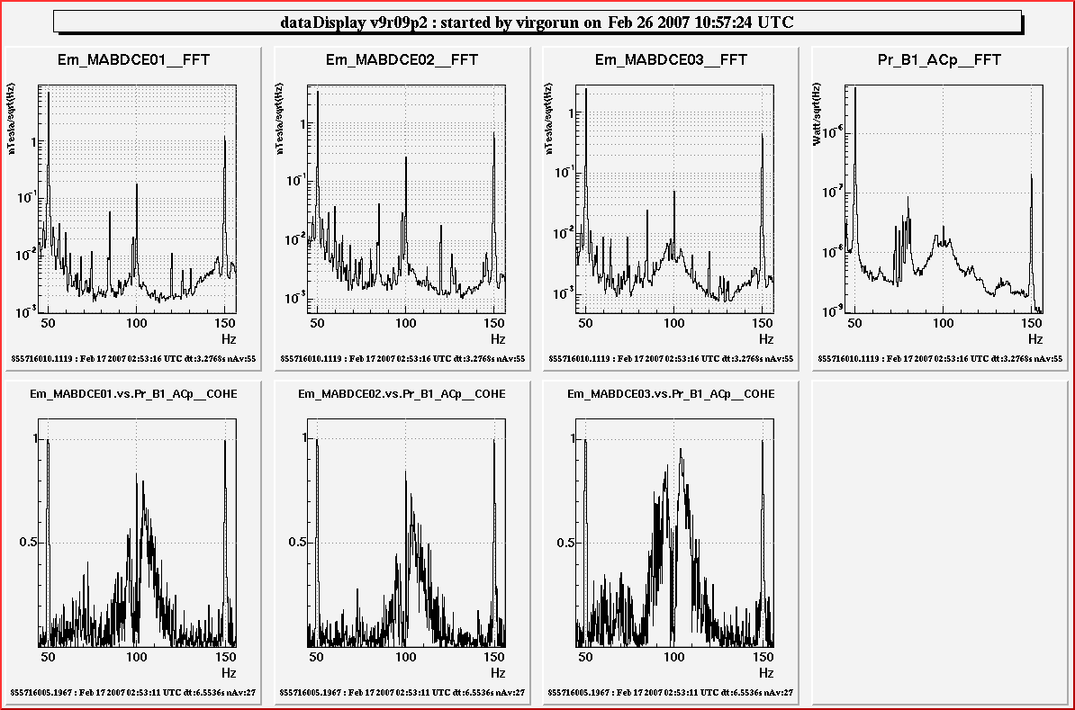
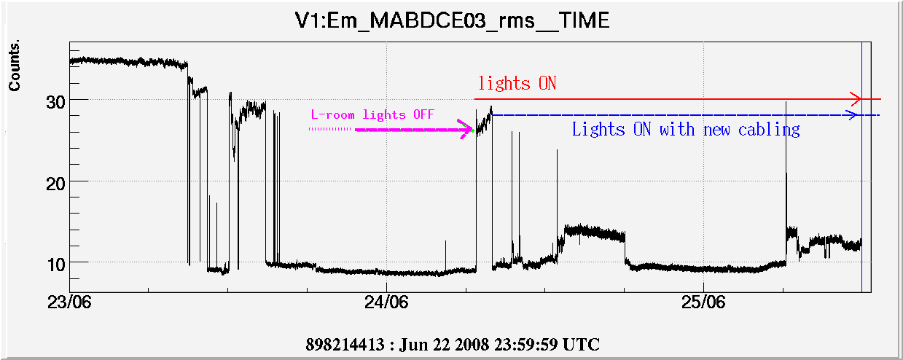
Magnetic coupling
Story begun in 2007
(DF coupling with CEB UPS Mains supply, L-room lights wiring problems …)
Sept. 2014 (AdV DIM VIR-0441A-14):
Outline of relevant “magnetic” problems we had in Virgo and how to avoid them
(new UPS system, new cabling architecture, toroidal transformers...)

Slide 3
Very short reminder
magnetic noise coupling to environment:
Sources Actuators Paths
typically only
one source:
Mains Supply (UPS)
Non-zero area
of mains wires
Transformers
leakage
Cables
Transformers

Slide 4
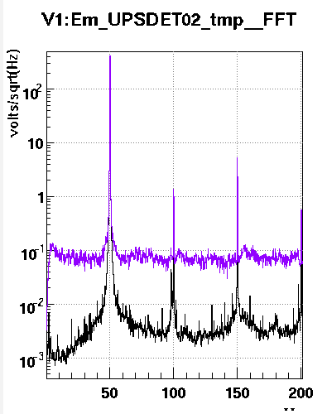
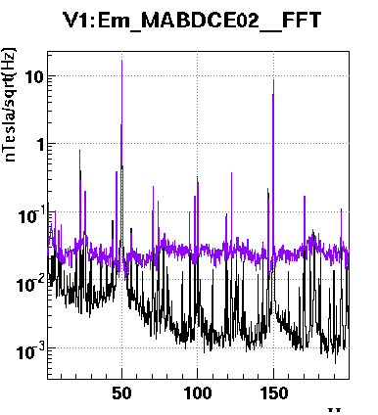
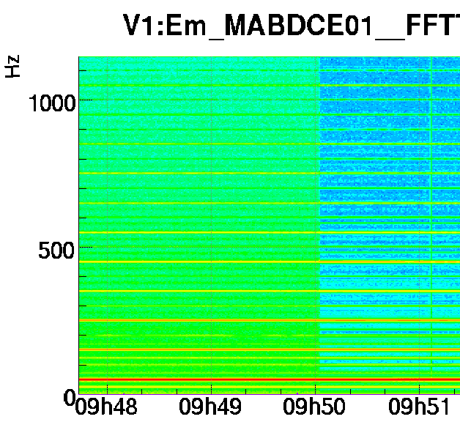
SOURCE: UPS vs IPS noise
Mains noise and magnetic noise in the CEB (typical) during an UPS switch-off test (eLog 25397 and VIR-0737B-09 F. Nocera, F. Paoletti)
Hz
Hz
Time
voltage mag. field mag. field
(IPS is ~10 times less noisier than old UPS)
Solution: use “quieter” UPS

Slide 5
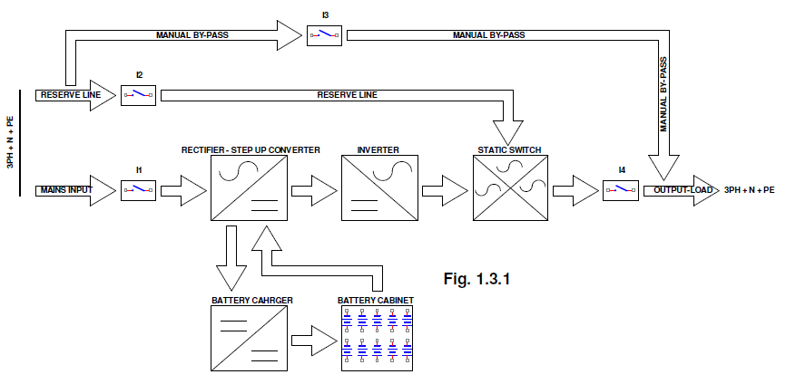
Uninterruptible Power Supply
Basic UPS block diagram
Critical point is the INVERTER, basically a “Power-DAC” that re-build the 50Hz AC Mains from DC (can be “noisy”)

Slide 6
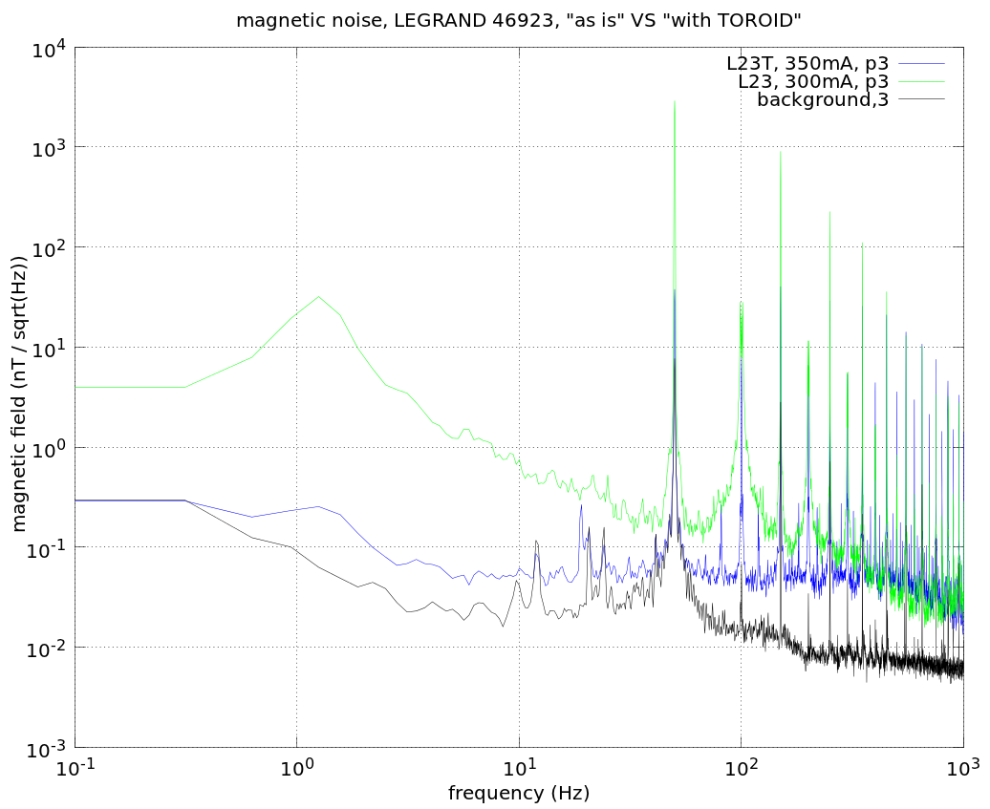
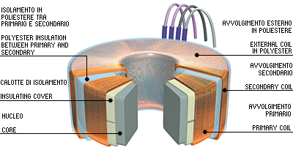
ACTUATORS/PATH: transformers
tests with vacuum equipment transformers, Aug. 2012, VIR-0289A-12
Solution:
use toroidal transformers wherever possible
(~10 times smaller stray field)
Green: typical EI-shape transformer
Blue: same power but toroidal
Black: power off (noise floor)

Slide 7
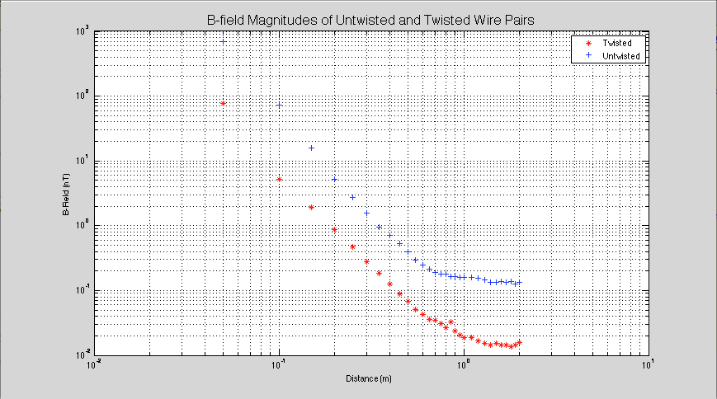

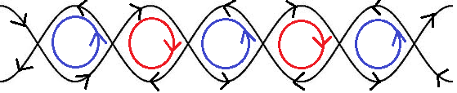
ACTUATORS/PATH: mains cables
D.Vander-Hyde (summer student) et al. VIR-0349A-13
Solution:
use twisted mains wires wherever possible
(~10 times smaller stray field)
Blue: standard wire
Red: twisted wire

Slide 8
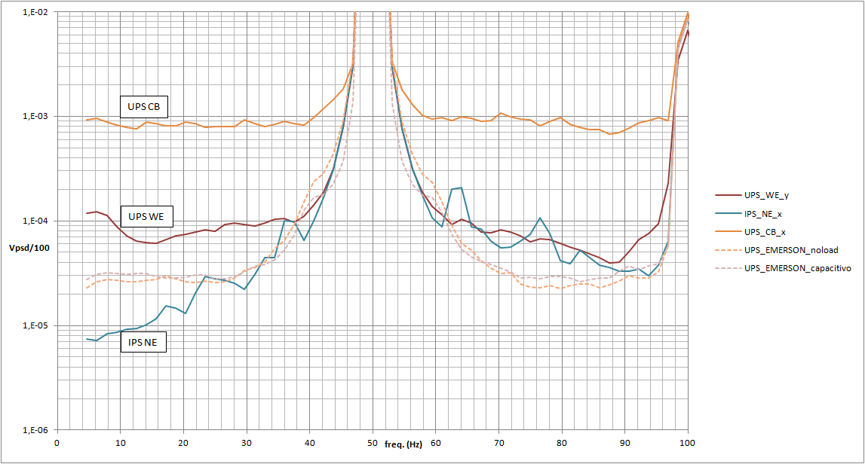
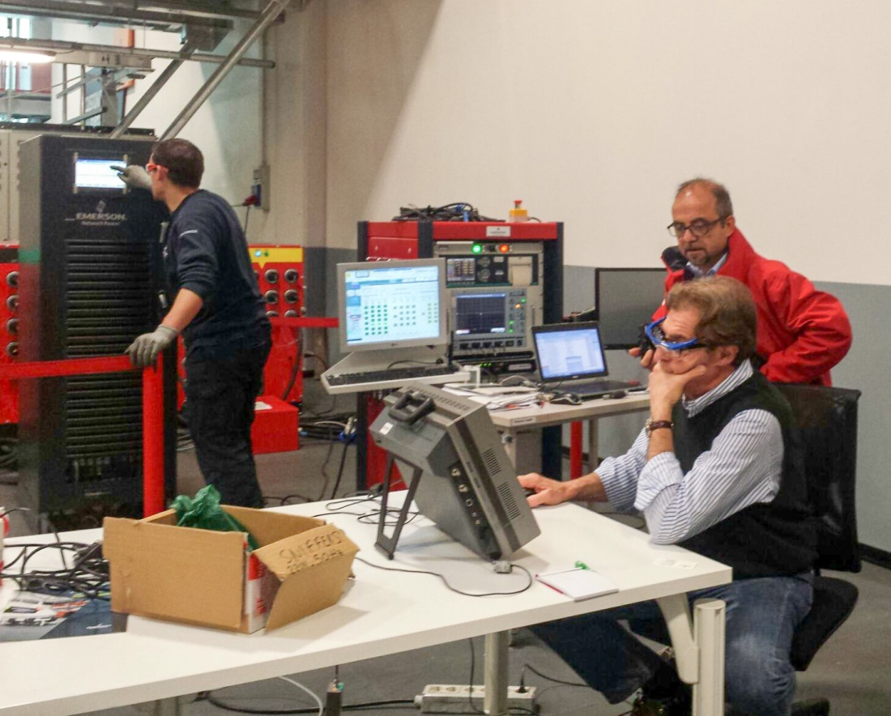
Searching for a “quieter” UPS
28 April 2015: measurements at a factory
(Chloride - Emerson Network Power) testing a low-noise UPS

Slide 9
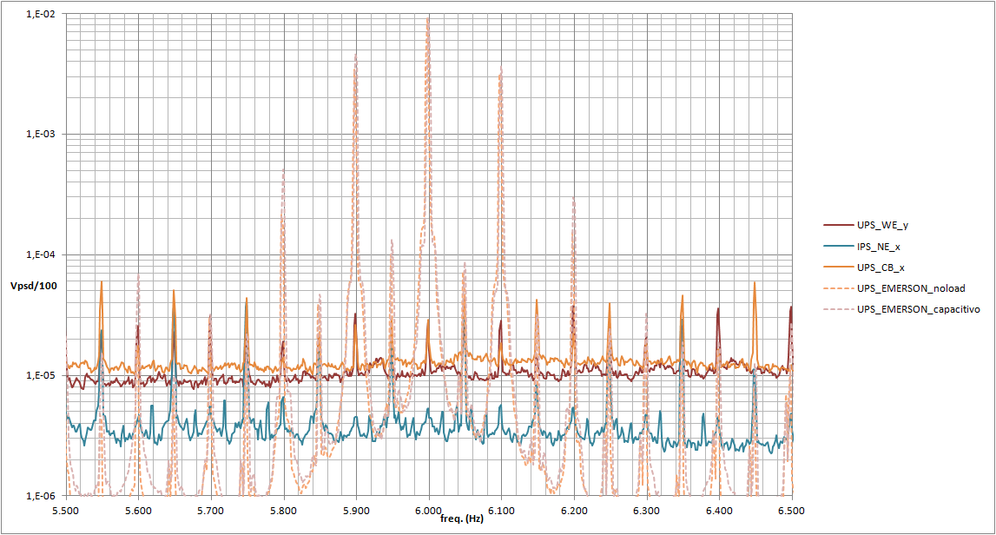
Searching for a “quieter” UPS
We had only small sharp lines around 6kHz (chopping frequency) where the new UPS was noisier (-50dB relative to 50Hz mains)

Slide 10
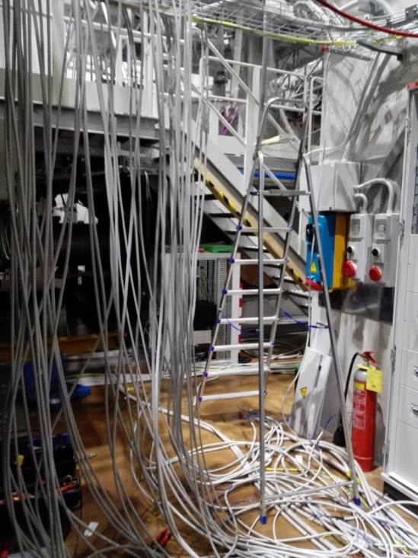
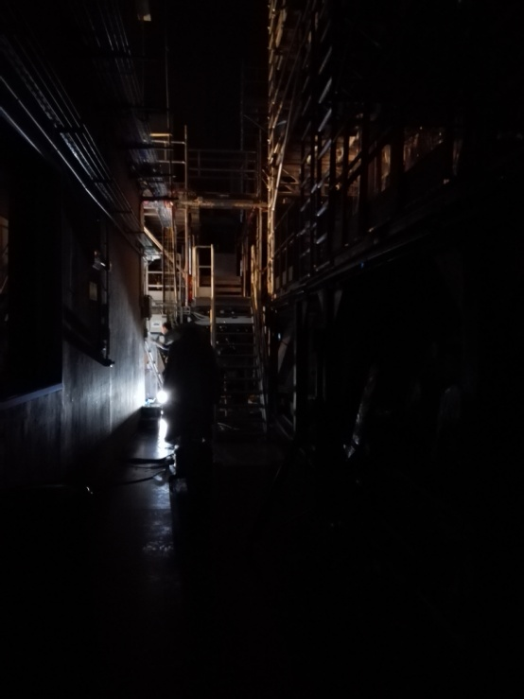
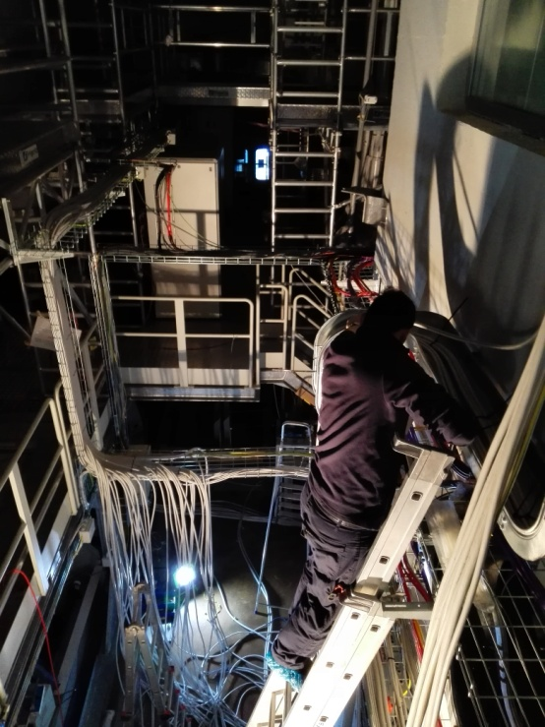
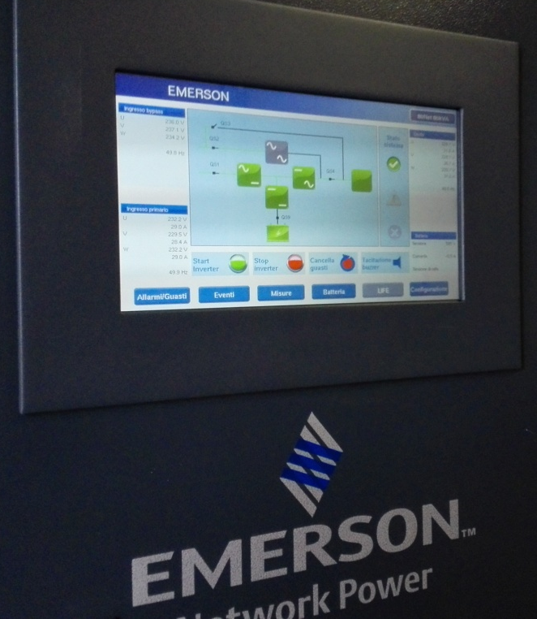
The last Christmas shutdown
Most of the works done in CEB during Christmas holidays
- Recabling Mains with Twisted pair cables
- Switch to the new UPS
- Removal of power cables from floor trenches around towers and re-routing
(see VIR-0338B-13)

Slide 11
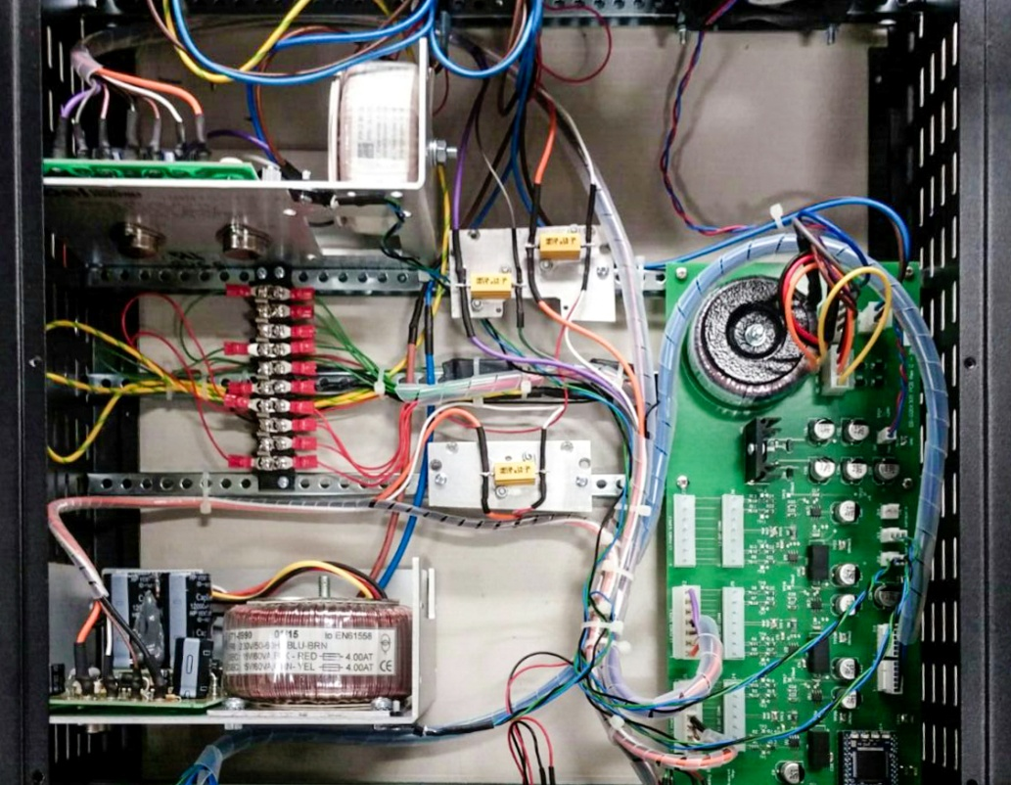
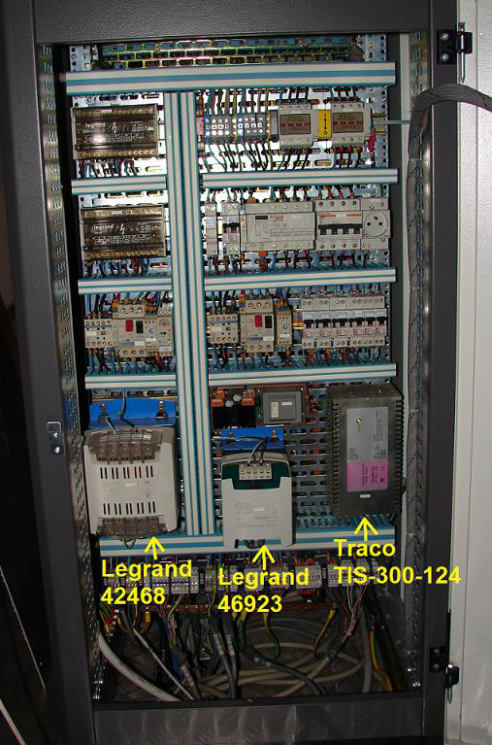
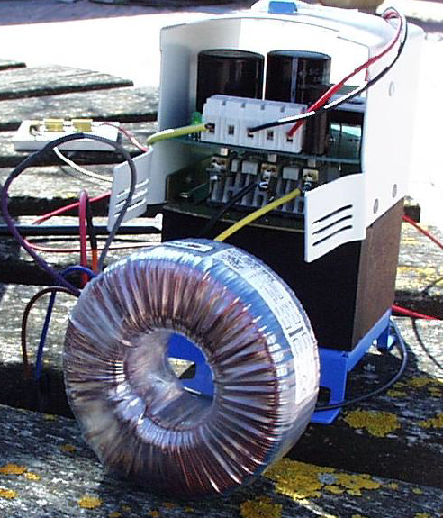
Sources mitigation
Other works carried out in late 2015: power supplies nearby towers equipped with toroidal transformers
SLED and Optical Lever power supply
Vacuum racks transformers
(VIR-0289A-12)

Slide 12
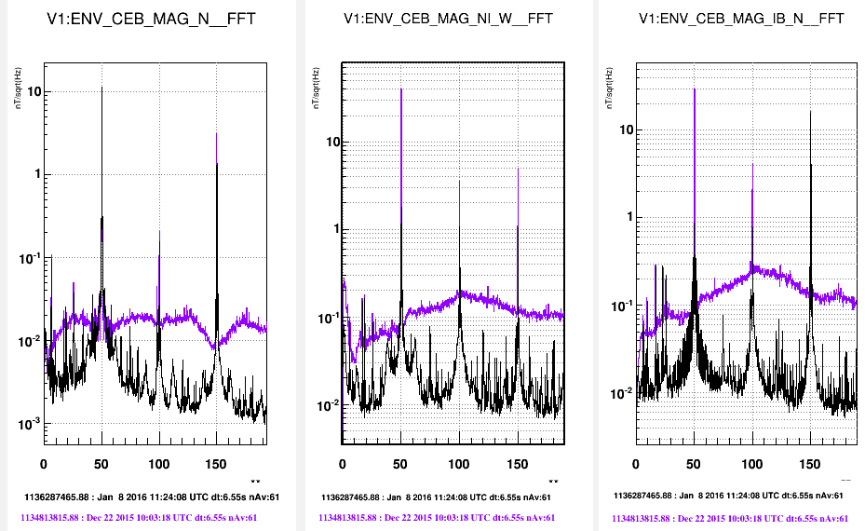
Results (at last!)
CEB magnetic field in different locations
(purple: before, black: after)

Slide 13
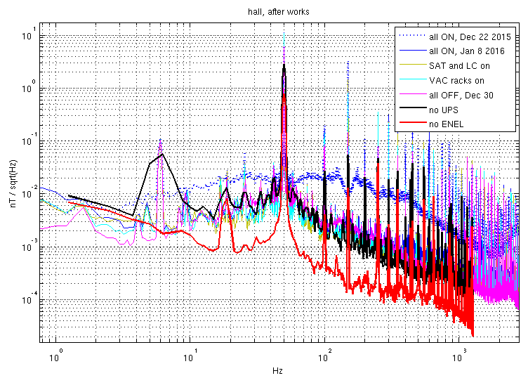
Results (at last!)
Magnetic Budget (preliminary) – details in eLog 33093
….. all on before
___ all on now
___ UPS off
Good result: magnetic noise from UPS is now at the level of IPS

Slide 14
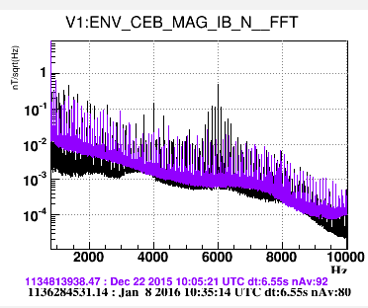
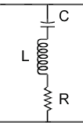
Concerns …
Some mag. lines @ 6kHz worse than before
… maybe a notch filter ?
10nF
70mH
Q ~10
250 Ω
(we’re in contact with UPS tech. staff)
Worst case: 100 times higher mag. field, but mirrors displ. drops 1/ω³

Slide 15
Conclusions
A lot of work done, by many people*
Good results! But:
not all devices are actually running in Virgo
+
environmental sensors still in temporary config./place
+
unknown situation @ NEB, WEB, MCB
=
repeat measurements in near future
*among many others: F. Carbognani, M. D’Andrea, I. Fiori, all the EGO Electronic group, D.Vander-Hyde ...

Slide 16
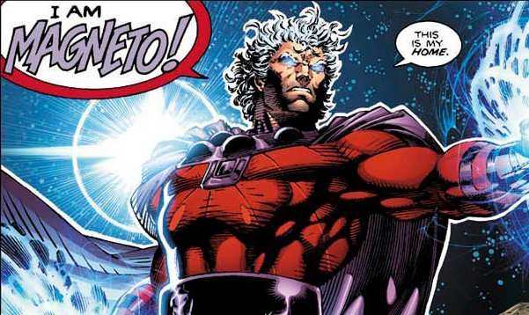

Thank you

