Slide 1



‘unexpected’ problems
1) Second-order fluctuations

Slide 2
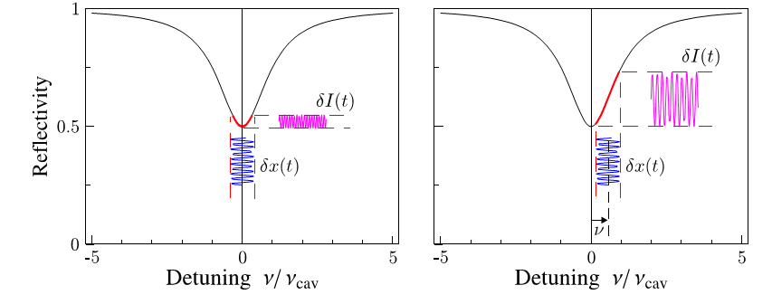
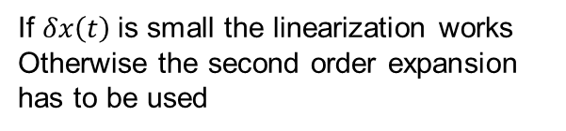


Non-linearity
If $δx\left(t\right)$is small the linearization works
Otherwise the second order expansion has to be used
$$\frac{1}{1+x^{2}}≅1−x^{2}$$
$$S_{φ^{2}}={\left|\int{\tilde{φ}\left(ω^{′}\right)\tilde{φ}\left({ω−ω}^{′}\right)}\frac{{dω}^{′}}{2π}\right|}^{2}$$

Slide 3
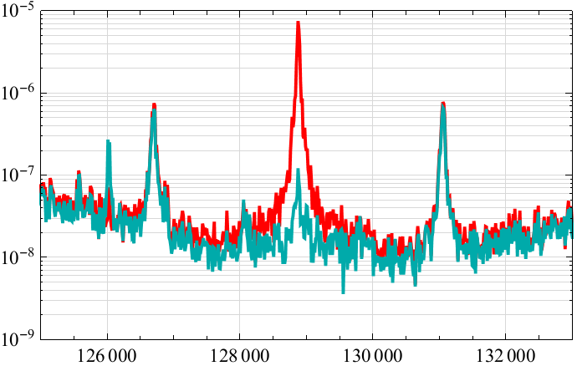
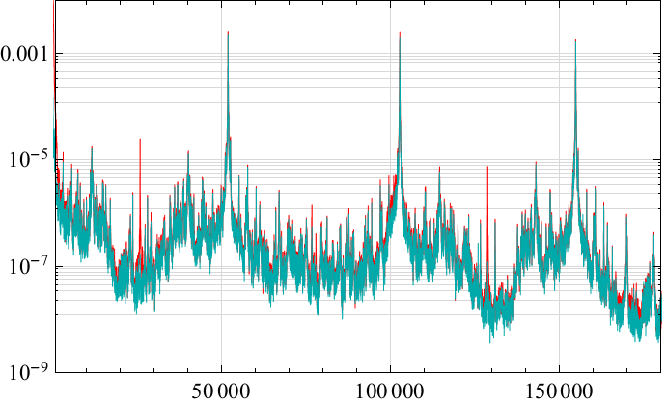
Non-linearity
Simultaneous acquisition of time series of
Output field intensity
PDH signal
Non linearized with optical resonance’s transfer function
Intensity PSD (W²/Hz)
Direct
Derived from PDH signal
Frequency (Hz)

Slide 4
‘unexpected’ problems
1) Second-order fluctuations
Solution: - higher input coupler transmission (lower Finesse)
- cleaner spectrum (low frequency mechanical modes are important)
2) Dynamic instability of ‘light’ modes at low frequency (within or close to the locking bandwidth)

Slide 5
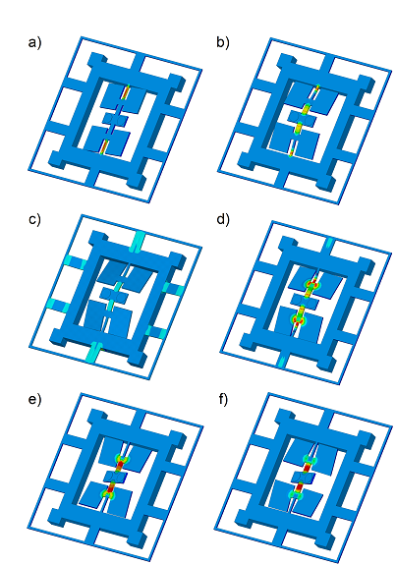
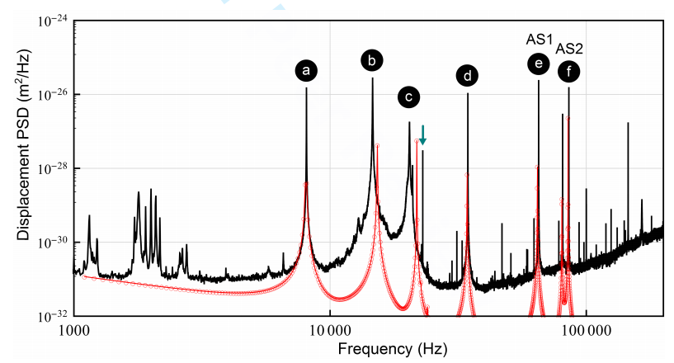

Slide 6
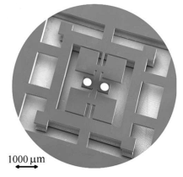
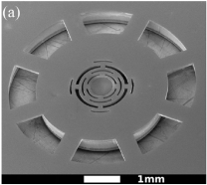
Freq. (kHz) [FEM] ±5% | Mass (kg) [FEM] ±10% | Q Room T ±10% | Q [FEM] LHe T ±10%
65.1 [67.0] | 2.6 x 10⁻⁷ [2.2 x 10⁻⁷] | 0.87 x 10⁵ | 0.85 x 10⁶ [4.0 x 10⁶]
85.5 [89.0] | 3.0 x 10⁻⁷ [2.2 x 10⁻⁷] | 1.45 x 10⁵ | 2.60 x 10⁶ [2.0 x 10⁶]
129 [136] | 1.35 x 10⁻⁷ [] | 2.80 x 10³ | 1.00 x 10⁵ [3.2 x 10⁶]
The problem concerns QPO oscillators, but WHEEL oscillators have lower Q

Slide 7
‘unexpected’ problems
1) Second-order fluctuations
Solution: - higher input coupler transmission (lower Finesse)
- cleaner spectrum (low frequency mechanical modes are important)
2) Dynamic instability of ‘light’ modes at low frequency (within or close to the locking bandwidth)
Solution: - new QPO with low-frequency modes up-shifted
- new WHEEL oscillators with balanced nodal suspension (enhanced de-coupling from the background and increased Q

Slide 8
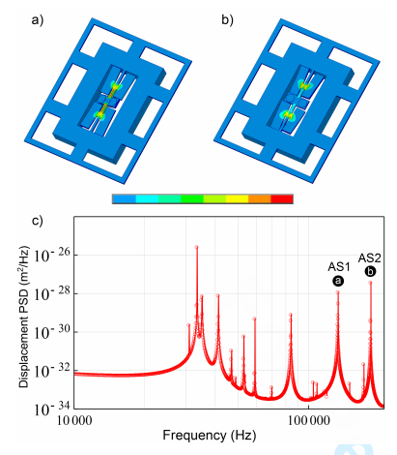
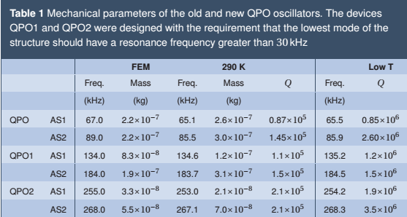
New QPO

Slide 9
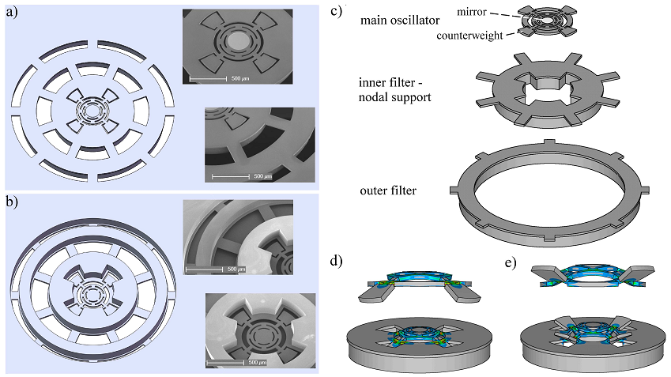
New WHEEL

Slide 10
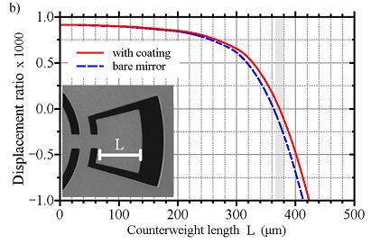
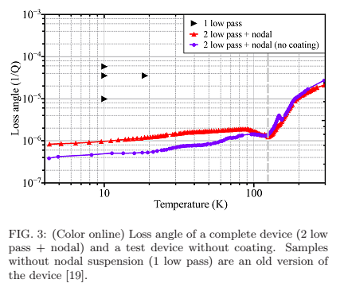
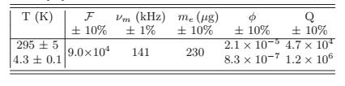
New WHEEL

Slide 11
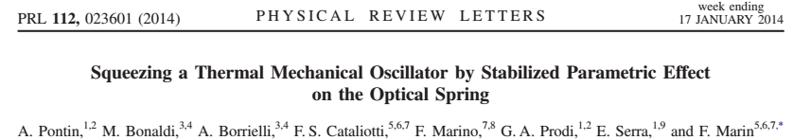
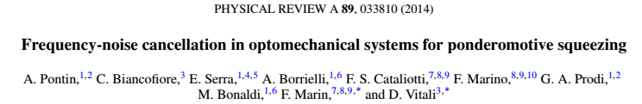
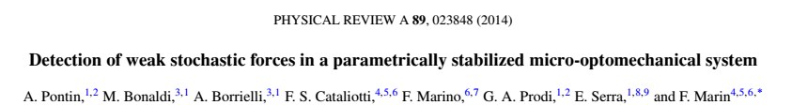
Published works with acknowledgement to the PRIN

