Slide 1

6th GraWIToN School
Michele Punturo
INFN Perugia
GraWIToN Project Coordinator

Slide 2
What is GraWIToN
GraWIToN is an Initial Training Network, funded by European Commission in FP7, under the Marie Curie Actions
Target of the project is to train young researchers (ESRs) in different aspects of the GW research
14 PhD (researchers) are trained for 3 years by the Institutes participating to the project

Slide 3
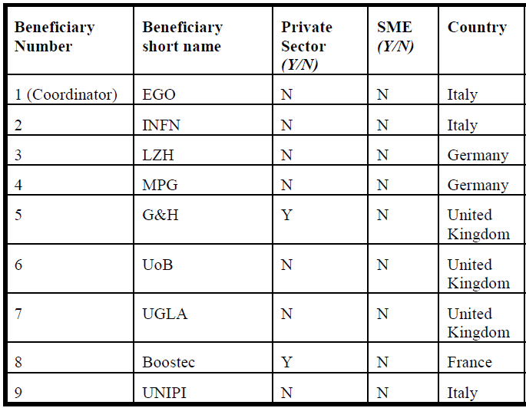
The GraWIToN Consortium
Full partners:

Slide 4
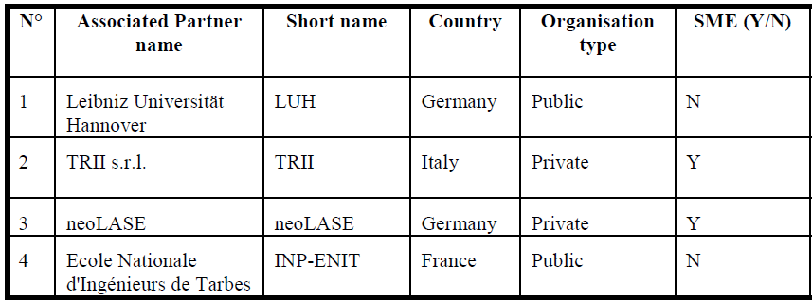
The GraWIToN Consortium
Associated partners:

Slide 5
Network schools
The GraWIToN training is based on
  Local training
  Secondments
  Network schools
    We had already 5 schools (Introductory, Data analysis and technical)
6th GraWIToN School:
  Management of scientific Projects, Why?

Slide 6
Management of scientific projects
Big science projects have a complexity comparable to large enterprises
Project life spans on several decades

Slide 7
Virgo
AdV
aLIGO
ET
1985
R&D
1990
15 years
White Paper, CDR (1989)
R&D
Approval (1994)
R&D
1995
Final Design, TDR (1995)
Beginning
Infrastructure (1996)
2000
R&D
CDR (1999)
Completion installation
Detector (2003)
15 years
First AdV
sensitivity projection (2004)
R&D
15 years
2005
AdV White Paper, CDR (2005)
First Idea (2005)
Scientific data taking
(2007)
Funding (2006)
Approval (2009)
Building (2008)
R&D
2010
Decommissioning (2011)
First orders (2010)
CDR (2011)
TDR (2012)
Installing completion
(2014)
R&D
2015
Completion Installation (2016)
Data taking (2015)
First data taking (2017)
2020
TDR ?
2025
Construction ?

Slide 8
Management of scientific projects
Big science projects have a complexity comparable to large enterprises
Project life spans on several decades
Projects involve hundreds or thousands researchers and engineers
The implementation of the detectors or of the analysis software requires the definition of thousands tasks, related, parallel or sequential
The quality control is a crucial issue for the success of a similar enterprise
Risk identification and evaluation must be at the base of the decision procedures

Slide 9
Management course
Hence, the tools needed to manage a large project cannot be improvised, but they have to be developed on a scientific (and technical) base
Management Course by Prof. Luisella Lari
  Currently Associated Project Manager for Planning and Reporting & Scientist @ Fermilab, ESS ERIC Consultant
  Previously:
    Senior Project Planning Manager & Senior Scientist @ ESS (Sweden)
    Planning Officer & Applied Physicist @ CERN
    AIV (Assembly, Integration & Verification) Engineer @ Alenia Spazio
“Evolution” of the course for INFN researchers (Formazione INFN, Perugia 2013-2014)

Slide 10
Complementary skills
Target of the ITN is provide to the ESR complementary skills usable both in the academic and in the private sector
Seminars:
  Sustainability, Dr Antonio Giacomucci
    Regional Sustainability / Health, Safety and Environmental Manager for ABB in Europe.
  Space projects, Prof. Enrico Flamini
    Scientific coordinator of the Italian Space Agency (ASI)
Outreaching activities:
  Preparation of the activities (Monday Morning)
  Team activities with the students of the “Liceo Internazionale Pesenti, Cascina”

Slide 11
Let Start
Have a productive and profitable week
For questions/doubts ….
  Erika Morucci: erika.morucci@ego-gw.it

