Slide 1
Machine Learning short course
Proposal for a Training school for GraWIToN
Elena Cuoco, EGO and INFN

Slide 2
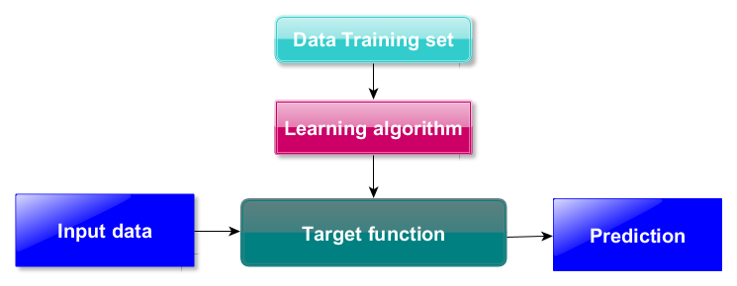
Machine Learning: learning from data
Machine Learning is a key technology in Big Data and in many financial, medical, commercial and scientific applications.
It is used to produces algorithms, tools to make predictions from data.

Slide 3
Example: ML in Astronomy
Big Data to analyze
Useful for automatic classification (for example galaxy classification)
Image processing
Useful for pattern recognition (transient events detection)

Slide 4
Example: ML in Medical science
Statistical studies
Classify groups of patients
Imaging techniques
Pattern recognition and image processing (NMR)

Slide 5
School objective
Multidisciplinary school
General introduction on ML concepts
Supervised and unsupervised learning
ML in astronomy
Applications (also to GW DA)
ML in medical science
Image processing and pattern recognition
Application
Useful Techniques for classification
Notes:
We are aware that different scientific communities (GW communities, Medical Science, Engineering, Telecommunications...) use similar techniques of signal processing.
Often we have to face the same problem : find weak signals buried in background noise
One of the main objectives of this workshop is to put in contact scientists with different backgrounds to exchange ideas and learn new techniques.
We would like to share competences and give these different environments the occasion to interact.

Slide 6
Program proposal
Minimum duration: Three Days
  First day: General introduction on Machine learning techniques (with help of Ciro Cattuto)
  Second day: Applications in Astronomy and link with GW community (with help of Marica Branchesi)
  Third day: Pattern recognition and Medical science application (with help of Andrea Chincarini)

Slide 7
Day prototype
9:00-11:00
Theory
Coffee-break
11:30-13:00
Theory
Lunch
14:30-16:30
Theory/exercises
Coffee-break
17:00-18:00
Exercises
end

Slide 8
Collaborators
Marica Branchesi: Researcher at Urbino University. In the steering committee and core team of the INAF project for EM follow-ups of GW triggers in the ADE
Ciro Cattuto: Data Science Laboratory leader of the and Research Director of Institute for Scientific Interchange Foundation (www.isi.it).
Andrea Chincarini: INFN Researcher at Genova University and National coordinator of MIND (Medical imaging for Neurodegenerative Diseases)
Elena Cuoco: EGO referent for Data Analysis and Virgo noise studies group coordinator

