Slide 1

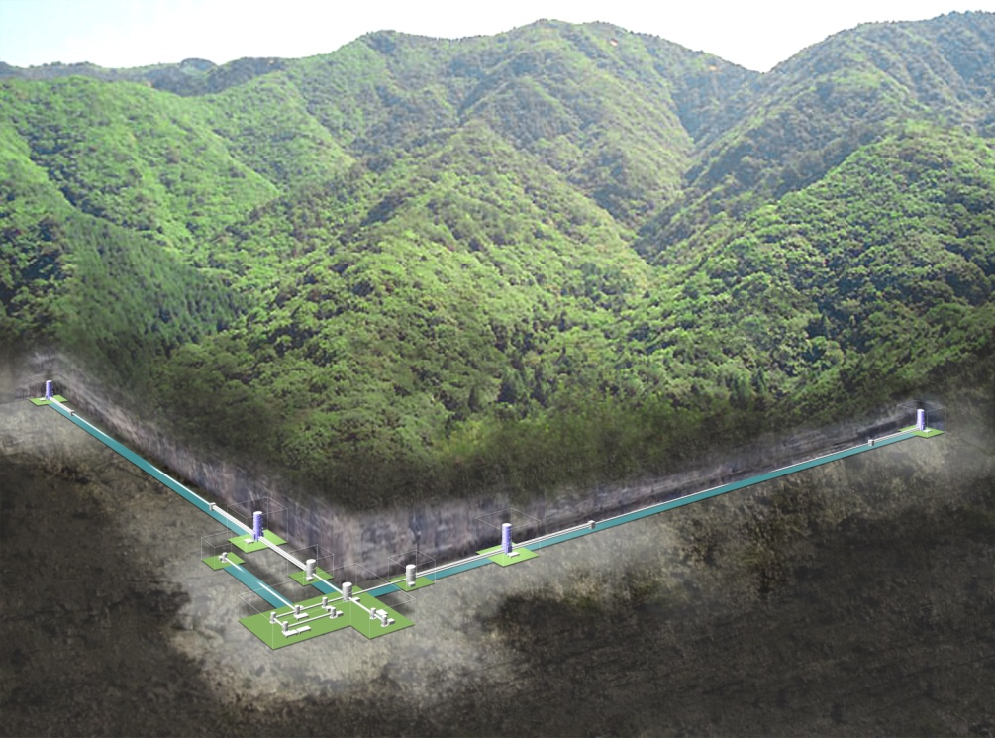
Status of KAGRA
ET Workshop @Hannover
4-5 December, 2012
Kazuaki Kuroda
ICRR, UT
On behalf of KAGRA Collaboration

Slide 2
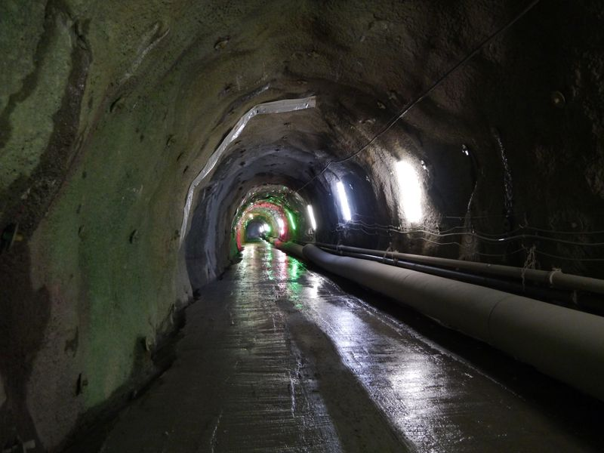
Overview
Scientific Objective
Interferometer
Schedule
Design & Construction
Man power
Collaboration
Summary

Slide 3
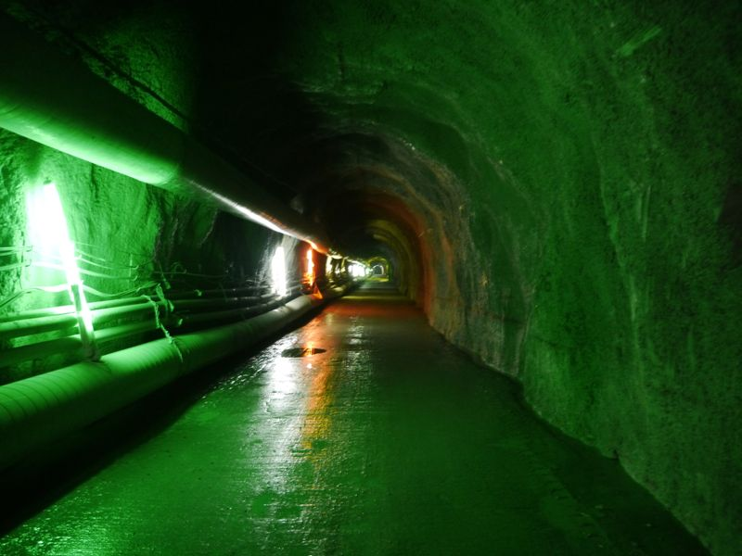
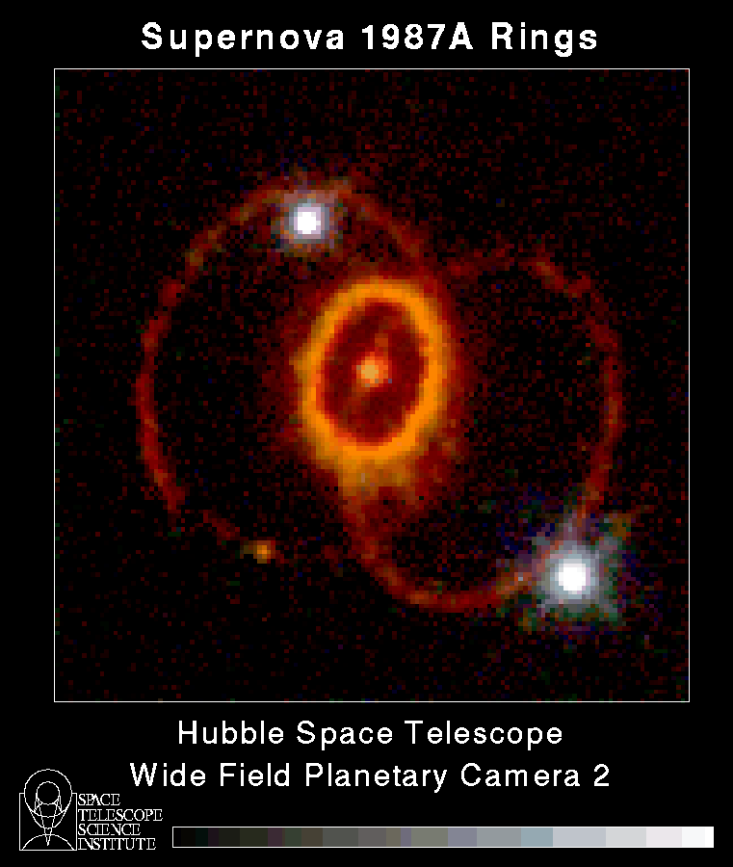
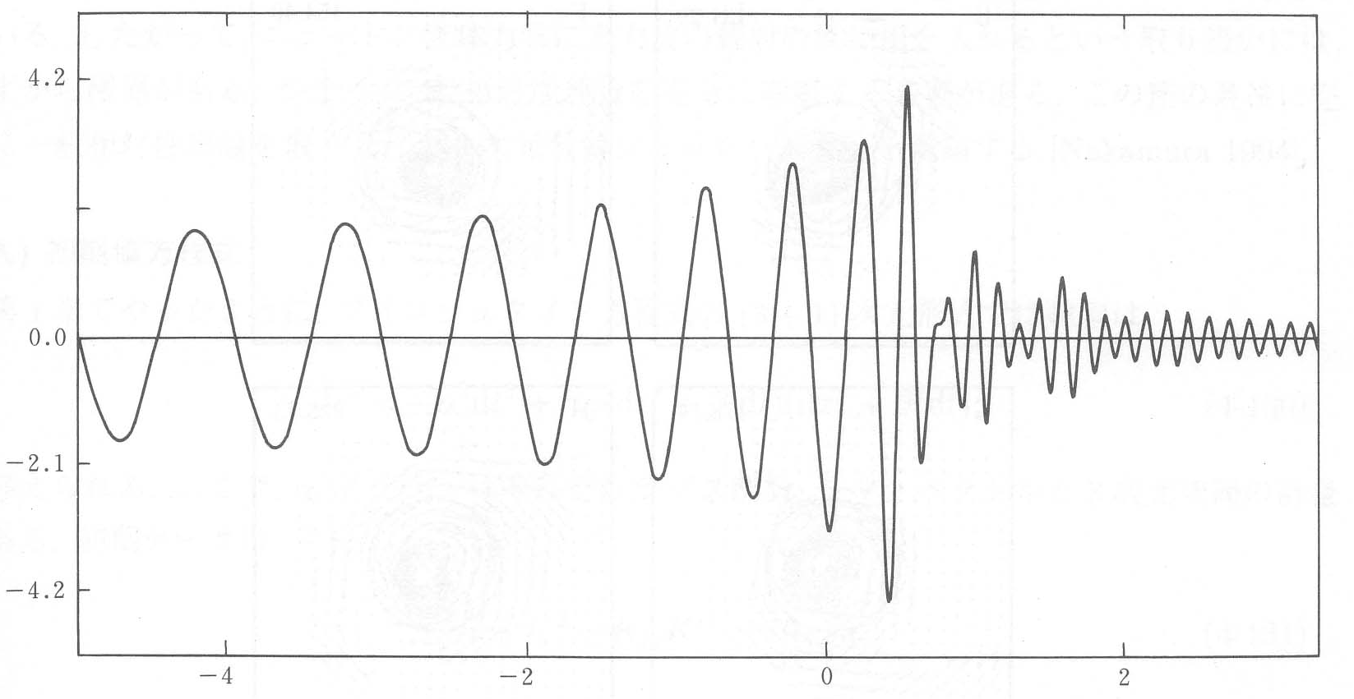
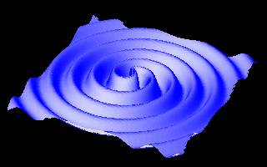
Scientific Objective
Detection of gravitational waves:
1. coalescence of compact star binaries
2. core collapse of massive stars
3. others
Existing neutron star binaries that coalesce in 10¹⁰Year
PSR B1913+16
PSR B1534+21
PSR J0737-3039A
PSR J1756-2251
PSR J1906+0746
PSR J2127+11C
quasi-mode
oscillation
coalescence
chirp signal
-300Hz
-1kHz
msec

Slide 4
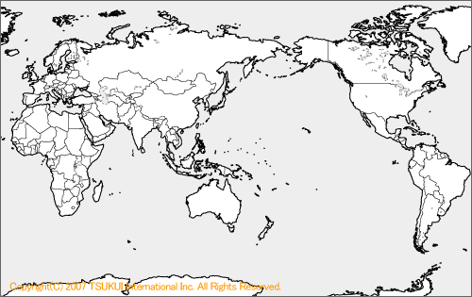
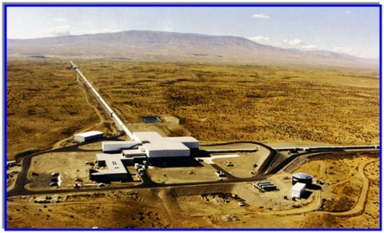
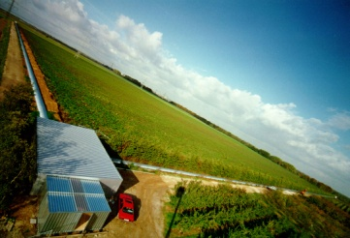
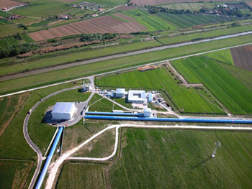
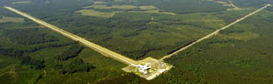
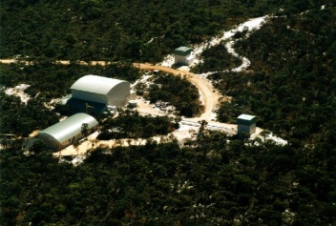
Detectors in the world
GEO HF
LIGO(I) Hanford
KAGRA
Adv. LIGO
(under construction）
TAMA/CLIO
KAGRA construction started in 2010
Virgo
Adv. Virgo (under construction)
LIGO(I) Livingston
ET (planed)
LIGO-India (budget request)
A network of detectors is indispensable to position the source.

Slide 5
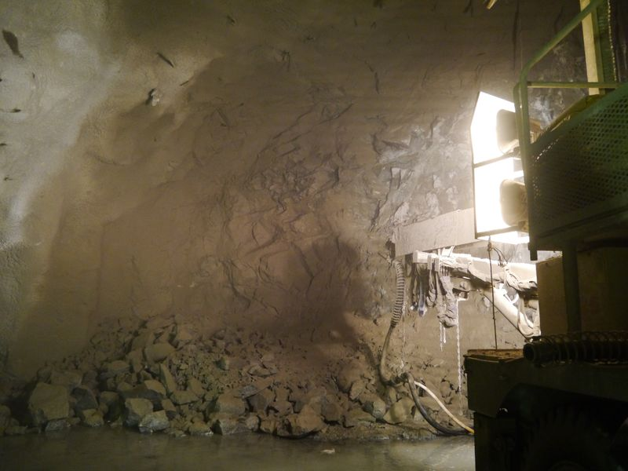
Interferometer configuration
Input/Output Optics
- Beam Cleaning and stab.
- Modulator, Isolator
- Fixed pre-mode cleaner
- Suspended mode cleaner
Length 26 m, Finesse 500
Main Interferometer
- 3 km arm cavities
- RSE with power recycling
- Cryogenic test masses
Sapphire, 20K
‘Type-A’ vibration isolator
Cryostat + Cryo-cooler
- Room-temp. Core optics
(BS, PRM, SEM, …)
ETM
- Output MC
- Photo detector
Y-arm cavity
ITM
Power
~180 W
80 W
825 W
Power ~400 kW
Input
Bench
PRM
BS
ITM
ETM
Laser
26-m MC
Power-recycling
Gain ~11
X-arm cavity
Length 3,000 m
Finesse 1,550
Laser Source
- Wavelength 1064 nm
- Output power 180 W
High-power MOPA
RSE: (Resonant
sideband Extraction)
Signal-band Gain ~15
Detuned RSE
(Variable tuning)
SEM

Slide 6
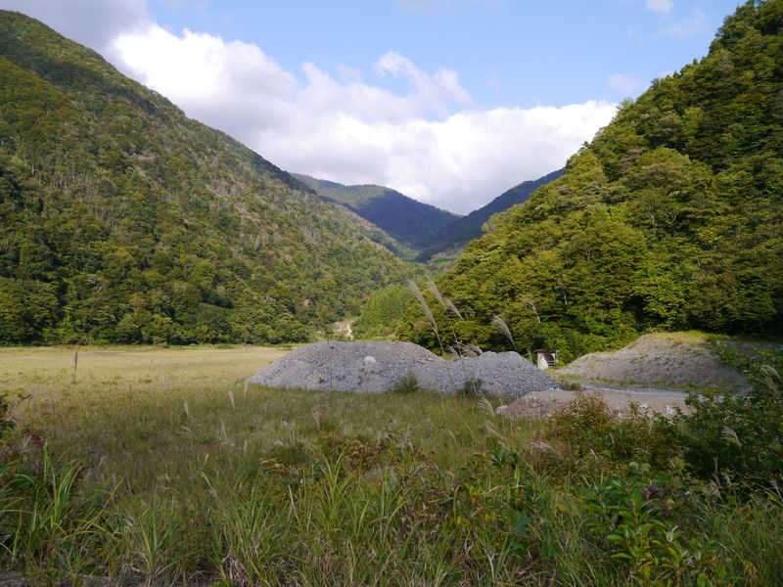
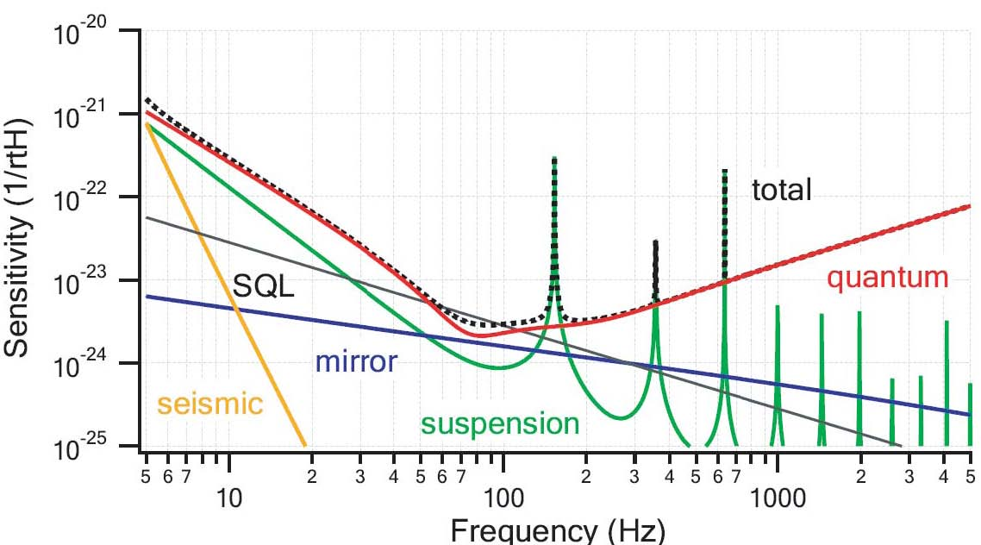
Ultimate design sensitivity of KAGRA
This sensitivity achieves 166 Mpc for
coalescence GW of 1.4 Ms NSB.
20kg test mass at 20 K
Suspension of Q=10⁸
Bulk Q of mirror 10⁸
400kW cavity power
Q of coating: 10⁴
DC read out

Slide 7
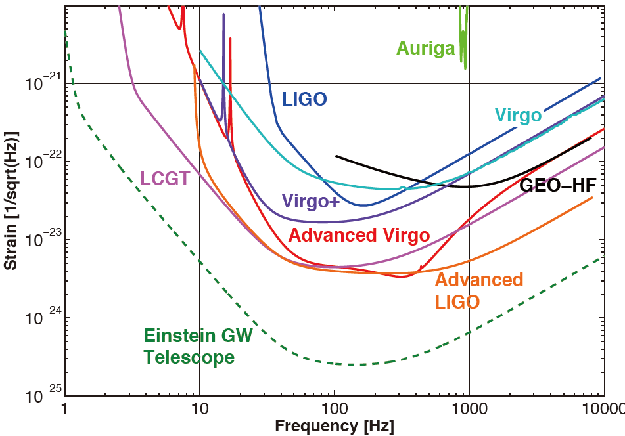
World sensitivities
2010 GWIC rept

Slide 8
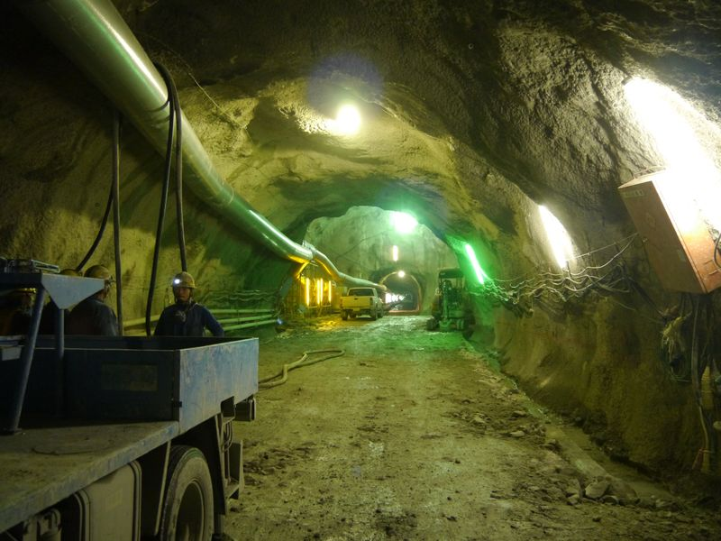
Coalescence events
Ｅｓｔｉｍａｔｅｄ ｒａｔｅ ｏｆ ｄｅｔｅｃｔｉｏｎ of compact binary stars
 | 1.4-1.4M_{sun} | 1.4-10M_{sun} | 10-10M_{sun} | comment
Range*¹ | 167 Mpc | 352 Mpc | 830 Mpc | Whole sky and angular average
(old definition of KAGRA) | (282 Mpc) | (593 Mpc) | (1398 Mpc) | Optimal event horizon
Detection rate*² Events/year | 0.2 - 200 (20) | 0.1 – 183 (5.5) | 0.2 – 717 (9.6) | ( ) : realistic estimate
*1 Re-calculated from Tagoshi for the case of BRSE-D
*2 CQG 27 (2010) 173001 + Galaxy density 0.01/Mpc³

Slide 9
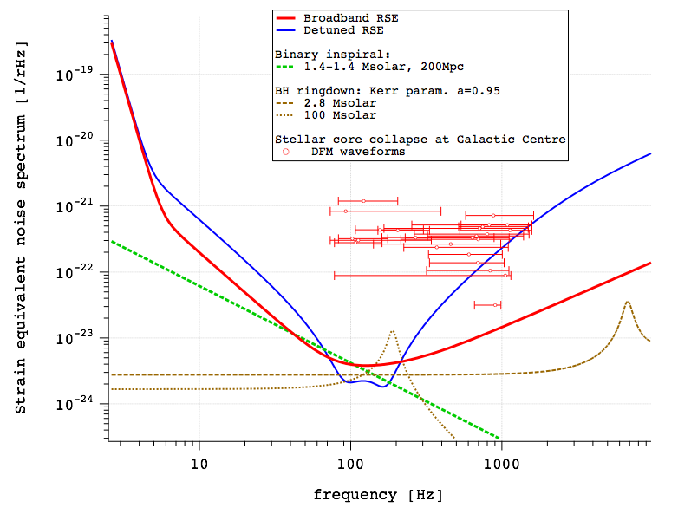
Burst waves

Slide 10
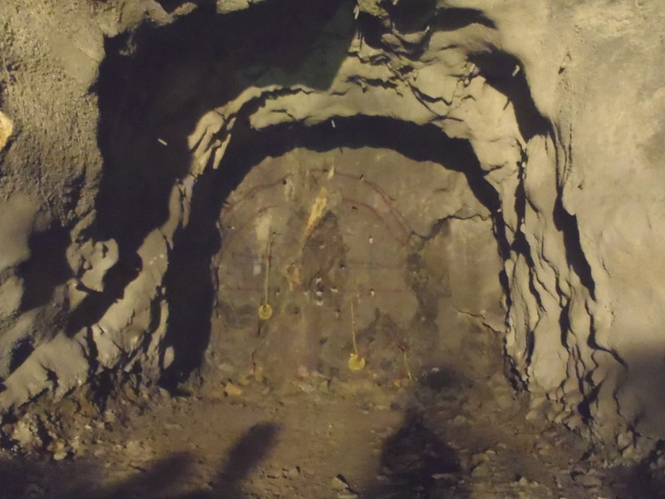
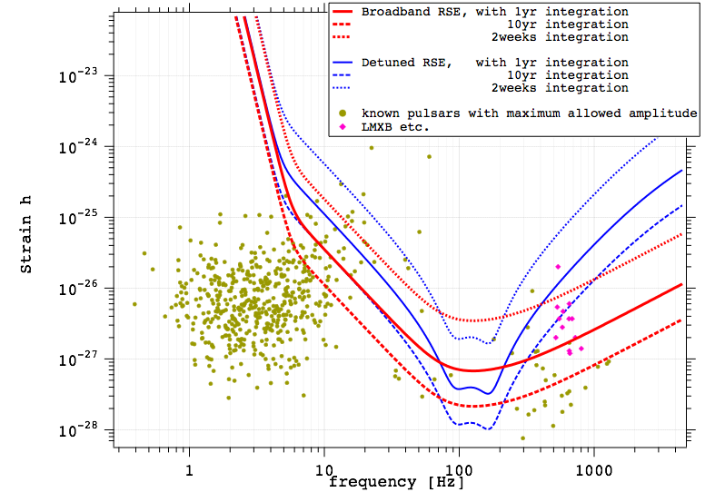
Continuous waves
Vela pulsar
ε=0.02
Crab pulsar
ε=10⁻⁵

Slide 11
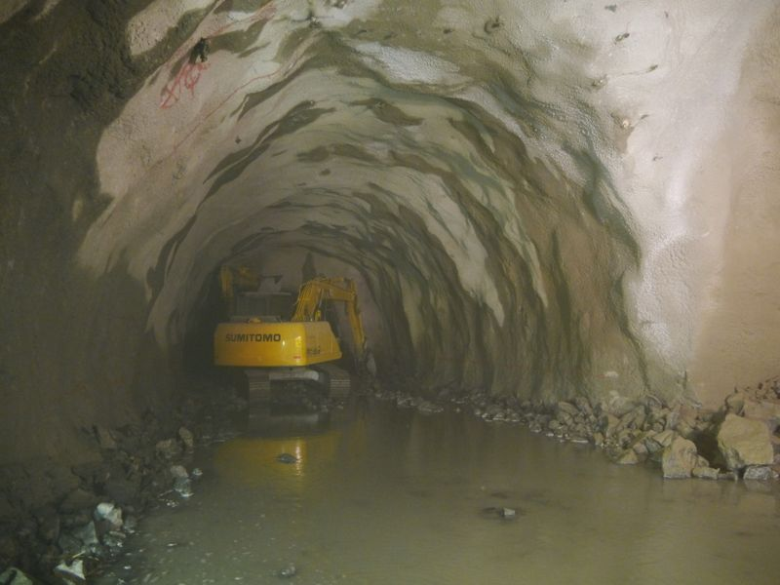
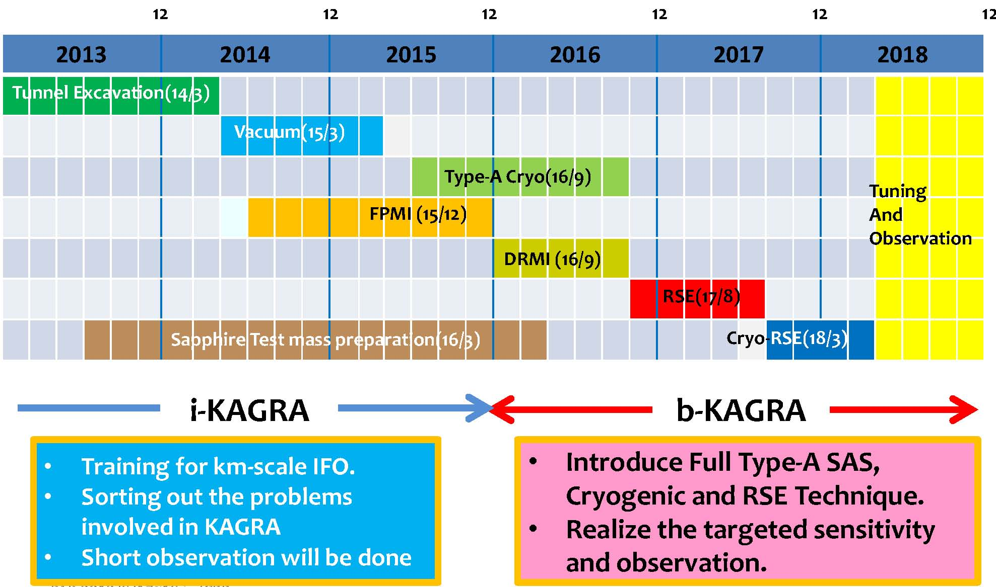
Planned schedule of KAGRA

Slide 12
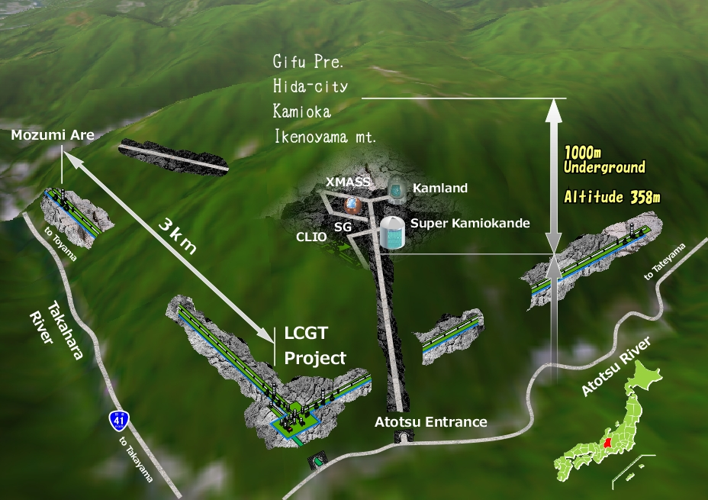
Location and Tunnel Design

Slide 13
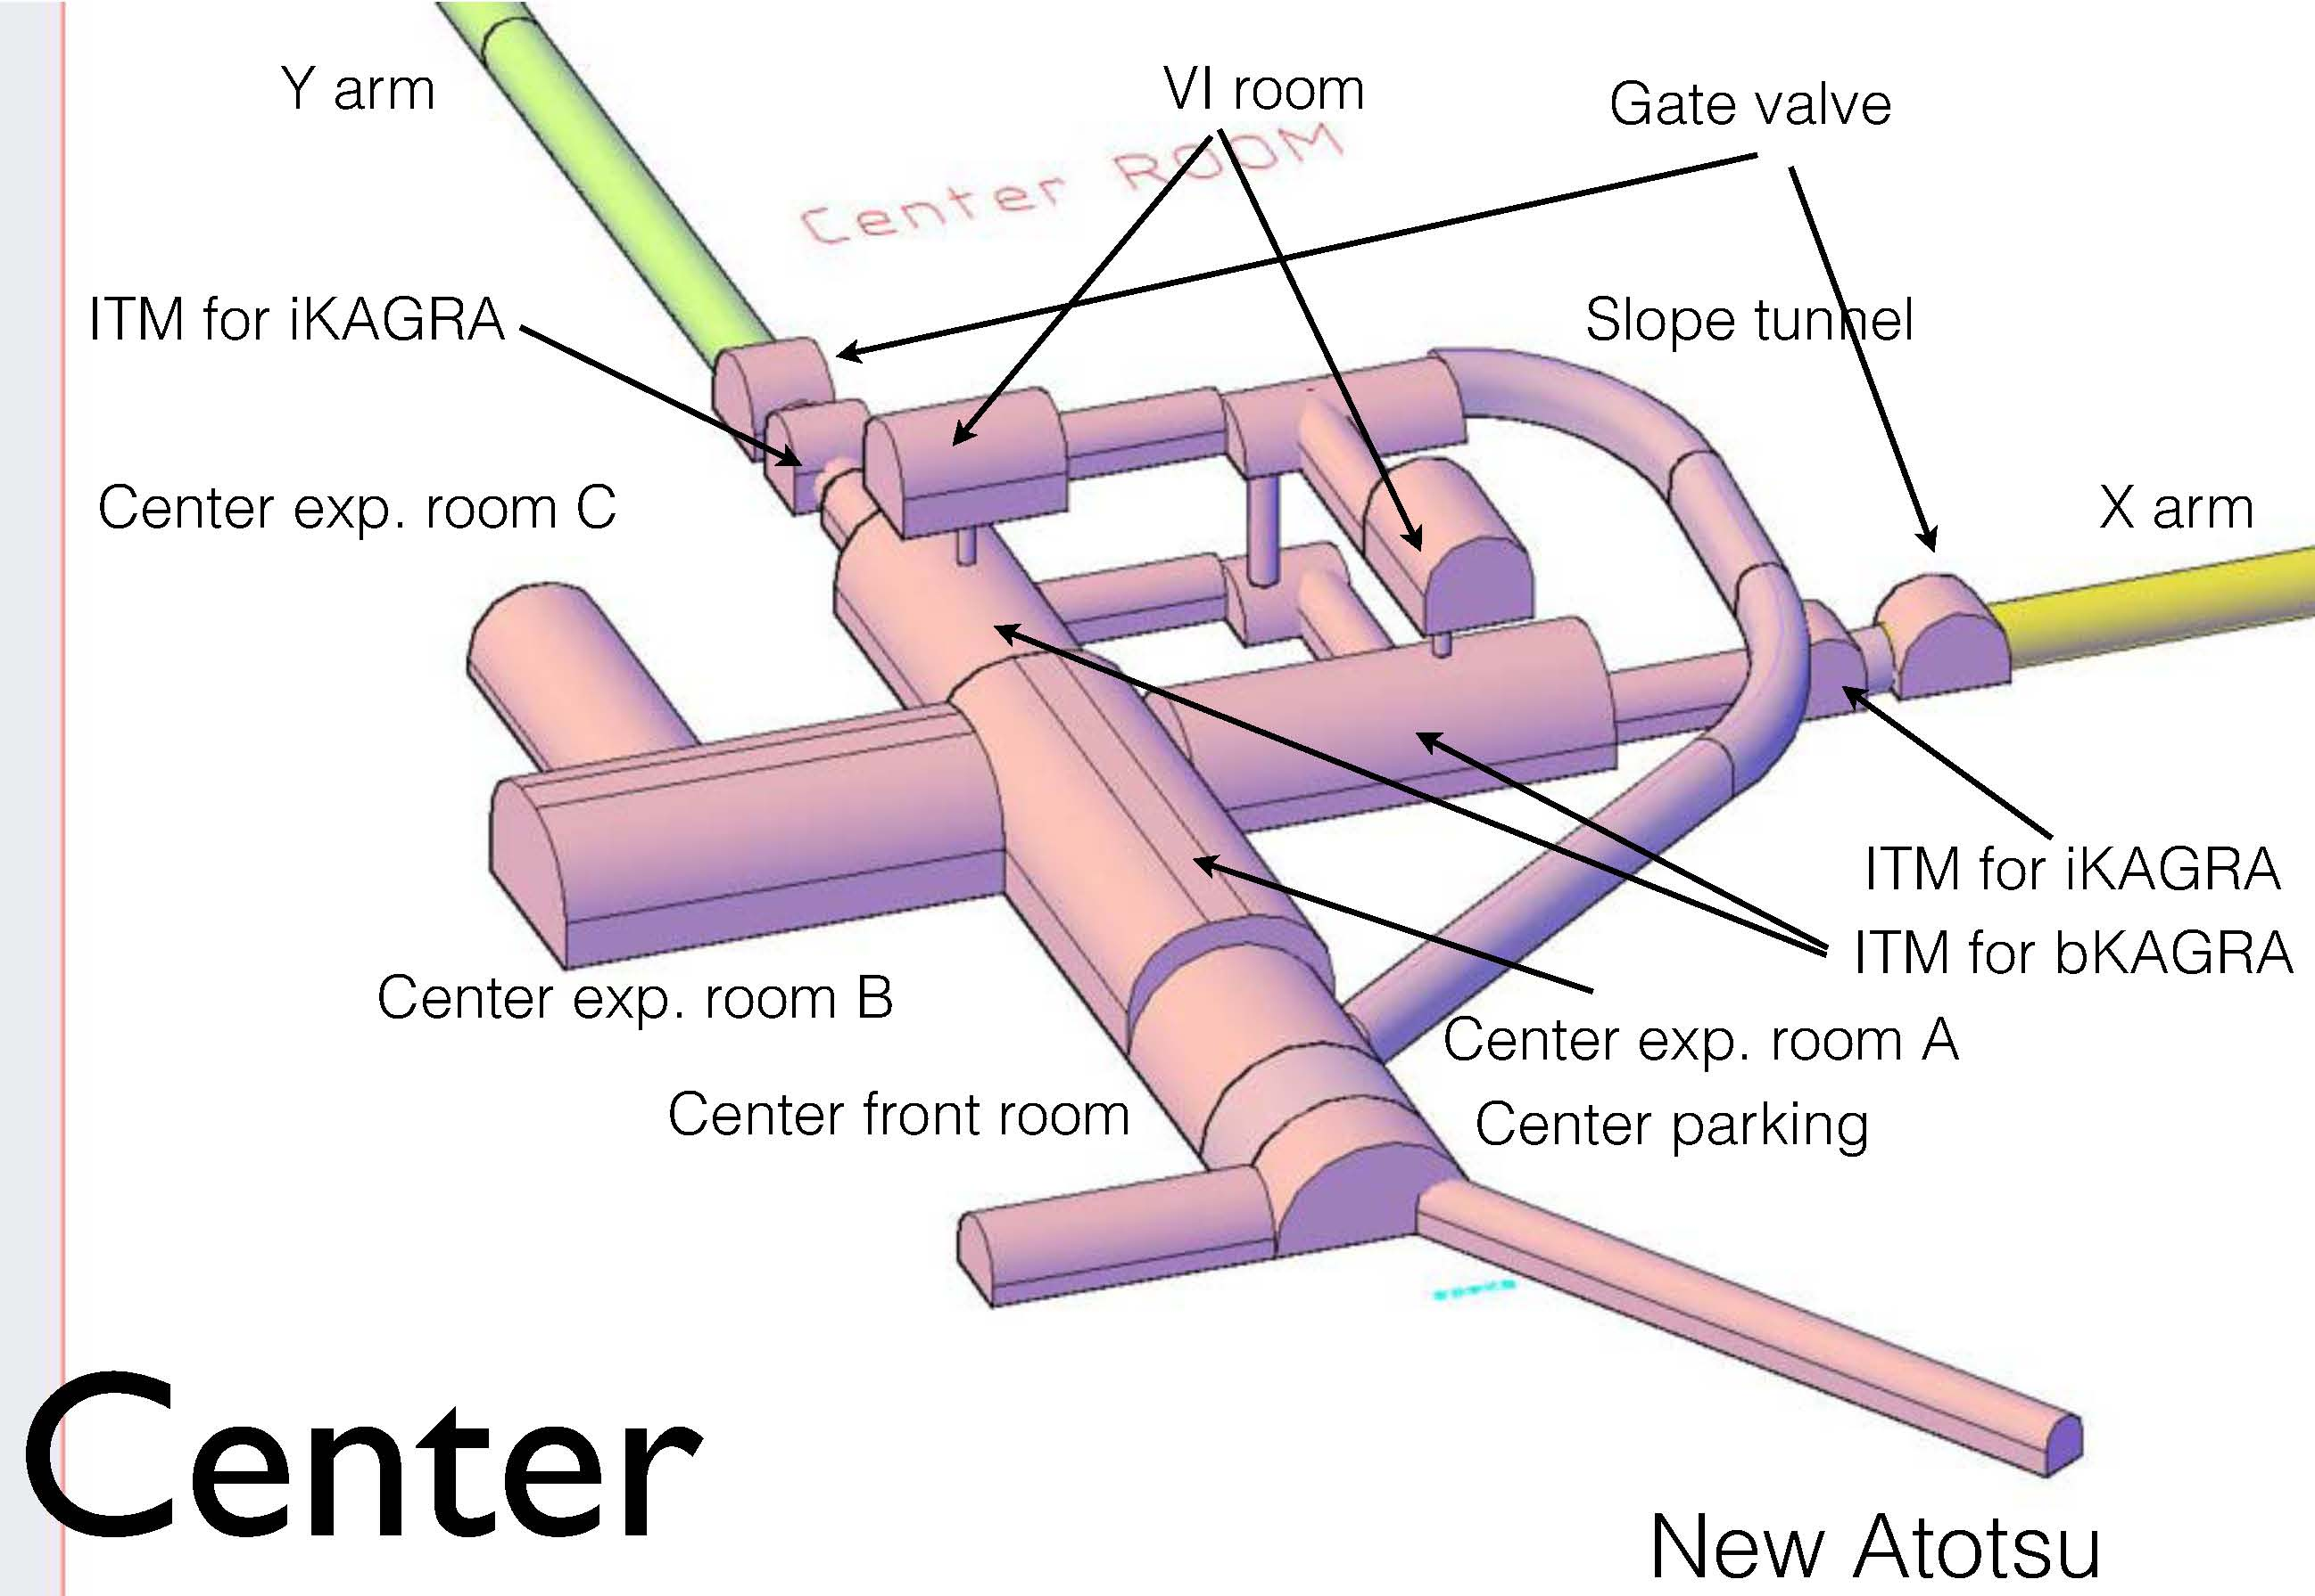
Tunnel Design

Slide 14
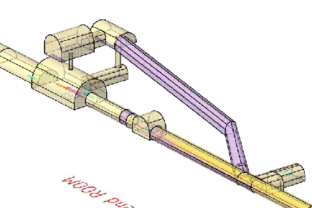
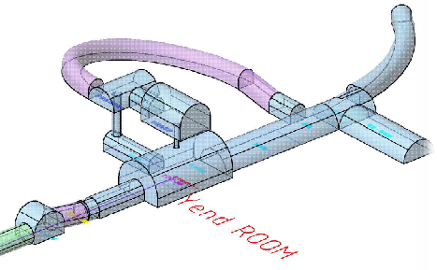
Tunnel Design
SAS-IP floor
X-end, Sin-Atotsu
Center
SAS-IP floor
Y-end, Mozumi side
Center

Slide 15
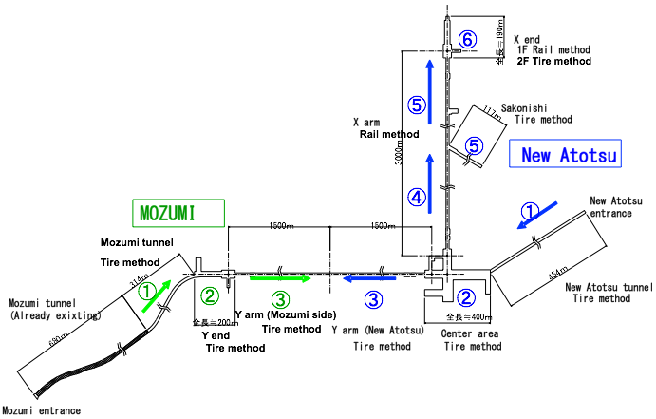
Tunnel construction status
The blasting started on May 22, 2012.
Excavation is carried out from the Mozumi and New-Atotsu entrances.
  The excavated area are shown by red.

Slide 16
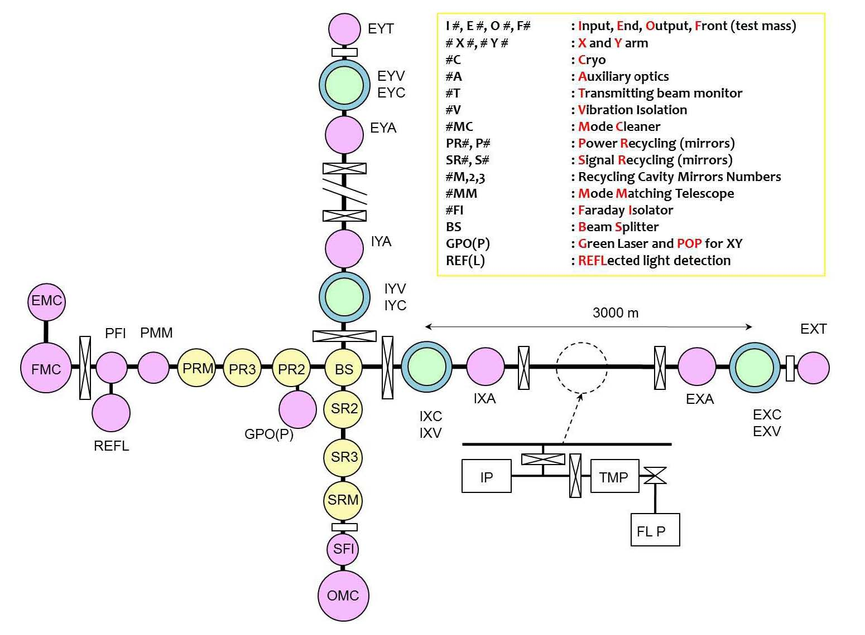
Vacuum System

Slide 17
Vacuum System
Planned by VAC (YS)
1) manufacturing 478 of tubes;
        from Apr 2011 to Mar 2013
2) manufacturing chambers;
        from Sep 2012 to Mar 2014
carrying tubes from ATOTSU pithead
BRTY
3) installing chambers in X and Y ends; Apr 2014
Apr 2014
4) carrying tubes and lay on the supports;
        from Apr 2014 to Jun 2014
ETMYA
EAOY
5) installing chambers in Center Room; Jul 2014
6) jointing tubes and pump down in X and Y arm
        from Jul 2014 to Mar 2015
Jul 2014 to Mar 2015
IAOY
MC
ITMY
Apr 2014
MCF
MMT
PRM
PR3
PR2
BS
ITMX
IAOX
EAOX
ETMXA
BRTX
SR2
3000 m
Apr 2014
SR3
Jul 2014 to Mar 2015
SRM
Jul 2014
PD

Slide 18
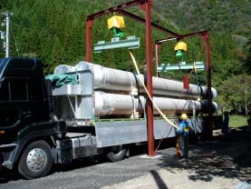
Vacuum System
Almost all vacuum parts will be manufactured by the end of
this financial year (End of the next March)
Vacuum tubes transported to a storage place near KAGRA site.

Slide 19
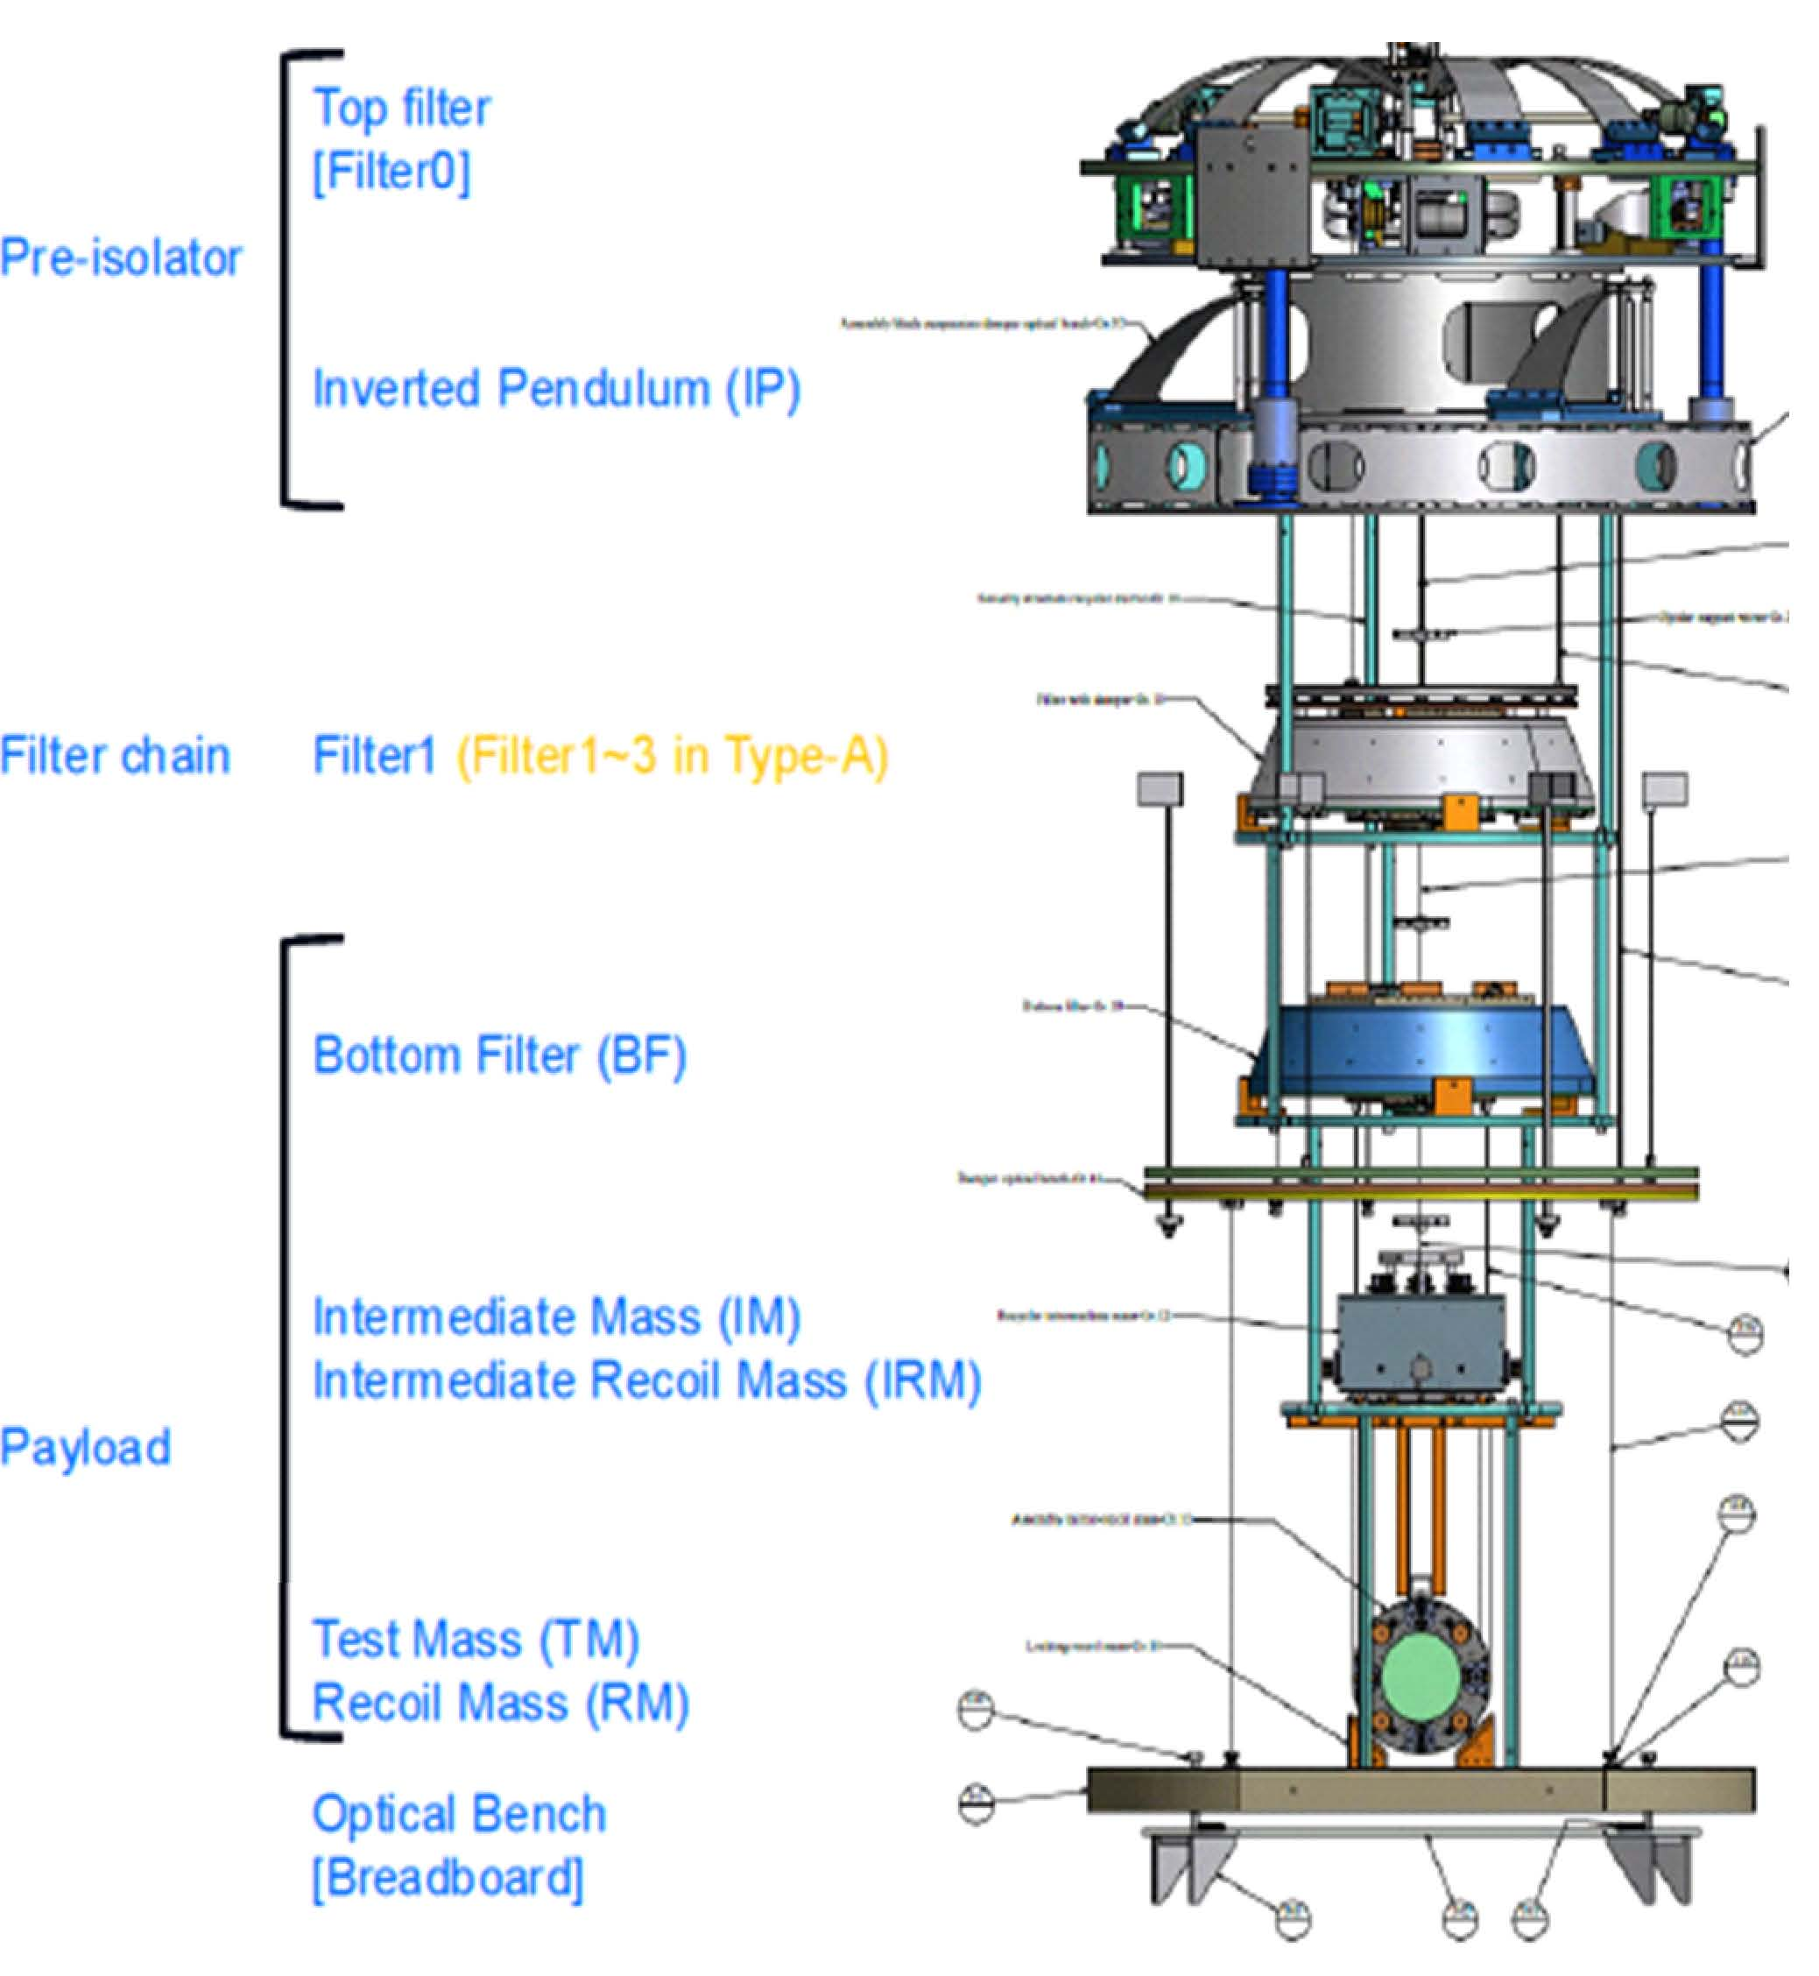
Vibration Isolation
Type A (13m tall)
for Main TM
&
Type B
for BS, PRM, SRM,
Etc
&
Type C
for
All parts are made
By the end of FY12

Slide 20
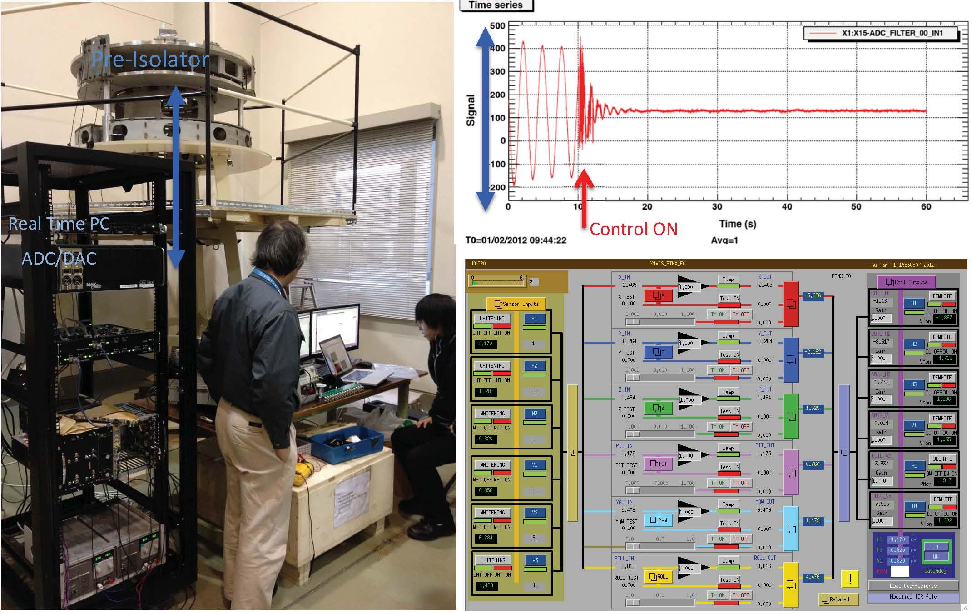
IP-prototype test by DGS

Slide 21
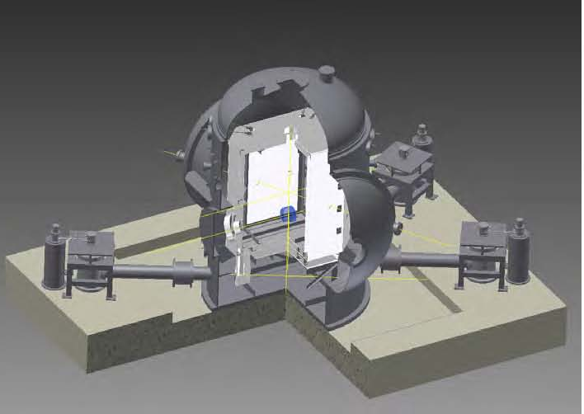
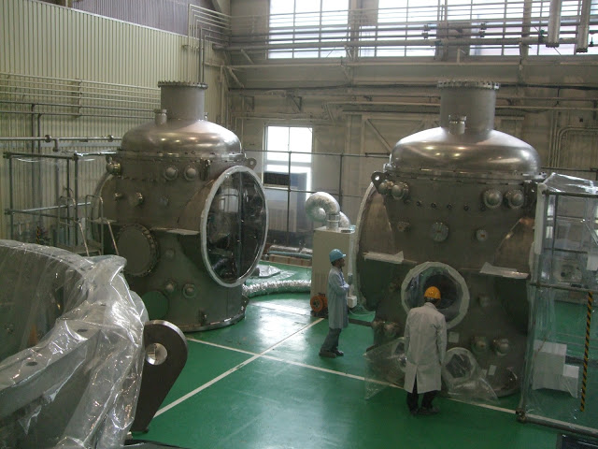
Cryogenic system
&
Suspension
Four vacuum cryostats are manufactured
and are inspected in Toshiba company.
Four cryo-coolers are designed to be
used: two for direct cooling of TM,
and two for radiation shields
(More detail by K Yamamoto)

Slide 22
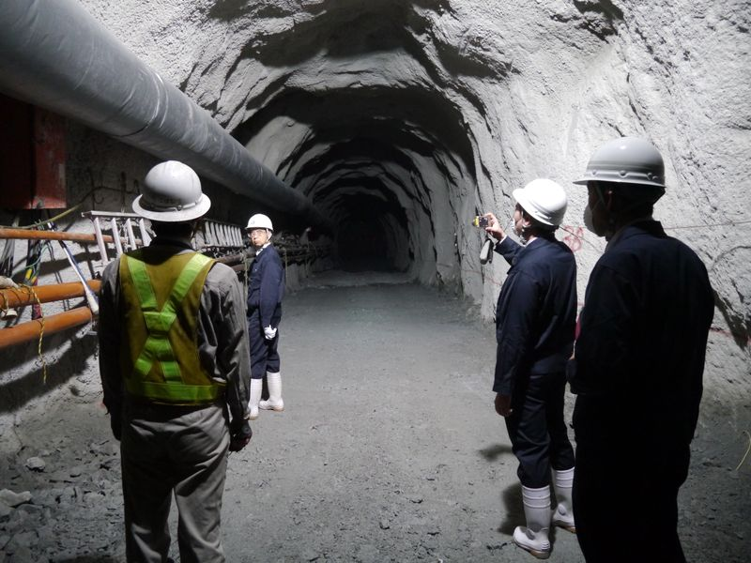
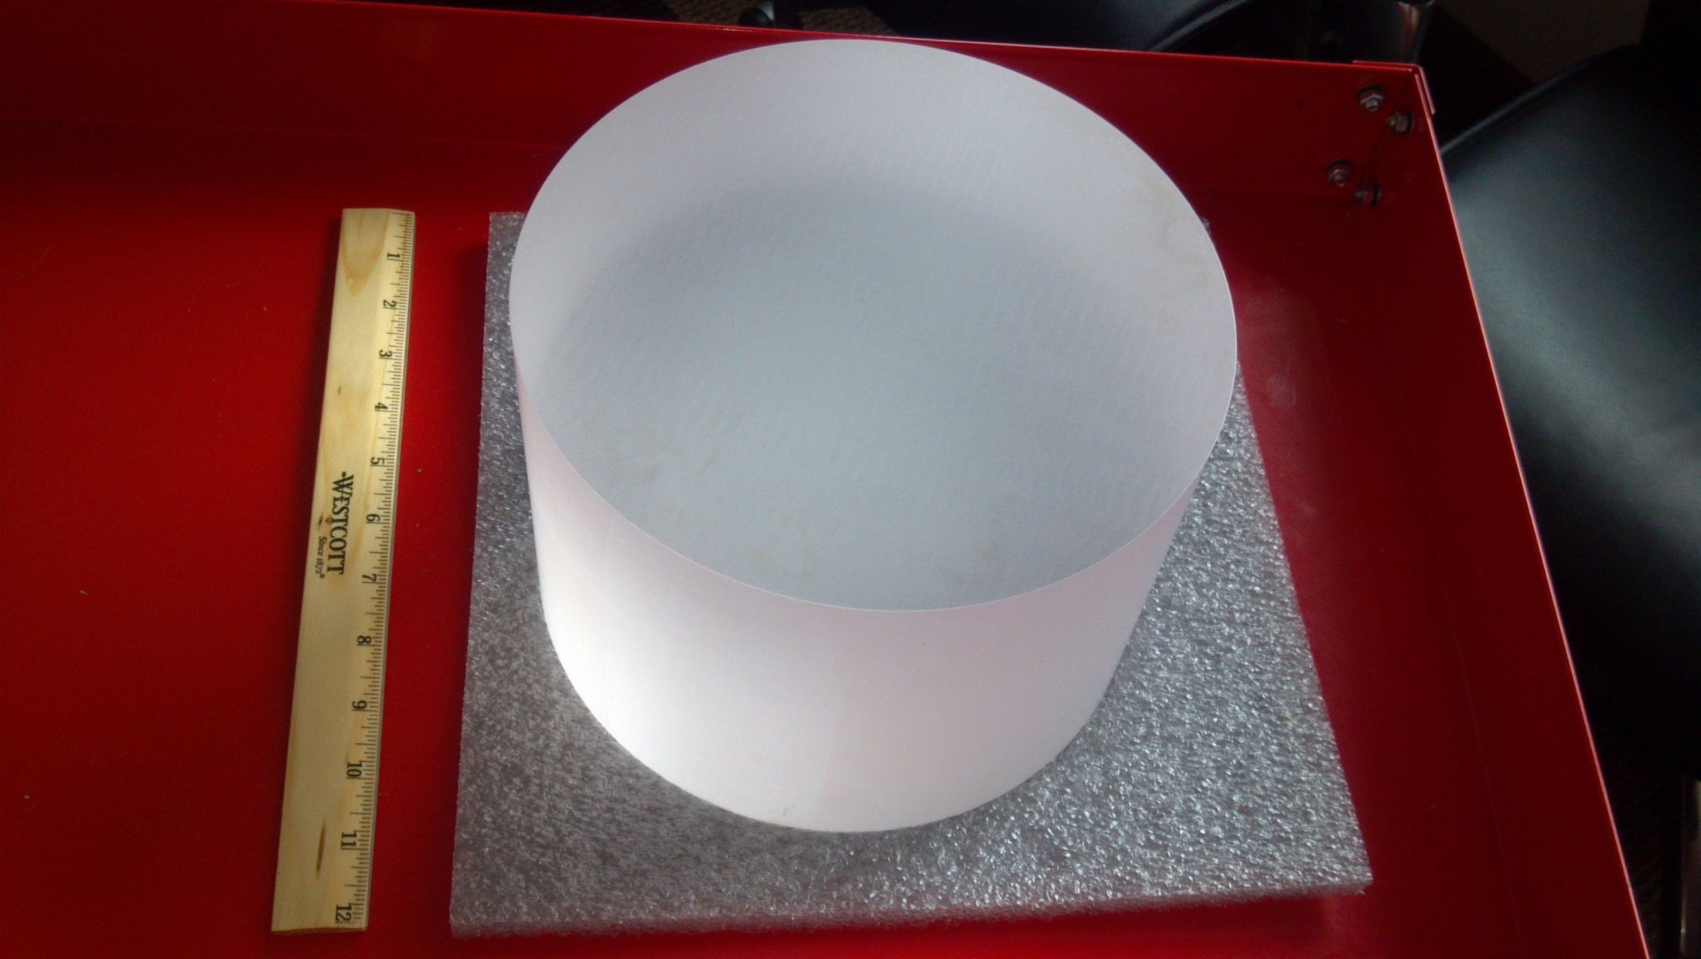
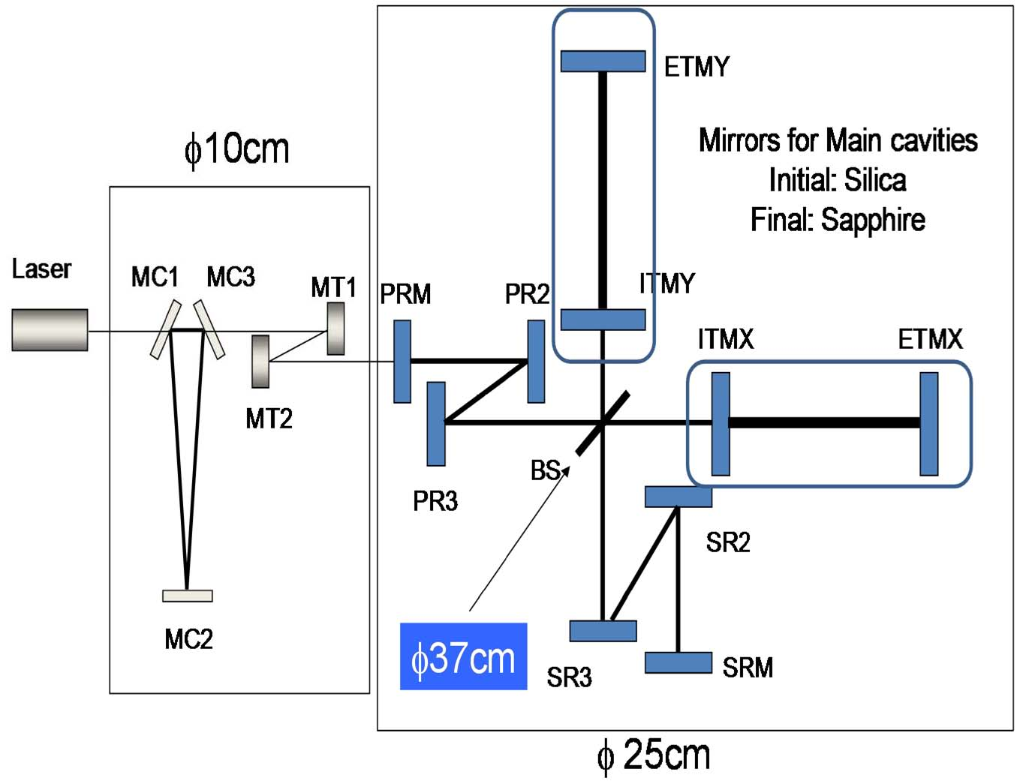
Mirrors Subsystem
Recently delivered to ICRR
22cm Sapphire substrate
Designed optics
(TMs : 22cm)

Slide 23
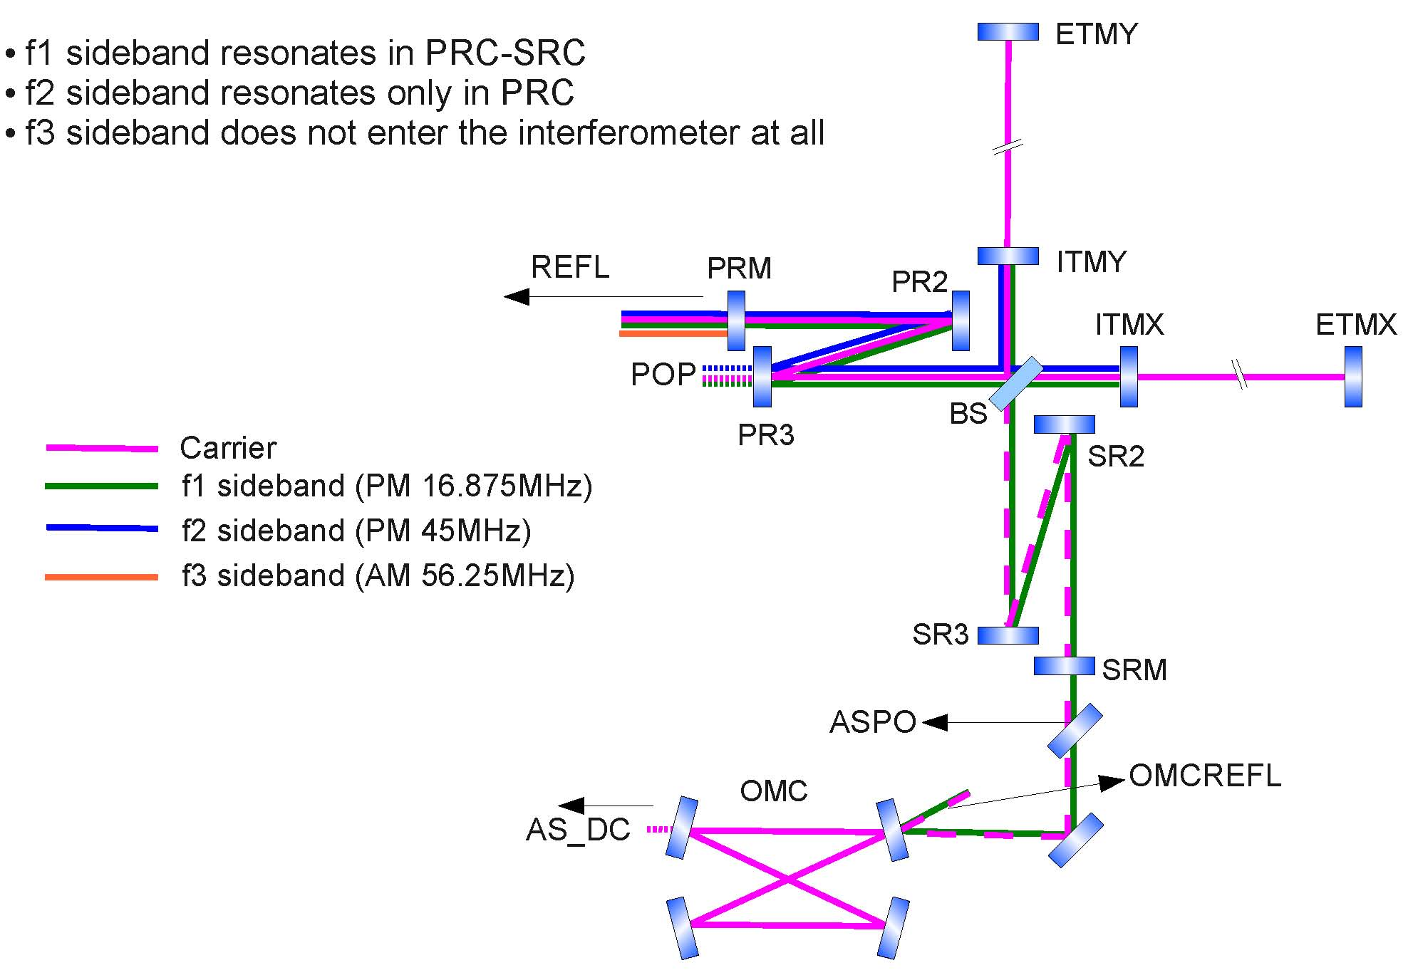
Main Interferometer Control

Slide 24
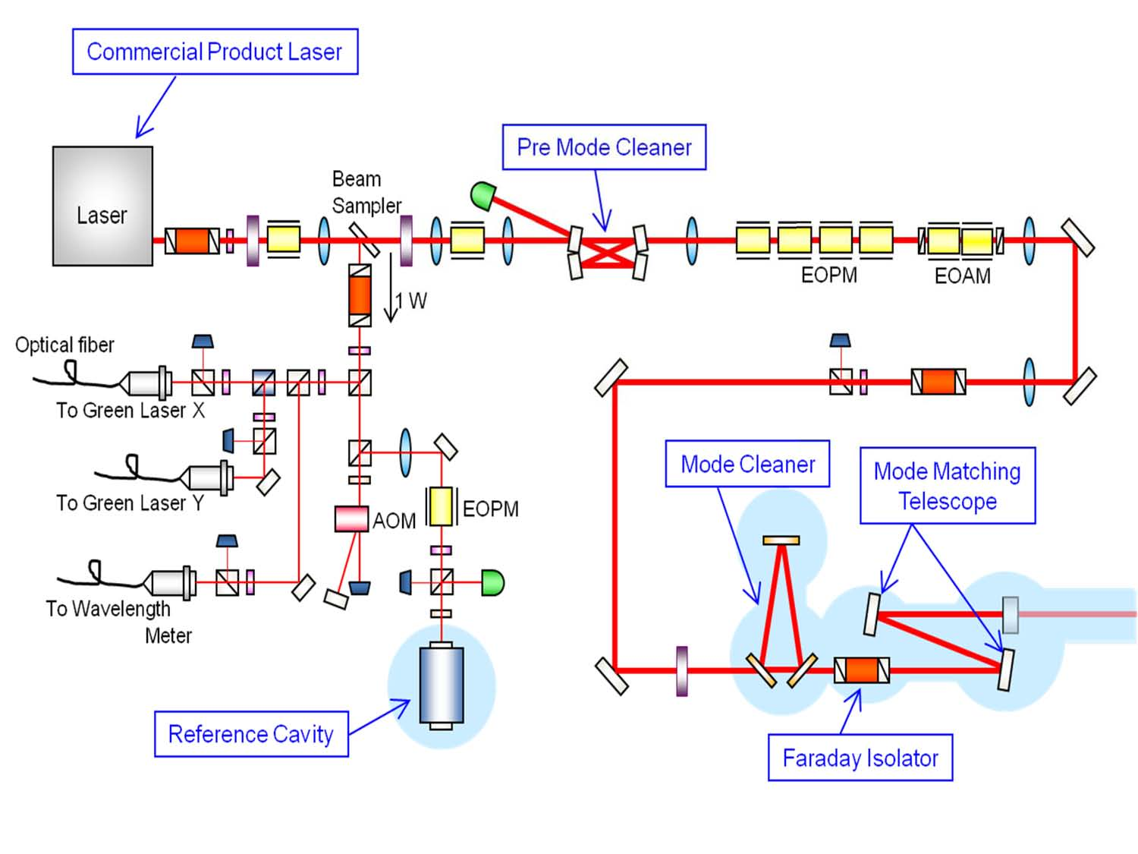
Input/Output Subsystem

Slide 25
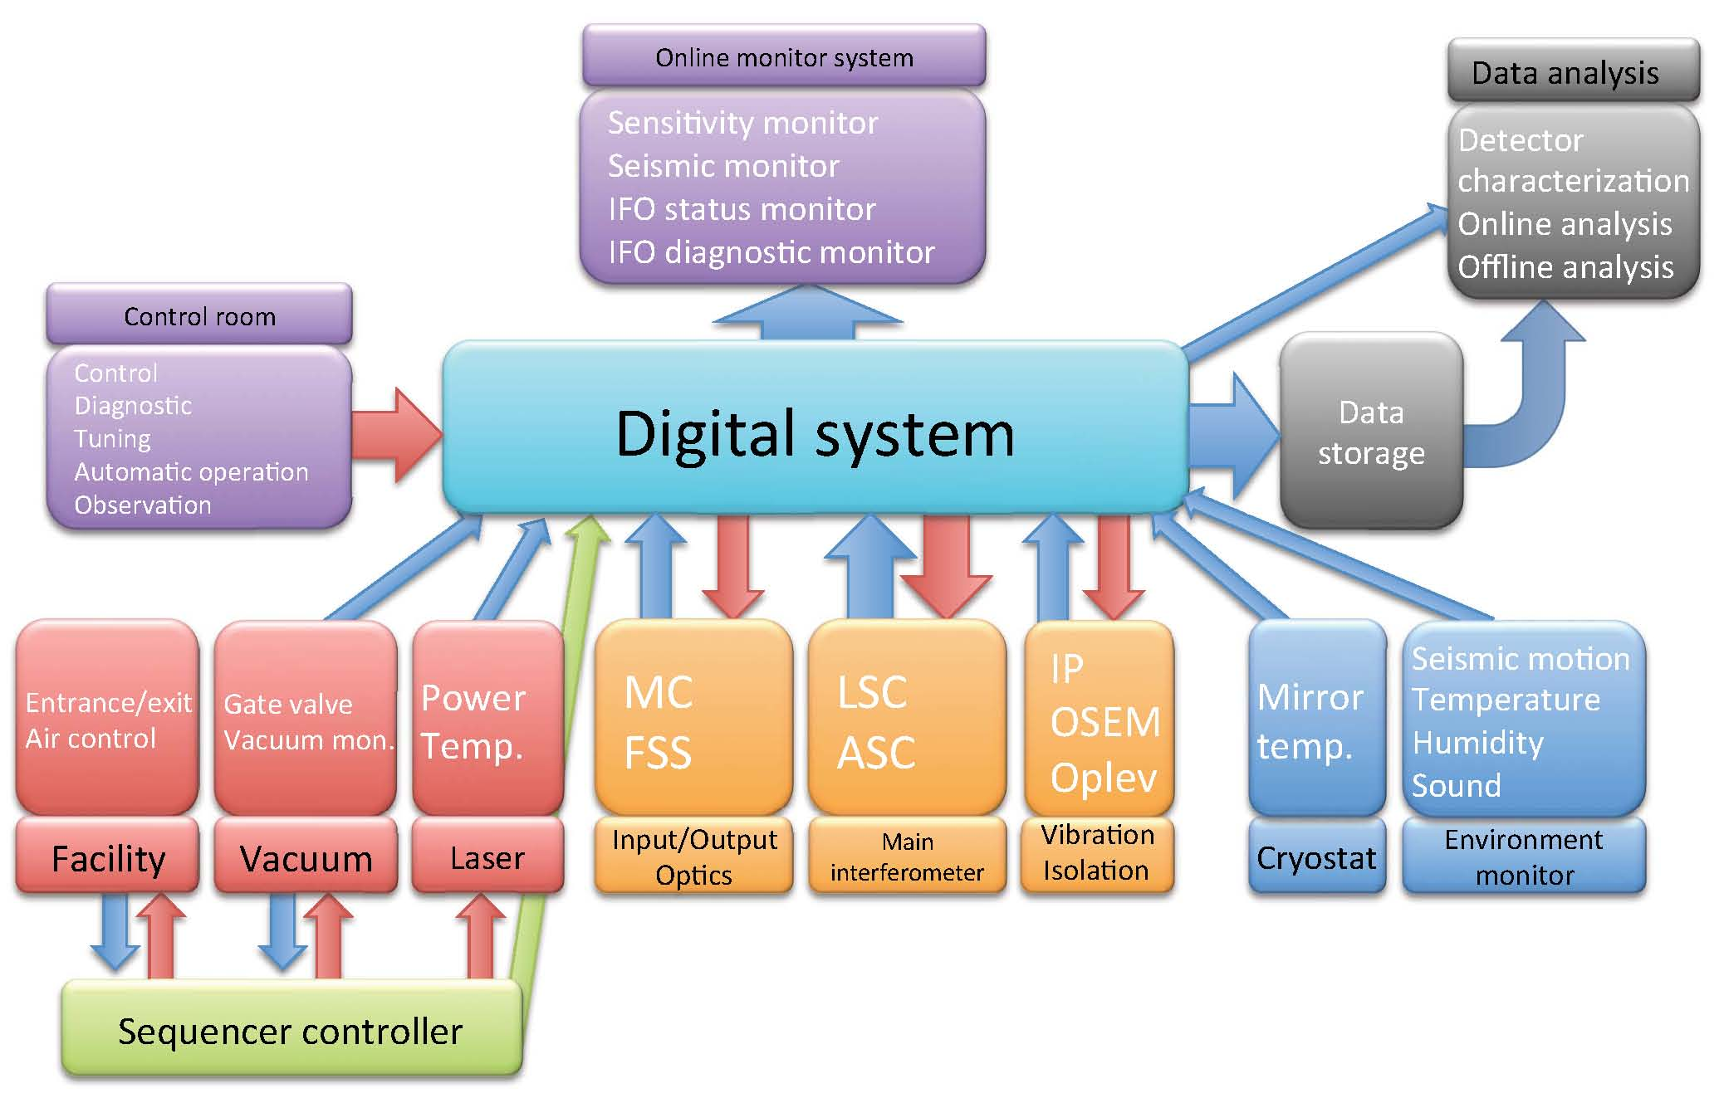
Digital Subsystem

Slide 26
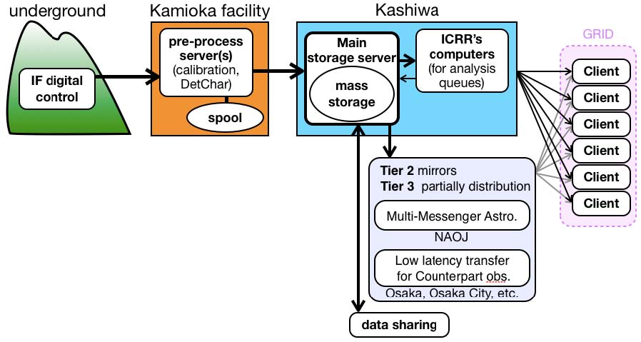
Data Taking & Analysis
5 TB/year for International
Data sharing
500 TB for iKAGRA
1 PB/year
70GB/hour
Data acquisition &
Detector characterization
*50 TB for one month in iKAGRA
(200 TB in total)

Slide 27
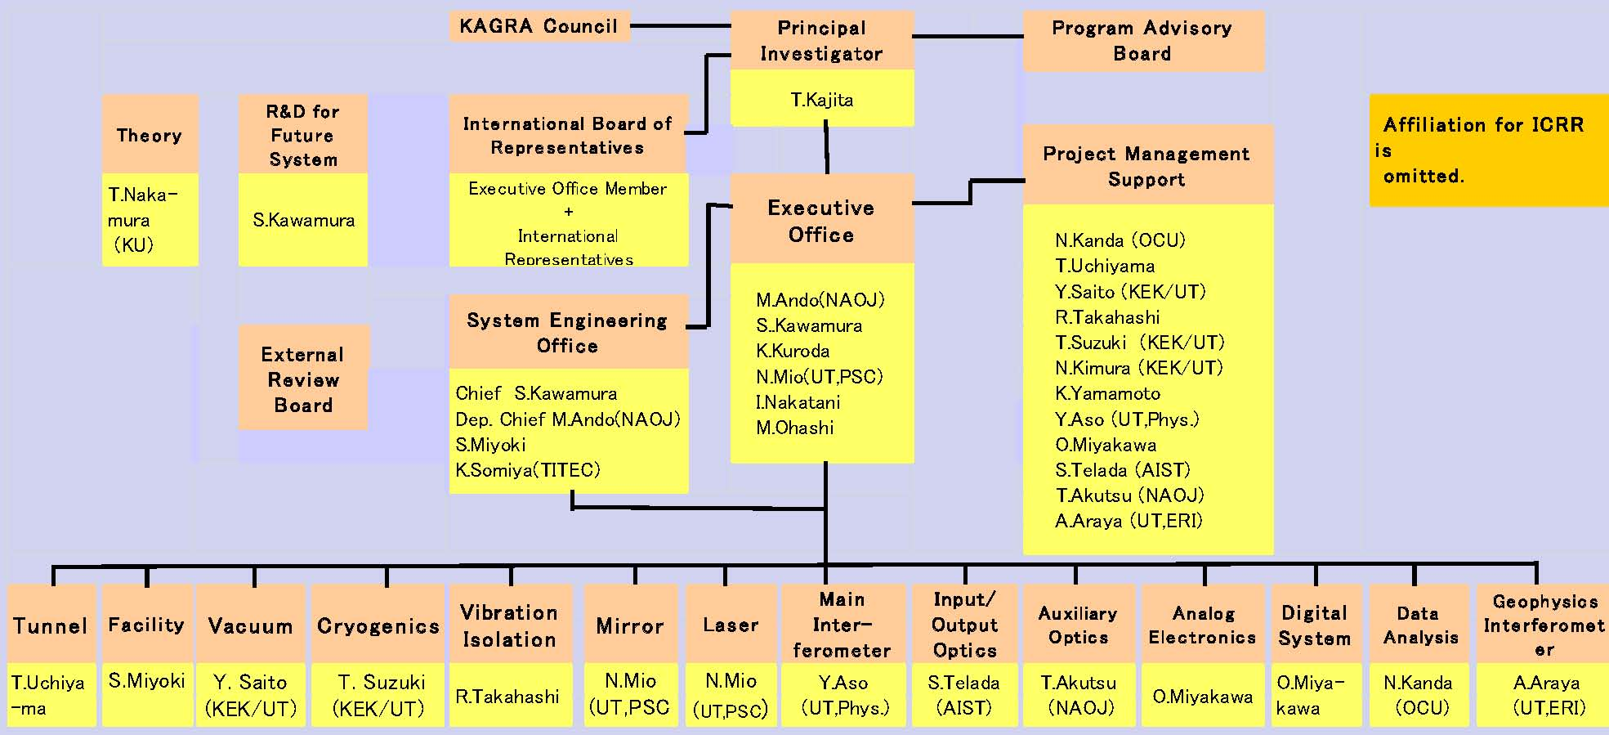
Manpower organization
No affiliation for ICRR members
Y. Saito (KEK)
Safety
N Ohishi
Procurement
E. Hirose
DetChar
K Hayama
(NAOJ)
Data
Management
Data Analysis
Inspection
A. Ueda
(NAOJ)
N. Kanda
(OCU)
H. Tagoshi
(OU)

Slide 28
Collaboration with Overseas Universities
Core research center in Asia & Oceania
UWA, Korea U, Beijing N U,
Tsing Hua U, Inje U,
Collaboration
Exchange of young
researcher
Japan: KAGRA
ICRR, UT
KEK, NAOJ etc.
R&D for 3rd gen. technique
R&D for 2nd gen. Detector
Europe: ET
& Virgo (EGO)
MPI, Glasgow, FSU,
Rome U, NIKHEF,
Sannio U
etc.
USA: LIGO
Caltech, MIT,
LSU, UF,
Etc.

Slide 29
Summary
Two and a half year have passed since project start.
Construction is underway as scheduled.
KAGRA plans operation in 2015 with modest sensitivity.
Observation in world wide network starts in 2017.
Thanks for strong supports by LSC & Virgo collaborations.

